Slide 1
Demystifying the Public Mental Health System
Mark Botts, JD
Associate Professor of Public Law and Government
School of Government
UNC Chapel Hill
botts@sog.unc.edu
919-962-8204
919-923-3229

Slide 2
Community-based service system
Area Authority
Local Management Entity (LME)
Managed Care Organization (MCO)

Slide 3


Managed Care
Managing the quality of care
Managing the cost of care
MCO
Doctor Patient
Notes:
All LMEs must implement the “1915(b)/(c) Managed Care Waiver” by July 2013
S.L. 2011-264 (H 916)
Federal government waives certain Medicaid rules to permit the state to implement Medicaid in a different way
From fee for service system to capitated funding system
From freedom of choice to mandatory enrollment
The state promises to implement a “managed care” system that contains costs while improving the quality of services
Financial authority and risk for managing Medicaid $$
Degree of control over provider behavior and patient choice to control quality and cost of care
Use managed care strategies, including care coordination and utilization management, to reduce the trend of escalating costs

Slide 4
State Government Role
General Assembly—policymaker
  Organization and Structure
  Funding
  Eligibility
DHHS
  Services—14 state-operated facilities (2,800)
  Funds for community-based services
    DMA—Medicaid money (insured)
    DMH/DD/SAS—Non-Medicaid funds (uninsured)
  Oversight of community-based system

Slide 5
What Is an Area Authority and What does It do?

Slide 6
What is an area authority?
An area authority is a local political subdivision of the state
Within the public system of mental health, developmental disabilities, and substance abuse services (MH/DD/SAS) an area authority is the locus of coordination among public services for clients of its catchment area
G.S. 122C-101, -116.

Slide 7
How are they established?
Two or more counties together must establish an area authority
A county must provide MH/DD/SA services through an area authority
With DHHS Secretary approval:
  A county may “disengage” from one LME and “realign” with another
  Two area authorities may consolidate (merge) to create one larger area authority
G.S. 122C-115.

Slide 8
Who Governs the LME?
Boards of county commissioners within the area authority’s catchment area appoint “area board” board members according to a plan
  jointly adopted by the counties and
  that describes the board composition, appointment, and selection process
Area board statute requires
  At least 11 and no more than 21 voting members
  11 prescribed categories of professional and constituent representation
                G.S. 122C-118.1, 122C-115.2

Slide 9
What does an area authority do?
Responsible for the management and oversight of the public system of MH/DD/SA services at the community level.
Must plan, develop, implement, and monitor services within a specified geographic area to ensure expected outcomes for consumers within available resources. G.S. 122C-115.4

Slide 10
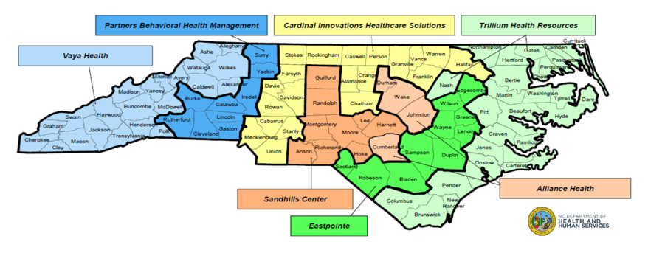
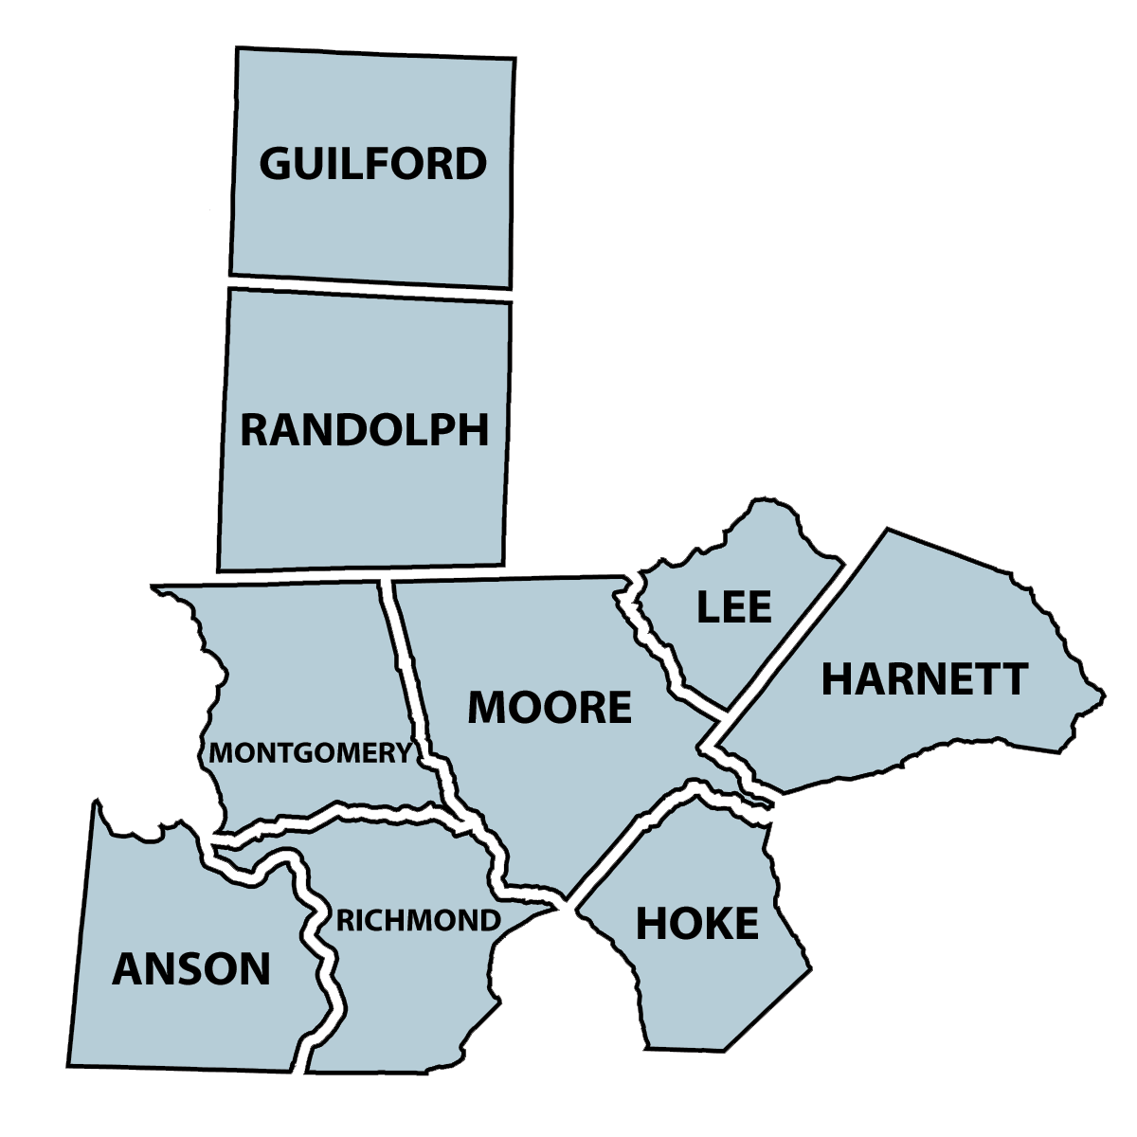
LME-MCO Regions
Map courtesy of Sandhills Center
Sandhills Center Area
Nine Counties
4,876 Square Miles
1,101,687 People
188,000 Medicaid Covered Lives
124,871 Uninsured Lives
Governed by 21 Member Board of Directors

Slide 11
Who Pays for Services?
Smoky Mountain Center
FY 2015-16 Budgeted Revenues By Source

Slide 12
Where Does the State and Federal Money Go?
Smoky Mountain Center
FY 2015-16 Budgeted Medicaid/State/Federal Revenues

Slide 13
Who is eligible for public services in North Carolina?
Medicaid enrollees—1.9 million—22.7% of the state population
  $1.9 billion
Uninsured—1.1 million—13.6% of population
  $233 million state, $60 million county

Slide 14
Among the eligible, who receives services?
Medicaid enrollees—16% of enrollees receive services
Uninsured—8% of the uninsured receive services
Estimated prevelance of Medicaid enrollees and uninsured (in need of services) = 1,075,000
  47% of these (475,000) receive services

Slide 15

Agency Functions and Mission
Personnel
Budget and finance
Consumer affairs
Information management
Services
  Access
  Provider relations
  Service management
  Quality management
  Community collaboration
To efficiently provide necessary and effective services to eligible people within available resources

Slide 16
Service Management
Approve specific services to
individual consumers—“service authorization”
Evaluate the medical necessity, clinical appropriateness, and effectiveness of services according to state criteria—“utilization management”
Monitor individual care decisions at critical treatment junctures to assure effective care is received when needed—“care coordination”
Notes:
7.4 Utilization Management:
29
Utilization Management Program: PARTNERS shall have a Utilization Management Program that is consistent
with the requirements of 42 C.F.R. 456 and 42 C.F.R. 438, Subpart D. The Utilization Management Program
shall include a written Utilization Management Plan which describes the mechanisms used to detect
underutilization of services as well as overutilization. The written Utilization Management Plan shall address
procedures used by PARTNERS to review and approve requests for medical services, and shall identify the
clinical criteria used by PARTNERS to evaluate the medical necessity of the service being requested.
PARTNERS shall ensure consistent application of review criteria and shall consult with requesting providers when

Slide 17



Service Management
LME
Eligible individual?
Covered service?
Based on clinical assessment?
Medically necessary?
Qualified provider?
Evidence that treatment helps?
Other needed services?
Outcomes over time?
LME
Provider
Notes:
Processes or techniques used by an entity that delivers, administers and/or assumes risk for health care services to control or influence the quality, accessibility, utilization, costs or outcomes of services provided to a defined enrollee population.

Slide 18
Quality Management
Analyze data on access, service authorization, and claims payment for:
  high cost/high need consumers
  utilization of various services in the service array
  gaps in the service array
  consumer access, initiation, engagement and retention
  The foregoing list is only a sample of the many QM activities that LMEs must engage in.
Notes:
DMH Contract---3.5. Analysis of Data (LME-MCO Data and Community Care of North Carolina
(CCNC) )
Exchange information with CCNC to inform decision-making on consumer access, initiation, engagement, retention, continuity of care, and other areas

Slide 19
Community Collaboration—LME Must
Establish and maintain effective collaborative working relationships with other public agencies, health care providers, and human services agencies
Build a community collaborative of crisis/emergency stakeholders that engage in and support crisis prevention and stabilization, and that engages individuals into services after a crisis event

Slide 20
Collaborative Context
LME-MCO
Social Services
Juvenile Justice
Schools
Others
Health Care Providers
Courts

Slide 21
What Does the Future Look LIke?
Medicaid “Transformation”

Slide 22
From Fee-for-Service to Private Managed Care Organizations
Private health plans enter into a prepaid, capitated contracts with the state
For the delivery of all Medicaid and NC Health Choice services—physical health services, prescription drugs, long-term care and supports, and behavioral health services—“whole care”
To all Medicaid and NC Health Choice aid categories—“enrollees” (except those dually eligible for Medicaid and Medicare)
In a specified geographic region defined by the State— “catchment area”
S.L. 2015-245 (H 372) → S.L. 2018-48 (H 403)

Slide 23
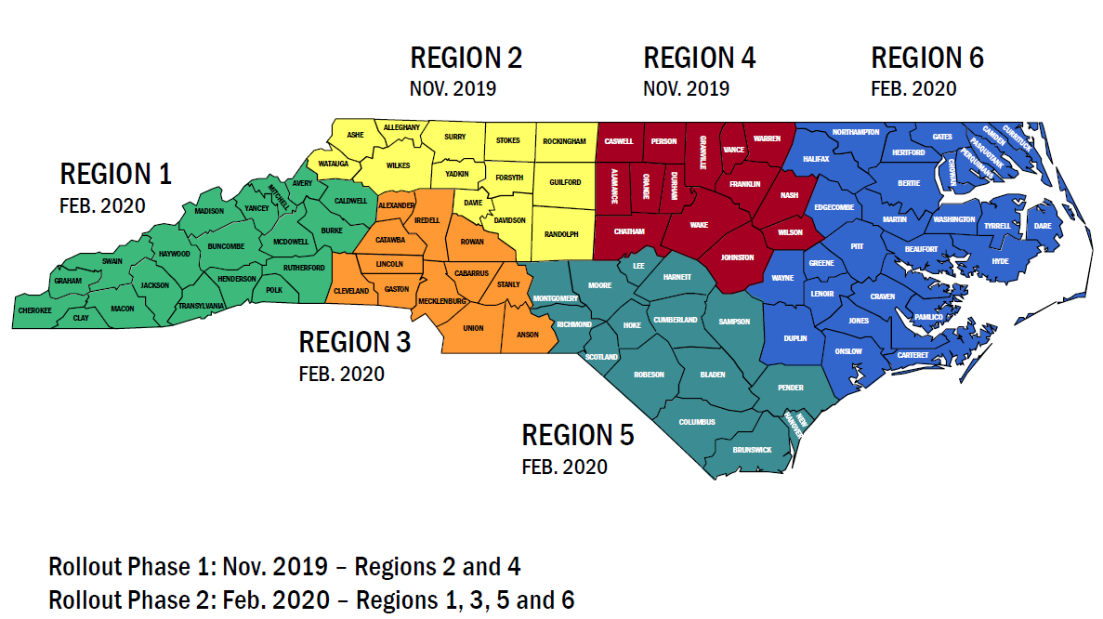
Medicaid Transformation Health Regions

Slide 24
Medicaid Transformation
Standard Plans
  Will provide integrated physical health, “primary care” behavioral health and pharmacy services to the majority of Medicaid and NC Health Choice beneficiaries with lower intensity behavioral health needs.
  LME/MCOs will continue to manage services for those with more serious BH/IDD needs.
  The Standard Plans will be administered by several comercial entities.
  Standard Plans begin phased-in operation by November 2019

Slide 25
What happens to LME-MCOs?
Tailored Plans—begin operation by July, 2021
  Specialized managed care plans targeted toward populations with significant behavioral health and intellectual and developmental disabilities needs (“serious” mental illness, “severe” substance abuse)
  Only LME/MCOs will be allowed to apply and must successfully complete a DHHS readiness review
  No more than 7 and no less than 5 Plans will be allowed
  Plans will also manage non-Medicaid funding for behavioral health services (federal/state/county)
  Plans must contract with the Standard Plans for coordination of physical healthcare for members
  Contract Term will be for 4 years, then will be competitively bid to non-profits and LME-MCOs

Slide 26
Medicaid Services
LME/MCO
Current: MH, IDD, SA Services
Fee for Service Medicaid
Current: physical health services, prescription, long term care
Private MCO
Physical health prescription, long term care, MH, SA (“Standard benefit plans”)
Future: MH, IDD, SA and physical health services for individuals with IDD and serious MH or SA (“Tailored Plans”)
Mild to Moderate MH and SA moves to Private MCO
Most move to Private MCO

Slide 27

Questions?
Mark Botts
  919.962.8204
  botts@sog.unc.edu

