Slide 1
Indian Child Welfare Act

Slide 2
Indian Boarding Schools Carlisle, PA 1879 Lt. Col., US Army

Slide 3
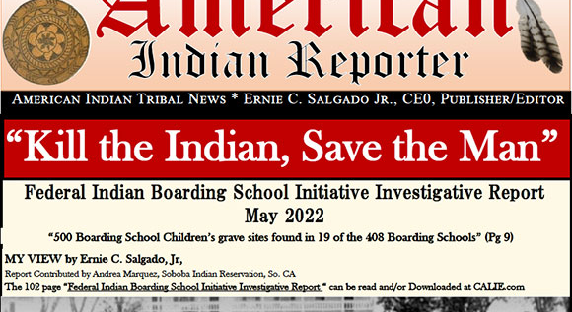

Slide 4
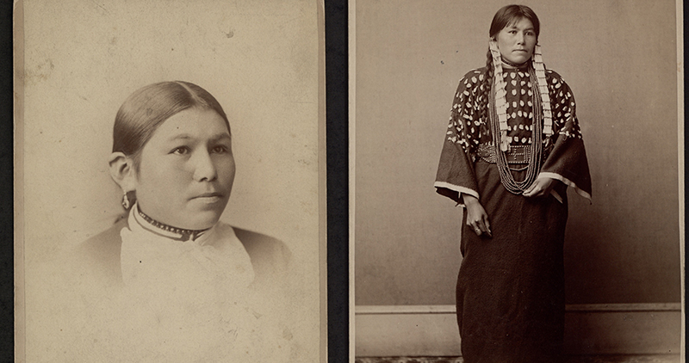

Slide 5
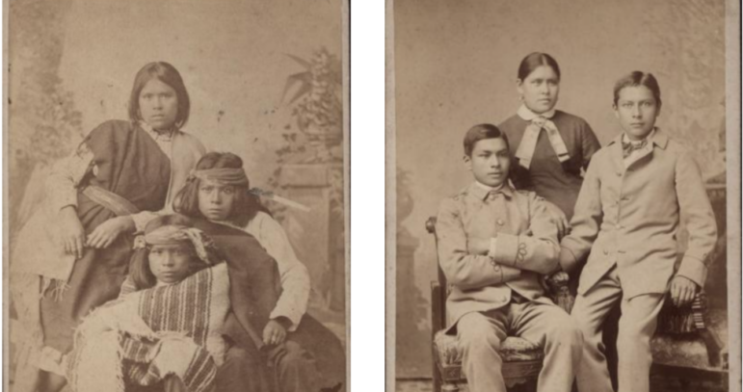

Slide 7
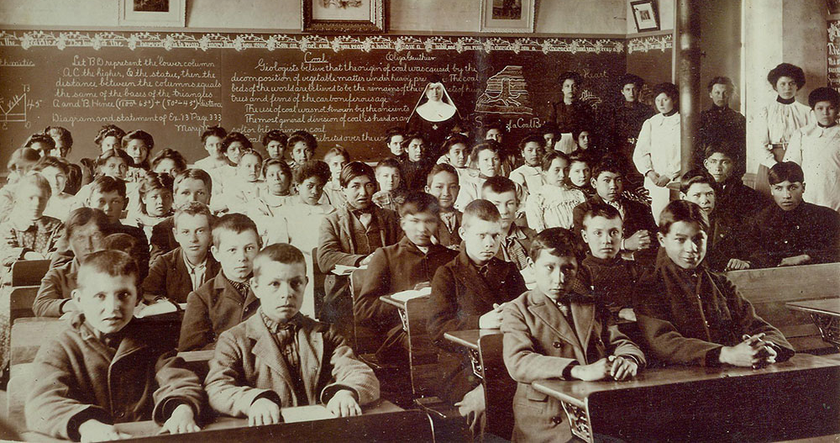

Slide 8
1819-1969: 408 federal schools 37 states territories

Slide 9
Religious Based

Slide 10
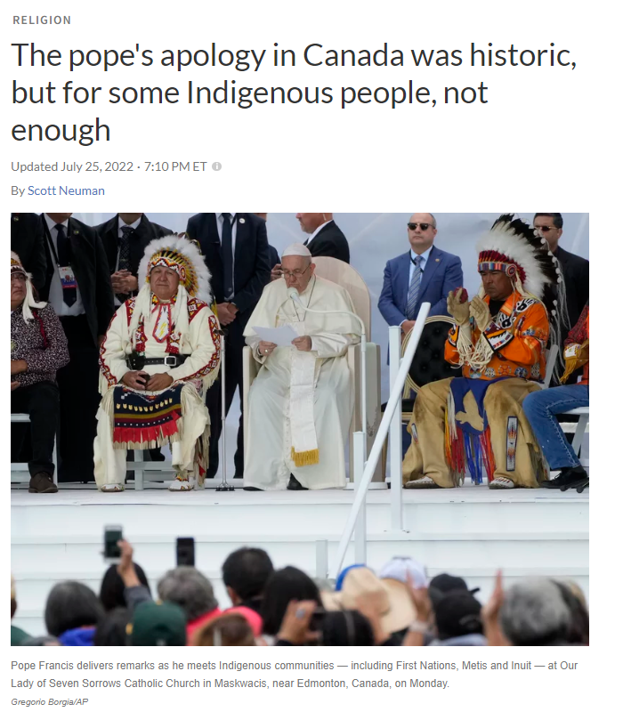
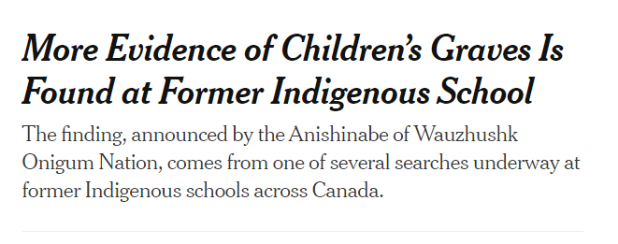

Slide 11
Deb Haaland: Secretary, Dept. of Interior

Slide 12
Federal Boarding School Initiative (2021)

Slide 13
Burial sites confirmed at 53 schools
Utah: 12 bodies Panguitch Boarding School
Nebraska: 86 children Genoa Indian Industrial School
Pennsylvania: Iroquois children, # unknown

Slide 15
25 U.S.C. 1901 et seq 25 C.F.R. Pt. 23 2016 BIA Guidelines
WHY

Slide 16
PURPOSE
Protect the best interests of Indian children
Promote stability and security of Indian tribes and families

Slide 17
Applies to “Child Custody Proceedings”
Foster Care Placement
Preadoptive Placement
Termination of Parental Rights
Adoptive Placement

Slide 18
Indian Child, 25 U.S.C. 1903(4)
Is child a member of a federally recognized Indian tribe?
Indian Child
Yes
No
Is the child eligible for membership in a federally recognized Indian tribe AND the bio parent is a member of a federally recognized tribe?
Indian Child
Not an Indian Child
No
Yes

Slide 19
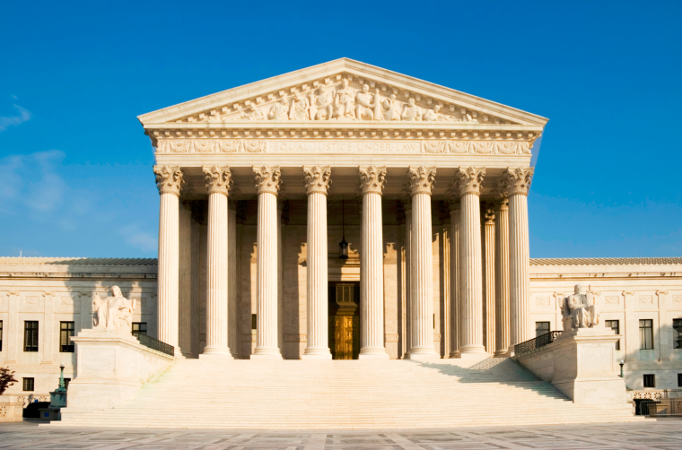
If Indian Child, ICWA applies
Tribe determines if Indian child
Court can’t substitute judgment or consider
Blood Quantum
Existing Family Doctrine
Child – parent relationship
25 C.F.R. 23.103(c); 23.108(b)
X
Adoptive Couple v. Baby Girl, 570 U.S. 637 (2013)

Slide 20
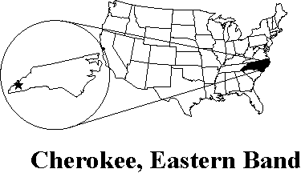
574 Federally Recognized Tribes for ICWA

Slide 21
What about State-recognized tribes?
Lumbee
Haliwa-Saponi
Coharie
Meherrin
Sappony
Occaneechi Band of the Saponi Nation
Waccamaw Siouan

Slide 22
Disproportionality Continues In re E.J.B., 375 N.C. 95 (2020)

Slide 23
Inquiry by Court

Slide 24
https://www.bia.gov/bia/ois/dhs/icwa/icwa-notice

Slide 25
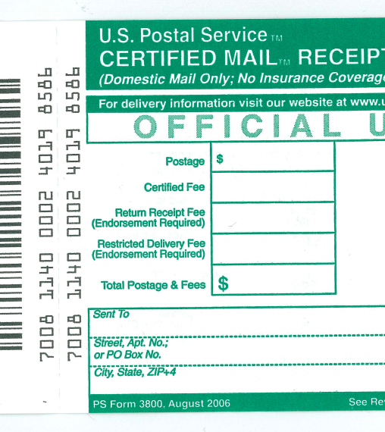
Notice
Registered/Certified Mail, Return Receipt
Parents
Indian custodians
Tribe
Copy to Regional Director
Specific Contents
Include right to intervene

Slide 26
Jurisdiction, 25 U.S.C. 1911, 1919
Tribal Court
Child domiciled or resides on reservation
Child is ward of tribal court
State Court
Agreement b/t Tribe and State re: jurisdiction
Must be admitted in evidence
Notes:
Look up emergency jurisdiction

Slide 27
Transfer to Tribal Court
Upon request (orally or in writing)
At any stage

Slide 28
Other Requirements
Active Efforts
Qualified Expert Witness re:
serious emotional or physical damage to child
TPR: Beyond a Reasonable Doubt of serious emotional or physical damage to child
Placement Preferences

Slide 29
Recent Challenge to ICWA

Slide 31
ICWA IS CONSTITUTIONAL
Article I
Indian Commerce Clause
Not Anticommandeering (10th Amendment)

Slide 32
Equal Protection: Race
Standing
Remedy

Slide 33
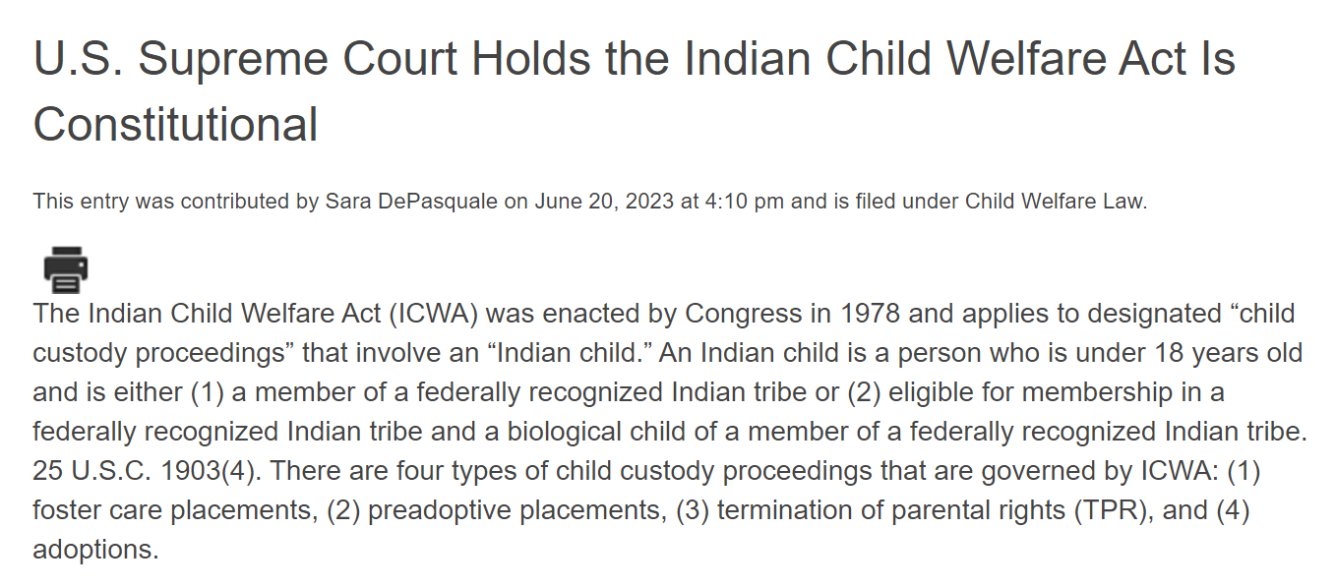

Slide 34
Concurrence
“Many sates have struggled with effective implementation….
Others resist ICWA outright as the present litigation in Texas attests....
And considerable research subsequent to Congress’s enactment of ICWA has borne out the statute’s basic premise – that it is generally in the best interests of Indian children to be raised in Indian homes”

