Slide 1
How do we measure success?
An overview of System performance metrics
Board of Trustees Workshop
October 15, 2025

Slide 2
UNC System Sets a National Standard in Access, Affordability, and Success
College Access
(Percentage of Students Receiving Pell Grants)
New York
California
Texas
New Mexico
Mississippi
Georgia
New Jersey
Illinois
Louisiana
Tennessee
North Carolina
Arkansas
Affordability
(Average Tuition and Fees)
Student Success
(Four-Year Graduation Rate)
North Carolina
Florida
Wyoming
Georgia
North Carolina
Montana
Alaska
New Mexico
New York
Idaho
Utah
Nevada
Oklahoma
Vermont
New Hampshire
Florida
Iowa
South Carolina
Minnesota
Virginia
Maryland
Indiana
North Carolina
Pennsylvania
Arizona
Sources: IPEDS; NSC Research Center
Notes:
NC in the top quarter of states for all three areas, no other state ranks higher in all three.
Pell – 2022-23
Tuition and Fees – 2023-24
Student Success – Fall 2018 Cohort

Slide 3
But we are facing headwinds …

Slide 4
Projections of High School Graduates
Source: WICHE
Notes:
WICHE updated projections Dec 2024
Includes public and private HS grads
Both US and NC will peak with class of ’25; nationally continued decline, but NC will recover

Slide 5
North Carolina Public High School Graduates
College-Going Behavior
Source: NSC-DPI dataset. Includes all North Carolina Public High School Graduates. Note: This data is preliminary and does not include NCSSM graduates.

Slide 6

Higher Expectations: 2022-2027
Economic Impact and Community Engagement
Excellent and Diverse Institutions
Access
Student Success
Affordability and Efficiency
Increase Access for Underserved Populations
Increase Undergraduate Student Success
Increase Graduate Student Success
Improve Student Mental Health
Increase Affordability
Improve University Productivity
Increase the University System’s Contribution to the State’s Critical Workforces
Increase Research Productivity
Increase Military Partnerships
Improve the Employee Experience
Improve Faculty and Staff Retention
www.northcarolina.edu/strategic-planning

Slide 7
Core Performance Metrics
Four-Year Graduation Rate
Undergraduate Degree Efficiency
Average Credits Earned per Year
First-Time Student Debt at Graduation
Transfer Student Debt at Graduation
Education and Related Expenses per Degree

Slide 8
Data-Informed Approach to Goal-Setting
Trends Across Other Public Universities
Trends Within the UNC System
Information Relevant to Future Trends
Data-Driven Goals for Each University on Each Metric
Notes:
Progress tracked against yourself, not other institutions
Each university has a threshold and a stretch goal identified for each metric
Student success metrics use gap closing methodology

Slide 9
Each performance period, chancellors are provided with a memo detailing their goals for each metric for the next three-year period.
 |  | 2024 |  | 2025 |  | 2026
 | 2022-23 Baseline | Threshold | Stretch | Threshold | Stretch | Threshold | Stretch | Weight^
4-Year Graduation Rate | 65.00 | 65.29 | 66.05 | 65.59 | 67.10 | 65.88 | 68.15 | 12.5%
Undergraduate Degree Efficiency | 24.25 | 24.30 | 24.42 | 24.34 | 24.60 | 24.39 | 24.77 | 6.7%
Average Credits Earned per Year | 27.33 | 27.42 | 27.62 | 27.50 | 27.91 | 27.59 | 28.20 | 12.5%
First-Time Student Debt at Graduation* | $12,000 | 0% | -5% | 0% | -10% | 0% | -15% | 8.3%
Transfer Student Debt at Graduation* | $8,000 | 0% | -5% | 0% | -10% | 0% | -15% | 3.3%
Education and Related Expenses per Degree* | $57,000 | -1.33% | -4.00% | -2.66% | -8.00% | -4.00% | -12.00% | 6.7%
*Goals are expressed as a percent change from the inflation-adjusted baseline, using CPI minus food and fuel to adjust for inflation.
^Metrics are weighted to mirror the goals established for the president by the Board of Governors
Note: Chart uses mock data used for demonstration purposes.

Slide 10
System-Level Progress on Core Metrics in Year 1 of Performance Period 2
Metric | 2022-23 (Baseline) | 2023-24 (Actual) | Overall Result (Systemwide)
Four-Year Graduation Rate | 55.06% | 56.87%
Undergraduate Degree Efficiency | 24.57 | 24.74
Average Credits Earned | 27.36 | 27.65
First-time Student Debt at Graduation | $10,821 ($11,243) | $9,924
Transfer Student Debt at Graduation | $9,396 ($9,762) | $8,919
Education and Related Expenses Per Degree | $69,959 ($72,687) | $73,995
Values in parentheses represent inflation-adjusted values. Inflation for the period was 3.90%

Slide 11
What is the key to improving ALL of the performance metrics?

Slide 12
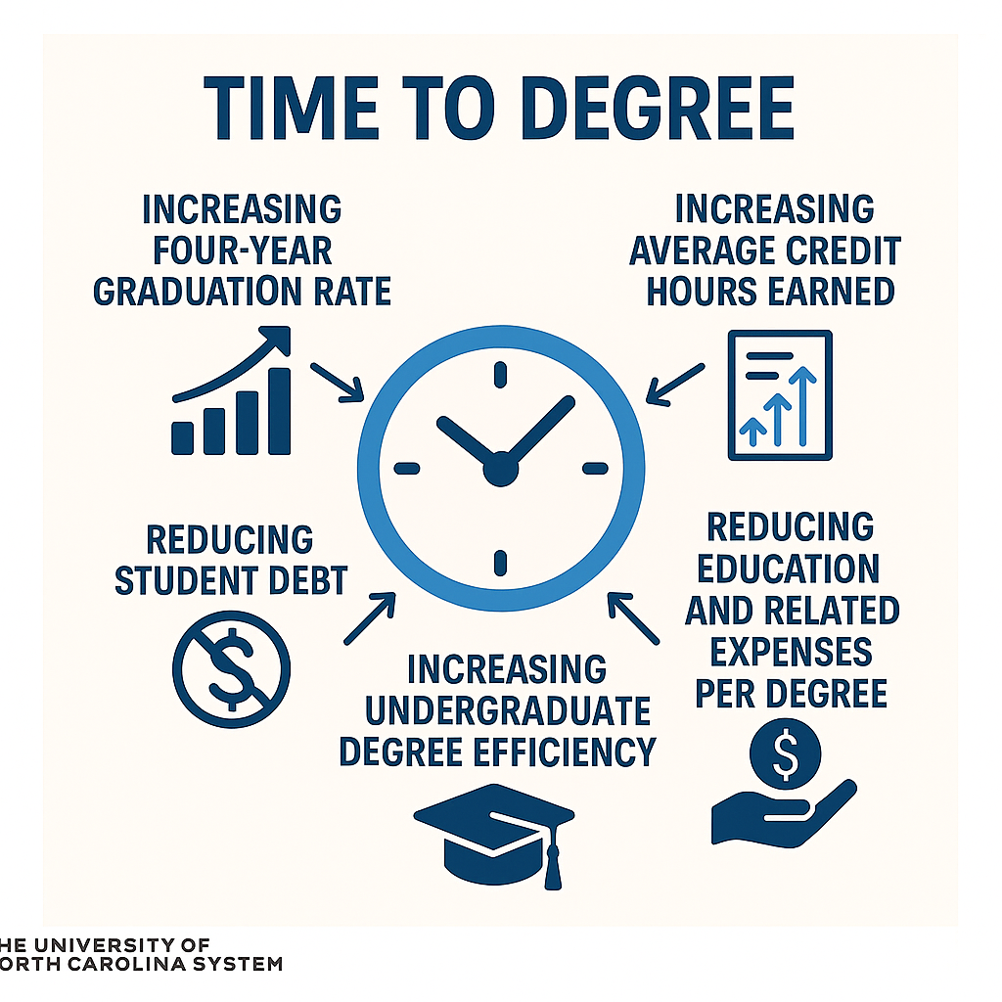

Slide 13
Systemwide Time-to-Degree
Students who started as first-time, full-time
4.80
4.70
4.60
4.50
4.40
4.30
4.20
4.10
4.00
3.90
3.80
4.46
4.44
4.41
Years to Degree
4.37
4.30
4.29
4.22
4.27
4.18
2015-16 2016-17 2017-18 2018-19 2019-20 2020-21 2021-22 2022-23 2023-24
Completion Year
Source: UNC System Student Data Mart
7

Slide 14




Strategies for Accelerating Time-to-Degree
Credit for prior learning
Military Equivalency System
  Launched public-facing tool in March 2024; includes more than 17,000 military credit equivalencies
Transfer articulation
New regulation adopted in Feb 2025 improves the transfer process Systemwide by ensuring adherence to the CAA, up-to-date transfer guides, and quick transcript review
Ensuring most degree programs are 120 credit hours
As required by Policy 400.1.5 on Fostering Undergraduate Student Success except by exemption
Year-round enrollment
Students who enroll in at least one summer term are more likely to meet credit benchmarks and graduate on time
9

Slide 15

Reminder: Keep the Main Thing the Main Thing
Affordability: Reduce student debt by keeping cost of attendance affordable and increasing on-time graduation
Student success: Improve student retention, credit hour completion, and on-time graduation
Cost-per-degree: Increase the productivity of state investments
FOCUS ON TIME TO DEGREE!!

