Slide 1
Keeping the University Team on Offense
Andrew Tripp UNC System General Counsel
October 15, 2025

Slide 2
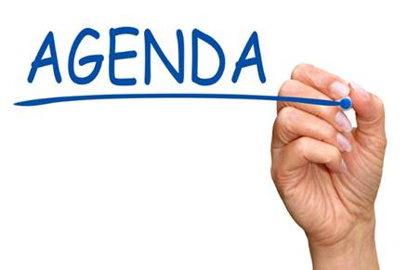
Session Overview
NC Law’s Commitment to Transparency
Key Best Practices
Conclusion

Slide 3

NC Law’s Commitment to Transparency
Public Records Act
Open Meetings Law

Slide 4
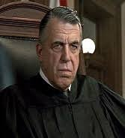
Public Records Act
First adopted in the 1980s.
Courts construe it broadly.
Nearly everything you write about the University is a public record.

Slide 5
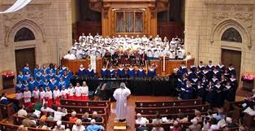
Once More for the People in the Back…
Nearly everything you write about the University is a public record…

Slide 6

Open Meetings Law
Open Meetings Law says if a majority of your board gets together and you’re conducting public business, you’re having a meeting.
If you’re having meeting, the law says that meeting must have been properly noticed.
If you had an unnoticed meeting, your work can be challenged in court.

Slide 7
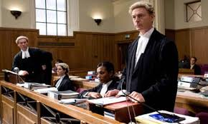
Similarities Between Public Records & Open Meetings
Both sets of law create penalties and attorneys' fees for prevailing parties.
Bad process can get very expensive for the University.
Your board could make a great decision—the best substantive decision it’s ever made—and still get penalized.

Slide 8
What in the World Can You Do?
“Use One Email Account”—Use your university email account for university business.
“Newspaper Rule”—Write as though what you send will be in tomorrow’s Technician.
“Set a Speed Limit for Texting”—Texting is a fast way to communicate—sometimes too fast! Have a speed limit.
“The Duck Theory of Open Meetings”—If it looks like a meeting and feels like a meeting, it probably is a meeting.

Slide 9
Conclusion: Keep the Defense Off the Field
Think About Offense & Defense.
When the University is on Offense, we are working on how we educate North Carolinians with excellence and affordability.
When the University is on Defense, we get lost in explaining process errors or emails or texts that cannot be unsent.
If we stay sharp on how we communicate as a BOT and when BOTs take up business, then we stay on Offense.
***The End***

