Slide 1


STATE AND LOCAL GOVERNMENT FINANCE DIVISION
Audit Contracts and Invoices
2025 Audit Review Communications
Becky Dzingeleski
Assistant Director
Fiscal Management Section
Melissa Cundey
Senior Accounting & Financial Management Advisor
Fiscal Management Section
Eric Faust
Assistant Director
Fiscal Management Section

Slide 2


Agenda
Audit Contracts
Invoicing for Audit work
Common ARC Issues
  NC General Statutes
  LOGOS Data Input Report (DIR) Entry Errors
2026 Data Input Report (DIR) Additions
LOGOS Updates

Slide 3
Audit Contracts

Slide 4
Audit Contracts
LGC-205 Standard Audit Contract Rev. 02/2026
LGC-205 Amendment to Contract to Audit Accounts Rev. 08/2025
  Only these contract versions will be accepted for FY 2026 audits due to contract changes.
Notes:
The beginning of the annual audit process - Audit contracts. For fiscal year 26 the LGC will only accept the 2/2026 Audit contract. Be sure to obtain a copy via the hyperlink in this presentation for your files. Older versions will not be accepted.
It is not recommended to begin any audit work before receiving back your approved contract from the LGC.
For the amended contract, if required, we accept the 8/2025 version. If amended contract is required, the LGC requires amended contract approval, in order to receive final invoice approval.
All contracts must be submitted through the LGC portal. Emailed or Mailed contracts will not be accepted. The portal date stamps the arrival of the contract for our filing.
Engagement letters are to be submitted to the LGC along with the audit contract. If the engagement letter states different criteria from the LGC contract, the LGC contract agreement trumps the engagement letter.

Slide 5
Audit Contracts
Please only upload contracts and audit-related documents to the LGC File Transfer Portal so they will be date and time-stamped:
Standard and Amended Audit Contracts · LGC File Transfer Portal
Engagement letters agreements between unit and auditor.
  Conflicts between the terms of the engagement letter and the terms of the audit contract? The terms of the audit contract shall take precedence.
Notes:
The beginning of the annual audit process - Audit contracts. For fiscal year 26 the LGC will only accept the 2/2026 Audit contract. Be sure to obtain a copy via the hyperlink in this presentation for your files. Older versions will not be accepted.
It is not recommended to begin any audit work before receiving back your approved contract from the LGC.
For the amended contract, if required, we accept the 8/2025 version. If amended contract is required, the LGC requires amended contract approval, in order to receive final invoice approval.
All contracts must be submitted through the LGC portal. Emailed or Mailed contracts will not be accepted. The portal date stamps the arrival of the contract for our filing.
Engagement letters are to be submitted to the LGC along with the audit contract. If the engagement letter states different criteria from the LGC contract, the LGC contract agreement trumps the engagement letter.

Slide 6
Audit Contracts
Changes to the FY 2026 Contract Form (Pgs. 1-5)
Basic financial statement changes due to GASB Statement No. 103
Change in thresholds for both Federal and State single audits
Guidance for when parties know the submission date will exceed 6 months after fiscal year end
Changes in references to AU-C §265 and AU-C §260 report
Pre-issuance review / corrective action as a result of peer review findings or quality control deficiencies
Clarification on who is responsible for submitting the audit report per G.S. 159-34 and the Data Input Report (DIR)
Finance officer certification required in a timely manner to ensure that all data inputted in LOGOS used for preparation of the financial statements and required supplementary information is complete and accurate
  Submission is not complete and shall not be accepted by the Secretary until the finance officer has reviewed and certified the DIR in accordance with Paragraph 14.
Notes:
Click the link to see all changes made by the LGC to the required Audit contract.
Examples –
GASBS 103 requires Budget-to actual comparisons at the level of the legally adopted budget ordinance shall be presented as required supplementary information and shall not be included in the basic financial statements.
FO will be required to certify the Audit and the DIR before Audit can be reviewed by LGC staff.
Thresholds for both State & Federal single audits

Slide 7
Audit Contracts
Instructions on Completing the Audit Contract Form (Pgs. 6-8)
Other important information
Staff Review
DPCU Audit contract requirements
Amended Contracts
  Needed if audit cannot be completed by the date specified in the original contract or the fees specified in the original contract are modified
    Instructions for Submitting Audit Contract Amendments
Submission of Invoices (units other than hospitals)
  Rule 20 NCAC 03 .0505: “All invoices for services rendered in an audit engagement as defined in Rule .0503 of this Section shall be submitted to the Secretary for approval before any payment is made. Payment before approval is a violation of law pursuant to G.S. 159-34(a).”
Notes:
Included in the Instructions on completing audit contract form pg. 6-8
Instructions on submitting an amended contract
Submission of Invoices for Audit work.

Slide 8
Audit Contracts
LGC staff must have completed review of the prior year audit, and all prior year invoices for audit work are received and approved by LGC staff before the next fiscal year contract can be approved.
Your audit contract is not valid until it is approved by the Secretary of the LGC.
  Recommend audit work not begin until you have an approved Audit contract.
Notes:
Before a new audit is started, the LGC must review all prior year audits and approve final invoices. Contracts will not be approved until previous year items are complete.
The staff of the LGC notifies the governmental unit and auditor of contract approval by email.
Again, all audit contracts must be uploaded to the portal for approval. Audit work should not be started before the contract is approved by the LGC

Slide 9
Audit Contracts
Contracts must include:
  The “Date the Audit Will Be Submitted to the LGC”
    The “Date the Audit Will Be Submitted to the LGC” should list the actual date, not the past due date.
  If the Unit’s audit is not going to be submitted by the contracted date, include a high-level explanation of why the audit is late.
Fiscal Year-End | Audit on time if received by | Audit is late if it is received on or after (Amended Contract Required)
30-Jun | 31-Dec | 1-Jan
31-Mar | 30-Sept | 1-Oct
Notes:
Please note the Audit due date is 6 months following year-end. To be considered on time, June 30 audits must be submitted by December 31st of that year. March 31st audits must be received by September 30th. If you submit January 1st or later (or October 1st for the March 31st fiscal year end), an Amended Contract is required. Save time and send the amended contract with your audit submission if possible as this can delay final invoice approval.

Slide 10
Invoicing for Audit work

Slide 11
Invoicing for Audit Work
G.S. 159-34 Annual independent audit; rules and regulations
“It shall be unlawful for any unit of local government or public authority to pay or permit the payment of such bills or claims without this approval.”
20 NCAC 03 .0505 Audit Billings
“(a) All invoices for services rendered in an audit engagement as defined in Rule .0503 of this Section shall be submitted to the Secretary for approval before any payment is made. Payment before approval is a violation of law pursuant to G.S. 159-34(a).”
Please do not send an invoice to the unit for payment unless it is stamped with LGC approval as required by G.S. 159-34 and 20 NCAC 03 .0505.
Notes:
An invoice marked 'approved’ by the LGC with approval date shall be returned to the auditor by LGC staff to present to the governmental unit(s) for payment.
Legally, Invoices for Audit services rendered under these contracts shall not be paid by the Governmental Unit(s) until the invoice has been approved by the Secretary of the LGC.
Audit invoices paid without LGC approval is a statutory violation of G.S. 159-34 .

Slide 12
Invoicing for Audit Work
All bills or claims for audit fees and audit related costs shall be submitted in PDF format to the Secretary of the LGC for approval. Billings need to conform to the requirements of the LGC-205 contract: specify under specific fee category noted on the LGC-205 contract.
The auditor may submit interim invoices for approval for services rendered under this contract to the Secretary of the LGC, not to exceed 75% of the billings for the unit's last annual audit that was submitted to the Secretary of the LGC.
Notes:
An invoice marked 'approved' with approval date shall be returned to the auditor by LGC staff to present to the governmental unit(s) for payment.
Legally, Invoices for Audit services rendered under these contracts shall not be paid by the Governmental Unit(s) until the invoice has been approved by the Secretary of the LGC. Audit invoices paid without LGC approval is a statutory violation of G.S. 159-34 .
Examples - Fees for AFIR work, Tax return preparation are not required by law to be approved by LGC

Slide 13
Invoicing for Audit Work
Only fees related to the audit work are legally required to be approved by LGC. Fees not related to the scope of annual audit work should be agreed to and billed separately / directly with the unit.
Please do not send an invoice to the unit for payment unless it is stamped with LGC approval as required by G.S. 159-34 and 20 NCAC 03 .0505.
Notes:
An invoice marked 'approved' with approval date shall be returned to the auditor by LGC staff to present to the governmental unit(s) for payment.
Legally, Invoices for Audit services rendered under these contracts shall not be paid by the Governmental Unit(s) until the invoice has been approved by the Secretary of the LGC. Audit invoices paid without LGC approval is a statutory violation of G.S. 159-34 .
Examples - Fees for AFIR work, Tax return preparation are not required by lw to be approved by LGC

Slide 14
Common ARC Issues
NC General Statutes

Slide 15
G.S. 159‑29. Fidelity bonds
The finance officer shall give a true accounting and faithful performance bond with sufficient sureties in an amount to be fixed by the governing board. A person may not be appointed as a finance officer if the person is unable to obtain the bond required by this section.
This statute also applies to Public Housing Authorities G.S. 159-42(h)
Article 31 – The School Budget and Fiscal Control Act: G.S. 115C-442
(a) The finance officer shall give a true accounting and faithful performance bond with sufficient sureties in an amount to be fixed by the board of education, not less than fifty thousand dollars ($50,000)
Notes:
Board of Education Units – are required to be not less than $50k.
Not the same requirements as G.S. 159-29.

Slide 16
G.S. 159‑29. Fidelity bonds
Amount of the bond fixed by the governing board may not be less than the greater of either:
    $50,000 (minimum)
    Equal to 10% of ALL the unit’s original annually budgeted funds (ex: General Fund and Enterprise Funds), up to $1 million
Applies to annually budgeted funds, not including multi-year capital project ordinances.
Encourage the unit to review the faithful performance bond amount during each budget season as annually budgeted expenditures will change year to year. Bond amount and Risk Management Note may need to be changed.
Make sure the Risk Management Note has been updated with the FO bond amount as it stood on July 1 every fiscal year audited.
Notes:
Audit review – ARC issues. Risk Management note was not updated to reflect the actual FO Bond amount.
Auditor calculation of required FO Bond included multi year funds, statutory violation was noted when violation had not occurred.

Slide 17
Budgetary Issues – Statutory compliance / violations
G.S. 159-8
G.S. 159‑8 Annual balanced budget ordinance.
“Each local government and public authority shall operate under an annual balanced budget ordinance adopted and administered in accordance with this Article. A budget ordinance is balanced when the sum of estimated net revenues and appropriated fund balances is equal to appropriations…”
Notes:
Auditor notes NO budget findings when our review indicates what appear to be budgetary / statutory violations. Materiality does not apply to statutory violations. Expectation is that the violation is noted either as a financial statement finding (material) or in the stewardship note (immaterial), based on auditors opinion.

Slide 18
Budgetary Issues – Statutory compliance / violations
G.S. 159-13
G.S. 159-13 The budget ordinance; form, adoption, limitations, tax levy, filing.
(b)(1)”The full amount estimated by the finance officer to be required for debt service during the budget year shall be appropriated”
(b)(6) “The estimated percentage of collection of property taxes shall not be greater than the percentage of the levy actually realized in cash as of June 30 during the preceding fiscal year…”
Notes:
Auditor notes NO budget findings when our review indicates what appear to be budgetary / statutory violations. Materiality does not apply to statutory violations. Expectation is that the violation is noted either as a financial statement finding (material) or in the stewardship note (immaterial), based on auditors opinion.

Slide 19
Budgetary Issues – Statutory compliance / violations
G.S. 159-28
G.S. 159-28 Budgetary accounting for appropriations.
“Incurring Obligations”
(a1) “Preaudit requirement” This instrument has been preaudited in the manner required by the Local Government Budget and Fiscal Control Act. __________________________________
(b) Disbursements
(d)(1) This disbursement has been approved as required by the Local Government Budget and Fiscal Control Act. ___________________________________
Notes:
Auditor notes NO budget findings when our review indicates what appear to be budgetary / statutory violations. Materiality does not apply to statutory violations. Expectation is that the violation is noted either as a financial statement finding (material) or in the stewardship note (immaterial), based on auditors opinion.

Slide 20
Applicable General Statutes and
Administrative Code
NC General Statute
G.S. 159‑8. Annual balanced budget ordinance.
G.S. 159‑13. The budget ordinance; form, adoption, limitations, tax levy, filing. (b)(1)
G.S. 159‑28. Budgetary accounting for appropriations.
G.S. 159‑29. Fidelity bonds. and G.S. 115C-442 Fidelity Bonds.
G.S. 159‑34. Annual independent audit; rules and regulations.
Administrative Code
20 NCAC 03 .0502 – Audit Contracts
20 NCAC 03 .0505 – Audit Billings
Notes:
Materials section of this course
LGC staff is fortunate to work with excellent legal advice. We advise based on this legal guidance / interpretation of the NC Statutes.

Slide 21
Common ARC issues
LOGOS: Data Input Report (DIR) Entry Errors

Slide 22
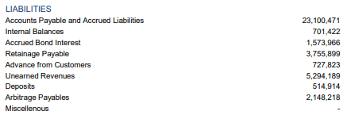
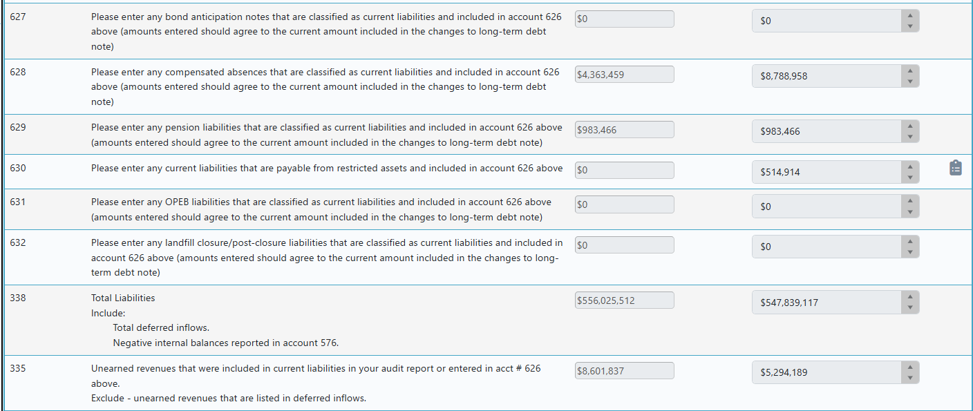
Current Liabilities Payable From Restricted Assets vs Unearned Revenues
Notes:
Unearned Revenues (Deferred Inflows of Resources under GASB 65/84 context)
Core idea: Timing issue related to earning revenue
Represents resources received before eligibility requirements are met
Government cannot recognize revenue yet under accrual or modified accrual
Common in:
Grants received in advance (before eligibility met)
Prepaid taxes or fees
Current Liabilities Payable from Restricted Assets
Core idea: Resource constraint on how liabilities are paid
These are existing obligations (not timing-related like unearned revenue)
Payment must come from restricted assets (externally or legally constrained)
Common in:
Debt service (bond principal/interest payable from restricted debt service funds)
Customer deposits held in restricted accounts
Claims or obligations tied to restricted funds

Slide 23
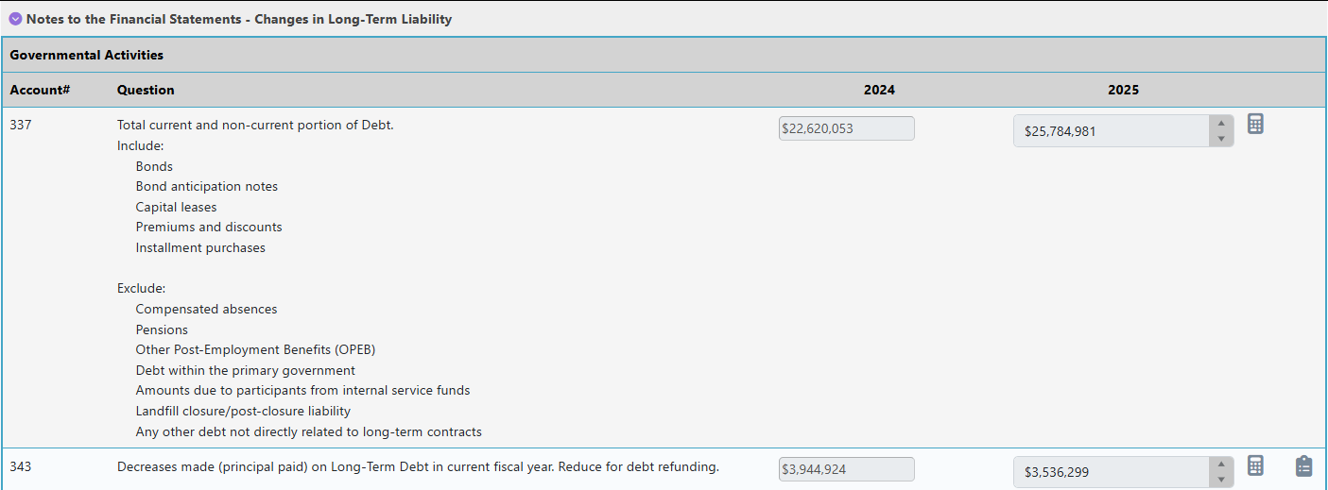
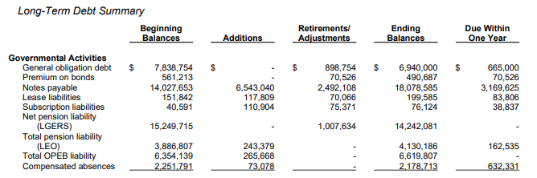
Total Current and Non-current Portion of Debt
Notes:
For accounts 337 and 343, please ensure that all applicable debt-related items are fully included. This encompasses bonds, bond anticipation notes (BANs), capital leases, premiums and discounts, installment purchase agreements, and subscription-based liabilities.
For account 343 specifically, the scope is the same as account 337 with one important exception: debt refunding should not be included in account 343.
This same approach should also be applied to proprietary fund accounts, where applicable. Please ensure consistency in the inclusion and exclusion criteria across both governmental and proprietary reporting.

Slide 24
Revenue Bonds
Long term debt note in the “Notes to the Financial Statements” - Revenue Bond Debt – required disclosures must be included
  Required by LGC-205 Audit Contract (Item 11) – If the Governmental Unit(s) has/have outstanding revenue bonds, the Auditor shall submit to LGC Staff, either in the notes to the audited financial statements or as a separate report, a calculation demonstrating compliance with the revenue bond rate covenant. Additionally, the Auditor shall submit to LGC Staff simultaneously with the Governmental Unit’s (Units’) audited financial statements any other bond compliance statements or additional reports required by the authorizing bond documents, unless otherwise specified in the bond documents.
2025 City Illustrative Statements - Start on page 76
Notes:
The auditor of a local government unit with outstanding bonds should include, within the notes to the audited financial statements, a calculation demonstrating compliance with applicable revenue bond rate covenants.
In addition, auditors should be aware that any supplementary bond compliance statements or additional reports required by the authorizing bond documents must be submitted to the Local Government Commission (LGC) concurrently with the local government’s audited financial statements, unless the bond documents specify otherwise.
It is important to note that revenue bond rate covenants may vary by issuance. The calculation and related note disclosures presented are for illustrative purposes only. Auditors should consult the specific bond order or governing documents to determine the exact covenant requirements and any additional reporting obligations.

Slide 25
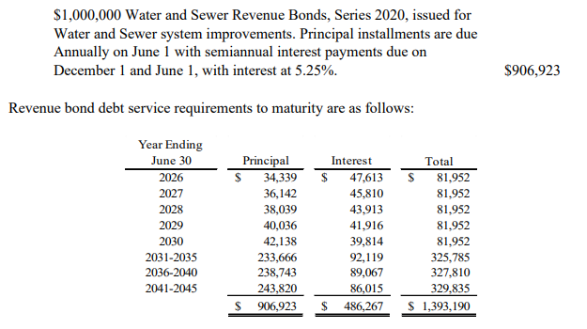
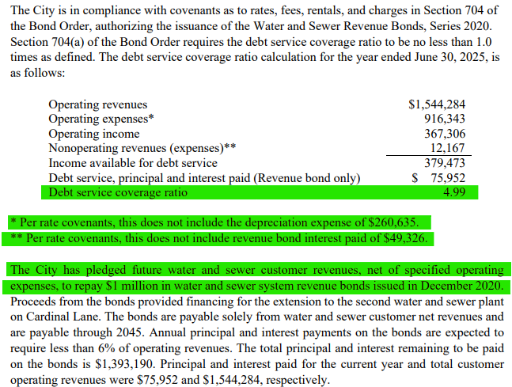
Revenue Bonds
Notes:
In the City of Dogwood example, you can see a brief description, supporting schedule, and a narrative indicating whether the unit is in compliance with its bond covenants related to its revenue bond debt. The example also includes the debt service coverage ratio calculation and disclosure of pledged revenues. These are key elements we look for when performing our audit reviews, as they help ensure that required disclosures are complete, accurate, and in compliance with applicable reporting standards and bond agreements.

Slide 26
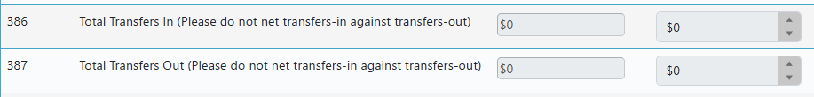
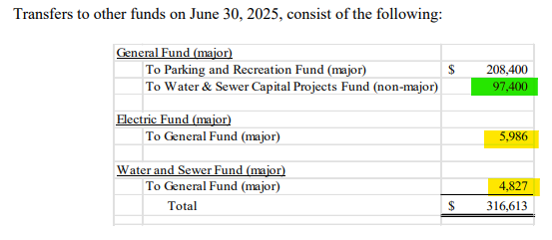
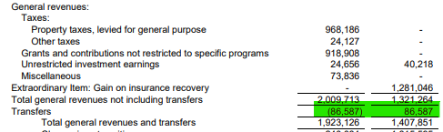
Transfers
Statement of Activities
$5,986 + $4,827 = $10,813
$97,400
Notes:
Throughout the DIR, there are multiple questions related to transfers, each with slight differences in focus and reporting requirements.
Beginning with the Statement of Activities, the transfers referenced here represent transfers between activities. For DIR purposes, we request that these transfers not be presented on a net basis, even though the Statement of Activities may display them netted. In some cases, the amounts may appear netted simply because only a single transfer occurred; however, when multiple transfers exist, netting obscures important detail.
In the example provided (bottom left), a snippet of the Statement of Activities is shown with transfers highlighted. As illustrated, these amounts appear to be netted. Because the DIR requires gross reporting, these transfers should be separately identified and disclosed in the notes to the financial statements, rather than combined.
It is important to emphasize that we are focusing specifically on transfers between governmental and business-type activities. In this example, multiple transfers are present:
The item highlighted in green represents a transfer from the General Fund to a Proprietary Fund, which is a transfer from governmental activities to business-type activities. This would be reported as a Transfer Out (account 387) for governmental activities.
The items highlighted in yellow represent transfers from business-type activities to governmental activities. These should be reported as Transfers In (account 386).
This level of detail ensures consistency with DIR requirements and provides greater transparency into the nature and direction of inter-activity transfers.

Slide 27
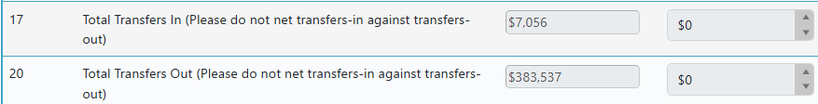
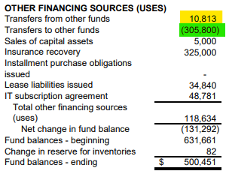
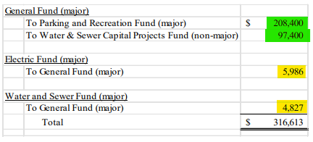
Transfers
Statement of Revenues, Expenditures, and Changes in Fund Balance – General Fund
$5,986 + $4,827 = $10,813
$208,400 + $97,400 = $305,800
Notes:
This set of transfer-related questions pertains to the Statement of Revenues, Expenditures, and Changes in Fund Balances, with a specific focus on the General Fund.
In the example provided, the statement snippet illustrates where transfers are typically presented. While most statements show Transfers In and Transfers Out as separate line items, there are instances where they may be combined.
For DIR purposes, however, accounts 17 and 20 should not be reported on a net basis. We are looking for Transfers In and Transfers Out to be presented separately, regardless of how they appear in the financial statements. The focus in this section is solely on transfer activity affecting the General Fund, and amounts should reflect the full detail of those inflows and outflows.
As the reviewer, I am using the notes to double check these entries, so complete notes are important.
Presenting transfers in this manner ensures consistency with DIR requirements and provides clearer visibility into the nature and direction of General Fund transfer activity.

Slide 28
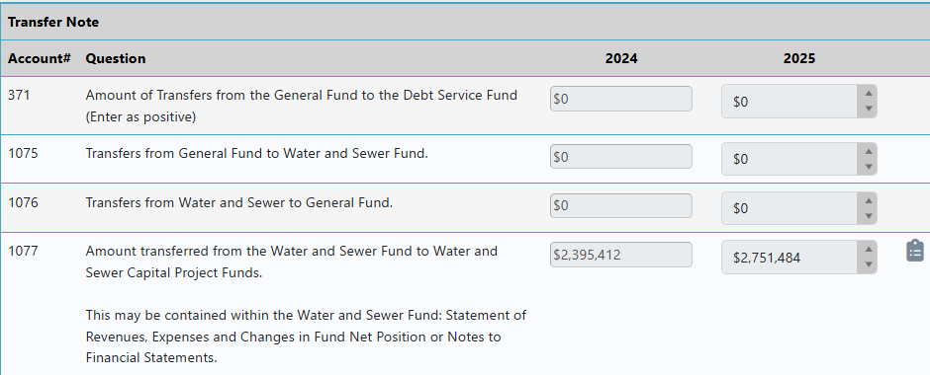
Transfers
Notes to the Financial Statements
Notes:
Moving on to the transfer-related questions associated with the Notes to the Financial Statements, these items are more straightforward in nature.
For example, account 1076 captures transfers from the water/sewer fund to the General Fund. It is important to note that this should include only transfers from the actual water/sewer operating fund. Transfers from water/sewer capital project funds or other water/sewer-related funds should not be included in this amount.
The same concept applies to account 1075, where we are similarly focused on transfers between the specified funds as defined, without including activity from related but separate fund types.
This distinction ensures that transfers are reported accurately and consistently, based on the specific fund relationships outlined in the DIR.

Slide 29
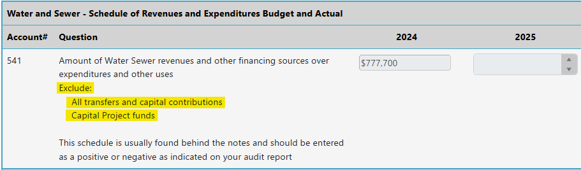
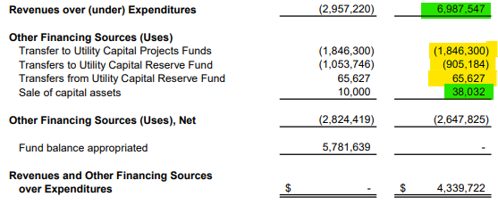
Water and Sewer - Schedule of Revenues and Expenditures Budget and Actual
$6,987,547 + $38,032 = $7,025,579
*Transfers are not included
Notes:
Lastly, account 541 is an area that is frequently misunderstood.
When completing this item, we are looking for water/sewer revenues and other financing sources in excess of expenditures, with specific exclusions. The calculation should exclude transfers, capital contributions, and activity related to capital project funds.
The amounts used to derive this figure should come directly from the water/sewer budget-to-actual statement, specifically from the actual column.
A common issue we see is the inclusion of all Other Financing Sources, when in fact transfers should be excluded. In the example provided, the only applicable Other Financing Source is the sale of capital assets. All other items (highlighted in yellow) should be excluded from the calculation.
Based on this, the correct calculation is:
$6,987,547 (revenues over expenditures)
+ $38,032 (sale of capital assets)
= $7,025,579
This approach ensures the response aligns with DIR requirements and accurately reflects the intended measure for account 541.

Slide 30
2026 Data Input Report (DIR) Additions
LOGOS Updates

Slide 31
Audited Financial Statement Upload
Starting in FY 2026, audited financial statements will be uploaded directly into LOGOS.
The first question on the auditor provided data tab (previously the transmittal document tab) will be a line to upload the PDF of the audited financial statements.
Only PDF will be accepted.
Audited financial statements for FY 2025 and earlier still go through the LGC File Transfer Portal.

Slide 32
Finance Officer Review and Sign Off
Finance Officer must sign off on the DIR before submission.
New certification checkbox added in LOGOS.
The Finance Officer must check this box before the DIR can be submitted.
The entire DIR must be complete before the Finance Officer can submit the DIR.
Auditors should prepare clients ahead of time.
Make sure finance officers have LOGOS access so there is no submission delay.
New finance officers need to go to the update portal to update their information: Finance Officer Updates · LGC File Transfer Portal
Notes:
Walk through key points for 2) Finance Officer Review and explain impact to auditors and units.

Slide 33
Audit Submission Date
With the new submission process for the audited financial statements and DIR, the way the submission date is determined has been changed.
For an audit to be considered submitted, the following must occur:
  A PDF of the audited financial statements are uploaded into LOGOS.
  The auditor provided data tab of the DIR must be completed by the auditor, saved, and validated by LOGOS.
Notes:
Walk through key points for 3) Audit Submission Date and explain impact to auditors and units.

Slide 34
Reminder Emails
LGC will send automated reminders in the month audits are due if the audit has not been submitted in LOGOS.
Notifications will go to both units and auditors.
Notices of Noncompliance will be issued pursuant S.L. 2023-59 (SB 299) via mail if audits are not submitted within nine months of fiscal year end.
Notes:
Walk through key points for 4) Reminder Emails and explain impact to auditors and units.

Slide 35
New Questions – Finance Officer Bond
The Finance Officer Bond required more ARCs than any other question on the DIR.
For FY 2026 submissions, LOGOS will now ask for the actual FO Bond amount.
System will compare bond to annually budgeted expenditures automatically.
If the bond appears insufficient, LOGOS will flag it as an error.
The hope is that this new question reduces follow-up clarification requests and decreases turnaround time for reviews.
Notes:
Walk through key points for 5) New Questions – FO Bond and explain impact to auditors and units.

Slide 36
Housing Authority Questions
We will have two new questions specific to housing authorities:
  We will ask about FO Bond compliance with G.S. 159-29, same as the other units.
  We will ask if the budget to actual schedules are included for all annually budgeted funds.
These questions will ensure consistency with regulatory and reporting requirements.
Notes:
Walk through key points for 6) Housing Authority Questions and explain impact to auditors and units.

Slide 37
Public Posting of Reports
All stamped audited financial statements, beginning with FY 2020, will be posted on a public website.
Beginning with FY 2025 DIRs, all submitted DIRs, which include the financial performance indicators, will also be posted on the public website.
This will increase transparency and accessibility of financial information.
Notes:
Walk through key points for 7) Public Posting of Reports and explain impact to auditors and units.

