Slide 1

Initial Appearance: Advanced Issues
Brittany Bromell, UNC School of Government

Slide 2

The Intersection of the Pretrial Integrity Act and Other Pretrial Release Laws
Probation violations
Impaired driving offenses
Domestic violence offenses
Rioting and looting

Slide 3
What is the Pretrial Integrity Act?
G.S. 15A-533(b): high-level felony offenses
G.S. 15A-533(h): 48-hour provision
  If a defendant is arrested for a new offense allegedly committed while the defendant was on pretrial release for another pending proceeding…
  … the judicial official who determines the conditions of pretrial release for the new offense shall be a judge.

Slide 4
Probation Violations

Slide 5

Defendant A
Defendant A is on probation. Defendant goes out of the state on a birthday trip without notifying the court or his probation officer. The probation officer files a violation report based on the violation of this regular condition to "remain within the jurisdiction of the court unless granted written permission to leave by the court or the probation officer." The defendant is arrested on an OFA for a probation violation.

Slide 6
First stop
D is on probation.
D is on probation and is arrested for a probation violation.

Slide 7
First stop
D is on probation.
- Probation ≠ pretrial release
D is on probation and is arrested for a probation violation.

Slide 8
First stop
D is on probation.
- Probation ≠ pretrial release
D is on probation and is arrested for a probation violation.
- Not on pretrial release; no issue.
- Arrest for probation violation is not a new offense; no issue.
SET CONDITIONS

Slide 9
Defendant A cont.
The magistrate imposes a $1,000 secured bond for the probation violation, which the defendant posts. The defendant is then released pending the probation violation hearing. The next day, the defendant is caught stealing from the local convenience store. The probation officer files a violation report based on the violation of this regular condition to "commit no criminal offense in any jurisdiction." The defendant is arrested on an OFA for a probation violation.

Slide 10
Second stop
D is on probation and is arrested for a probation violation. D has conditions of release set on the probation violation and is released pending the hearing….
…D commits a new criminal offense, and another probation violation is issued.

Slide 11
Second stop
D is on probation and is arrested for a probation violation. D has conditions of release set on the probation violation and is released pending the hearing….
- D is on pretrial release within the meaning of the statute.
…D commits a new criminal offense, and another probation violation is issued.

Slide 12
Second stop
D is on probation and is arrested for a probation violation. D has conditions of release set on the probation violation and is released pending the hearing….
- D is on pretrial release within the meaning of the statute.
…D commits a new criminal offense, and another probation violation is issued.
- D is on pretrial release within the meaning of the statute.
- Arrest for probation violation is not a new offense, no issue.
SET CONDITIONS

Slide 13
Defendant A cont.
ALTERANTIVELY: The magistrate imposes a $1,000 secured bond for the probation violation, which the defendant posts. The defendant is then released pending the probation violation hearing. The next day, the defendant is caught stealing from the local convenience store. The defendant is arrested for misdemeanor larceny.

Slide 14
Third stop
D is on probation and is arrested for a probation violation. D has conditions of release set on the probation violation and is released pending the hearing….
- D is on pretrial release within the meaning of the statute.
…D commits a new criminal offense and is arrested on a warrant for that offense.

Slide 15
Third stop
D is on probation and is arrested for a probation violation. D has conditions of release set on the probation violation and is released pending the hearing….
- D is on pretrial release within the meaning of the statute.
…D commits a new criminal offense and is arrested on a warrant for that offense.
- D is on pretrial release within the meaning of the statute.
- Arrest for a new offense within meaning of statute. PTIA applies.
DO NOT SET CONDITIONS

Slide 16
Impaired Driving Offenses

Slide 17
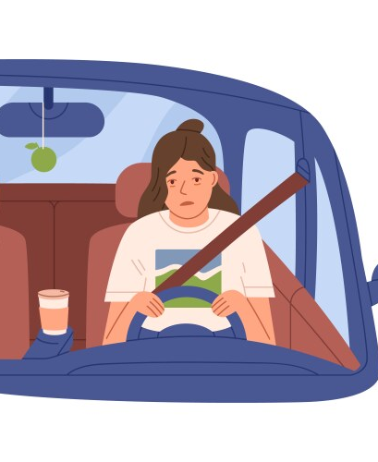
Defendant B
After Duke wins the NCAA basketball tournament, Defendant B, who is on pretrial release, decides to go out drinking with a group of friends. Shortly after leaving the bar in her car, she is arrested for driving while impaired. When she is brought before you, she appears to be fully coherent, is respectful, and is not showing any subjective signs of impairment.

Slide 18
Under normal circumstances…
D is arrested for driving while impaired.
Governed by G.S. 15A-534.2 and 20-38.4.
Magistrate duties:
  Set conditions of release.
  Implied consent offense notice. If D is unable to make bond,
    (1) inform D in writing of the established procedure to have others appear at the jail to observe his or her condition or to administer an additional chemical analysis and
    (2) require D to list the name and telephone numbers of all people he or she wishes to contact, on a form that sets forth the procedure for contacting the persons listed.
  Determine if impaired driving hold necessary.
  Consider whether D’s license is subject to civil revocation pursuant to G.S. 20-16.5.
  Evaluate whether vehicle driven by D is subject to seizure.

Slide 19
Under these circumstances…
D on PTR is arrested for driving while impaired.
Governed by G.S. 15A-534.2, G.S. 20-38.4, and G.S. 15A-533(h).
Magistrate duties:
  Implied consent offense notice. D by definition initially will be “unable to make bond,” since the magistrate is not authorized to set conditions within the first 48 hours of arrest.
    (1) inform D in writing of the established procedure to have others appear at the jail to observe his or her condition or to administer an additional chemical analysis and
    (2) require D to list the name and telephone numbers of all people he or she wishes to contact, on a form that sets forth the procedure for contacting the persons listed.
  Determine if impaired driving hold necessary.
  Consider whether D’s license is subject to civil revocation pursuant to G.S. 20-16.5.
  Evaluate whether vehicle driven by D is subject to seizure.

Slide 20



Comparing
 | When D was NOT on PTR | When D was on PTR
Set conditions of release
Determine if impaired driving hold necessary
Implied consent offense notice
Consider whether D’s license is subject to civil revocation
Evaluate whether vehicle driven by D is subject to seizure

Slide 21
Domestic Violence Offenses

Slide 22
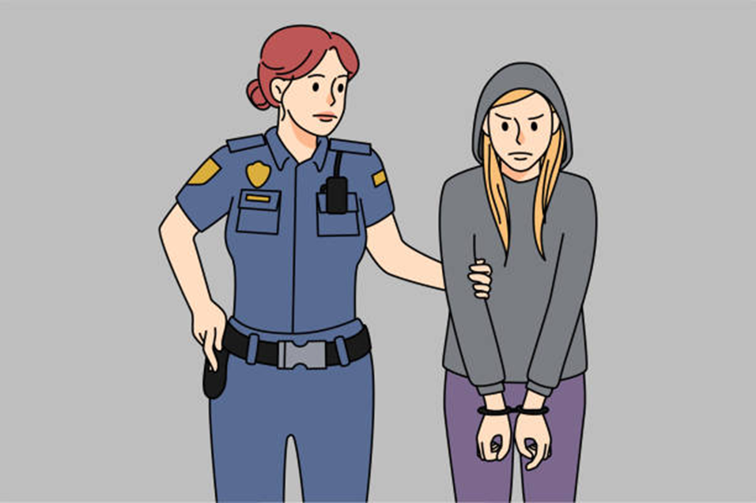
Defendant C
Defendant C, who is on pretrial release, is arrested for violation of a DVPO.

Slide 23
Under normal circumstances…
D is arrested for violation of a DVPO.
Governed by 48-hour rule under G.S. 15A-534.1.
No magistrate authority to set conditions within the first 48 hours.

Slide 24
Under these circumstances…
D on PTR is arrested for violation of a DVPO.
Governed by G.S. 15A-533(h) and G.S. 15A-534.1.
Both 48-hour statutes apply, but simultaneously.
D is subject to only one 48-hour window.

Slide 25

Defendant D
Defendant D, who is on pretrial release, is arrested for AWDWIKISI against the defendant’s spouse.

Slide 26
Under all circumstances…
Regardless of whether D is on pretrial release, there is only one outcome.
AWDWIKISI is subject to provisions of G.S. 15A-533(b), and only a judge can determine whether or not to afford D pretrial release conditions.
When all three statutes apply –{ G.S. 15A-533(b), 15A-533(h), and 15A-534.1 }– G.S. 15A-533(b) controls.

Slide 27
Rioting and Looting

Slide 28

Defendant e
After the results of the election, Defendant E, who is on pretrial release, decides to go rioting with a group of friends. They go downtown and toss Molotov cocktails into roads and empty storefronts. Defendant is arrested for rioting in violation of G.S. 14-288.2.

Slide 29
Under normal circumstances…
D is arrested for rioting in violation of G.S. 14-288.2.
Governed by G.S. 15A-534.8.
No magistrate authority to set conditions within the first 24 hours.

Slide 30
Under these circumstances…
D on PTR arrested for rioting.
Governed by G.S. 15A-533(h) and 15A-534.8.
One has a 24-hour window, the other has a 48-hour window.
The longer window controls, and magistrate is unable to set conditions until 48 hours after arrest.

