Slide 1
Ethics Code and Magistrates’ Criminal Duties
Belal Elrahal – UNC School of Government – October 30, 2024
Notes:
Why are ethics important – Frank’s Red Hot? Goes on everything?

Slide 2
Roadmap
Potential Issues…
with law enforcement appearing before you, when you are former law enforcement?
when you are related to people appearing before you?
when you know people well or their matters appearing before you?
Secondary Employment
Receiving Gifts

Slide 3
Magistrate Rules of Conduct
Pursuant to G.S. 7A-171.3, NC AOC issued rules of conduct for magistrates (first effective 10/1/2021).
Last modified 10/1/2022
Can be found on NC AOC’s public website by searching for “NC Rules of Conduct for Magistrates”

Slide 4
Preamble
An independent and honorable judicial system is indispensable to justice in our society, and to this end and in furtherance thereof, these Rules of Conduct for Magistrates are hereby established. A violation of these Rules of Conduct may be deemed conduct prejudicial to the administration of justice that brings the Office of the Magistrate into disrepute, or willful misconduct in office, or otherwise as grounds for removal proceedings pursuant to Article 16 of Chapter 7A of the General Statutes of North Carolina.

Slide 5
Preamble
An independent and honorable judicial system is indispensable to justice in our society, and to this end and in furtherance thereof, these Rules of Conduct for Magistrates are hereby established. A violation of these Rules of Conduct may be deemed conduct prejudicial to the administration of justice that brings the Office of the Magistrate into disrepute, or willful misconduct in office, or otherwise as grounds for removal proceedings pursuant to Article 16 of Chapter 7A of the General Statutes of North Carolina.

Slide 6
We’ll focus on the following Rules
Rule 1 – Upholding the integrity of the office
Rule 2 – Avoiding impropriety
Rule 3 – Being impartial and diligent
Rule 5.C.1 – Avoiding certain financial dealings

Slide 7
Remaining Rules
Rule 4 – Participating in activities concerning the administration of justice.
Rule 5 – Extra-judicial activities that don’t prevent carrying out duties.
Rule 6 – Political activity
Rule 7 – Respecting the Chief District Court Judge

Slide 8
Rule 1
Title: A magistrate should uphold the integrity of the Office of Magistrate and act accordingly.
Failing to be impartial and have integrity undermines public confidence.
Support professionalism.
Treat all persons with respect.

Slide 9
Rule 2
Title: A magistrate should avoid impropriety in all the magistrate’s activities.
Promote public confidence in the integrity and impartiality of the judicial system.
Shall not allow family, social, or other relationships to influence conduct or judgment.
Do not convey or permit others to convey the impression that they are in a special position to influence magistrates.

Slide 10
Rule 3
Title: A magistrate should perform the duties of the magistrate’s office impartially and diligently.
Be faithful to the law, unswayed by partisan interests, fair, courteous, prompt, avoid ex parte communications, abstain from public comments about pending proceedings.
You may obtain the advice of a disinterested expert (SOG for example).

Slide 11
Rule 3 (cont’d)
Must remain diligent, competent, present on the job, and comply with scheduling directives.
Duty to disqualify/recuse where impartiality may be reasonably questioned
Includes: personal bias, personal knowledge of facts, and relations within the third degree re: parties, attorneys, interests, or witnesses.

Slide 12
Degrees of Relationship
Use Table of Consanguinity to determine if someone is within Rule 3(E)(1)(e)
But remember: third degree relations are not the only disqualified group
Personal Bias can be favorable or unfavorable

Slide 13
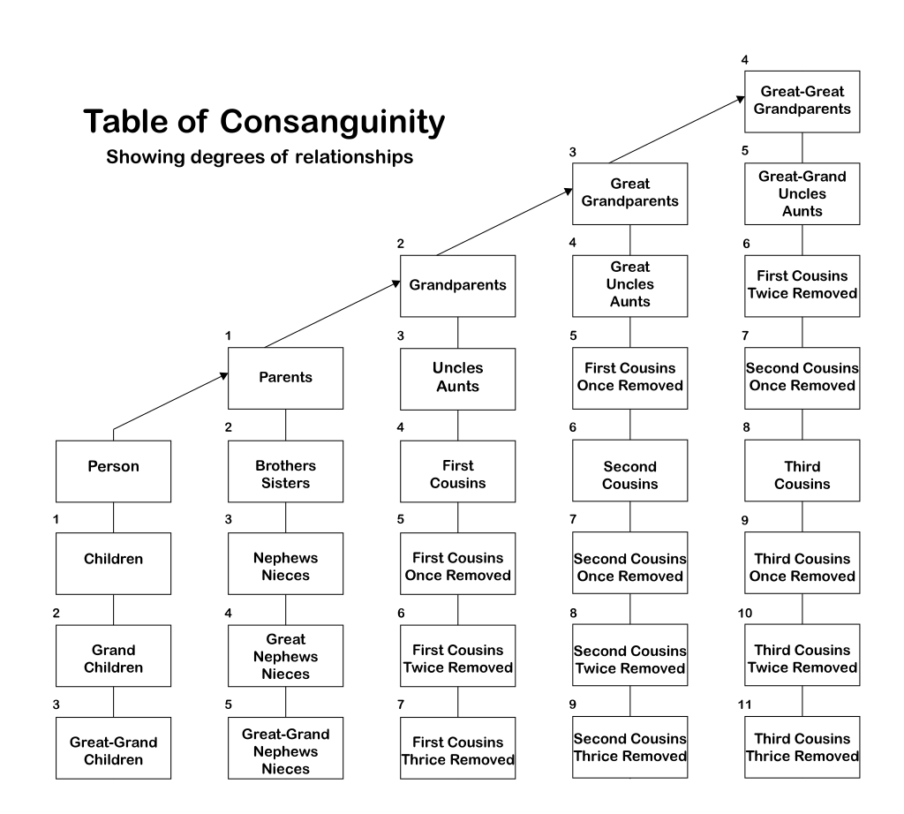

Slide 14
Rule 5
Refrain from financial dealings that reflect adversely on impartiality, exploit your mission, or involve you in frequent transactions with people likely to come before you.
Receipt of gifts is limited and may not be from a “party presently before the magistrate.”
Gifts are permitted as part of a professional event, “ordinary social hospitality,” or business transactions under regular terms.

Slide 15
Rule 5 (cont’d)
There is a temptation to scrutinize the Rule and be very technical – but is it wise?
Don’t forget Rule 2C, and consider a broad personal rule
Always ask: does the gift look like it’s intended to gain influence over me? Will accepting this lead someone to question my impartiality?

Slide 16
Rule 5 (cont’d)
What about secondary employment?
AOC references Rule 5C(1) and advises you seek counsel from AOC HR before accepting secondary employment.
Two main concerns: “interfere with the proper performance of the magistrate’s judicial duties” and “involve the magistrate in frequent substantial transactions with lawyers or persons likely to come before the court”

Slide 17
Example Scenarios

Slide 18
Scenario 1
Magistrate M was previously an officer with a municipal police department in her judicial district. Can she hear criminal matters, such as search warrant applications, from officers with that agency?
What rules of the code apply?
Does it matter whether she is maintaining her law enforcement certification?

Slide 19
Scenario 1 Analysis
Magistrate M was previously an officer with a municipal police department in her judicial district. Can she hear criminal matters, such as search warrant applications, from officers with that agency?
It Depends
What rules of the code apply?
Rule 2C “should not allow the magistrate’s family, social, or other relationships to influence conduct or judgment”
Rule 3E Duty to Recuse
Does it matter whether she is maintaining her law enforcement certification?
Same analysis as above. AOC advice is to maintain certification as far away as possible from where you are working as a magistrate. Local policies?

Slide 20
Scenario 2
Magistrate M is married to a police officer. Can the magistrate handle matters in which the officer spouse appears before the magistrate with criminal process requests? What if, instead of spouses, they are BFFs who do everything together?

Slide 21
Scenario 2 Analysis
Magistrate M is married to a police officer. Can the magistrate handle matters in which the officer spouse appears before the magistrate with criminal process requests? What if, instead of spouses, they are BFFs who do everything together?
Not covered by Rule 3E(1)(e)
Rule 2C again

Slide 22
Scenario 3
What should Magistrate M do if a sheriff’s deputy brings the magistrate’s nephew into the magistrate’s office, having arrested the nephew without a warrant for a felony?
What rules of the code apply?
What changes if the person arrested is M’s cousin they grew up with?

Slide 23
Scenario 3 Analysis
What should Magistrate M do if a sheriff’s deputy brings the magistrate’s nephew into the magistrate’s office, having arrested the nephew without a warrant for a felony?
Recuse – nephew is a third degree relation
What rules of the code apply?
Rule 3E(1)(e)
Any others?
What changes if the person arrested is M’s cousin they grew up with?
Recuse – but not third degree?
Rule 2C, Rule 3E(1)(a)

Slide 24
Rule 3 Exception
Withdrawal may not be required if you disclose on the record the basis of potential disqualification, and the parties agree in writing that the potential disqualification is immaterial and that you may participate (Rule 3E(4))
In practice – rarely see both “parties” in criminal proceedings
Rule does not address mandatory disqualifications

Slide 25
Checkpoint
What is your local practice when a magistrate identifies a conflict of interest in a criminal matter before them?
Is there a process for parties to agree that potential disqualification is not necessary?

Slide 26
Scenario 4
A sheriff’s deputy who appears regularly with arrestees in Magistrate M’s office learns that Magistrate M is newly engaged and sends them a celebratory bottle of bourbon. Should Magistrate M accept the gift?

Slide 27
Scenario 4 Analysis
A sheriff’s deputy who appears regularly with arrestees in Magistrate M’s office learns that Magistrate M is newly engaged and sends them a celebratory bottle of bourbon. Should Magistrate M accept the gift?
Rule 5C(4)(b) – “a wedding, engagement, or other special occasion gift”
Remember Rule 2C

Slide 28
Scenario 5
A bail bondsman throws a holiday party at a local bar every December and invites Magistrate M. Should they go?
Does it matter who else is invited?

Slide 29
Scenario 5 Analysis
A bail bondsman throws a holiday party at a local bar every December and invites Magistrate M. Should they go?
Remember the appearance of impartiality
Does it matter who else is invited?
Technical reading of the rules vs. gut instinct
If there’s a question, often times there is no question

Slide 30
Questions
Belal Elrahal
elrahal@sog.unc.edu
(919) 962-7098

