Slide 1
Juvenile Justice for Magistrates

Slide 2
Jurisdiction
Place of confinement
Transfer and bond
Sight and sound separation
Juvenile petitions

Slide 3
Original Jurisdiction

Slide 4
Current Exclusions From Original Juvenile Jurisdiction for Offenses at 16/17
Chapter 20 motor vehicle offenses
NOT including transactionally related offenses
Once an adult, always an adult
Emancipated
Married
Member of armed services

Slide 5
Current Case Movement Pathways
Ch. 20 at 16/17 must start and end as criminal matters
Criminal Jurisdiction
Original: Ch. 20 at 16/17
Transfer:
Mandatory: Class A, 13-15
Class A-C, 16/17
Mandatory if prosecutor elects to transfer: Class D-G 16/17
Discretionary: B1 – I, 13-15
Class H/I, 16/17
Juvenile Jurisdiction
Original: everything other than Ch. 20 at 16/17
Remand
(16/17 only)

Slide 6
Effective Date for Changes
Offenses committed on or after December 1, 2024
Notes:
S.L. 2024-17

Slide 7
Exclusions From Original Juvenile Jurisdiction for Offenses at 16/17 Offenses Committed on or after 12/1/24
Class A – E felonies AND transactionally related offenses
Chapter 20 motor vehicle offenses
NOT including transactionally related offenses
Once an adult, always an adult
Emancipated
Married
Member of armed services

Slide 8
Case Movement Pathways Offenses on or after 12/1/24
Removal
Class A-E, 16/17
Ch. 20 at 16/17 must start and end as criminal matters
Criminal Jurisdiction
Original: Class A-E at 16/17
Ch. 20 at 16/17
Transfer:
Mandatory: Class A, 13-15
Mandatory if prosecutor elects to transfer: Class F-G 16/17
Discretionary: B1 – I, 13-15
Class H/I, 16/17
Juvenile Jurisdiction
Original: Class F and under at 16/17 (no Ch. 20); everything under 16
Remand
(any transferred case)

Slide 9
Removal
Charges originate in criminal system
Indictment returned or criminal information issued
Joint motion (prosecutor and defense) for removal
Superior court must order removal to juvenile court

Slide 10
When Removal is Ordered
Order must be in writing and require DJJ to file a juvenile petition within 10 calendar days
Superior court record must be expunged (per G.S. 15A-145.8)
Superior court may issue a secure custody order if criteria in G.S. 7B-1903 are met

Slide 11
Jurisdiction
Place of confinement
Transfer and bond
Sight and sound separation
Juvenile petitions

Slide 12
Place of Confinement
Criminal jurisdiction and under 18
Juvenile detention
Criminal jurisdiction and 18 or older
Jail
Juvenile Jurisdiction
Juvenile detention*
* with exceptions for rare cases that did not begin before aging out and the person is 18 or older
Notes:
G.S. 15A-521, 7B-1905(b)

Slide 13
Jurisdiction
Place of confinement
Transfer and bond
Sight and sound separation
Juvenile petitions

Slide 14
If Transfer Ordered
Must set bond
Immediate appeal to Superior Court*
Fingerprinting Required
G.S. 7B-2204
G.S. 7B-2603
G.S. 7B-2201
*only for discretionary transfers beginning with offenses on 12/1/24
Notes:
Address bond issues and potential role of magistrate

Slide 15
AOC-CR-922

Slide 16
10-Day Appeal Window
Dispelling Transfer Confusion: 10-Day Appeal Window, Orders for Arrest
https://civil.sog.unc.edu/dispelling-transfer-confusion-10-day-appeal-window-orders-for-arrest/

Slide 17
Key Points
Criminal matter under jurisdiction of the superior court
CRS numbers can and should be manually generated
No orders for arrest based on returned indictment

Slide 18
Jurisdiction
Place of confinement
Transfer and bond
Sight and sound separation
Juvenile petitions

Slide 19
Sight and Sound Contact Prohibition 34 U.S.C. § 11133(a)(11)(B)
Notes:
Changes applying to minors charged with criminal offenses took effect in 2021

Slide 20
Applies to Contact Between “Juveniles” and “Adult Inmates”
Juvenile
Adult Inmate
juveniles awaiting trial or other legal process who are treated as adults for purposes of prosecution in criminal court and housed in a secure facility
has reached the age of 18; and
has been arrested and is in custody for or awaiting trial on a criminal charge, or is convicted of a criminal offense.
does not include an individual who—
at the time of the offense, was younger than 21or
was committed to the care and custody or supervision of DJJ

Slide 21
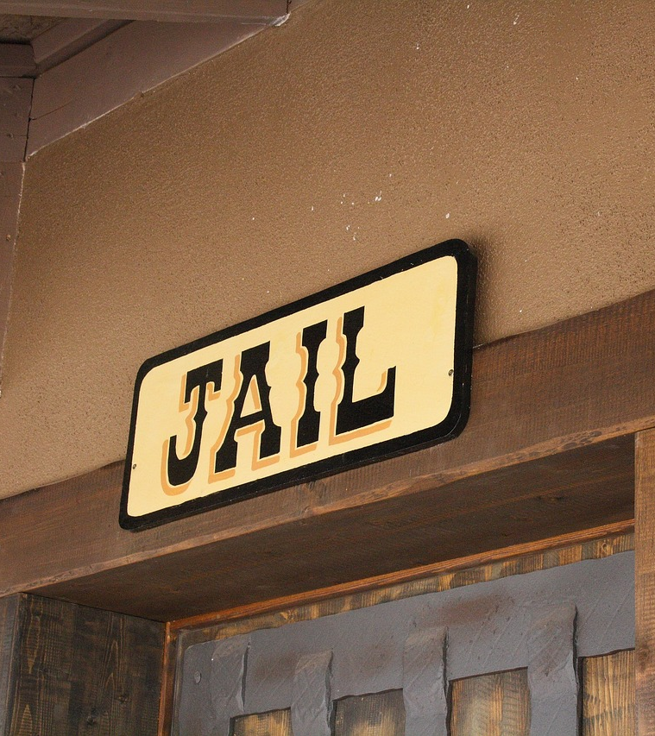
Prohibition of Detention or Confinement in Adult Jail 34 U.S.C. §11133(a)(13)
Exception: Up to 6 hours for
(i) for processing or release;
(ii) while awaiting transfer to a juvenile facility; or
(iii) in which period such juveniles make a court appearance.

Slide 22
Still No Sight or Sound Contact
Notes:
Additional exceptions:
48 hours for initial appearance if outside of metropolitan statistical area
Travel condition exception (not allow for court appearances within 48 hours; distance, lack of highway , road, or transportation
Conditions of safety – severe, adverse life-threatening weather, up to 24 hours after conditions allow for reasonable safe travel
Sight and sound separation still apply
Court ordered exception; factors to consider; up to 180 days; ongoing hearings required

Slide 23
Jurisdiction
Place of confinement
Transfer and bond
Sight and sound separation
Juvenile petitions

Slide 24
Juvenile Petitions
Authority for magistrate to draw and verify petition and accept it for filing when:
Office of the Clerk is closed
Court counselor requests a petition
Secure or nonsecure custody order sought
G.S.7B-1804(b)

Slide 25
Secure Custody Orders
MUST be authorized by a district court judge or court counselor (if delegated by a local administrative order)
Magistrate is the person who receives telephonic approval

Slide 26
Notes:
AOC-J-440

Slide 27
Contact Information
Jacqui Greene
UNC School of Government
greene@sog.unc.edu
(919) 966-4327

