Slide 1
Intro 1 Module 8
Torts
&
Motor Vehicle Liens

Slide 2
But first, a look back . . .

Slide 3
The Hardest Problem in Basic School
Abe Barker calls Sam’s Heating and Cooling and asks to have them deliver and install a window unit. Sam’s Heating and Cooling comes out to his house installs the unit and then sends a bill to Barker for $300, the cost of the unit and installation. Barker does not pay the bill; Sam’s Heating and Cooling brings an action to recover possession of the air conditioning unit as a nonsecured plaintiff. At the trial Sam’s proves the facts stated above; Barker is not present. How do you rule and why?
Sam Seller agrees to sell Betty Buyer a (very old) car for $400. Betty pays $200 and drives the car home, promising to return tomorrow with the rest of the money. When she doesn’t return, Sam goes to her house and repossesses the car.

Slide 4
Secured, non-secured, or neither!
Remember that there are two situations in which a plaintiff may qualify for a judgment awarding possession of property:
Plaintiff is the owner of the property or Plaintiff is a secured party with interest in the collateral.
What evidence is required?

Slide 5
Remember that we talked about lawsuit #2
Commercially reasonable manner

Slide 6
Right to Repo, Gone Wrong
Eley v. Mid/East Acceptance, 171 NC App 368 (2005). (Hertford Co.)
Notes:
Summarize facts. Two torts here. Chat box/guess which? Conversion and UTP. Examples of intentional torts.

Slide 7
Conversion
Taken together, all of these facts combine to support the inference that defendant assumed and exercised the right of ownership over plaintiff's watermelons without her permission, to the exclusion of her own rightful ownership interest. More colloquially, as plaintiff put it, “It was too hot. The melons was already there a week. The melons were spoiled. They wouldn't do me any good. They were their melons. They took the truck, they took the melons. They were their melons then.”

Slide 8
Unfair or deceptive practice
A practice is unfair when it offends established public policy as well as when the practice is immoral, unethical, oppressive, unscrupulous, or substantially injurious to consumers.” Marshall v. Miller, 302 N.C. 539, 548, 276 S.E.2d 397, 403 (1981). Also, “ ‘[a] party is guilty of an unfair act or practice when it engages in conduct [that] amounts to an inequitable assertion of its power or position.’

Slide 9
Unfair or deceptive practice
A practice is unfair when it offends established public policy as well as when the practice is immoral, unethical, oppressive, unscrupulous, or substantially injurious to consumers.” Marshall v. Miller, 302 N.C. 539, 548, 276 S.E.2d 397, 403 (1981). Also, “ ‘[a] party is guilty of an unfair act or practice when it engages in conduct [that] amounts to an inequitable assertion of its power or position.’
The trial court found and evidence supports that (1) two men appeared at the female plaintiff's house at 4:05 a.m. with a tow truck and hauled away her truck without giving plaintiff a reasonable time to unload her 130 watermelons; (2) following the repossession, when plaintiff contacted defendant to inquire as to the location of her truck so she could retrieve her watermelons, defendant denied knowledge of the truck; (3) defendant was unresponsive to plaintiff's inquiries about her watermelons; (4) defendant only offered to give plaintiff access to the truck—by requesting her truck key—after the watermelons were already rotting and of no value; and (5) defendant has never compensated, nor offered to compensate, plaintiff for the converted property. These unchallenged findings of fact, taken together, are such as “a reasonable mind might accept as adequate” to support the finding that the defendant deprived plaintiff of her property by means of inequitably asserting its relative position of power.

Slide 10
Right to Repo Gone Wrong
Eley v. Mid/East Acceptance, 171 NC App 368 (2005). (Hertford Co.)
$455 x 3= $1365 + $1562.50 atty fees + add’l fees for appeal

Slide 11
Who were the actors?
Vicarious liability
Mid/East Acceptance corporation of nc, inc.
Carolina repossessions
Employees: Joyce White, maybe others
Employees: Roger Pinkham & his brother
Who drove the repo truck?
Who said, “What truck?”

Slide 12
Traditional negligence analysis
Did defendant have a duty of reasonable care to the plaintiff?
Did defendant breach that duty (i.e., was defendant negligent)?
Was defendant’s negligence the proximate cause of injury to plaintiff or plaintiff’s property?
What damages did plaintiff suffer?

Slide 13
Test for negligence
What would a reasonably prudent person, acting with due care and diligence, do under the same circumstances?

Slide 14
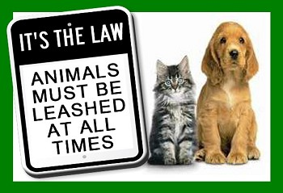
Substitutes for negligence requirement:
Negligence Per Se
Violation of safety statute
Strict Liability
Any person or other legal entity shall be entitled to recover actual damages suffered in an amount not to exceed a total of two thousand dollars ($2,000) from the parent or parents of any minor who shall maliciously or willfully injure such person or destroy the real or personal property of such person. N.C. Gen. Stat. Ann. § 1-538.1

Slide 15
Most common defense
Contributory negligence
Π is 1% / ∆ is 99%

Slide 16
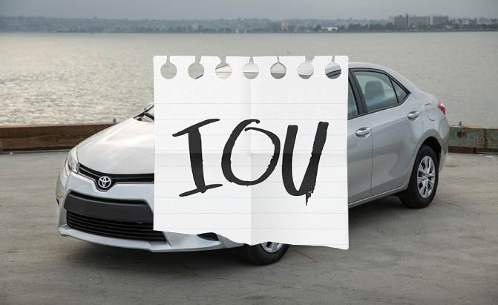
Motor Vehicle Liens

Slide 17
In a nutshell
Who? Person or business who tows, stores, or repairs motor vehicle in ordinary course of business, OR public parking facilities, OR landowner with abandoned MV for 30+days.
What? Right to sell vehicle to obtain reimbursement for reasonable charges of repair, service, towing, or storage.
How? Usually by notifying DMV. When judicial approval is required, often a special proceeding. But sometimes law requires small claims hearing.
Issues before the magistrate: (1) Is there a lien? (2) What are the reasonable charges for s ervices rendered (including reasonable storage charges)?

Slide 18
Note special procedural rules!
Amount in controversy = amount of lien (not FMV of vehicle)
Action must be brought in county where claim arose (i.e., place of repair, storage, etc.)
Service by publication is allowed if plaintiff, using“due diligence,” is unable to locate defendant
Your judgment authorizes sale; it does not award money.

Slide 19
This is a POSSESSORY lien.
It arises when plaintiff takes possession and ends when plaintiff surrenders vehicle or defendant pays all amount owed.
Basic lawsuit: Business files CVM-203/COMPLAINT TO ENFORCE POSSESSORY LIEN ON MOTOR VEHICLE / Judgment entered on CVM-402.
Twist: Owner steals his own car: Business files CVM-903/Complaint to Recover Motor Vehicle Held for Lien and to Determine Amount of Lien/Judgment CVM-905
Twist: Owner initiates challenge to lien: Owner files CVM-900/Complaint to Recover Motor Vehicle Held for Lien and to Determine Amount of Lien/Judgment CVM-905
PLUS Forms CVM-901M (Order for release of motor vehicle held for lien), and
CVM-904M (Bond to keep possession of motor vehicle taken from lienor).

Slide 20
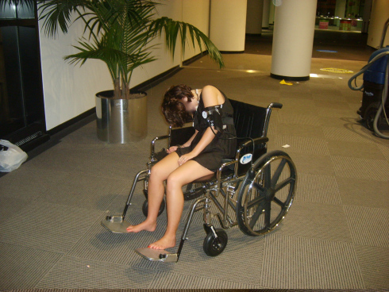
Davis v. Hulsing Enterprises, LLC

Slide 21
Negligence per se/Violation of safety statute
GS 18B-305(a): Sale to Intoxicated Person.--It shall be unlawful for a permittee or his employee or for an ABC store employee to knowingly sell or give alcoholic beverages to any person who is intoxicated.

Slide 22
For next time:
It’s our last class. I’ll bring the cookies!
Our final class will be light on lecture, heavy on practice. Come prepared to enter judgment “in open court” in the case described in the Homework document posted this morning. You may want to look back at Module 4’s description of the steps to entering judgment to prepare for this exercise.

