Slide 1
Taking Bail Bonds Advanced Criminal Procedure for Magistrates
UNC School of Government
October 30, 2024
Seth Kandl
Assistant Legal Counsel, NCAOC Office of General Counsel

Slide 2
Agenda
Taking Bonds – General Provisions
Secured Bonds – Cash
Secured Bonds – Mortgage by Defendant
Secured Bonds – Sureties
Surety Bonds – General
Licensed Sureties
Accommodation Bondsmen
Stacking and Splitting Bonds, Bonds and ICE Detainers
Reference Material

Slide 3
Taking Bail Bonds General Provisions
Any judicial official “must effect the release of [the defendant] upon satisfying himself that the conditions of release have been met.” G.S. 15A-537(a).
Meeting a monetary condition of release, unsecured or secured, requires execution of an Appearance Bond (AOC-CR-201).
The Appearance Bond is the defendant’s (and surety’s) contract with the State, permitting forfeiture of the bond if the defendant doesn’t appear.
The Release Order (AOC-CR-200) no longer contains contractual terms that would support forfeiture of the bond.
Defendant always must sign the Appearance Bond, whether secured or unsecured, even if secured by a surety’s property.

Slide 4
Taking Bail Bonds General Provisions
Unsecured Bonds
Requires no more proof of defendant’s solvency than a written promise.
Secured Bonds
Can be secured by:
Cash (possibly the defendant’s)
Mortgage (only the defendant’s)
“at least one solvent surety”
Accommodation Surety
Professional Surety (and agents or runners)
A bond can be “secured” by a surety’s promise, alone.

Slide 5
Taking Bail Bonds Secured Bonds – Cash
An Appearance Bond can be secured by “a cash deposit of the full amount of the bond.” G.S. 15A-531(4) (definition of “bail bond”).
When “Cash” means “CA$H (only)”
“Cash only” Release Orders are not uncommon, but their legal basis is uncertain.
When a Release Order specifies cash, bond posted by an insurance company (via a bail agent) or a professional bondsman (personally or via a runner) “is considered the same as a cash deposit.” G.S. 15A-531(4).
But “[c]ash bonds set in child support contempt proceedings shall not be satisfied in any manner other than the deposit of cash.” Id.

Slide 6
Taking Bail Bonds Secured Bonds – Cash – Ownership (or “Who gets the refund?”)
Cash deposited by defendant
Appearance Bond should be executed in defendant’s name, only.
Cash deposited by third party
If the third party wants to preserve ownership of the cash, it’s a “Surety Appearance Bond”
The third party must execute the Appearance Bond as surety to preserve ownership of the cash and other rights as a surety.
If third party does not want to (or can’t) execute the bond as surety, prepare the Appearance Bond as a “Cash Appearance Bond” (i.e., by defendant).

Slide 7
Taking Bail Bonds Secured Bonds – Cash – Over $10,000
The clerk must report cash in excess of $10,000 received as bail to the IRS and Financial Crimes Enforcement Network (FinCEN) and to the US Attorney(s) where defendant resides (and where the charged offense occurred, if different).
A single report to the IRS satisfies both the IRS and FinCEN.
Includes anyone receiving money on behalf of the clerk (e.g., magistrates, jailers).
Required only for certain offenses: drugs, racketeering, and money laundering (so for N.C. offenses, it’s just drugs).
May also include a source of funds restriction under G.S. 15A-539(b) imposed by a judge
“Cash” means any combination of:
Actual currency, and
Negotiable instruments (e.g., money orders) for $10,000 or less.

Slide 8
Taking Bail Bonds Secured Bonds – Cash – Over $10,000
Cash bonds must be counted in the aggregate unless for “separate bail requirements.”
Bond for multiple charges arising from the same event should be aggregated.
Suspicious transactions.
A cash bond transaction that doesn’t technically require reporting should be reported anyway if “suspicious” – usually meaning the payor tries to structure a transaction in a way that wouldn’t require reporting.
Report on IRS Form 8300; guidance is in IRS Publication 1544.
Current version of the form is Dec. 2023.
Current version of Publication 1544 is Sep. 2014.

Slide 9
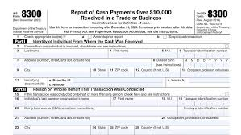
Taking Bail Bonds Secured Bonds – Cash – Over $10,000 – IRS Form 8300
Must include information on defendant and any third party posting cash, even if the third party does not sign the Appearance Bond as surety.
Official taking bond must verify identity of any third party providing the cash by some official documentation.
For cash provided by alien - passport, alien ID card, or other document showing nationality or residence.
G.S. 15A-311: No matricula consular or non-passport issued by a foreign consulate or embassy.
IDs issued by local authorities may suffice in a pinch. G.S. 15A-311(c).
For anyone else - any ID normally accepted when cashing a check.

Slide 10
Taking Bail Bonds Secured Bonds – Cash – Over $10,000 – IRS Form 8300
Parties’ Taxpayer ID Number (TIN) (generally a social security number) is required.
Failure to include is a common reason for Form 8300’s return to the clerk and assessment of penalties.
No TIN req’d for certain foreign nationals. See Pub. 1544.
“Suspicious” transactions are noted by check-box ‘b’ in the form heading.
IRS regulations require reporting by “the clerk,” but local practice may have the magistrate complete Part IV for the recipient (clerk).

Slide 11
Taking Bail Bonds Secured Bonds – Mortgage by Defendant
A defendant may post a mortgage to his own property for an Appearance Bond.
Most counties require a deed of trust, rather than an actual mortgage.
Use “Defendant’s Property Appearance Bond” on AOC-CR-201 for a bond posted by mortgage or deed of trust to property owned solely by the defendant.
One unique feature of bonds secured by a true “mortgage” - they require an affidavit of the property’s value from a disinterested witness. G.S. 58-74-30.

Slide 12
Taking Bail Bonds Secured Bonds – Surety Bonds - General Provisions
Surety: “one who, with the principal [defendant], is liable for the amount of the bail bond upon forfeiture of the bail.” G.S. 58-71-5(10).
Upon forfeiture, defendant and surety are jointly and severally liable to the State for the amount of the bond. G.S. 15A-544.7(a).
A surety must be one of three entities, G.S. 15A-531(8):
Professional Bondsman
Insurance Company
Accommodation Bondsman
[Actually, there’s a fourth – a Motor Club.]

Slide 13
Taking Bail Bonds Secured Bonds – Surety Bonds - General Provisions
A surety must be “solvent.”
G.S. 15A-537(a): Determining that a defendant’s conditions of release have been met “includes determining if sureties are sufficiently solvent to meet the bond obligation.”
Ways of determining a surety’s solvency generally are in local bond policies.
Most common policy: a threshold bond amount at which specific collateral (i.e., cash or a deed of trust) will be required.
Solvency of licensed sureties is based on deposits with the Department of Insurance, but current deposits are not available to review when taking a bond.

Slide 14
Taking Bail Bonds Secured Bonds – Surety Bonds – Licensed Sureties
Professional Bondsmen and Insurance Companies.
Licensed by the Department of Insurance to do bail bond business.
Runners and Bail agents (surety bondsmen), are sureties’ agents; they are not sureties.
An agent may not execute bonds outside the scope of his license.
E.g., If a runner’s professional bondsman also is a bail agent (holding two licenses), the runner may not execute bonds for his employer’s insurance company unless licensed as a bail agent of that company, himself.

Slide 15
Taking Bail Bonds Secured Bonds – Surety Bonds – Licensed Sureties
A licensed surety whose license is not suspended, cancelled or revoked generally may execute bonds in any county in the State.
An unsatisfied bond forfeiture judgment prohibits licensed entities from executing new bonds. G.S. 15A-544.7(d).
The surety on a forfeiture judgment may not execute new bonds for that same county’s cases until the judgment is satisfied.
An individual licensee (bondsman, agent, or runner) “whose name appears on a bond” executed >= 12/1/2016 that is the subject of an unsatisfied forfeiture judgment may not execute any new bonds in any licensed capacity, statewide, until the judgment is satisfied.

Slide 16
Taking Bail Bonds Secured Bonds – Surety Bonds – Licensed Sureties
Statewide licensee prohibition applies only to human licensees (not insurance companies).
Practical effect for magistrates who take bonds: the surety (ins. co. or professional) might be listed on the Surety Report as allowed, but the agent trying to execute the bond might be prohibited in his own capacity as a licensee.
Need to confirm that both the surety and the agent currently appear as allowed on the Surety Report.
See memo on Juno, “2016 Legislation - Bail Bonds and Bond Forfeitures - S.L. 2016-107,” Nov. 17, 2016.
https://juno.nccourts.org/legal-memos

Slide 17
Taking Bail Bonds Secured Bonds – Surety Bonds – Licensed Sureties
A surety prohibited from executing new bonds will be omitted from the county’s Surety Report (along with their agents).
If not on the report for a county, the surety cannot execute a bond for that county’s cases.
An agent executing a bond must be listed on the current Surety Report as affiliated with the surety on whose behalf he wants to sign the bond.
Printed hardcopy of the Surety Report may be out of date; use the report on nccourts.gov: https://www.nccourts.gov/services/find-a-bail-bondsman
Unlike AWARE, Odyssey will warn about prohibiting judgments in Odyssey counties, only. Odyssey does not import information from VCAP, so use the Surety Report to verify eligibility to post bonds for a county still on VCAP.

Slide 18
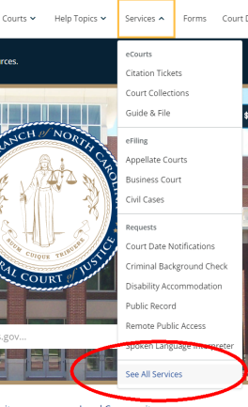
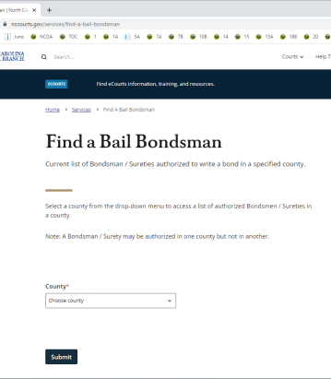
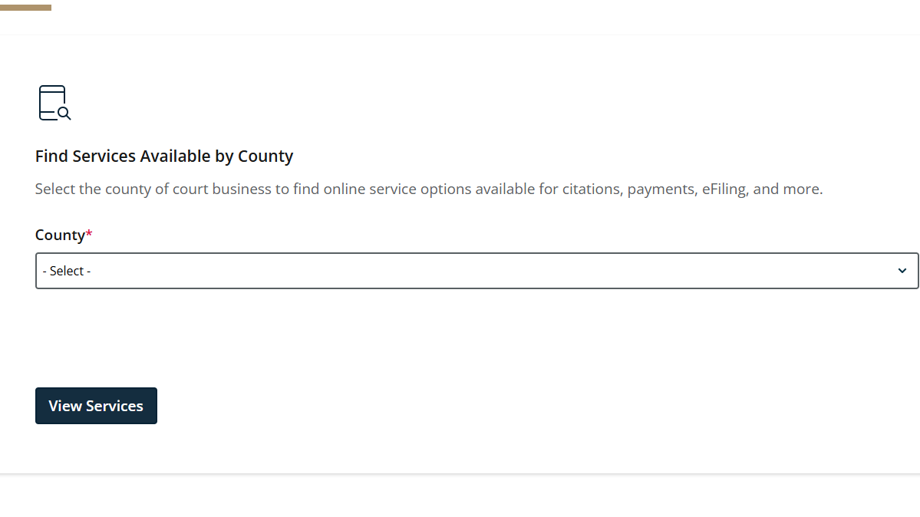
Taking Bail Bonds Secured Bonds – Surety Bonds – Licensed Sureties
On “Services” page:

Slide 19
Taking Bail Bonds Secured Bonds – Surety Bonds – Licensed Sureties
If charging county not yet implemented on Odyssey, and a licensee is prohibited but claims the prohibition is invalid, check VCAP’s Bondsman/Surety Details screen (VCBD) for the licensee in the county for which the bond is being executed.
VCBD screen shows all 3 types of prohibition (surety, licensee, and by DOI) and provides links to:
the Forfeiture Index (county-specific, license-specific, shows both pending forfeitures and final judgments); and
the Statewide Forfeiture Index (judgments only, but statewide and for all licensee’s licenses).
If licensee can’t prove all prohibiting judgments have been satisfied (i.e., receipts), don’t allow execution of new bonds.

Slide 20
Taking Bail Bonds Secured Bonds – Surety Bonds – Licensed Sureties
Affidavit required for every bond by a licensed surety.
A licensed surety executing a bond must “file with the clerk of court having jurisdiction over the principal an affidavit on a form furnished by the Administrative Office of the Courts.” G.S. 58-71-140(d).
This is the affidavit on Side Two of the Appearance Bond (AOC-CR-201) and must be executed on every bond posted in the name of a licensed surety.
The affidavit “shall” include details of any premium paid (or to be paid) or collateral received in exchange for posting the bond.
No blank bonds.
Licensed sureties may not execute “blank” bonds to be executed by another person. G.S. 58-71-110.

Slide 21
Taking Bail Bonds Secured Bonds – Surety Bonds – Licensed Sureties
Violation of any provision of Article 71 of G.S. Chapter 58 is a Class 1 misdemeanor. G.S. 58-71-185.

Slide 22
Taking Bail Bonds Secured Bonds – Surety Bonds – Licensed Sureties
Professional Bondsmen.
Like a defendant, a professional bondsman is personally liable for a bond.
Bonds may not be executed in a professional bondsman’s business name (e.g., “XYZ Bail Bonds”), because the Department of Insurance licenses bondsmen only in their personal capacities.
Bondsmen’s deposits – the “solvency” of a professional bondsman.
A professional bondsman may not have outstanding at any time bonds exceeding:
Twelve times his/her total deposits with DOI, G.S. 58-71-145; or
One-fourth of his total deposits posted for a single defendant. G.S. 58-71-175.
DOI does not have bondsmen deposits online for real-time verification.

Slide 23
Taking Bail Bonds Secured Bonds – Surety Bonds – Licensed Sureties
Insurance Companies.
An insurance company can execute bonds only through a bail agent currently affiliated with that company on the Surety Report.
Mere possession of a company’s POA certificate does not mean the agent is currently permitted to sign bonds for that company, so check the Report.
The POA certificate – the “solvency” of an insurance company.
Like professional bondsmen, insurance companies maintain deposits held in trust by the Commissioner of Insurance, but the company’s authority to execute an individual bond is not linked to those deposits.
“Solvency” is determined by the face value of the company’s POA certificate; it must be enough to cover the bond.

Slide 24
Taking Bail Bonds Secured Bonds – Surety Bonds – Motor Club Bonds
Motor club bonds are secured by an insurance company licensed to business in the State, but not necessarily to do bail bond business.
Authorized to post appearance bonds for traffic offenses, up to $1,500, except for an impaired driving offense or any felony. G.S. 58-69-55.
Beware disclaimers of liability on a motor club bond, such as:
dollar amount limitations lower than $1,500;
excluded offenses; or
expiration dates.

Slide 25
Taking Bail Bonds Secured Bonds – Surety Bonds – Motor Club Bonds
Motor clubs are not on the Surety Report or in the list of licensed sureties in Odyssey.
Workaround: Prepare as a “Surety Appearance Bond” with the motor club’s information entered as an “Accommodation Bondsman.”
Before manually adding a motor club as a new party in Odyssey, search Party records to see if a particular motor club already has an Odyssey party record.

Slide 26
Taking Bail Bonds Secured Bonds – Surety Bonds – Accommodation Bondsmen
Accommodation bondsman – private party not regulated by the Department of Insurance. Definition/qualifications are in G.S. 15A-531(1), G.S. 58-71-1(1):
Natural person (i.e., no corporations, non-profits, partnerships, etc.)
18 years of age
Resident of the State
Receives no compensation for executing the bond.
Endorses the bail bond (i.e., must sign the Appearance Bond)
Provides proof of solvency to satisfy the bond.
NO judicial or criminal justice official or attorney can serve as a surety, except for defendants who are close relatives. G.S. 15A-541; G.S. 58-71-105.

Slide 27
Taking Bail Bonds Secured Bonds – Surety Bonds – Accommodation Bondsmen
“Solvency” of an accommodation bondsman:
“satisfactory evidences of ownership, value and marketability of real or personal property … sufficient to assure that the full principal sum of the bond will be realized.” G.S. 15A-531(1).
Official taking the bond can be satisfied about the surety’s solvency without requiring that specific property (cash or land) be encumbered for the bond.
The surety’s assets or equity in property must be enough to satisfy the bond after deducting the value of his/her constitutional exemptions ($1,000 in real property; $500 in personal property).
Statutory exemptions in Chapter 1C don’t apply to judgments on bond forfeitures. G.S. 1C-1601(e)(2).

Slide 28
Taking Bail Bonds Secured Bonds – Surety Bonds – Specific Security
Local bond policy generally sets the threshold amount at which specific security (cash or land) must be posted to satisfy a bond.
The bond policy of the county where the charge is pending should be followed whenever possible.
Cash is always acceptable.
Local school boards will prefer cash; collection is easier.

Slide 29
Taking Bail Bonds Secured Bonds – Property Bonds
A property bond is the encumbrance of a specific parcel(s) of real property in order to secure the appearance bond (i.e., by deed of trust).
A surety who executes a bond merely upon proof they own real property of a certain value might have demonstrated solvency, but without a deed of trust recorded with the Register of Deeds, the State has no priority interest in that land.
All owners of an interest in the property must execute both the deed of trust and the Appearance Bond.
If the property is owned by sureties, each owner must meet all the qualifications of an accommodation bondsman. I.e., no property owned in whole or in part by a non-person (e.g., business, church, charity), by a minor, or by a non-resident.

Slide 30
Taking Bail Bonds Secured Bonds – Property Bonds – Rented Residential Property
The federal Protecting Tenants and Foreclosure Act of 2009 (PTFA), Pub. L. 111-22, Title VII, was re-enacted with no sunset date, effective June 2018. Pub. L. 115-174, Title III, sec. 304. (Original enactment in 2009 expired in 2014.)
Similar state law, G.S. 45-21.33A, was enacted in 2015 but repealed in 2019.
The PTFA protects a tenant under a “bona fide lease or tenancy” of “a dwelling or residential real property” from immediate removal under certain circumstances.
Property rented to a tenant covered by the PTFA may have less “marketability,” one of the factors a judicial official must consider when evaluating property as proof of an accommodation bondsman’s solvency. G.S. 15A-531(1).

Slide 31
Taking Bail Bonds Secured Bonds – Property Bonds – Common Questions
“Case in County A, property in County B.”
Bond policies of the county where the charge is pending should be followed whenever possible.
Clerk of the charging county must be made trustee and hold the court’s copy of all bond documentation (including the deed of trust).
Jointly-owned property.
Local rules may prohibit bonds secured by property owned jointly by defendant and another person (e.g., a spouse).
If not prohibited by local rule, any bond secured thereby should be collectible if the Appearance Bond and deed of trust are executed by both owners, and the deed indicates the grantors are spouses.

Slide 32
Taking Bail Bonds Stacking and splitting Bonds
Stacking: Posting a single Appearance Bond to satisfy the monetary condition of a release order, using multiple (“stacked”) forms of security, none of which individually covers the full amount of the bond.
Example: A bail agent and the defendant’s girlfriend sign a single bond (CR-201) to satisfy a $100,000 condition of release, attaching to that single bond:
a POA certificate from agent’s insurance company worth $60,000; and
a deed of trust to girlfriend’s property for $40,000.

Slide 33
Taking Bail Bonds Stacking and splitting Bonds
Sureties should not be allowed to stack security for a bond.
By signing the same bond, the sureties are jointly and severally liable for the entire amount, but neither has proved solvency for the entire amount.
Several liability – each party is responsible for their portion.
Joint and Several liability – each party is responsible for the entire amount.
Insurance companies present an additional problem when stacking: power of attorney certificates often are void if joined with other security for the same bond or same defendant.

Slide 34
Taking Bail Bonds Stacking and splitting Bonds
Splitting: Posting multiple bonds (multiple CR-201s) to satisfy the total amount required, with each bond secured by separate security.
This creates several liability
Example: a bail agent and the defendant’s girlfriend execute two separate CR-201s to satisfy a $100,000 condition of release:
Bond #1 with a $60,000 POA certificate from an insurance company, executed only by defendant and bail agent; and
Bond #2 with a $40,000 deed of trust to the girlfriend’s property, executed only by defendant and girlfriend.

Slide 35
Taking Bail Bonds Stacking and splitting Bonds
There is no statutory guidance on splitting (for or against), but it may be prohibited by local policy.
Beware splitting that is really “stacking” in disguise, e.g., a bail agent wants to sign two bonds, with POA certificates from the same company attached to both.

Slide 36
Taking Bail Bonds Bonds and ICE Detainers
Immigration and Customs Enforcement (ICE) detainers authorize law enforcement with custody of a person to continue holding the person for 48 hours after he is “not otherwise detained.” 8 CFR §287.7.
Detainer has no bearing on a defendant’s eligibility for release on a State proceeding, including the ability to post bond.
A judicial official asked to take a bond for a defendant with a detainer should process the bond as if the detainer did not exist.
May wish to inform the defendant/surety that the bond will not secure the defendant’s immediate release.
Defendant/surety is not entitled to cancel the bond, obtain a refund, or retrieve a bondsman’s seal or POA due to the detainer. Once executed, the bond (and documentation) is a record of the court

Slide 37
Taking Bail Bonds Reference Material
North Carolina Clerk of Superior Court Manual Series (SOG)
See Criminal Manual, Chapter 3, “Criminal Appearance Bonds: Taking Secured Bonds”
Accessed via:
Juno - see “AOC Manuals and Benchbooks” link on home page; or
https://clerks.sog.unc.edu/
Criminal Proceedings before North Carolina Magistrates (SOG, 2014)
Appendix (taking bonds), covers common questions like:
$10,000 cash and IRS 8300
Stacking vs. Splitting
ICE Detainers

Slide 38
Taking Bail Bonds Reference Material
Legal Memos on Juno (select “Criminal Memos” in the “Category” dropdown)
Your county’s local bond policy
Produced by your senior resident superior court judge, in consultation with the chief district court judge. G.S. 15A-535.
May be filed as an administrative order in the “R” files.
Your NCAOC field support staff:
https://juno.nccourts.org/resources/references/bapm-field-support-staff-assignments-map (map currently unavailable,

Slide 39
Taking Bail Bonds Bond Forfeitures – Frequently Asked Questions
Questions?

Slide 40
Thank You
Seth P. Kandl
Assistant Legal Counsel
T 919-890-1323
Seth.P.Kandl2@nccourts.org

