Slide 1
HB 1779 Vehicle Property Tax Collection A Priority Goal of the NCACC
W.A. (Pete) Rodda, CAE, RES
David Baker, MPA, PPS

Slide 2
Project Goals
To improve the citizen’s experience:
Reduce the number of government interactions.
Eliminate the need for delinquent collections.
Reduce/share costs:
Duplicate mailings (postage, materials, handling, and so on)
Increase Efficiency of an Existing Tax
Improved collections and revenues.
Improved compliance.

Slide 3
Current System: “Billing In Arrears”
Vehicle registration currently triggers the taxation of a registered vehicle:
Monthly renewal files are delivered to counties.
The assessor determines value, SITUS, and taxable status of the vehicle; tax bills are calculated, receipts are “delivered” to the collector, and monthly levy is created.
The tax collector is responsible for collecting the RMV taxes.
Enforcement tools include garnishment, attachment, levy/sale, and blocking.

Slide 4
Current System: “Billing In Arrears”
Major Issues:
Average of 66% of RMV bills are paid on time
Average Collection Rates at Fiscal Year End by County Population:
RMV Annual
Statewide Average 87.22% 97.91%
100,000+ 88.09% 98.37%
50,000 – 99,999 85.37% 96.96%
25,000 – 49,999 84.01% 96.61%
24,999 and Below 84.08% 95.23%
*Source: LGC Memorandum #2012-14, 4/17/2012

Slide 5
Current System: “Billing In Arrears”
Why?
Even at 5%, first month interest not much of an incentive to pay timely.
Sheer volume of RMV bills versus local collection resources:
The older the RMV bill, the harder it is to collect.
Demographic data (employers, SSNs, banking information) is not in DMV database.
Levy and sale are expensive, time-consuming , and risky.
Staggered System versus Fiscal Year.

Slide 6
New System: “Simultaneous Billing”
In the new system, property taxes will be included with the “invitation to renew”:
Assessor determines value, SITUS, and taxable status of the vehicle in advance – not in arrears.
File is “delivered” to DMV to prepare the invitations to renew the registration.
Taxes must be paid in order to obtain the registration – no partial payments will be allowed.

Slide 7
New System: “Simultaneous Billing”
In the new system property taxes will be included with the “invitation to renew.”
The RMV owner has legitimate options NOT to renew the registration.
Taxes are collected by DMV/License Plate Agencies (LPAs) (no partial payments).

Slide 8
Major Differences Between “Current” Verses “New” System
With the new system:
No more billing in arrears – billing is done when the invitation to renew is sent. Vehicle cannot be registered unless the taxes are paid.
The local collector is not charged with collection.
A tax levy (in the traditional sense) is not created.

Slide 9
Major Differences Between “Current” Verses “New” System
With the new system:
All assessments (valuation, SITUS, taxability) will be performed in statewide Vehicle Tax System (VTS) administered by the Department of Revenue.
Refunds will still be handled by the local governments using the VTS.
DOT Fiscal will distribute local tax revenue to the counties, who will in turn distribute to other taxing units.

Slide 10
New System: More Revenue, Savings , and Efficiency
The new system should:
Save the taxpayer approximately $3 million in printing/postage costs.
Increase local property tax revenues derived from RMVs by approximately $80 million at fiscal year end.
Eliminate diversions – beginning July 1, 2013, 3% of first-month interest no longer diverted to the Special Account:
Equates to approximately $6 million annually.
Return any remaining money in Special Account to local governments.

Slide 11
How We Pay For It
Project costs are paid through the Special Fund administered by the State Treasurer:
3% additional interest.
Operational Costs will be passed to the local governments:
Costs will be prorated, based on a given jurisdiction’s contribution to the total of all local taxes/fees.

Slide 12
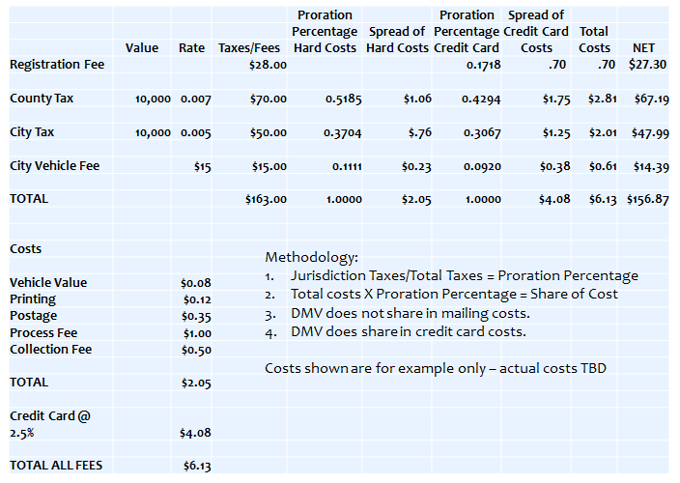
How We Pay For It

Slide 13
Costs – Points to Consider:
Slide clearly states the “cost” shown is for the purposes of example only. The example is the demonstration of the allocation of costs among the entities represented on a fictitious bill.
Slide clearly states the actual costs were to be determined.
Costs are still under review.
Actual costs are still under review; will likely be no more than $1.70 per renewal transaction.
The costs shown are to illustrate that counties are already paying for the items shown through their local budgets; these costs were not “new”.

Slide 14
Costs - Points to Consider:
All taxing jurisdictions represented on the combined notice would bear their share of the costs based upon each unit’s contribution to the total amount of the notice.
An effective cost comparison should prorate costs among jurisdictions.
Assumption that all costs are borne by the county overstates the impact to the county.
This overstatement could be quite significant depending upon the number of other jurisdictions represented on the notice as well as the actual tax rate of those jurisdictions.

Slide 15
Costs – Points to Consider:
G.S.105-330.5(b) states: The county may retain the actual cost of collecting municipal and special district taxes collected pursuant to this Article, not to exceed one and one‑half percent (1 ½%) of the amount of taxes collected. (expires July 1, 2013).
This statute addresses collection costs, making no reference to valuation, situs or taxability.
The municipalities will pay their share of the actual costs of billing and collections; however, the costs will be paid to the project, not the county.
This is not a revenue loss as the retainage was a reimbursement for actual costs that will no longer be incurred by the county.

Slide 16
Costs – Points to Consider:
An analysis of current county costs should include:
Staff costs
Assessing
Cashiering
Delinquent enforcement
IT support
Administrative support
Printing and Postage
Initial Bills
Past due notices
Blocking notices
Enforcement notices

Slide 17
Costs – Points to Consider:
An analysis of county costs should include:
Vehicle valuation costs
Lock box and banking fees
IVR and credit card costs
Collection agency, debt setoff, certified mail and other enforcement costs
Software licensure
Annualized equipment costs
Any other indirect costs

Slide 18
Registered Motor Vehicle Process Chart – July 2013 Implementation
 | File Delivery/ | File Delivery/
Registration | Processing | Processing | Notice | Taxes | Taxes Past | Enforcement
Renewed | Old System | New System | Prepared | Due | Due & Notice | Begins | Block Notice | Block
Nov-12 | Jan-13 |  | Feb-13 | Mar-13 | Apr-13 | May-13 | Jun-13 | Jul-13
Dec-12 | Feb-13 |  | Mar-13 | Apr-13 | May-13 | Jun-13 | Jul-13 | Aug-13
Jan-13 | Mar-13 |  | Apr-13 | May-13 | Jun-13 | Jul-13 | Aug-13 | Sep-13
Feb-13 | Apr-13 |  | May-13 | Jun-13 | Jul-13 | Aug-13 | Sep-13 | Oct-13
Mar-13 | May-13 |  | Jun-13 | Jul-13 | Aug-13 | Sep-13 | Oct-13 | Nov-13
Apr-13 | Jun-13 |  | Jul-13 | Aug-13 | Sep-13 | Oct-13 | Nov-13 | Dec-13
May-13 | Jul-13 |  | Aug-13 | Sep-13 | Oct-13 | Nov-13 | Dec-13 | Jan-14
Jun-13 | Aug-13 |  | Sep-13 | Oct-13 | Nov-13 | Dec-13 | Jan-14 | Feb-14
Jul-13 |  | Mar-13 | Apr-13 | Jul-13 | Aug-13 | N/A | N/A | N/A
Aug-13 |  | Apr-13 | May-13 | Aug-13 | Sep-13 | N/A | N/A | N/A
Sep-13 |  | May-13 | Jun-13 | Sep-13 | Oct-13 | N/A | N/A | N/A
Oct-13 |  | Jun-13 | Jul-13 | Oct-13 | Nov-13 | N/A | N/A | N/A
Nov-13 |  | Jul-13 | Aug-13 | Nov-13 | Dec-13 | N/A | N/A | N/A
Dec-13 |  | Aug-13 | Sep-13 | Dec-13 | Jan-14 | N/A | N/A | N/A
Jan-14 |  | Sep-13 | Oct-13 | Jan-14 | Feb-14 | N/A | N/A | N/A
Feb-14 |  | Oct-13 | Nov-13 | Feb-14 | Mar-14 | N/A | N/A | N/A
Mar-14 |  | Nov-13 | Dec-13 | Mar-14 | Apr-14 | N/A | N/A | N/A
Apr-14 |  | Dec-13 | Jan-14 | Apr-14 | May-14 | N/A | N/A | N/A
May-14 |  | Jan-14 | Feb-14 | May-14 | Jun-14 | N/A | N/A | N/A
Jun-14 |  | Feb-14 | Mar-14 | Jun-14 | Jul-14 | N/A | N/A | N/A

Slide 19
Local Impact
County-level responsibilities:
Sufficient staff resources to process two RMV files per month from March through August, 2013.
Normalization of inconsistent non-DMV data in their existing system.
Budget for training costs.
Fully operational local VTS at least through FY 2014.

Slide 20
Local Impact
County-level responsibilities:
Counties must cover costs (if any) of the extraction of historical vehicle data to a common file format for loading into new VTS. (Conversations are taking place with tax software vendors.)
Counties must cover the costs of developing a software interface with local financial systems.
VTS will provide the file containing financial data.
Distributions will occur monthly:
Counties will distribute funds to towns, fire districts, and so on.
A file will be provided; interface will be a county responsibility.

Slide 21
Local Impact
FY 2014 reductions in locally budgeted mailing and postage costs under current system:
Last initial billing under current system will be September, 2013 (June renewals are due October 1).
We may need one more catch up file for late renewals under the old system. Over 1 million late renewals within the first four months after due.
Last initial past-due notices (current system) in November, 2013.
Last blocking notices (current system) in January, 2014.
Other past due notices at local discretion.
Last vehicle values (current system) in August, 2013.

Slide 22
Local Impact
16 billing cycles in FY 2014:
Four under current system, twelve under new system.
Additional billing cycles due to moving away from billing in arrears to concurrent billing/registration renewal.
Vehicle tax years remain the same; only the due dates are changing.
The additional billing cycles are a one-time occurrence.
THIS IS NOT A WINDFALL!

Slide 23
Local Impact
Increase in Revenue
Depending on your individual RMV collection rate, equivalent to 9 to 15 percentage points
Affects the collection rate for budget purposes.
Under the current system approximately $80 million in uncollected RMV taxes for counties, cities, fire districts, etc. at fiscal year end.
Four months of additional RMV revenue in FY 2014.
One-time occurrence.
We will no longer need to divert 3% of first-month interest to the Special Account after June 30, 2013.

Slide 24
Questions?

