Slide 1
Probation and
Post-Release Supervision
Advanced Criminal Procedure for Magistrates
Jamie Markham
October 2024

Slide 2
Overview
Probation
Post-release supervision & Parole
Interstate Compact
Notes:
All crimes are extraditable, but state will only pay for felonies. County pays for others, so misd. extradition (with some exceptions, like nonsupport, repeated worthless checks) somewhat rarer. But anyway, this is not the magistrate’s problem – it’s for the DA and law enforcement to decide.

Slide 3
Probation
Notes:
All crimes are extraditable, but state will only pay for felonies. County pays for others, so misd. extradition (with some exceptions, like nonsupport, repeated worthless checks) somewhat rarer. But anyway, this is not the magistrate’s problem – it’s for the DA and law enforcement to decide.

Slide 4
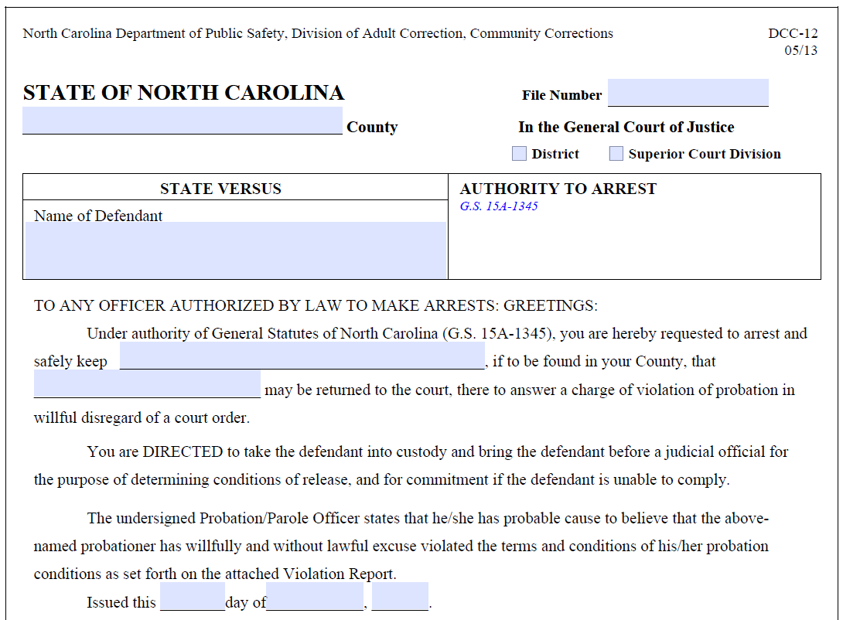
Probation
Probation violation
  Order for Arrest
  “Authority to arrest” (DCC-12)
  “Orderless” arrest

Slide 5
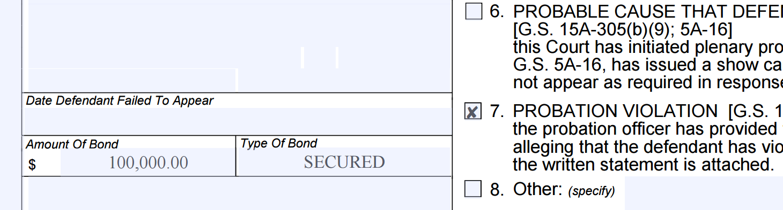
Probation
In general, arrested probationers are entitled to conditions of release
State v. Hilbert, 145 N.C. App. 440
“First positive drug screen, arrest and place under $100,000 cash bond”
“[W]e feel compelled to urge caution on the part of our trial courts regarding the setting of anticipatory probation violation appearance bonds . . . . [W]e perceive the better practice to be that the court ‘recommend’ bond in a certain amount upon issuance of a probation violation warrant.”
Notes:
All crimes are extraditable, but state will only pay for felonies. County pays for others, so misd. extradition (with some exceptions, like nonsupport, repeated worthless checks) somewhat rarer. But anyway, this is not the magistrate’s problem – it’s for the DA and law enforcement to decide.

Slide 6
Special rules for certain defendants
Notes:
All crimes are extraditable, but state will only pay for felonies. County pays for others, so misd. extradition (with some exceptions, like nonsupport, repeated worthless checks) somewhat rarer. But anyway, this is not the magistrate’s problem – it’s for the DA and law enforcement to decide.

Slide 7
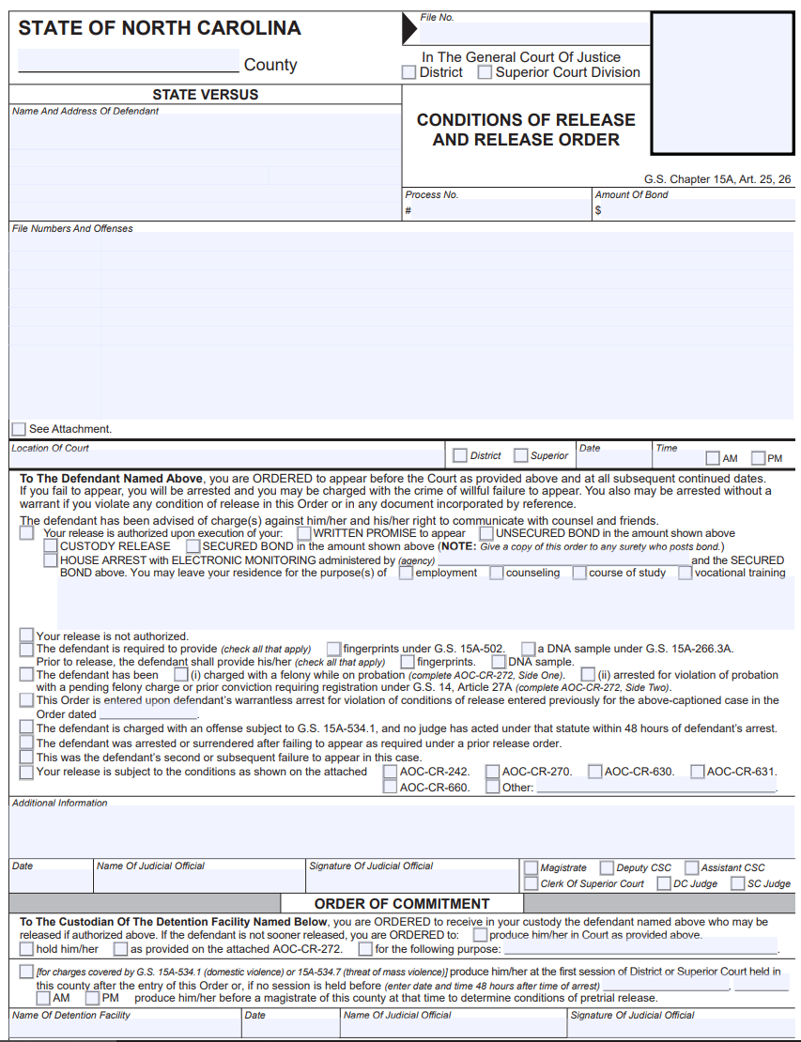
Charged with a felony while on probation
Arrested for a violation of probation with a pending felony charge or prior conviction requiring sex offender registration
AOC-CR-272
Notes:
All crimes are extraditable, but state will only pay for felonies. County pays for others, so misd. extradition (with some exceptions, like nonsupport, repeated worthless checks) somewhat rarer. But anyway, this is not the magistrate’s problem – it’s for the DA and law enforcement to decide.

Slide 8
Charged with a felony while on probation
Notes:
All crimes are extraditable, but state will only pay for felonies. County pays for others, so misd. extradition (with some exceptions, like nonsupport, repeated worthless checks) somewhat rarer. But anyway, this is not the magistrate’s problem – it’s for the DA and law enforcement to decide.

Slide 9
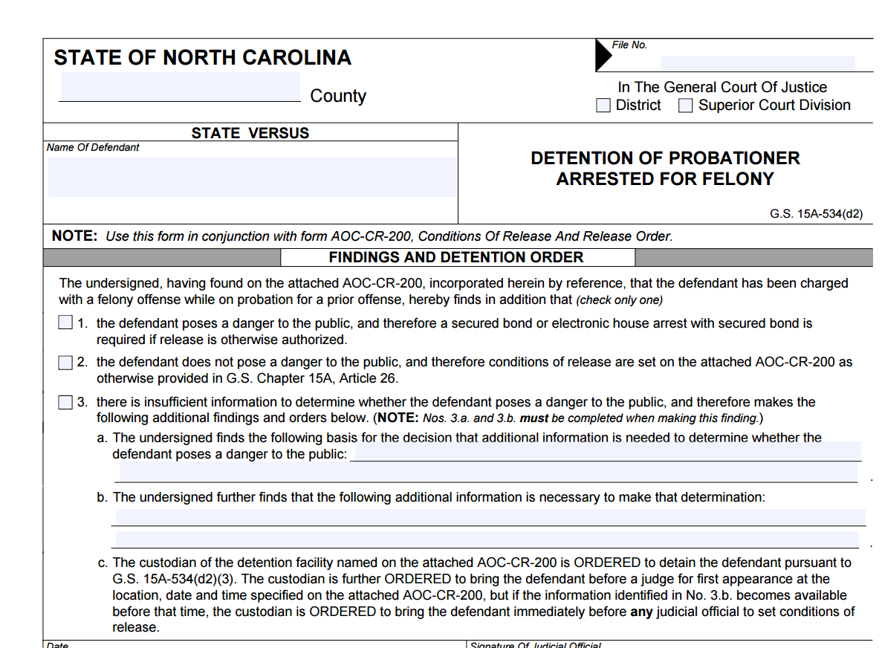
AOC-CR-272
Side One
Notes:
All crimes are extraditable, but state will only pay for felonies. County pays for others, so misd. extradition (with some exceptions, like nonsupport, repeated worthless checks) somewhat rarer. But anyway, this is not the magistrate’s problem – it’s for the DA and law enforcement to decide.

Slide 10
G.S. 15A-534(d2)
“When conditions of pretrial release are being determined for a defendant who is charged with a felony offense and the defendant is currently on probation for a prior offense, a judicial official shall determine whether the defendant poses a danger to the public prior to imposing conditions of pretrial release and must record that determination in writing.”
Notes:
All crimes are extraditable, but state will only pay for felonies. County pays for others, so misd. extradition (with some exceptions, like nonsupport, repeated worthless checks) somewhat rarer. But anyway, this is not the magistrate’s problem – it’s for the DA and law enforcement to decide.

Slide 11
Probation
Magistrate must determine whether defendant “poses a danger to the public” before releasing
  If not dangerous, set conditions as usual
  If dangerous: set secured bond or bond + EHA
  If you have insufficient information on dangerousness . . .
Notes:
All crimes are extraditable, but state will only pay for felonies. County pays for others, so misd. extradition (with some exceptions, like nonsupport, repeated worthless checks) somewhat rarer. But anyway, this is not the magistrate’s problem – it’s for the DA and law enforcement to decide.

Slide 12
Probation
If you have insufficient information about dangerousness . . .
  Retain the defendant in custody
  Record the basis for your decision that additional information is needed to determine whether the defendant poses a danger to the public and the nature of the necessary information
  Set a first appearance before a judge within 72 hours of the time of arrest (or 96 hours if the courthouse is closed for transactions for a period longer than 72 hours)
  If the necessary information is provided to the court at any time prior to the first appearance, the first available judicial official shall set the conditions of pretrial release
Notes:
All crimes are extraditable, but state will only pay for felonies. County pays for others, so misd. extradition (with some exceptions, like nonsupport, repeated worthless checks) somewhat rarer. But anyway, this is not the magistrate’s problem – it’s for the DA and law enforcement to decide.

Slide 13
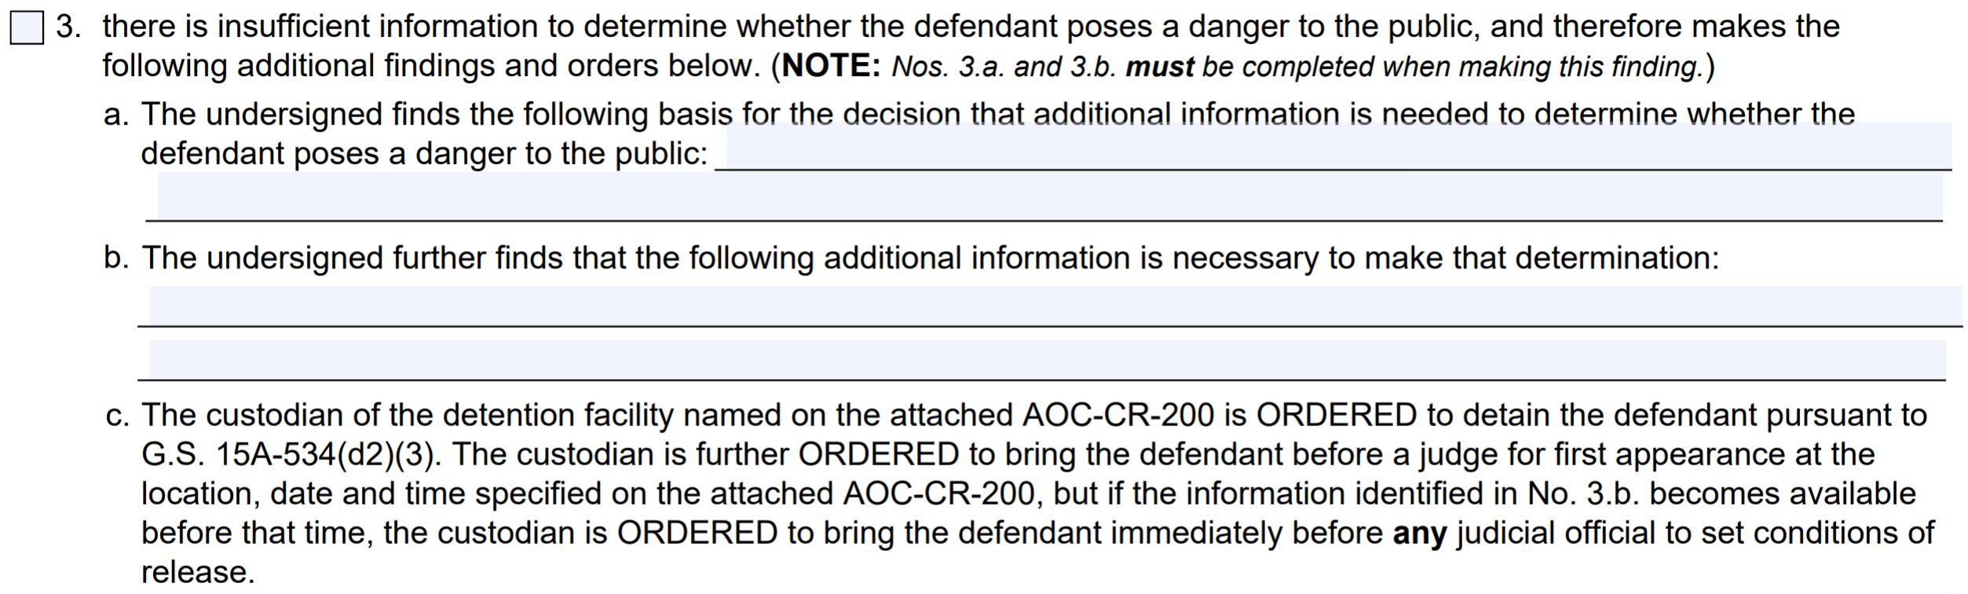
Probation
If you have insufficient information about dangerousness . . .
Notes:
All crimes are extraditable, but state will only pay for felonies. County pays for others, so misd. extradition (with some exceptions, like nonsupport, repeated worthless checks) somewhat rarer. But anyway, this is not the magistrate’s problem – it’s for the DA and law enforcement to decide.

Slide 14
Arrested for probation violation with (a) felony charge pending, or (b) prior crime requiring sex offender registration
Notes:
All crimes are extraditable, but state will only pay for felonies. County pays for others, so misd. extradition (with some exceptions, like nonsupport, repeated worthless checks) somewhat rarer. But anyway, this is not the magistrate’s problem – it’s for the DA and law enforcement to decide.

Slide 15
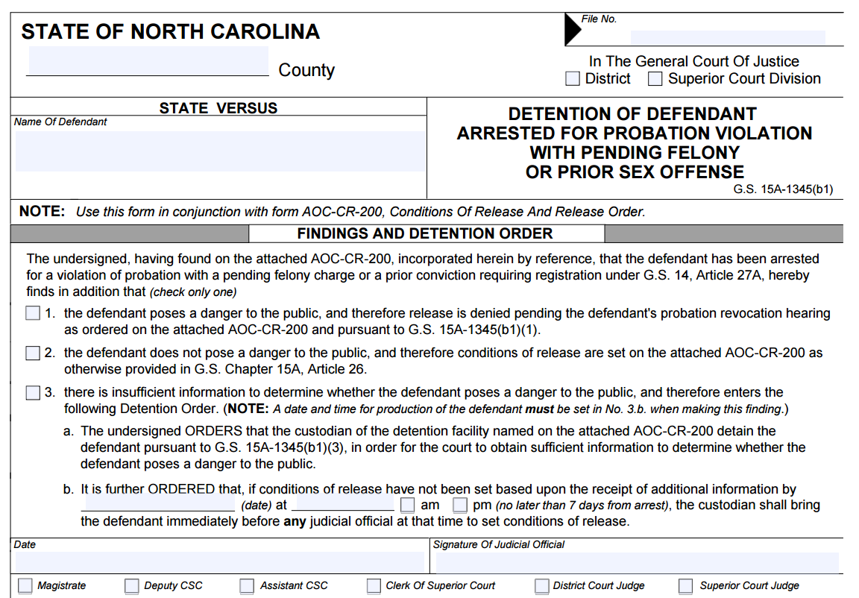
AOC-CR-272
Side Two
Notes:
All crimes are extraditable, but state will only pay for felonies. County pays for others, so misd. extradition (with some exceptions, like nonsupport, repeated worthless checks) somewhat rarer. But anyway, this is not the magistrate’s problem – it’s for the DA and law enforcement to decide.

Slide 16
Probation
Arrested for a probation violation and:
  Has pending felony charges
  Has ever been convicted of a crime that requires sex offender registration
For these probationers, magistrate must first assess “danger to public”
  If not dangerous, set conditions as usual
  If dangerous, deny release pending violation hearing
  If insufficient information, retain defendant in custody for up to seven days to obtain sufficient information
Notes:
All crimes are extraditable, but state will only pay for felonies. County pays for others, so misd. extradition (with some exceptions, like nonsupport, repeated worthless checks) somewhat rarer. But anyway, this is not the magistrate’s problem – it’s for the DA and law enforcement to decide.

Slide 17
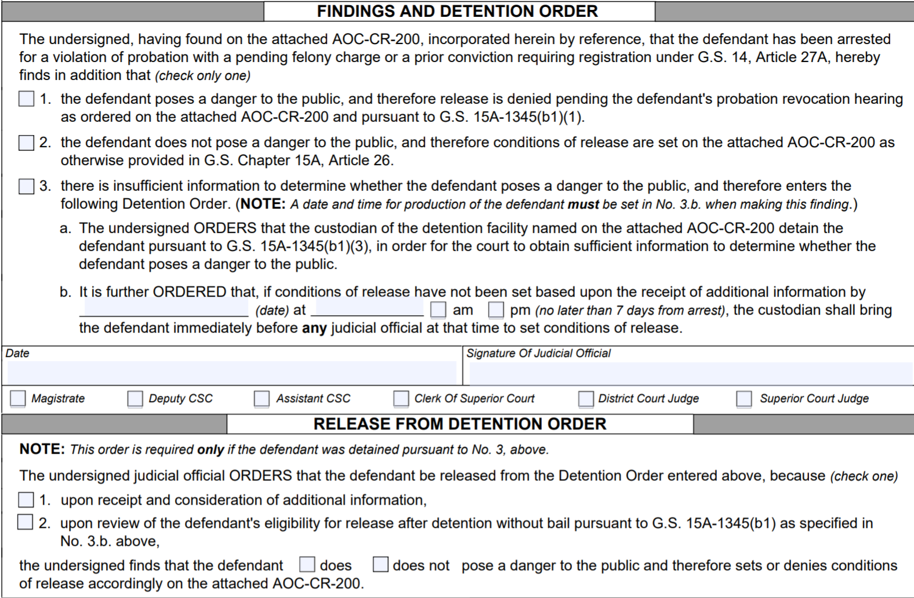
Notes:
All crimes are extraditable, but state will only pay for felonies. County pays for others, so misd. extradition (with some exceptions, like nonsupport, repeated worthless checks) somewhat rarer. But anyway, this is not the magistrate’s problem – it’s for the DA and law enforcement to decide.

Slide 18
Probation
Pending felony charges: statewide search
Sex offenders:
  Search registry
  Check criminal history
Notes:
All crimes are extraditable, but state will only pay for felonies. County pays for others, so misd. extradition (with some exceptions, like nonsupport, repeated worthless checks) somewhat rarer. But anyway, this is not the magistrate’s problem – it’s for the DA and law enforcement to decide.

Slide 19
Pretrial Integrity Act
G.S. 15A-533(h): “If a defendant is arrested for a new offense allegedly committed while the defendant was on pretrial release for another pending proceeding, the judicial official who determines the conditions of pretrial release for the new offense shall be a judge.”
  Likely includes defendants on “prehearing release” for a pending probation violation hearing
Notes:
All crimes are extraditable, but state will only pay for felonies. County pays for others, so misd. extradition (with some exceptions, like nonsupport, repeated worthless checks) somewhat rarer. But anyway, this is not the magistrate’s problem – it’s for the DA and law enforcement to decide.

Slide 20
Quick Dips
Notes:
All crimes are extraditable, but state will only pay for felonies. County pays for others, so misd. extradition (with some exceptions, like nonsupport, repeated worthless checks) somewhat rarer. But anyway, this is not the magistrate’s problem – it’s for the DA and law enforcement to decide.

Slide 21
“Quick Dips”
Probation officers can jail certain probationers for violations without a court hearing
  2 or 3 days of confinement
  No more than 6 days per month
  During any three separate months during the period of probation
Notes:
Another break-in and sexual assault.

Slide 23
Post-Release Supervision
Notes:
All crimes are extraditable, but state will only pay for felonies. County pays for others, so misd. extradition (with some exceptions, like nonsupport, repeated worthless checks) somewhat rarer. But anyway, this is not the magistrate’s problem – it’s for the DA and law enforcement to decide.

Slide 24
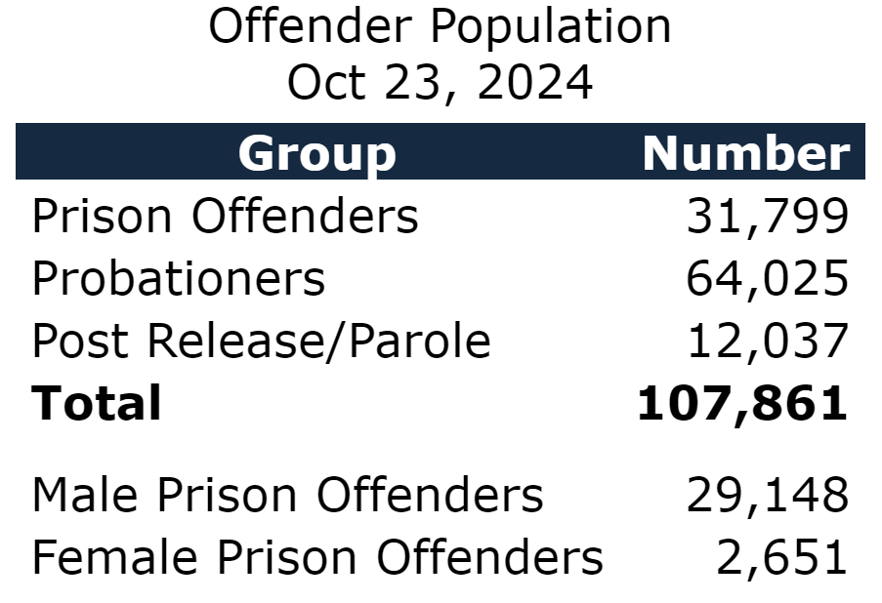
Post-Release Supervision
Notes:
All crimes are extraditable, but state will only pay for felonies. County pays for others, so misd. extradition (with some exceptions, like nonsupport, repeated worthless checks) somewhat rarer. But anyway, this is not the magistrate’s problem – it’s for the DA and law enforcement to decide.

Slide 25
Post-Release Supervision
Class F-I felons: 9 months
Class B1-E felons: 12 months
Sex offenders: 5 years
Notes:
All crimes are extraditable, but state will only pay for felonies. County pays for others, so misd. extradition (with some exceptions, like nonsupport, repeated worthless checks) somewhat rarer. But anyway, this is not the magistrate’s problem – it’s for the DA and law enforcement to decide.

Slide 26
Post-Release Supervision
G.S. 15A-1368.6
  (b1) Notwithstanding subsection (b) of this section, if the releasee has been convicted of an offense that requires registration under Article 27A of Chapter 14 of the General Statutes and is arrested for a violation in accordance with this section, the releasee shall be detained without bond until the preliminary hearing is conducted.
Notes:
All crimes are extraditable, but state will only pay for felonies. County pays for others, so misd. extradition (with some exceptions, like nonsupport, repeated worthless checks) somewhat rarer. But anyway, this is not the magistrate’s problem – it’s for the DA and law enforcement to decide.

Slide 27
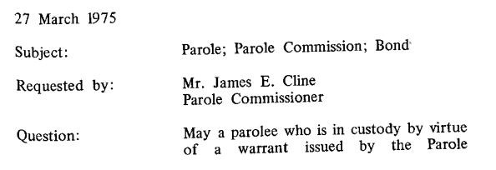
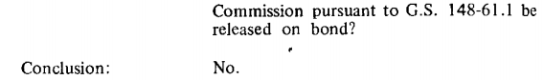
Parolees
No release for parole violators
Notes:
All crimes are extraditable, but state will only pay for felonies. County pays for others, so misd. extradition (with some exceptions, like nonsupport, repeated worthless checks) somewhat rarer. But anyway, this is not the magistrate’s problem – it’s for the DA and law enforcement to decide.

Slide 28

Interstate Compact for Adult Offender Supervision

Slide 29
Interstate Compact
Allows offenders to transfer supervision
Must abide by both “sending state” and “receiving state” rules
Sending state retains legal jurisdiction
Offenders must waive extradition in advance

Slide 30
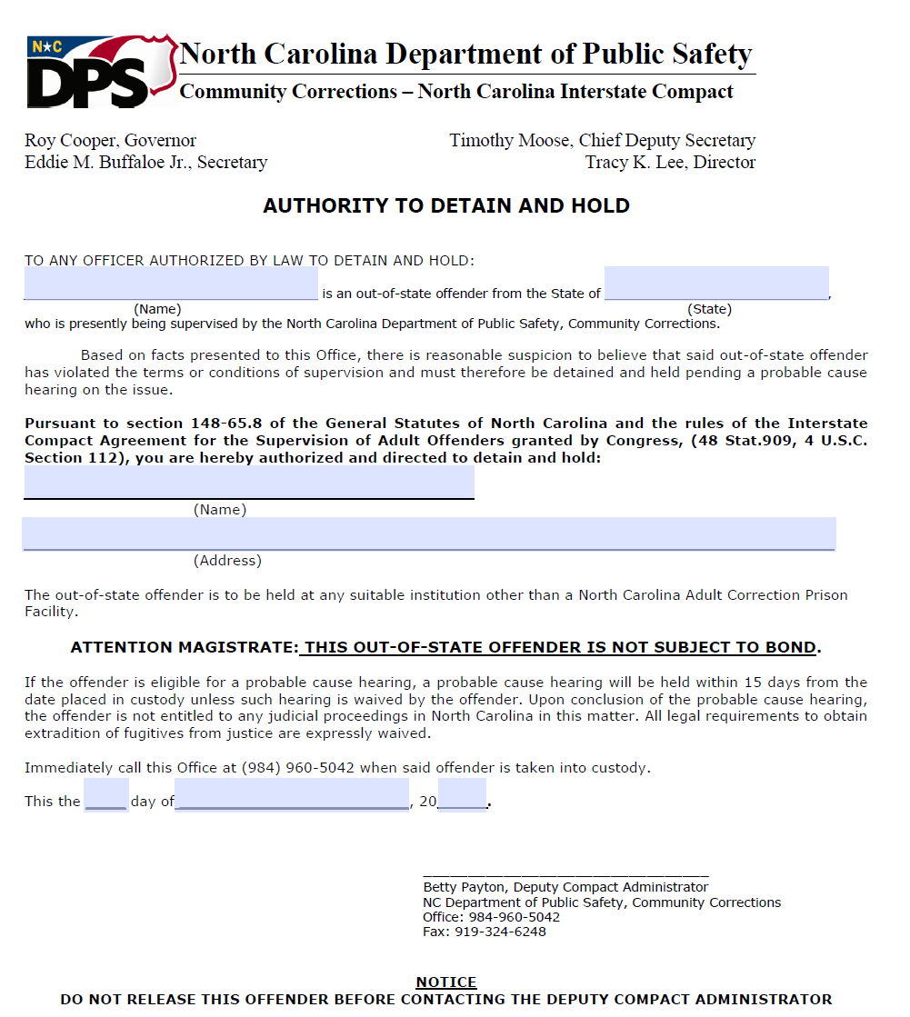
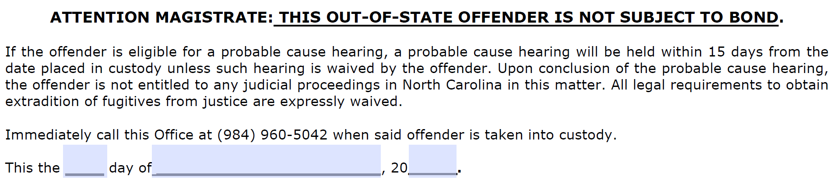

Slide 31
Interstate Compact
When a Compact offender is before you:
  Inform of alleged violation and rights
  Under ICAOS rules and state law, NO RELEASE
  Commit the offender to the jail
Contact probation or NC Compact Administrator who will schedule a probable cause hearing
  Should occur within 15 days

Slide 32
Interstate Compact
Distinguishing Compact offenders from fugitives

Slide 33
Interstate Compact
Distinguishing Compact offenders from fugitives
  Authority to Detain and Hold form
  Arrested by probation officer
If unsure:
  Contact local probation office
  Contact Compact Administrator in Raleigh
  Search online

Slide 34
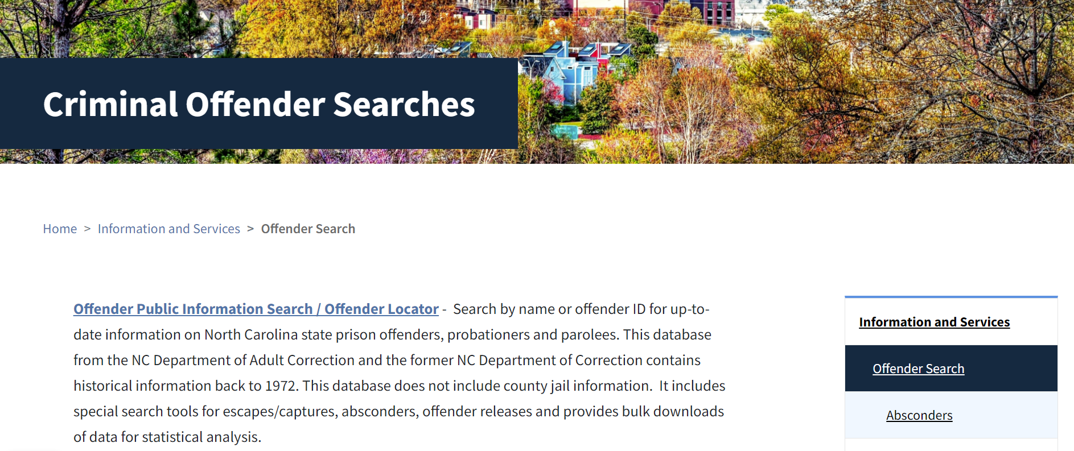
https://www.dac.nc.gov/dac-services/criminal-offender-searches

Slide 35
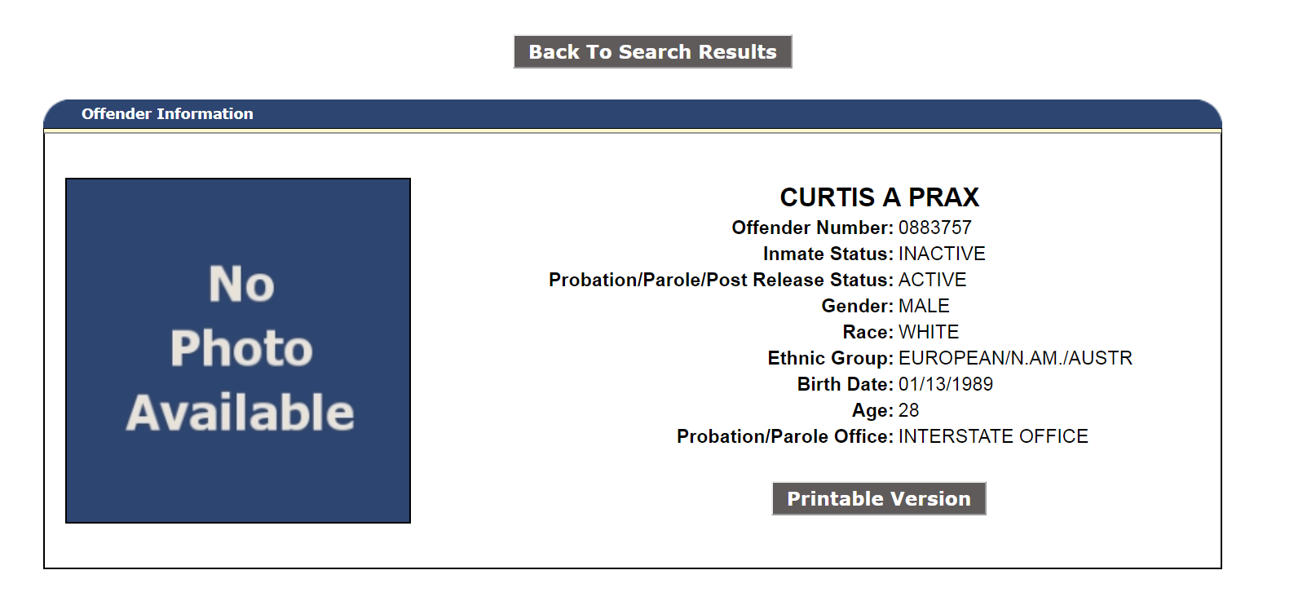

Slide 36

Questions?

