Slide 1

Tobacco-free/Smoke-free Local Government Regulations and the Community Transformation Grants
Jim D. Martin, M.S.
Director of Policy
Tobacco Prevention and Control Branch
NC Division of Public Health
April 26, 2012

Slide 2
What G.S.130A-498 Means for Local Government
  Expands local governments’ authority to regulate smoking
  Expands authority to regulate smoking on government grounds and for certain enclosed public places.
  Became effective January 2, 2010.
http://www.ncga.state.nc.us/Sessions/2009/Bills/House/PDF/H2v10.pdf
Notes:
HB24- 143-601.

Slide 3
″Local government” – A local political subdivision of this State, an airport authority, or an authority or body created by an ordinance, joint resolution, or rules of any such entity.
Local Governments that will most likely create smoke-free or tobacco-free laws:
  City Council
  Board of County Commissioners
  Airport Authority
  Local Board of Health and District Board of
  Health (Such rule or policy enacted after July
  1, 2009 must obtain approval of rules by an
  ordinance adopted by the Board of County
  Commissioners--G.S. 130A-498 (a)

Slide 4
A local government may adopt and enforce ordinances, board of health rules, and policies restricting or prohibiting smoking/tobacco use that are more restrictive than state law and that
apply to:
  Local Government Buildings
  Local Government Grounds
  Local Government Vehicles
  Enclosed Public Places

Slide 5
Local Government Buildings
“Any building owned, leased or occupied by local government.”
Local Government Grounds
“Any unenclosed area owned, leased or occupied by local government.”

Slide 6
Local Government Vehicles
“A passenger-carrying vehicle owned, leased, or otherwise controlled by local government and assigned permanently or temporarily by local government to local government employees, agencies, institutions, or facilities for official government business.”
Public Places
“An enclosed area to which the public is invited or in which the public is permitted.”
Can include: Convenience Stores, Retail Stores, Bowling Alleys, etc.

Slide 7
AREAS A LOCAL SMOKE-FREE ORDINANCE MAY NOT COVER
(G.S. 130A-498 (b1)
Private Residence
Private Vehicle
Tobacco Shop (subject to limitations provided for in the law)
All Premises, Facilities and Vehicles owned, operated or leased by any Tobacco Products Processor or Manufacturer, or any Tobacco Leaf Grower, Processor, or Dealer
Cigar Bar, as exempted
Private Club—non-profit
Designated Smoking Guest Room in a Lodging Establishment
Motion Picture, Television, Theater, or other Live Production Set

Slide 8
Key Findings from the Surgeon General’s Secondhand Smoke Report
Secondhand smoke (SHS) causes premature death and disease in non-smokers.
Exposure of adults to SHS causes immediate adverse effects on the cardiovascular system and causes coronary heart disease and lung cancer.
Children exposed to SHS are at an increased risk for acute respiratory infection, ear problems and asthma.
The Health Consequences of Involuntary Exposure to Tobacco Smoke: A Report of the Surgeon General, U.S. Department of Health and Human Services, October 2006.
Notes:
http://www.surgeongeneral.gov/library/secondhandsmoke/report/

Slide 9
The Health Care Cost of Smoking
In North Carolina:
  Total health care costs from smoking:
  $2.46 billion
Centers for Disease Control and Prevention , 2011
Notes:
Campaign for Tobacco-Free Kids, “The Toll of Tobacco in North Carolina” Fact Sheet accessed Sept. 12 at http://www.tobaccofreekids.org/reports/settlements/toll.php?StateID=NC

Slide 10
The Health Care Cost of Secondhand Smoke
In North Carolina:
Total health care costs from secondhand smoke:
$288.8 million
North Carolina’s Secondhand Smoke Healthcare Cost Burden, BCBSNC Clinical Informatics Department, 2009
Notes:
Additional Estimated costs:
Acute lower respiratory illnesses (birth to 3) - $7.6 million
Otitis media / middle ear effusion (birth to 17) - $14.5 million

Slide 11
The Benefits of Being
Tobacco-Free
Reduces harmful health effects of second- hand smoke exposure
Supports opportunities for employees to successfully quit tobacco use
Reduces costs of on-the-job tobacco use
Improves health, morale and productivity
Provides a cleaner, healthier work setting
Notes:
www.rwjf.org/.../2006/images/chart-tobacco.gif

Slide 12
Notes:
Approximately $103 million was awarded to a total of 61 states and communities throughout the US.
NC is one of 14 “states minus large county” grantees and has the 4th highest award in the country.
•26 states and communities will work to build capacity to implement changes by laying a solid foundation for community prevention efforts to ensure long-term success. Funding amounts range from $147,000 to $500,000 depending on population size and scope of project.
•35 states and communities will implement evidence- and practice-based programs designed to improve health and wellness. Funding amounts range from $500,000 to $10 million depending on population size and scope of project

Slide 13
Community Transformation in
North Carolina
Promotes tobacco free living, active living, healthy eating and evidence-based clinical preventive services
Implements state and local changes to support healthy behaviors
NC strategies were selected to build upon existing partnerships, current efforts and past successes

Slide 14
North Carolina Strategies
Tobacco–Free Living
Increase smoke-free regulations of local government buildings and of indoor public places
Increase tobacco-free regulations for government grounds, including parks and recreational areas
Increase smoke-free housing policies in affordable multi-unit housing and other private sector market-based housing
Increase 100% tobacco-free policies on community colleges, state and private university and college campuses

Slide 15
Counties reporting written regulations prohibiting
smoking or tobacco use in all county buildings
Ashe
Alleghany
Surry
Caswell
Warren
Northampton
Gates
Camden
Currituck
Stokes
Rockingham
Person
Vance
Hertford
Pasquotank
Watauga
Wilkes
Yadkin
Granville
Halifax
Chowan
Perquimans
Mitchell
Avery
Forsyth
Guilford
Alamance
Orange
Franklin
Bertie
Yancey
Caldwell
Alexander
Davie
Durham
Nash
Edgecombe
Washington
Madison
Iredell
Wake
Martin
Tyrrell
Dare
Haywood
Buncombe
McDowell
Burke
Catawba
Davidson
Randolph
Chatham
Wilson
Swain
Lincoln
Rowan
Pitt
Beaufort
Hyde
Graham
Jackson
Henderson
Rutherford
Cabarrus
Lee
Johnston
Greene
Cherokee
Macon
Polk
Cleveland
Gaston
Mecklenburg
Stanly
Montgomery
Moore
Harnett
Wayne
Lenoir
Craven
Clay
Transylvania
Pamlico
Richmond
Hoke
Cumberland
Sampson
Jones
Union
Anson
Duplin
Indicates County buildings only
Scotland
Onslow
Carteret
Robeson
Bladen
Pender
Columbus
New
Indicates Comprehensive Board of Health Rule or
Comprehensive County Commission Ordinance
Hanover
Brunswick
Information based on statewide surveys conducted in 2008, 2010, and 2011. Please contact TPCB with questions, or to provide updated information.
March 2012

Slide 16
Smoke-free or Tobacco-free Grounds
County:
There are currently 12 counties that have 100% smoke-free or tobacco-free grounds (buildings that are already smoke free)
Municipal:
There are currently at least 33 municipalities with 100% smoke-free or tobacco-free grounds.
There are increases in parks, recreation areas, or other limited grounds policies that are not reflected in these numbers.

Slide 17
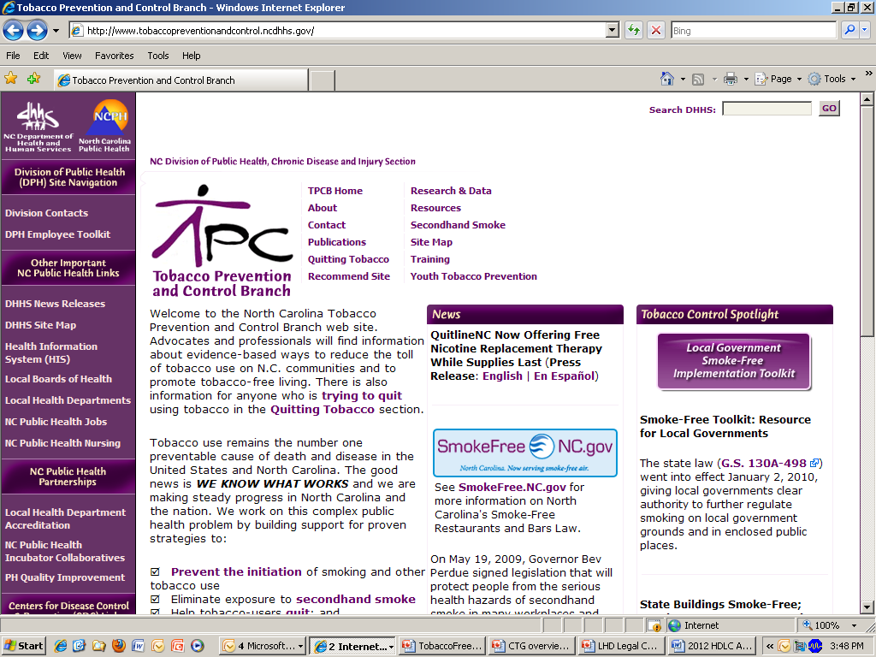

Slide 18
Resources
Tobacco Prevention and Control Branch has a “Toolkit” to assist local governments as they begin the process of creating local smoke-free and/or tobacco-free regulations. The items available in this toolkit include:
  Health Effects of Secondhand Smoke Exposure
  Costs of On-the-Job Tobacco Use
  Benefits of a Tobacco-free Workplace
  Process for Developing and Implementing Local Regulations
  Model Ordinances and Rules
  Sample Timeline for Implementation
  Cessation/Support for Employees Who Use Tobacco
  Sample Signs
  Sample Pocket cards and Business Cards as Compliance Aids

Slide 19
The NC League of Municipalities reviewed the model municipal ordinances listed below and the NC Association of County Commissioners reviewed the county model ordinances.
Model City Ordinances
  Grounds
  Public Places
  Parks
Model County Ordinances
  Grounds
  Public Places
  Parks
  Approval of Board of Health Rules
Board of Health Rules
  Grounds
  Public Places
  Parks
Resolutions
  BOH Parks and Recreation
  BOH Overall Authority
  City Committee Parks and Recreation
  County Committee Parks and Recreation

Slide 20
How do you enforce this policy?
“Enforcement " is really a misnomer ⎯
you’re really after compliance
Most folks comply with policies provided they know those policies exist
Public awareness and clear communications are key elements
If individuals violate the policy, what do you do? Simply remind them.

Slide 21

WE ARE
Thank you for not using tobacco
products on our campus, and for
helping to make NC healthier for
all!
Tobacco free
If you want to quit smoking or using spit tobacco, call QuitlineNC at 1-800-QUIT-NOW (1-800-784-8669) or visit, www.QuitlineNC.com for information.
QuitlineNC is FREE, confidential and open 24 hours a day.
(logo)

Slide 22
Resources
Local Government Tobacco-Free Implementation Toolkit
  http://www.tobaccopreventionandcontrol.ncdhhs.gov/lgtoolkit/index.htm
UNC School of Government Webinar Series
  http://www.sog.unc.edu/programs/ncphl/SmokingRegulation/webinar_series.html

Slide 23
Further Information or Assistance from the Tobacco Prevention and Control Branch
Sally Herndon, M.P.H.
Branch Head
(919) 707-5401
sally.herndon@dhhs.nc.gov
Anna Stein, J.D.
Attorney
(919) 707-5406
anna.stein@dhhs.nc.gov
Jim D. Martin, M.S.
Director of Policy
(919) 707-5404
jim.martin@dhhs.nc.gov
Elisabeth K. Constandy, M.S.
Director of Program Development
(910) 790-6007
elisabeth.constandy@dhhs.nc.gov

