Slide 1
The TRUSTEE ROLE IN FINANCIAL DECISION-MAKING
Board of Trustees Workshop
October 15, 2025
Jennifer Haygood
Senior VP for Finance and Administration
Notes:
Good afternoon! It is great to be here for what I hope you would agree is quite a special day in the life of the University of North Carolina.
This afternoon we transition from celebrating its history and its new President, to discussing how do we put into practice its ideals and live up to the vision of its founders.
Consider this and the afternoon’s breakout sessions as the “applied” portion of the program.

Slide 2
Providing Value is Our Statutory Duty
On-time Graduation
Less Student Debt
Lower Cost per Degree
G.S. 116-1(b) – “…In the fulfillment of this mission, the University shall seek an efficient use of available resources to ensure the highest quality in its service to the citizens of the State.”
Notes:
These goals should be a North Star for trustees

Slide 3



The Role of the Board of Trustees
OPERATING | CAPITAL | OVERALL
All-Funds Budget | Advanced Planning Approval | Monitoring Financial Health
What is your responsibility as a trustee? How do financial decisions impact our strategic goals? What questions should you be asking?

Slide 4
Operating:
All-Funds Budget

Slide 5
Funds Have Different Sources and Uses
Institution
General Fund
Sources
State Appropriation
Tuition
Uses
Instruction
Financial Aid
Academic & Institutional Support
Trust Funds
Sources
Student Fees
Auxiliary Revenues
Research Funding
Uses
Research
Financial Aid
Auxiliaries
  Housing
  Dining
  Athletics
More State Support
More Flexibility
Notes:
Universities operate like nonprofit organizations with missions in the fields of instruction, research, and public service.
The different constituencies that fund universities have special interests in the ways the funds are used. These include federal, state, and local governments, commercial organizations, individual donors, and bondholders.
Because of these different interests, each fund type has unique restrictions to reflect these priorities.
Universities also have unique obligations for accounting and financial reporting according to the sources of funds received and their subsequent uses rather than to report net income to investors.

Slide 6
General Fund Revenue is Less Than Half
FY 2025-26 Budgeted UNC System Revenue by Fund Type

Slide 7

The Trustee Role: All-Funds Budgeting
Effective for FY23 and annually thereafter, the board of trustees shall approve a comprehensive, “all-funds” budget for the institution.
  Per the UNC Policy Manual, this responsibility cannot be delegated.
Notes:
Effective for FY2023 and annually thereafter, Boards of trustees will need to approve a comprehensive all-funds budget for the institution.
FY2023 begins July 1, 2022. So at one of your meetings this spring, you will deliberate and approve said budget prior to the submission deadline in May.
The institutional budgets will be compiled and presented to the Board of Governors at its May meeting and will include a budget for the institution as a whole and major organizational units, as well as a budget narrative that explains how the numbers connects with our policy priorities.
Provide comprehensive expenditure plan that includes both General Fund and Trust Funds
Better align resources with strategic priorities
Promote stewardship and financial sustainability
Better understand the impact of discrete decisions on the broader financial picture
Improve transparency and campus engagement
Strengthen the fiduciary responsibility of the boards of trustees

Slide 8
UNC System Revenues: FY 2024
(excluding UNC Hospitals)
$13.7 Billion
8

Slide 9
Campus Mission Drives Revenue Mix
16%
45%

Slide 10
Revenue Drivers
State Appropriations
  Performance on Board of Governors metrics
  Legislative adjustments for salaries and benefits
Tuition and Fees
  Tuition and fee rates
  Amount of tuition and fee revenue used for financial aid
Sales and Services
  Housing and dining rates
  Patient revenues
Contracts and Grants
  Institutional mission
Enrollment
Remember – retention matters!

Slide 11
Key Questions and Considerations
What are your institution’s main revenue drivers?
  How have those revenues and their associated drivers changed over time?
  How is the institution responding to changes in revenues?
What assumptions are being used to project revenues?
  Are those assumptions reasonable?
  Are actual revenues meeting projections?
How are tuition, fee, housing, and dining rates set?
  Has the intended use of the additional receipts been clearly articulated and justified?
  Has the institution demonstrated efforts to manage costs and prioritize the use of existing funds?
  Is the institution adequately considering affordability and the impact on student debt?
Notes:
When presented with tuition and fee increase proposals, here’s a few key questions you should be asking
Why is the increase needed?
Has the intended use of the additional receipts been clearly articulated and justified?
You should be mindful of changes in various price and income indices to recognize not only the level of inflationary pressure being faced by the institution, but also to keep proposed increases in context with broader economic trends.
Are other revenue sources available?
Instruction, academic administration, and general institutional support are primarily supported through a combination of State appropriation and tuition. Tuition increase proposals should be viewed in context of changes in State appropriation.
In contrast, fee-supported activities are generally expected to be self-supporting and don’t enjoy State support. Therefore, fewer alternative revenues sources are generally available.
Efforts to manage costs and prioritize the use of funds is another key consideration. There will always be more worthy needs and ideas than resources. If resources are needed to support a new expense, consideration should be given to whether existing funds should be repurposed from a lower priority before concluding an increase is necessary.
What is the potential impact on student access, particularly in context of other proposed increases?
As we’ll discuss further in just a few moments, tuition and fees is just one component of the cost of attending college. It is important to consider any increases in the broader context of other student costs that may also be increasing.
Likewise, you should consider the availability of financial aid to cover potential costs increases and how an increase will impact the amount of unmet need among students on your campus.
That is important because unmet need is closely tied to student debt levels.

Slide 12
UNC System Expenditures: FY 2024
(excluding UNC Hospitals)
$12.0 Billion
Note: Some research and private/endowment revenues are not available for immediate expenditure.
12

Slide 13
Expenses by Campus Size: FY 2024
Fall 2024 enrollment has been used for the purpose of classifying the universities as small (<10K), medium (10K-25K), and large (>25K). The UNC System Office, North Carolina School of Science and Mathematics, and UNC Hospitals are excluded from the above graphs.
13
Notes:
Total reve

Slide 14
Key Questions and Considerations
What pressures are impacting budget allocation decisions?
  Inflation? Enrollment? Grant funding? Investment returns?
  Are certain units disproportionately impacted by these pressures?
Are resources being allocated strategically?
  Can funds be repurposed to better align with priorities?
  How are resources being used to promote on-time graduation?
Are there opportunities to improve efficiency?
  Does the budget reflect any decisions to stop or scale back underperforming programs/activities?
  Can programs, offices, and services be streamlined or consolidated?
  Can layers of management and administration be reduced?
Notes:
To be clear, this new requirement is not an invitation for boards of trustees to micromanage the campus budget.
Rather, boards should be focused on three key questions:…
Are resources being allocated strategically? Can funds be repurposed to better align with priorities?
I encourage to particularly consider this question as it relates to your institution’s strategy for improving on-time graduation rates. The longer it takes a student to earn their degree, the more debt they take on and the more it costs to produce that degree. Therefore, improvement in this area is key to moving the needle on all three of our System goals.
Are there opportunities to improve efficiency?...
Does the budget promote the institution’s financial sustainability?...
As we approach this new requirement, keep in mind that this is necessarily be a maturation process. While the ultimate product is important for use at the System level, the intent is for this requirement to also promote productive conversations at the campus level… to surface issues that need further attention, some of which may take multiple years to address.
This first year is just step one on a long-term journey.

Slide 15
Change in Fund Balance
Scenario | Direction of Change | Common Situation
Revenues Expenses |  | General Fund budget
Revenues Expenses |  | Building up reserves
Revenues Expenses |  | Making a strategic one-time expenditure
=
>
<

Slide 16
Key Questions and Considerations
How are fund balances changing – both in total and by organizational unit?
  Are these changes by design or an indication of a structural budget issue?
Is the budget structurally sound?
  Are recurring expenses supported by recurring revenues?
  What proportion of the institution’s budget is “fixed”?
  Are any auxiliary enterprises running a deficit?
Does your institution have adequate reserves?
  Could the institution withstand an unexpected, temporary shock?
  Is the institution proactively planning on future repairs and renovations needed to keep auxiliary facilities in good condition?

Slide 17
Property and Capital:
Advanced Planning Approval

Slide 18
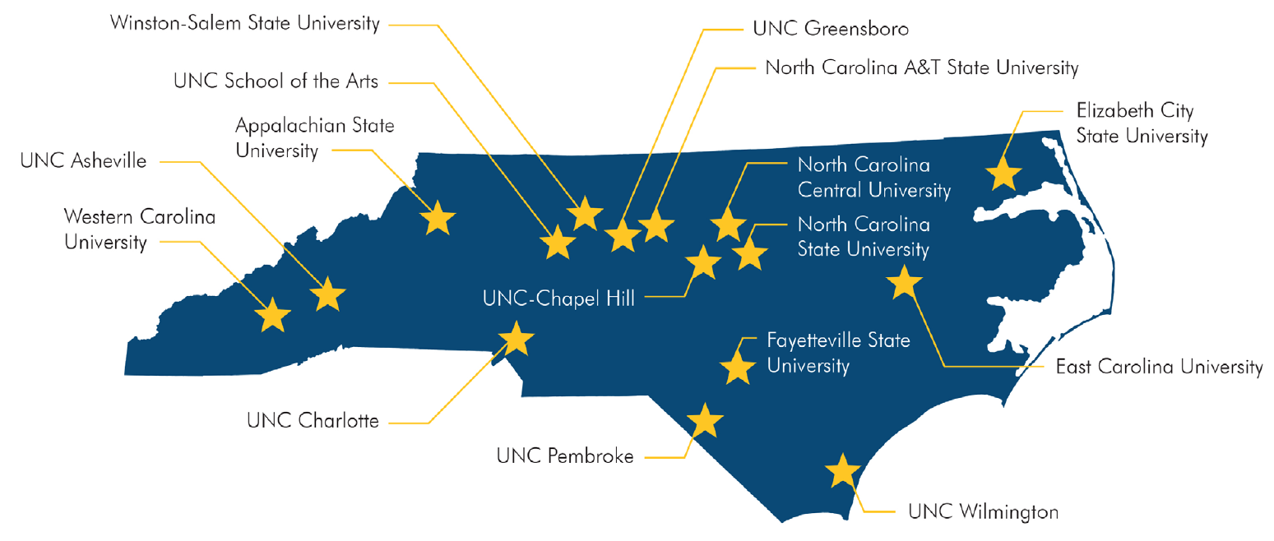
UNC System Capital Assets
The UNC System has almost 93.9 million gross square feet of capital assets.
This includes approximately 2,965 buildings.
Current replacement value almost $37.2 billion.
*Source: 2023 Facilities Inventory and Utilization Study (excludes UNC Hospitals)

Slide 19
The Trustee Role: Property & Capital Projects*
Delegated | Additional Delegated
BOG authorizes BOT to approve: | BOG authorizes BOT to approve: | BOG Approval Required
CAPITAL PROJECTS
Projects less than $750,000 | Projects less than $2M | Projects above delegation ($750k or $2M)
ACQUISITION OR DISPOSITION OF PROPERTY†
Property value less than $1 million | Property value less than $2 million | Property value above delegation ($1m or $2m)
LEASES†
Lease payment less than $1 million annually and term less than 10 years | Lease payment less than $2 million annually and term less than 10 years | Annual lease payment above delegation or term more than 10 years
*Projects supported by non-State funds. †Pending BOG action on October 16, 2025.
BOTs are authorized to approve advance planning of capital improvement projects in any amount, where the advance planning effort is funded entirely with non-State funds.
Notes:
This chart summarizes what property, capital, and leasing decisions are delegated to boards of trustees for final approval and which must receive subsequent BOG approval.

Slide 20
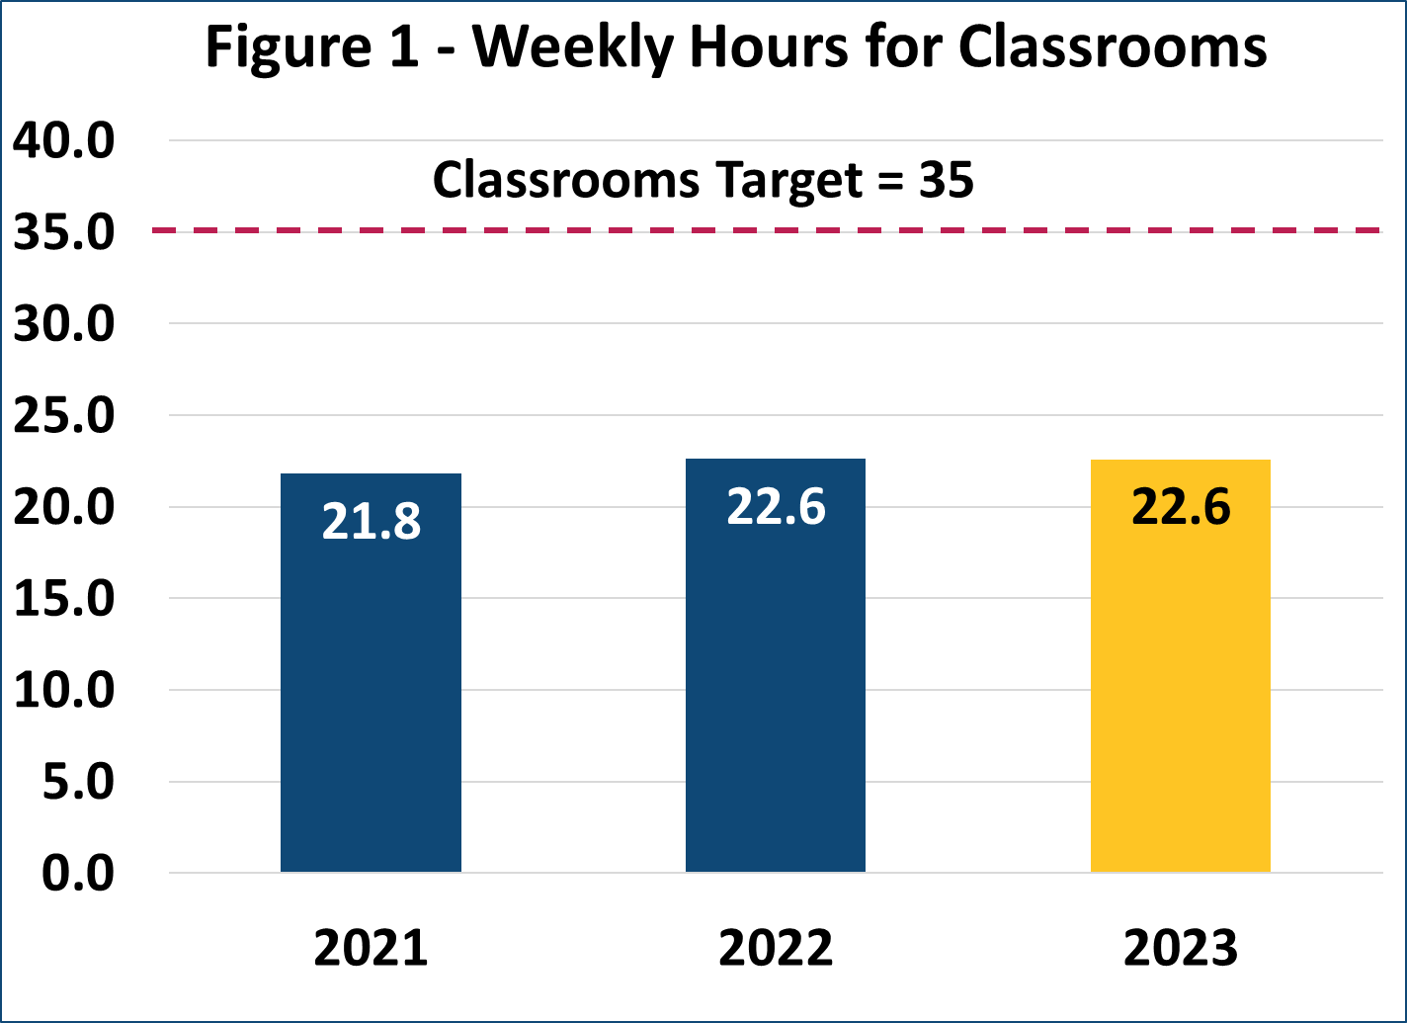
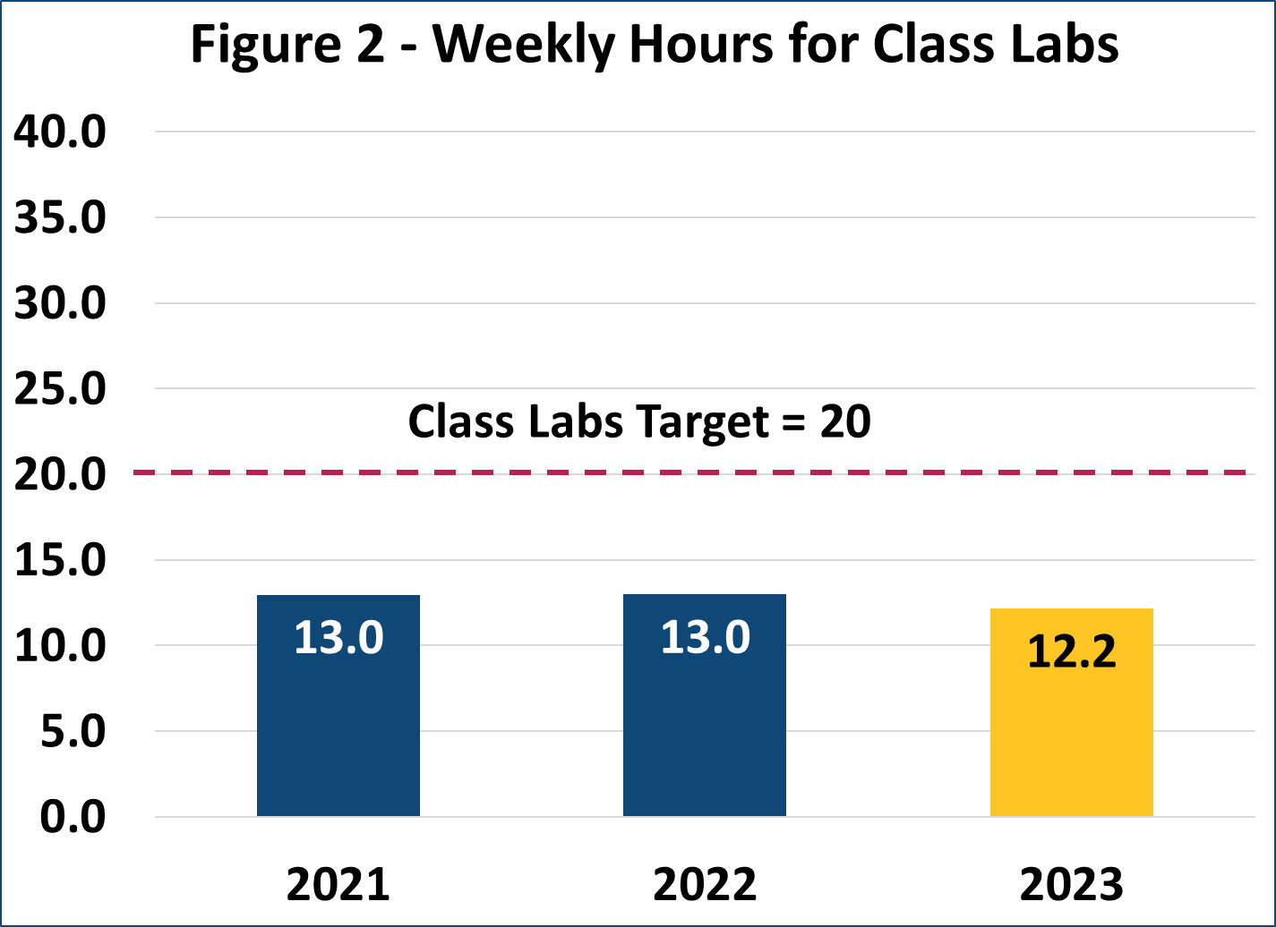
Many Spaces are Underutilized
In 2023, weekly classroom hours were unchanged and weekly class lab hours decreased by 0.8.

Slide 21
Key Questions and Considerations
Why is the capital project needed?
  How does it support the institution’s Six-Year Capital Plan?
  What is the impact if the project is not done?
  Before adding more square footage, is there a way to improve utilization of existing space?
How will the project be funded?
  How will long-term building operations and maintenance and future repairs and renovations be supported?
  Before adding more square footage, is there a way to better utilize existing space with some additional investment?
  If supported by debt, will the debt issuance require an increase in student fees?

Slide 22
Monitoring Financial Health

Slide 23
Tools for Monitoring Financial Health
      Financial reports
        Annual and interim financial statements
        Budget-to-actual reports
      Audits (internal and external)
      Revenue drivers
        Enrollment
        Tuition & fee collections
        Housing occupancy
      Debt
        Credit rating agency reviews
        Outstanding indebtedness and annual debt service
      Financial metrics and ratios
23

Slide 24
Composite Financial Index
      University-specific composite measure developed by NACUBO:
        Evaluates overall institutional financial health and strategic risk
        Used widely throughout higher education
        Derivable from audited financial statements
        Useful for private and public institutions
24

Slide 25
Composite Financial Index
Viability Ratio
(35%)
Can the institution cover its debts?
Expendable Net Position/
Plant-Related Debt
Return on Net Position Ratio (20%)
Is the institution’s financial strength improving?
Change in Net Position/
Total Net Position
Net Operating Revenues Ratio (10%)
Is the institution living within its means?
Net Operating Income/
Total Operating Income
Primary Reserve Ratio
(35%)
How much does the institution have in reserve?
Expendable Net Position/
Total Expenses

Slide 26
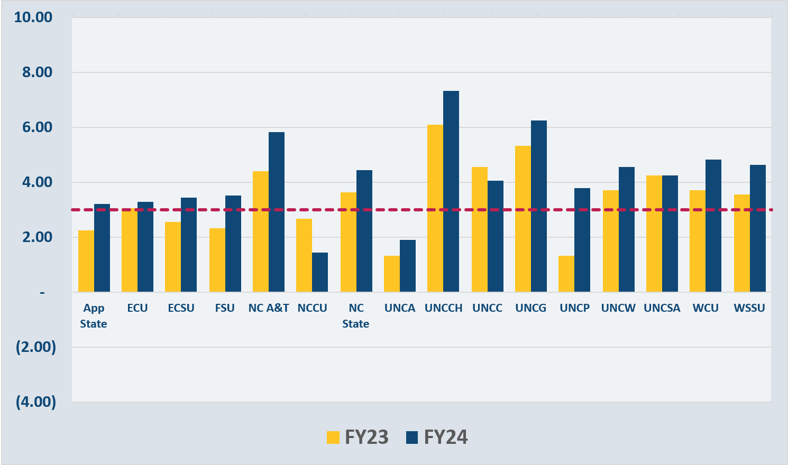
CFI – Composite Score
Threshold for financial health = 3.0

Slide 27

Trustees Play A Key Role
Notes:
We’ve covered a lot of information, but if you come away from this session with just one thing, I hope it is this: trustees play a key role.
Campus flexibility relies on accountability.
Trustees are on the “front line” of ensuring key financial decisions support our strategic goals. Demonstrating alignment with System priorities is the most effective way to preserve and grow campus flexibility.
If you did not strongly agree with all of today’s poll questions, I hope you’ll consider ways your board can engage on these issues and support progress towards our System goals.
Together, we can build on the legacy of the consolidated university’s first 50 years and position it for an even brighter future.

