Slide 1
Introduction to Program Evaluation
(Morning)
Maureen Berner, PhD
University of North Carolina at Chapel Hill
School of Government
June, 2025

Slide 2
It’s 2030
I know my program is a success because…..
Notes:
Hold this thought – we will come back to it.

Slide 3
Three Parts
Part 1: The Big Picture: What Program Evaluation Is ….and Is Not
Part 2: The ”Must Know” Things
Part 3: Making An Evaluation Plan
Notes:
The basics – here are the five HIGH LEVEL questions that form how we evaluate programs. (walk through) LETS GO THROUGH THEM ONE BY ONE>

Slide 4
Part 1
Big Picture:
What Program Evaluation Is
….and Is Not
Notes:
The basics – here are the five HIGH LEVEL questions that form how we evaluate programs. (walk through) LETS GO THROUGH THEM ONE BY ONE>

Slide 5
What Program Evaluation Is Not
Performance Measurement
Financial Reporting
Financial Auditing
Annual Progress Reports
Other?
Notes:
The basics – here are the five HIGH LEVEL questions that form how we evaluate programs. (walk through) LETS GO THROUGH THEM ONE BY ONE>

Slide 6
What is Program Evaluation?
What was the problem?
How was the program supposed to solve the problem?
Did it work the way we intended?
Were there mid-stream adjustments to improve the program?
Is it a success?
Notes:
The basics – here are the five HIGH LEVEL questions that form how we evaluate programs. (walk through) LETS GO THROUGH THEM ONE BY ONE>

Slide 7
Problem? Needs Assessment
Understanding the nature and extent of a problem

Slide 8
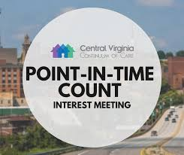
Needs Assessment Example
Homeless Population Point-In-Time (PIT) Count

Slide 9
What Can Happen if Needs Assessment is Ignored?
Right program → wrong population
Wrong program → right population
Program → no need
Program (can be) doomed from start

Slide 10
How To Solve Problem?
Program Theory
Showing the connections between problem and proposed solution
Also called Logic Model

Slide 11
Steps in Outlining Program Theory/Logic Model
What is program supposed to do and what results are expected? Outline theory of how program addresses need.
Talk with stakeholders, get materials, articulate and question assumptions
I.D.’s the links between theory and program goals/objectives/ implementation

Slide 12
What is Going On? Process Eval
Outlining exactly how a program works

Slide 13
Steps in Process Evaluation
Outline the program activities (the step by steps) that should take place (and are they linked to the program theory?)
Outline the program activities that actually do take place

Slide 14
What Can Happen if Process Evaluation is Ignored?
Evaluation results can be misleading, even wrong
Limits accountability
Even with good results, there is question: where/why did program fail or succeed?

Slide 15
Links Between All
Needs Assessment is basis for intervention
Program theory provides blueprint for program/intervention design
Process Evaluation tests design to see if it is working as intended

Slide 16
Is it Working (Early Eval)?
Formative Evaluation:
Assessing the short-term impact of your program in order to improve program design

Slide 17
Is it Working (Longer-Term)?
Impact/Outcome Evaluation: Assessing the long-term impact of your program
Measuring Your Success

Slide 18
“Real” Evaluation
Did you meet your goals/objectives? Goal-based Evaluation
Did you program make a difference – did it address the need? Impact Evaluation

Slide 19
Where do I start?
Notes:
THE MUST KNOW CONTEXT THINGS

Slide 20
Part 2
The “Must Know” Things
Notes:
The basics – here are the five HIGH LEVEL questions that form how we evaluate programs. (walk through) LETS GO THROUGH THEM ONE BY ONE>

Slide 21
The “Must Know” Things
Context
Agreed-upon goals, outputs, outcomes
Criteria and standards
Evidence to be used and how to get it
Limits

Slide 22
The “Must Know” Things
Context
Agreed-upon goals, outputs, outcomes
Criteria and standards
Evidence to be used and how to get it
Limits

Slide 23
The “Must Know” Things
Context
Agreed-upon goals, outputs, outcomes
Criteria and standards
Evidence to be used and how to get it
Limits

Slide 24
The “Must Know” Things
Context
Agreed-upon goals, outputs, outcomes
Criteria and standards
Evidence to be used and how to get it
Limits

Slide 25
The “Must Know” Things
Context
Agreed-upon goals, outputs, outcomes
Criteria and standards
Evidence to be used and how to get it
Limits

Slide 26
The “Must Know” Things
Context
Agreed-upon goals, outputs, outcomes
Criteria and standards
Evidence to be used and how to get it
Limits

Slide 27
Important Context
What’s the story? And just the facts, ma’am..….
Notes:
Politics, unusual circumstances, stability –including financial, personnel - keep it focused

Slide 28
Context Example: Stakeholders
Who funds, supports, criticizes the program?
Who does the program impact, positively or negatively?

Slide 29
Stakeholders
Who is important to the evaluation?
Who are involved, from program delivery to program beneficiaries?

Slide 30
Stakeholders
All are stakeholders, but not all need to be involved in the actual evaluation
Who should participate in the evaluation?
Who should be directly consulted?
Who should be just informed?

Slide 31
FM Food Donation Program
Example: The TarHeelBoro Farmer’s Market Food Donation Program
Notes:
https://commons.wikimedia.org/wiki/File:Interior_of_food_building_at_the_St._Jacobs_Farmers_Market,_2011_July_7.jpg

Slide 32
FM Food Donation Program
Farmers
Notes:
https://commons.wikimedia.org/wiki/File:Hmong_farmers_market_vendor_02.jpg

Slide 33
FM Food Donation Program
Direct donors
Notes:
https://www.flickr.com/photos/stevendepolo/12736375034

Slide 34
FM Food Donation Program
Potential Funders
Notes:
https://www.flickr.com/photos/healthiermi/8120068996

Slide 35
FM Food Donation Program
Potential Regulators
Notes:
https://commons.wikimedia.org/wiki/File:Winston-Salem_City_Hall.jpg

Slide 36
Additional Important Context
Before you start, you should know….
Program’s history, growth, target audience
The reason the evaluation is taking place
How results will be used
Notes:
Politics, usual circumstances, stability –including financial, personnel -

Slide 37
The “Must Know” Things
Context
Agreed-upon goals, outputs, outcomes
Criteria and standards
Evidence to be used and how to get it
Limits

Slide 38
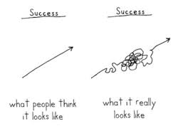
The “Must Know” Things
Context
Agreed-upon goals, outputs, outcomes – what is success

Slide 39
The “Must Know” Things
Context
Agreed-upon goals, outputs, outcomes
Criteria and standards
Evidence to be used and how to get it
Limits

Slide 40

The “Must Know” Things
Context
Agreed-upon goals, outputs, outcomes
Criteria and Standards: what and how much

Slide 41
The “Must Know” Things
Context
Agreed-upon goals, outputs, outcomes
Criteria and standards
Evidence to be used and how to get it
Limits

Slide 42
The “Must Know” Things
Context
Agreed-upon goals, outputs, outcomes
Criteria and standards
Evidence (data/information) to be used and how to get it
Limits

Slide 43

How do people gather data?
Surveys
Interviews
Documents – records, memos, numerical data
Case Studies/Comparison studies
Almost way is legitimate if done well, is acceptable to stakeholders and objective

Slide 44
The “Must Know” Things
Context
Agreed-upon goals, outputs, outcomes
Criteria and standards
Evidence to be used and how to get it
Limits

Slide 45
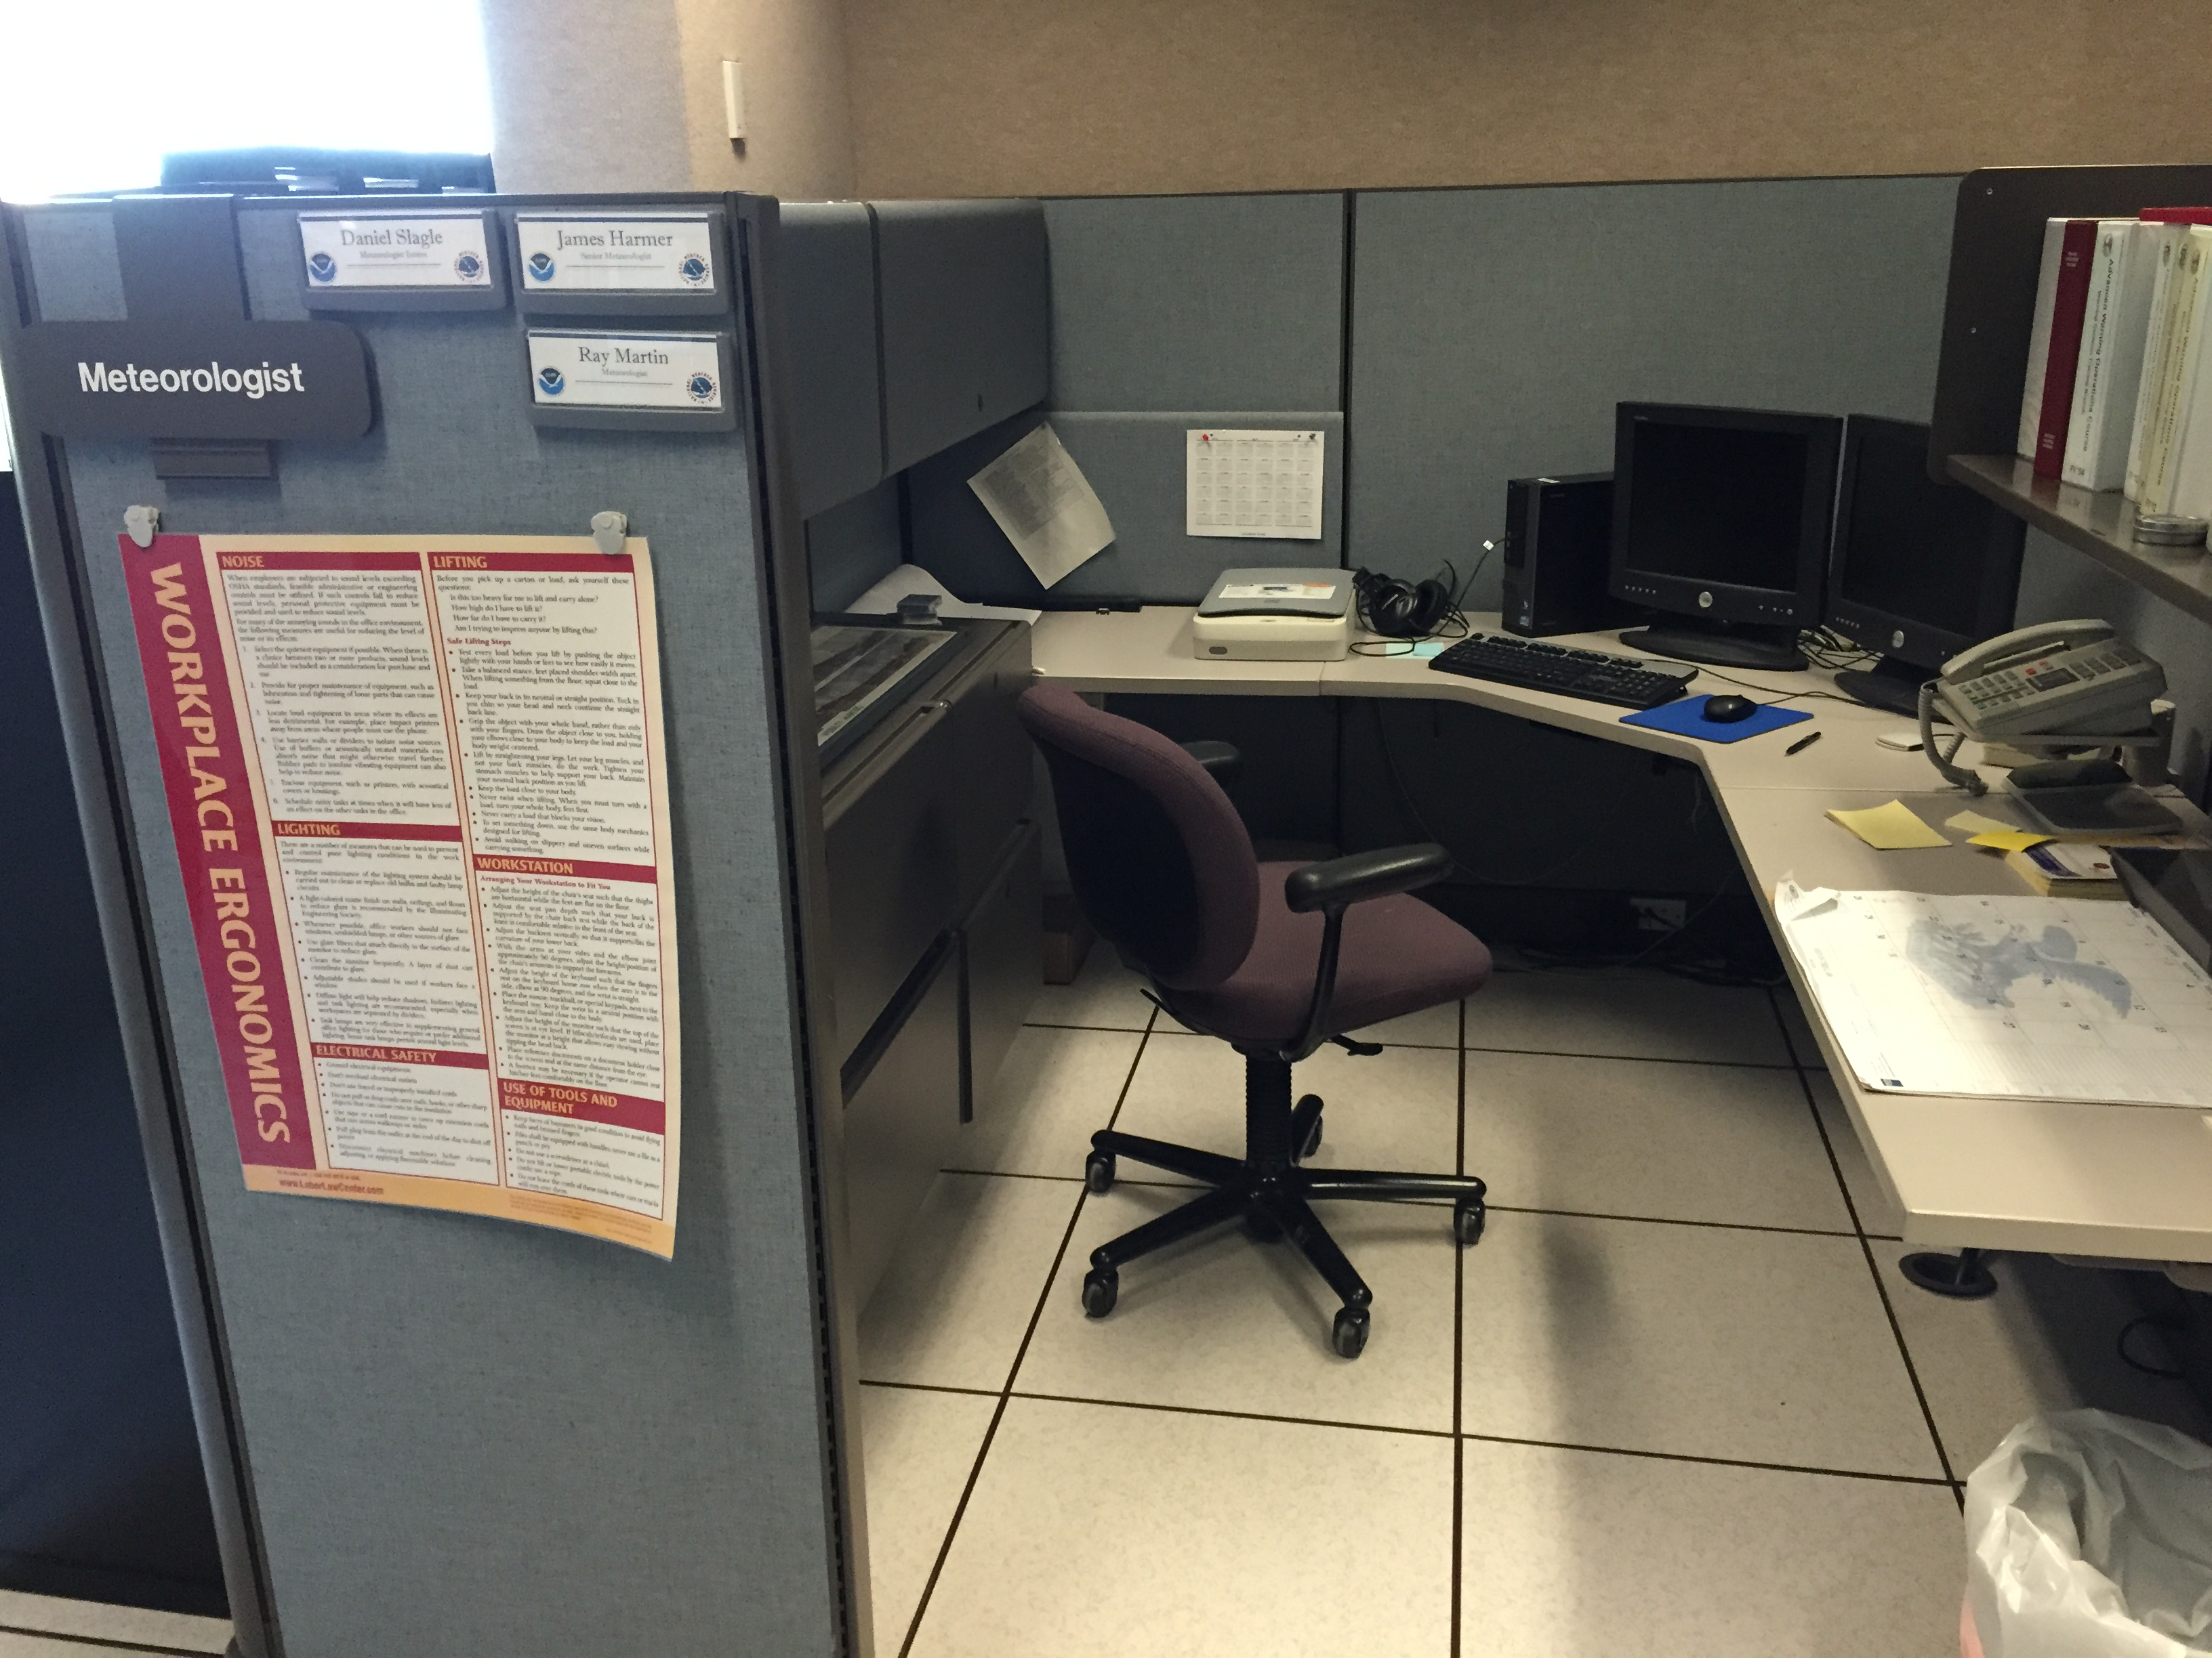
The “Must Know” Things
Context
Agreed-upon goals, outputs, outcomes
Criteria and standards
Evidence used and how to get it
Limits – capacity…

Slide 46
Part 3
Program Theory/Logic Models
Notes:
The basics – here are the five HIGH LEVEL questions that form how we evaluate programs. (walk through) LETS GO THROUGH THEM ONE BY ONE>

Slide 47
Steps in Outlining Program Theory/Logic Model
What is program supposed to do and what results are expected? Outline theory of how program addresses need.
Talk with stakeholders, get materials, articulate and question assumptions
I.D.’s the links between theory and program goals/objectives/ implementation

Slide 48
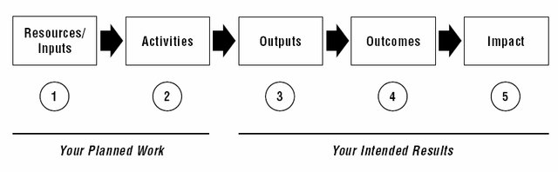
Steps in Outlining Program Theory/Logic Model

Slide 49
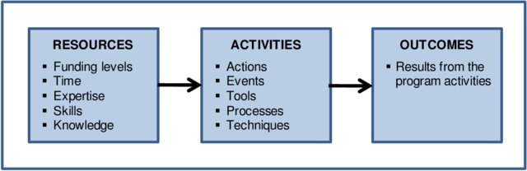
Steps in Outlining Program Theory/Logic Model

Slide 50
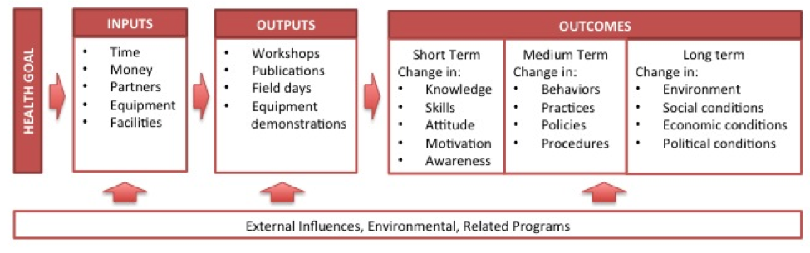
Steps in Outlining Program Theory/Logic Model

Slide 51
Notes:
Thank you

Slide 52
Logic Model Practice
Name two inputs/resources ($, people, time)
Name two things you will be doing with these resources
Name two things – outputs -- that result from these assets and activities

Slide 53
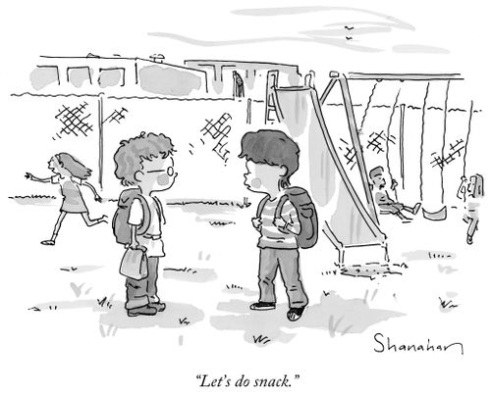
Lunch Break

