Slide 1
Introduction to Program Evaluation
(Afternoon)
Maureen Berner, PhD
University of North Carolina at Chapel Hill
School of Government

Slide 2
Part 3
Making an
Evaluation Plan
Notes:
The basics – here are the five HIGH LEVEL questions that form how we evaluate programs. (walk through) LETS GO THROUGH THEM ONE BY ONE>

Slide 3
Making An Evaluation Plan

Slide 4
Parts of an Evaluation Plan
Evaluation question
What is needed to answer that question
Where are you going to get what you need?
Data Collection Methods
Data Analysis Methods
Limitations

Slide 5
Evaluation Question
What do they want to know?

Slide 6
Evaluation Question
Clear and Specific
Fair and objective
Politically neutral
Measurable
Key Terms Defined – Scope, Timeframe Population
Doable in a practical manner

Slide 7
Information Could Include…
Evidence – Physical, Testimonial, Documentary, Analytical
Program criteria
Agency procedures
Participant rates
Cost information
Funding levels or other resources

Slide 8
Example Information Source(s)
Officials
Program participants
Inventory records
Data bases
Laws and regulations
Previous studies

Slide 9
Where is the information?
Notes:
http://www.usar.army.mil/Commands/Functional/85th-Support-Command/Photo-Page/igphoto/2001287333/

Slide 10
Data Collection Methods
How are you going to get the information?
Notes:
https://www.flickr.com/photos/mattjiggins/4123415605

Slide 11
Data Collection Methods: Options
How are you going to get the information?
Structured interviews
Focus groups
Structured questionnaires or surveys
Visual inspection
File/document review

Slide 12
Data Analysis Methods
What will you do with it once you get it?
Notes:
https://www.libertymutual.com/life-insurance/life-insurance-tools-and-resources/vul-documents

Slide 13
Data Analysis Methods: Options
What will you do with it once you get it?
Descriptive statistics
Cost/benefit analysis
Inferential statistics
Qualitative analysis (interviews, case studies)
T-test
Regression analysis

Slide 14
FM Food Donation Program
Returning to the FM Donation Program:
What did they want to know?
Remember the stated goal:
Reduce local hunger by diverting surplus farmer’s market products from waste to local pantries

Slide 15
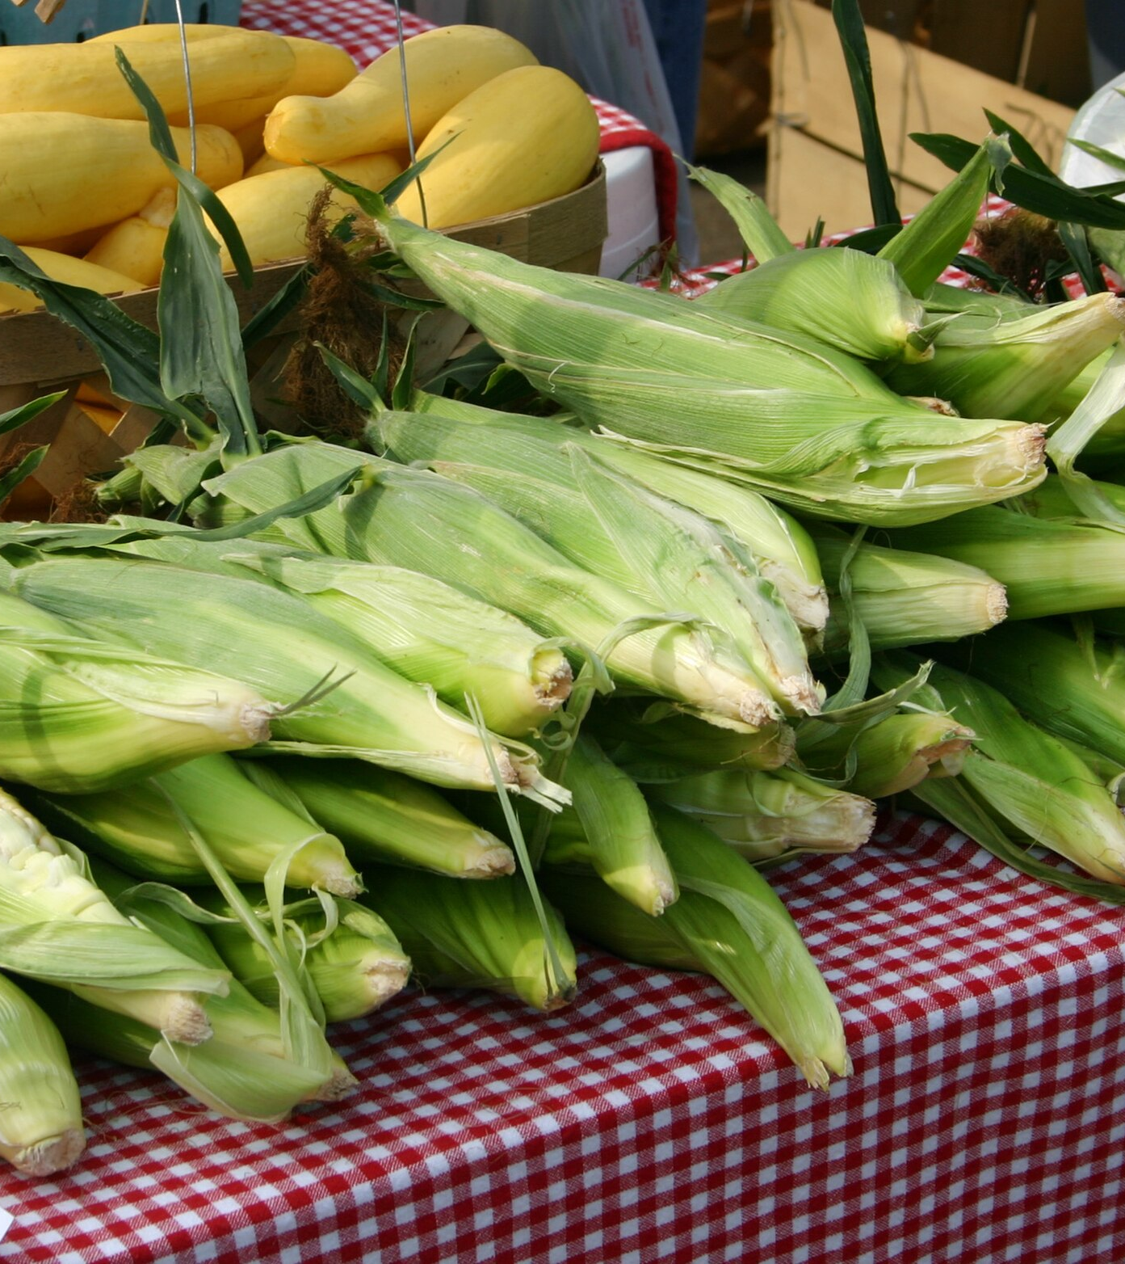
The Evaluation Question
Did the Carrboro Farmers’ Market reduce hunger by diverting surplus farmer’s market products from waste to local pantries?

Slide 16
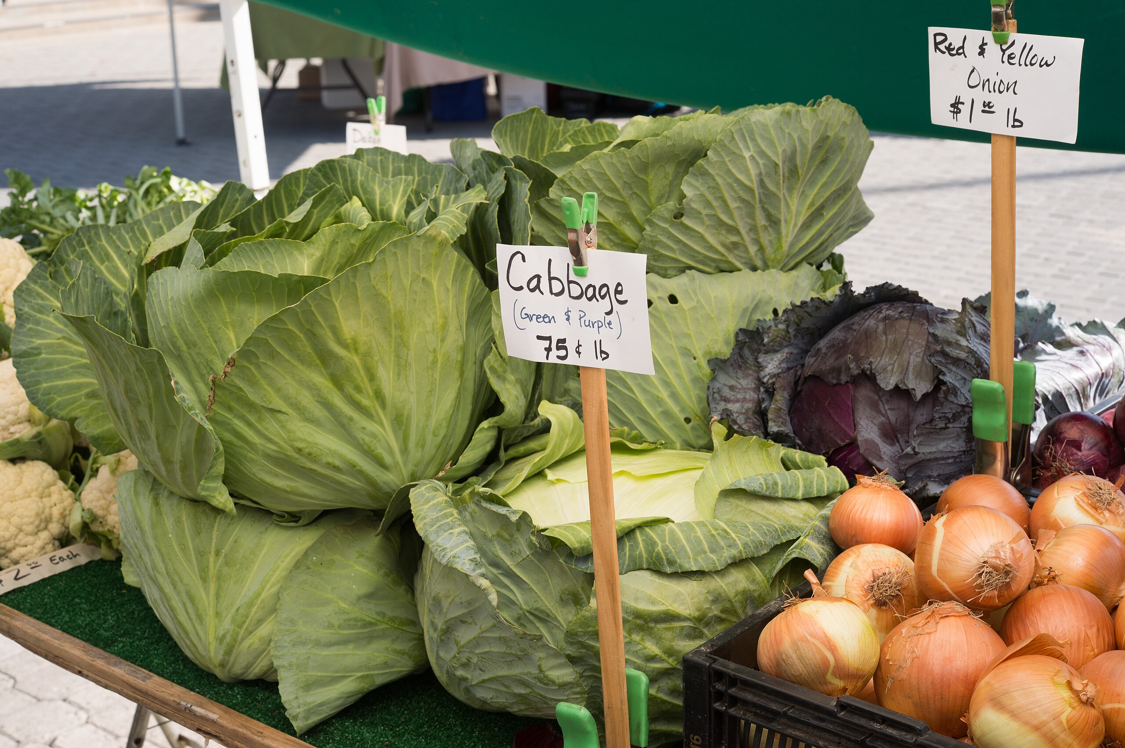
What’s needed to answer it?
Information on actual food donated – type and amount
Collection and delivery process
Who receives it
What happens to it after delivery

Slide 17
The FM Food Donation Program
Where are you going to get information?
Farmers
Farmer’s Market officials
Pantries
Clients

Slide 18
How will you get the Info?
Interview farmers, officials, pantry staff, clients
Observe/document the entire process on random days
Review farmer, market and pantry records
Client logs?

Slide 19
Food Donation Program Data
What will you do with it once you get it?
Descriptive statistics - ✔️
Cost/benefit analysis - ✔️
Inferential statistics
Qualitative analysis - ✔️
T-test
Regression analysis

Slide 20
More Evaluation Question Practice
Complete this sentence for your own program:
“I want to know if……..”

Slide 21
Data Needed
Records can be data…

Slide 22
How to Get Data
How will you get the information you need?

Slide 23
What Do You Do With It?
How will you analyze your information?

Slide 24
Limitations
What can’t you do (Caveats)?
Generalize
Data quality and reliability
Access to records
Staffing/travel constraints
Notes:
https://www.flickr.com/photos/tallentshow/2399373550

Slide 25
What Can You Say?
What will you be able to say?
What won’t you?

Slide 26
Making a Plan – GAO example
Evaluation question
What is needed to answer that question
Where are you going to get what you need?
How are you going to collect it?
How are you going to analyze it?
What will you be able to say (and not?)
See GAO template

Slide 27
My Contact Information
Maureen Berner PhD
Professor of Public Administration and Government
UNC Chapel Hill School of Government
Mberner@sog.unc.edu

