Slide 1
Relief from Financial Obligations in N.C. Criminal Cases
Phil Dixon
Mar. __, 2022
Notes:
HI EVERYBODY!

Slide 2
Over 650,000 North Carolinians carry debt stemming from a criminal case (1 out of 12 adults)
Over 1.2 million suspended driver’s licenses for Failure to Appear and Failure to Comply

Slide 3
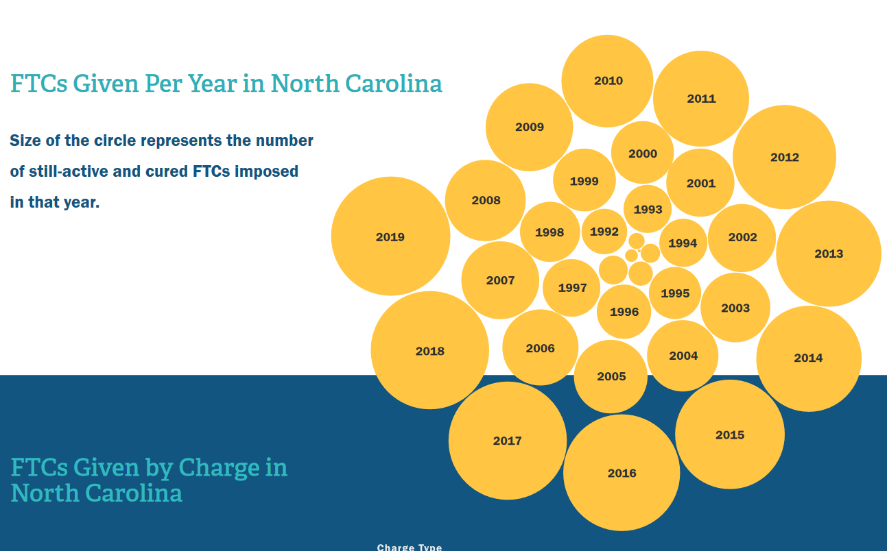
-Communities of color and the poor disproportionately represented
-Failure to comply suspensions have grown at an exponential rate
-Nearly 30% of license suspensions lead to eviction per survey

Slide 5
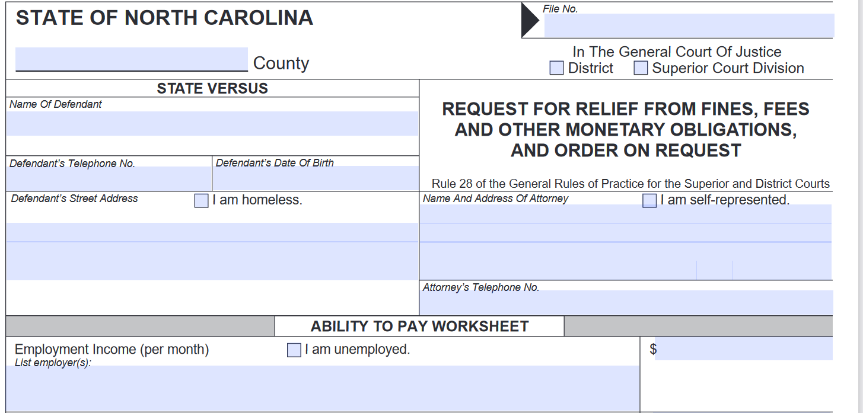

Slide 6
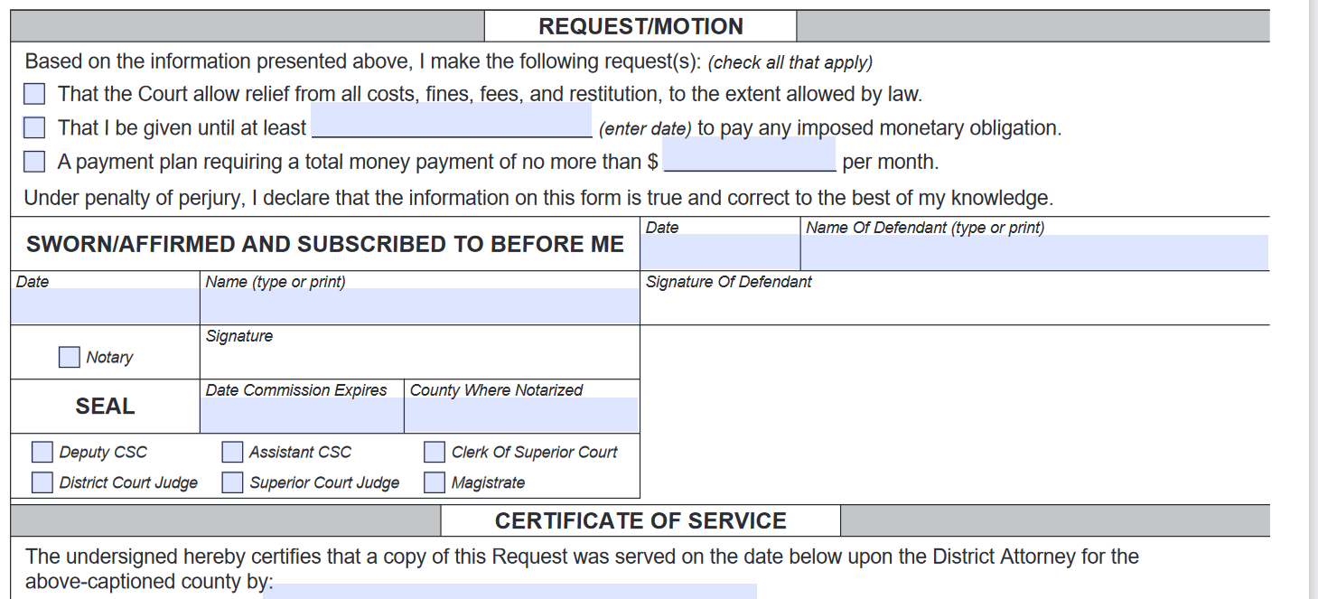

Slide 8
Four Main Categories
Restitution
Fines/Costs
Attorney Fees
Other Court-Imposed Costs

Slide 9
Civil Judgments
A civil judgment is not relief
Civil judgments for fines accrue interest

Slide 10
Restitution
Per G.S. 15A-1340.36, the trial court shall consider the defendant’s ability to pay
The trial court should consider the debts and assets of the defendant along with any other relevant evidence

Slide 11
Restitution in CVRA Cases
In CVRA cases, restitution is mandatory, but a partial award is permitted if the court finds the amount exceeds Δ’s ability to pay
The record must reflect the reasons for the partial award
Restitution in CVRA cases may be ordered as a civil judgment if amount exceeds $250

Slide 12
Restitution in Non-CVRA Cases
In non-CVRA cases, restitution is discretionary
The trial court may order partial restitution, or none at all

Slide 13
CVRA Offenses Refresher
Applies to any offense against a person and any felony property crime. G.S. 15A-830(7).
Felony property crimes are narrowly defined as only offenses within subchapters IV and V of Chapter 14 of the N.C. General Statutes E.g., Burglary and B/E; Arson and other burnings; Larceny and Robbery; Frauds and Forgery; etc.
Crimes against a person probably include any crime with a human victim

Slide 14
Fines
Per G.S. 15A-1362, the trial court should consider the defendant’s ability to pay a fine
Court may choose not to impose any non-mandatory fine
No notice or findings of fact required

Slide 15
Fines
Mandatory fines should be imposed unless constitutionally excessive
State and federal constitutions protect against excessive fines. U.S. Const. amend. VIII; N.C. Const., Art. I § 27
See also Timbs v. Indiana, 139 S. Ct. 682 (2019)(finding the Excessive Fines Clause of the Eighth Amendment applicable to the States)

Slide 16
Court Costs
Only one set of court costs per all related charges per State v. Rieger, 267 N.C. App. 477 (2016)

Slide 17
Court Costs
Court may waive costs with automatic AOC notice to affected entities
Trial court must make findings of fact and conclusions of law that waiver is supported by just cause

Slide 18
Court Costs
Probationary jail fees are not subject to notice and findings provision
Lab and testifying lab expert fees may be waived or reduced
Court also has discretion to not impose these costs

Slide 19
Other Court-Imposed Fees
Per G.S. 15A-1343, a defendant may be exempted from paying probation supervision and electronic house arrest fees for good cause
No notice or findings required
A defendant may also be exempted from paying satellite-based monitoring fees without notice or findings
No authority to waive community service fee in G.S. 143B-708

Slide 20
Attorney Fees
Determined by IDS rules per G.S. 7A-455(b)
$75.00 attorney appointment fee is mandatory and cannot be remitted, waived, or reduced by the court per G.S. 7A-455.1(b)

Slide 21
Practical Advice for Defenders Before Hearing
Discuss
Discuss monetary obligations and ability to pay with the client before court
Assist
Have the client obtain as much information about the client’s finances as possible and help them complete the form accurately
Humanize
Humanize the client to the other court actors

Slide 22
Practical Advice for Defenders at Hearing
Ask
Ask for relief at sentencing, and ask again after sentencing as needed (e.g., probation, etc.)
Be Prepared
Argue
Raise constitutional arguments in addition to statutory and equity grounds
Be prepared to present evidence of the defendant’s ability to pay

Slide 23
Practical Advice for Judges
Consider
Consider Δ’s ability to pay before imposing monetary obligations
Know
Know where you have discretion to not impose, or to impose reduced financial obligations
Inform
Inform pro se parties of the option to seek relief and make AOC-CR-415 forms available

Slide 24
Authority to Grant Relief from Monetary Obligations
AT SENTENCING
Restitution | The court must consider ability to pay. Under G.S. 15A-1340.36, in determining the restitution amount, the court shall take into consideration the resources of the defendant including: Real property Personal property Income derived from property Ability to earn Obligation to support dependents Any other matters that pertain to the defendant’s ability to make restitution TO GRANT RELIEF: Don’t impose or order partial Non-imposition. In cases not covered under the CVRA, restitution is discretionary. G.S. 15A-1340.34(c). In CVRA cases, the court shall require restitution, G.S. 15A-1340.34(b), although it may require partial restitution as described immediately below. Order partial restitution. The court may order partial restitution when it appears that the damage or loss caused by the offense is greater than that which the defendant is able to pay. If the court orders partial restitution, it shall state on the record the reasons for doing so. Civil Judgment. In cases covered under the CVRA, restitution to a victim in excess of $250 may be enforced like a civil judgment. If the defendant receives probation, the order is not enforceable until a judge finds, upon terminating or revoking probation, that restitution in a sum certain remains due and payable. G.S. 15A-1340.38. Use form AOC-CR-611.
Fines | The court should consider ability to pay. In determining the method of payment of a fine, the court should consider the burden the payment will impose in view of the financial resources of the defendant. G.S. 15A-1362. TO GRANT RELIEF: Don’t impose Non-imposition. A fine need not be “waived.” Rather, it is part of the sentence that a judge generally may, in his or her discretion, choose not to impose, without any requirement of findings or notice. Excessive fines. If a statute calls for a particular fine as a mandatory component of a sentence the judge should impose it unless he or she determines that it would violate the constitutional prohibition against excessive fines. N.C. Const. Art. I § 27; State v. Zubiena, 251 N.C. App. 477 (2016) ($1,000 fine not excessive).
Costs | Remember: One set of costs. The court should impose only one set of costs for all charges stemming from the same underlying incident that are adjudicated together. State v. Rieger, 267 N.C. App. 647 (2019). TO GRANT RELIEF: Waive or reduce Waiver. The court may waive costs upon entry of a written order, supported by findings of fact and conclusions of law, that there is just cause to do so. Before waiving costs the court must provide notice by first-class mail to directly affected government entities of the date and time of the hearing and the right to be heard make objection at least 15 days prior to the hearing. The AOC provides statewide monthly notice to all potentially affected government entities, which may satisfy this requirement. It is error for a judge to operate under the impression that he or she has no discretion to waive costs. State v. Patterson, 223 N.C. App. 180 (2012). Exception for probationary jail fees. The $40/day jail fee for split sentences and other probationary confinement applies only when the court specifically imposes it; no findings or notice are required when the court chooses not to impose that fee. G.S. 7A-313. Note, however, that the $10/day fee for pretrial jail confinement is a cost that applies unless waived as described above. Reduction. If not waived, the state and local lab or hospital fee ($600) and testifying lab expert fee ($600) may, in the alternative, be reduced.
Fees | TO GRANT RELIEF: Exempt Probation supervision fee ($40/month). The court may exempt a person from paying the fee for good cause and upon motion of the probationer. G.S. 15A-1343(c1). There is no requirement for notice or findings. EHA fee ($90 setup fee plus $4.48/day). The court may exempt a person from paying the fee for good cause and upon motion of the probationer. G.S. 15A-1343(c2). There is no requirement for notice or findings. Satellite-based monitoring fee ($90 fee). The court may exempt a person from paying the SBM fee for good cause and upon motion of the defendant. There is no requirement for notice or findings. Community Service fee. No statute governs waiver of the $250 community service fee. G.S. 143B-708.
Attorney Fees | Attorney fees. Attorney fees are a judgment against the defendant, determined in accordance with rules adopted by IDS. G.S. 7A-455(b). Appointment fee. The $75 appointment fee is mandatory and may not be remitted or revoked by the court. G.S. 7A-455.1(b).
Notes:
I think we should just provide these sheets as pdf materials for the webinar. Maybe still include the slides here to reference them? And have a ‘the end’ slide, yeah?

Slide 25
Authority to Grant Relief from Monetary Obligations
LATER ACTION
Restitution | TO GRANT RELIEF: Remit all or part Remission. The court may remit all or part of an order of restitution after providing notice and an opportunity to be heard to the district attorney, the victim, the victim’s estate, or any other recipient of restitution. The notice must be made by first-class mail and must provide the date and time of the hearing and notice of the right to be heard and make objection to the remission. G.S. 15A-1340.39. Civil Judgment. In cases covered under the CVRA, restitution to a victim in excess of $250 may be enforced like a civil judgment. If the defendant received probation, the order is not enforceable until a judge finds, upon terminating or revoking probation, that restitution in a sum certain remains due and payable. G.S. 15A-1340.38. Use form AOC-CR-612 for balances due upon revocation or termination of probation.
Fines & Costs | TO GRANT RELIEF: Remit or modify Remission. At any time, upon petition of the defendant or a prosecutor to the sentencing court, the court may remit a cost or fine if it appears to the court that: (1) The circumstances which warranted imposition of the obligation no longer exist; (2) It would otherwise be unjust to require payment; or (3) the proper administration of justice requires resolution of the case. G.S. 15A-1363. Before remitting a cost or fine in whole or in part, the court must provide notice by first-class mail to directly affected government entities of the date and time of the hearing and the right to be heard make objection at least 15 days prior to the hearing. G.S. 7A-304(a). The AOC provides statewide monthly notice to all potentially affected government entities, which may satisfy this requirement. Modification upon by default. If it appears that the default in the payment of a fine or costs is not attributable to failure on the defendant’s part to make a good faith effort to obtain the necessary funds for payment, the court may enter an order: (1) Allowing the defendant additional time for payment; or (2) Reducing the amount of the fine or costs or of each installment; or (3) Revoking the fine or costs or the unpaid portion in whole or in part. G.S. 15A-1364(c). Civil judgment. If a defendant has defaulted in payment of a fine or costs, the court may order that the unpaid obligation be docketed as a lien on the defendant’s real estate. G.S. 15A-1365.
Fees | TO GRANT RELIEF: Exempt from further payment, modify, or remit Probation supervision fee ($40/month). The court may exempt a person from paying the fee for good cause and upon motion of the probationer. G.S. 15A-1343(c1). There is no requirement for notice or findings. EHA fee ($90 setup fee plus $4.48/day). The court may exempt a person from paying the fee for good cause and upon motion of the probationer. G.S. 15A-1343(c2). There is no requirement for notice or findings. Satellite-based monitoring fee ($90 fee). The court may exempt a person from paying the SBM fee for good cause and upon motion of the defendant. There is no requirement for notice or findings. Community Service fee. No statute governs waiver of the $250 community service fee. G.S. 143B-708. Balances owed for these fees probably may be modified or remitted.
Attorney Fees | Attorney fees. Attorney fees are a judgment against the defendant, determined in accordance with rules adopted by IDS. In probation cases, the judgment for attorney fees is docketed when probation terminates, expires, or is revoked. G.S. 7A-455. Appointment fee. The $75 appointment fee is mandatory and may not be remitted or revoked by the court. G.S. 7A-455.1(b).

Slide 26
Constitutional Concerns
Timbs v. Indiana, 139 S. Ct. 682 (2019) (excessive fines protections of the Eighth Amendment apply to the States)
Bearden v. Georgia, 461 U.S. 660 (1983) (a defendant may not be imprisoned for failure to pay if the defendant has made good faith efforts unless alternatives to imprisonment are insufficient to satisfy the governmental interests)

Slide 27
And that’s all folks!
Phil Dixon
dixon@sog.unc.edu

