Slide 1
Rule 9(j): A Special Pleading Requirement with “Teeth”
Ann M. Anderson
School of Government
Appellate Training: New and Emerging Legal Issues
December 5, 2019

Slide 3
“A bad beginning makes a bad ending.”
-Euripides, Aeolus
“Before beginning, plan carefully.”
-Cicero

Slide 4
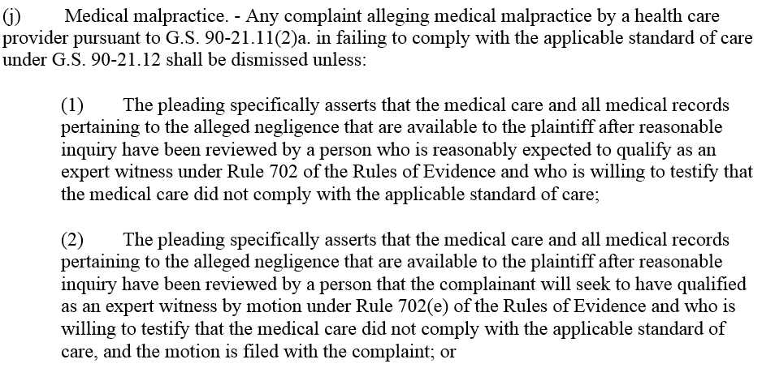
Rule 9(j)
The Law:
If a plaintiff does not comply with Rule 9(j), the complaint “shall be dismissed.”

Slide 5
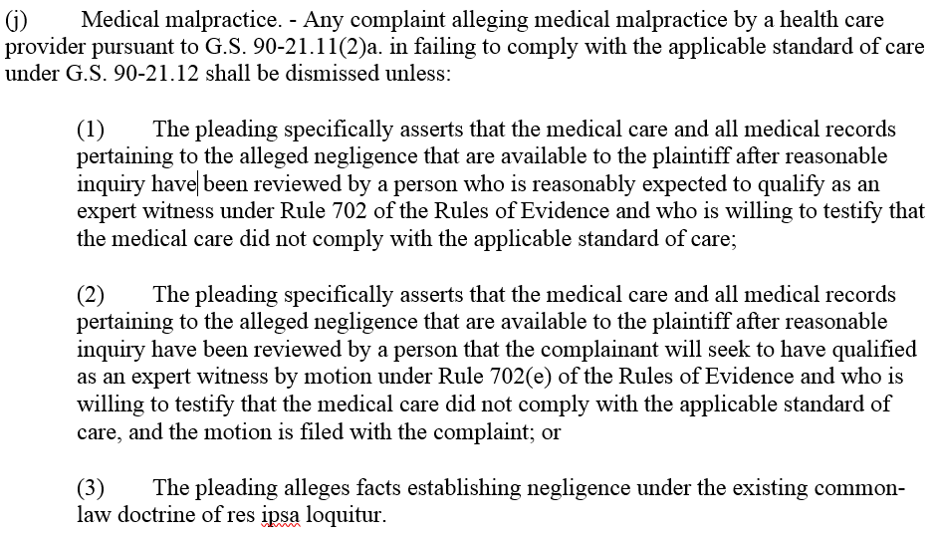
Rule 9(j)

Slide 6
Rule 9(j)

Slide 7
It’s a “must”
“[M]edical malpractice complaints have a distinct requirement of expert certification with which plaintiffs must comply. Such complaints will receive strict consideration by the trial judge. Failure to include the certification necessarily leads to dismissal.”
-NC Supreme Court
Notes:
Supreme Court

Slide 8
“[M]edical malpractice complaints have a distinct requirement of expert certification with which plaintiffs must comply. Such complaints will receive strict consideration by the trial judge. Failure to include the certification necessarily leads to dismissal.”
-NC Supreme Court
“Facial” Requirement
Notes:
Supreme Court

Slide 9
“Factual” Requirement
“[M]edical malpractice complaints have a distinct requirement of expert certification with which plaintiffs must comply. Such complaints will receive strict consideration by the trial judge. Failure to include the certification necessarily leads to dismissal.”
-NC Supreme Court
Notes:
It is “well established” that even when a complaint complies on its face with Rule 9(j), if “discovery subsequently establishes that the statement is not supported by the facts, then dismissal is likewise appropriate.”
-Moore v. Proper, NC 2012

Slide 10
Rule 9(j)

Slide 11
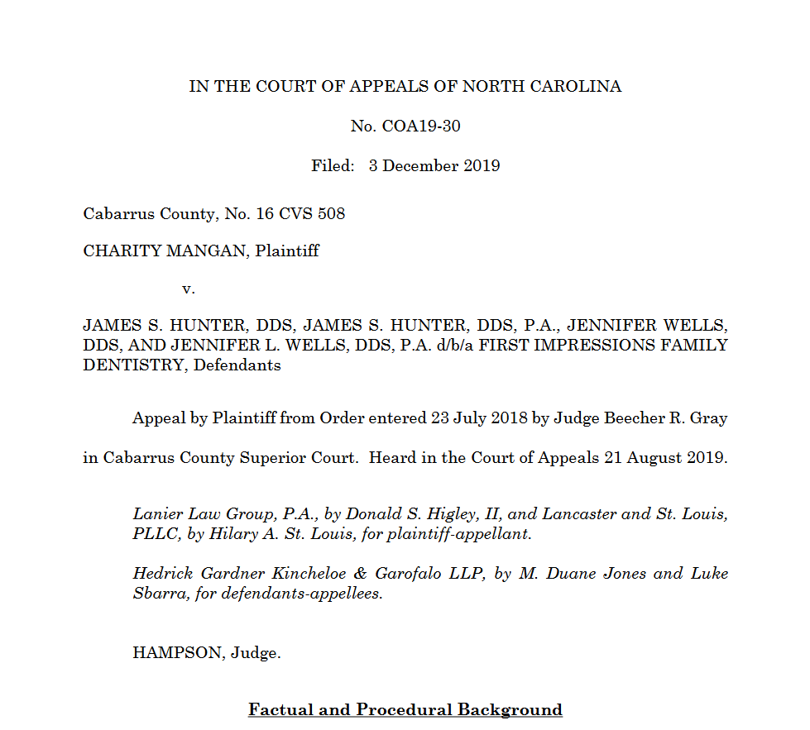
Rule 9(j)

Slide 12
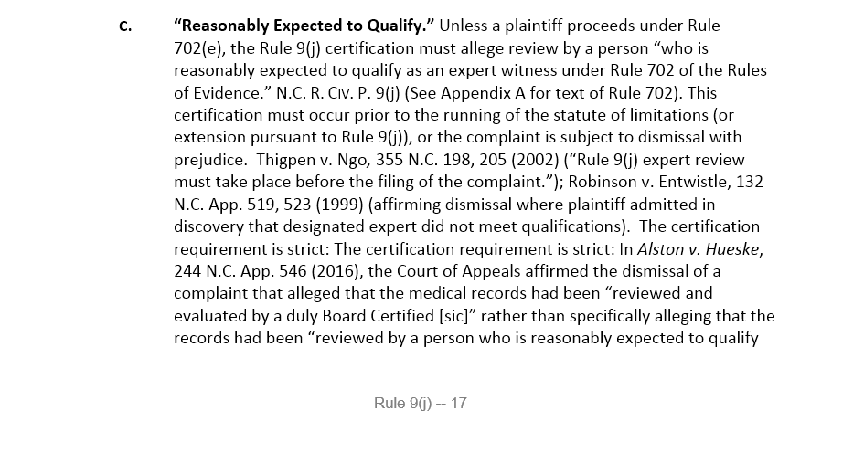
Rule 9(j)
pp. 17-21
Notes:
The question for the court under Rule 9(j) is not whether the expert ultimately will qualify, but whether the plaintiff, at the time the pleading was filed, reasonably expected the witness to qualify: “In other words, were the facts and circumstances known or those which should have been known to the pleader such as to cause a reasonable person to believe that the witness would qualify as an expert under Rule 702.” Grantham v. Crawford, 204 N.C. App. 115, 118–19 (2010) (citations omitted). The question is whether “there is ample evidence in th[e] record that a reasonable person armed with the knowledge of the plaintiff at the time the pleading was filed would have believed” the witness would qualify. Morris v. Southeastern Orthopedics Sports Med. & Shoulder Ctr., 199 N.C. App. 425, 437–38 (2009) (quotation omitted). Determining what the plaintiff knew or should have known is largely a matter of examining the discovery materials, and
[T]o the extent there are reasonable disputes or ambiguities in the forecasted evidence, the trial court should draw all reasonable inferences in favor of the nonmoving party at this preliminary stage of determining whether the party reasonably expected the expert witness to qualify under Rule 702. Moore v. Proper, 366 N.C. 25, 32 (2012). Whether the plaintiff could reasonably expect the witness to qualify as an expert under Rule 702 is a question of law reviewed by the appellate courts de novo. Trapp v. Macchioli, 129 N.C. App. 237, 241 n.2 (1998). The trial court must, however, make findings of fact and conclusions of law when determining plaintiff’s expectation was not reasonable. Moore, 366 N.C. at 32. Beyond the determination under Rule 9(j) of “reasonable expectation” is the broader issue of an expert’s ultimate qualification to testify. “Whether an expert will ultimately qualify to testify is controlled by Rule 702.” Moore v. Proper, 366 N.C. 25 (2012). A discussion of the cases interpreting the requirements of Rule 702(b) is outside the scope of this chapter.

Slide 13
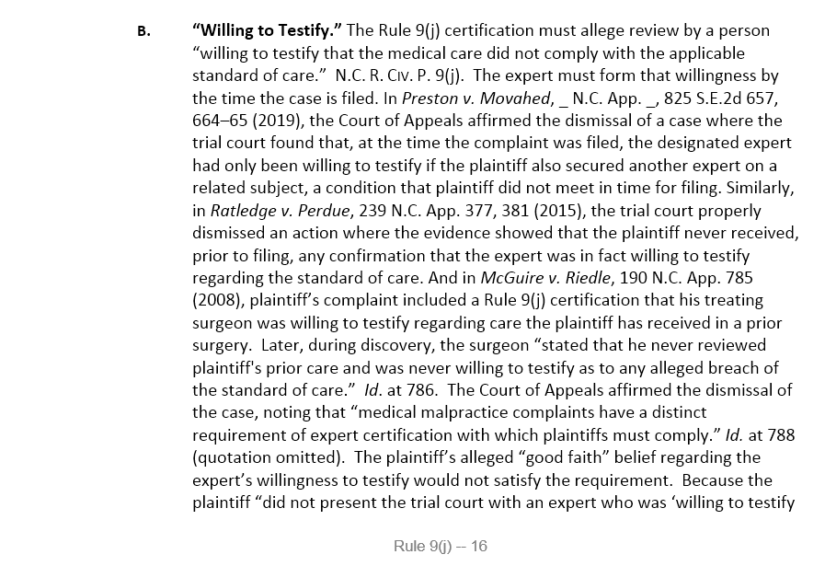
Rule 9(j)
pp. 16-17

Slide 14
“[M]edical malpractice complaints have a distinct requirement of expert certification with which plaintiffs must comply. Such complaints will receive strict consideration by the trial judge. Failure to include the certification necessarily leads to dismissal.”
-NC Supreme Court
“Facial” Requirement
Notes:
Supreme Court

Slide 15
What if a plaintiff fails (neglects/forgets) to include a Rule 9(j) certification, or the certification language is defective
…and then the statute of limitations expires?
Can this be corrected?
Rule 15 amendment?
Rule 41(a) voluntary dismissal/refiling?

Slide 16
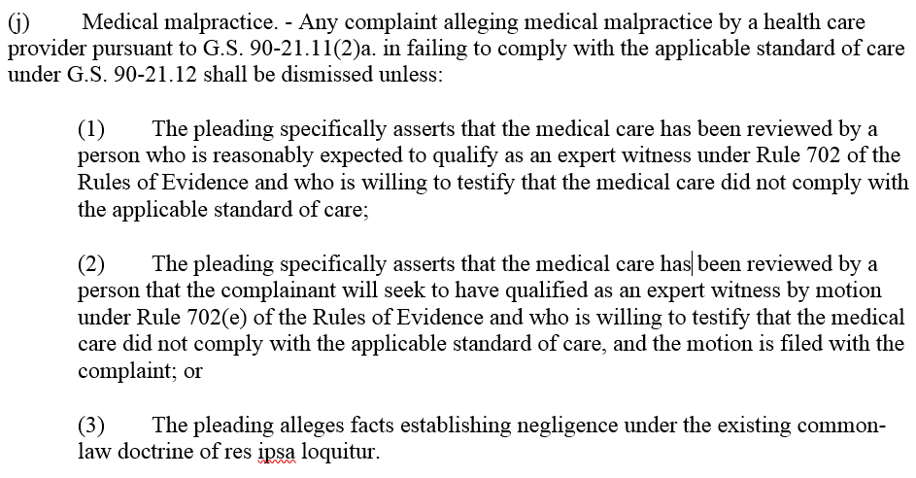
Rule 9(j) before Oct. 1, 2011

Slide 17
Rule 9(j) after Oct. 1, 2011

Slide 18
Vaughn v. Mashburn (N.C. App. Dec. 2016; N.C. 2018))
Plaintiff moves to amend to correct Rule 9(j) language
Plaintiff obtained Rule 9(j) review from expert
Plaintiff files
med mal complaint – Rule 9(j) cert, but defective
Motion to amend denied as “futile” because s/lim had expired.
Case dismissed.
Statute of limitations expires
Affirmed.
Based on Fintchre (2016), Alston (2016), Keith (1998)

Slide 19
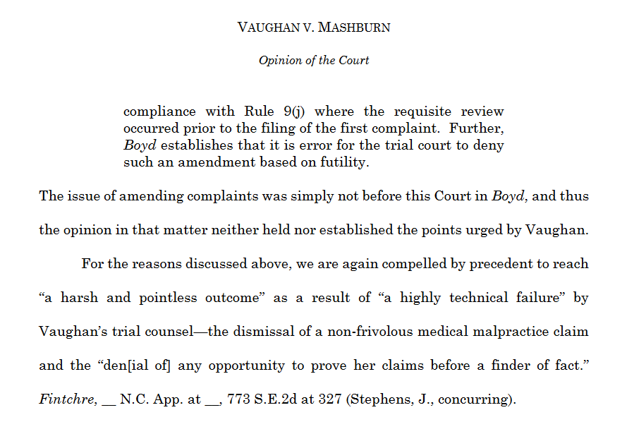
Notes:
We are sympathetic to the arguments of Vaughn’s able counsel appellate counsel and appreciate the highly technical nature of our decision here, [but] we are bound by our existing precedent. This Court simply does not have authority to rule otherwise.

Slide 20
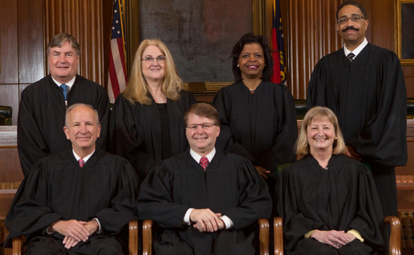
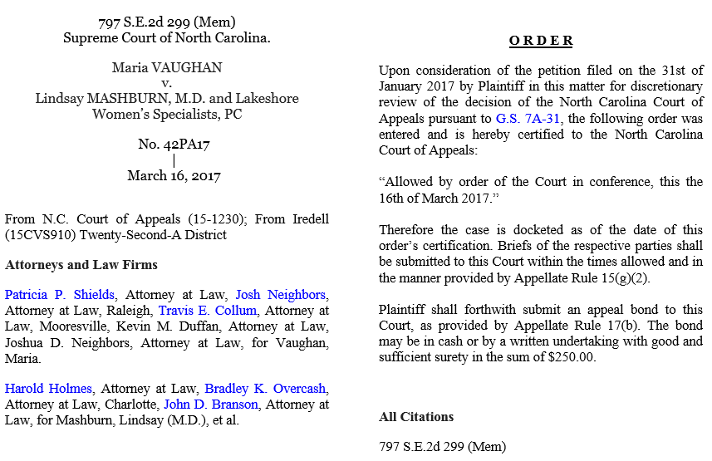
REVERSED
“…a plaintiff…may file an amended complaint under Rule 15(a) to cure a defect in a Rule 9(j) certification when the expert review and certification occurred before the filing of the original complaint…[and]…such an amended complaint may relate back under Rule 15(c)”

Slide 21
“We again emphasize that…the expert review required by Rule 9(j) must occur before the filing of the original complaint. …But when a plaintiff prior to filing has procured an expert who meets the appropriate qualifications and, after reviewing the medical care and available records, is willing to testify that the medical care at issue fell below the standard of care, dismissing an amended complaint would not prevent frivolous lawsuits. Further, dismissal under these circumstances would contravene the principle ‘that decisions be had on the merits and not avoided on the basis of mere technicalities.” (emphasis added)

Slide 22
REVERSED
“…a plaintiff…may file an amended complaint under Rule 15(a) to cure a defect in a Rule 9(j) certification when the expert review and certification occurred before the filing of the original complaint…[and]…such an amended complaint may relate back under Rule 15(c)”
What if it’s missing altogether?
Notes:
Complete absence of Rule 9(j) certificate?

Slide 23
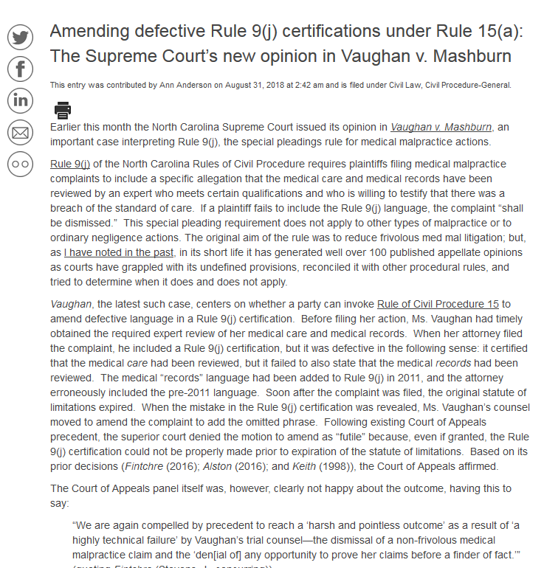
www.civil.sog.unc.edu

Slide 24
Griffin v. United States, 2019 WL 2270616 (W.D.N.C. 2019):
Interpreting Vaughan:

Slide 25
What if a plaintiff fails (neglects/forgets) to include a Rule 9(j) certification, or the certification language is defective
…and then the statute of limitations expires?
Can this be corrected?
Rule 15 amendment?
Rule 41(a) voluntary dismissal/refiling?

Slide 26
…and asserts that the expert review had occurred prior to filing original complaint
Boyd v. Rekuc, 246 N.C. App. 227 (2016)
Plaintiff filed med mal complaint –
No Rule 9(j) certification in complaint
Trial court dismissed on grounds that statute of limitations had expired before Rule 9(j) certification filed.
Plaintiff dismisses action under Rule 41(a)
Plaintiff refiles with Rule 9(j) certification
Statute of limitations expires
Reversed.
Notes:
“[W]e hold that the trial court erred in…dismissing Plaintiff's complaint: Plaintiff filed his original complaint within the applicable statute of limitations. Though his original complaint was filed without the required Rule 9(j) certification and, therefore, subject to be dismissed with prejudice, see N.C. Gen. Stat. § 1A–1, Rule 9(j), Plaintiff voluntarily dismissed his original complaint pursuant to Rule 41(a)(1) before any such dismissal with prejudice occurred. He, then, refiled his complaint within the one year time period allowed under Rule 41, and asserted in said complaint that the expert review of his medical care and history had been conducted prior to the filing of the original complaint. Therefore, we reverse the order of the trial court dismissing Plaintiff's complaint and remand the matter for further proceedings not inconsistent with this opinion.

Slide 27
“[M]edical malpractice complaints have a distinct requirement of expert certification with which plaintiffs must comply. Such complaints will receive strict consideration by the trial judge. Failure to include the certification necessarily leads to dismissal.”
-NC Supreme Court
“Facial” Requirement
Notes:
Supreme Court

Slide 28
So, just how “exact” must the wording of the Rule 9(j) certification be?

Slide 29
Rule 9(j)

Slide 30
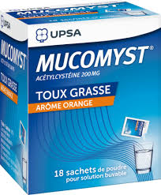
Fairfield v. Wakemed (N.C. App. Oct. 2018)
Plaintiff files
med mal complaint – Rule 9(j) cert, but defective
Notes:
Accidental overdose of acetaminophen

Slide 31
Rule 9(j)
“certain medical records”

Slide 32
Fairfield v. Wakemed (N.C. App. Oct. 2018)
Plaintiff files
med mal complaint – Rule 9(j) cert, but defective
Case dismissed.
Defective Rule 9(j) certificate.
Statute of limitations expires
Affirmed.

Slide 33
Alston v. Hueske (N.C. App. Oct. 2016)
Plaintiff files
med mal complaint – Rule 9(j) cert, but defective

Slide 34
Rule 9(j)
“the medical records were reviewed and evaluated by a duly Board Certified [sic]”

Slide 35
Alston v. Hueske (N.C. App. Oct. 2016)
Plaintiff files
med mal complaint – Rule 9(j) cert, but defective
Case dismissed.
Defective Rule 9(j) certificate.
Statute of limitations expires
Affirmed.

Slide 36
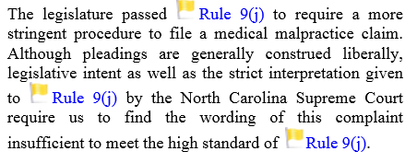
Alston v. Hueske (N.C. App. Oct. 2016)
Plaintiff files
med mal complaint – Rule 9(j) cert, but defective
Case dismissed.
Defective Rule 9(j) certificate.
Statute of limitations expires
Affirmed.

Slide 37
And now let’s talk about when a Rule 9(j) certification is not required at all:
When it’s not “medical malpractice” in the first place.
When the doctrine of res ipsa applies.

Slide 38
Rule 9(j)

Slide 39
Rule 9(j)
Is it just ordinary negligence?
(No Rule 9(j) required)

Slide 40
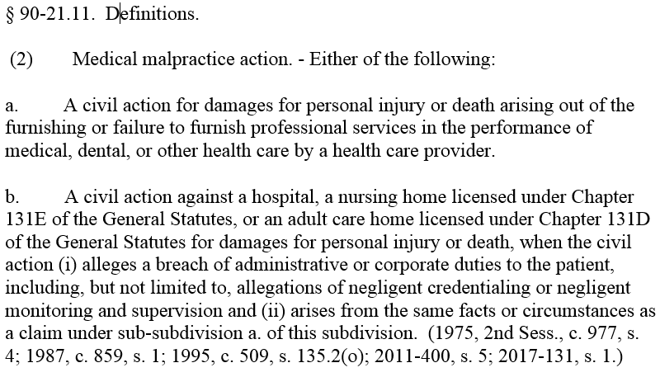
Rule 9(j)

Slide 41
“professional services”
““an act or service…involving specialized knowledge, labor, or skill[.]” Horsley v. Halifax Regional Med. Ctr., 220 N.C. App. 411, 725 S.E.2d 420, 421 (2012).
These services “aris[e] out of a vocation, calling, occupation, or employment involving specialized knowledge, labor, or skill, and the labor [or] skill involved is predominantly mental or intellectual, rather than physical or manual.” Taylor v. Vencor, 136 N.C. App. 528, 530 (2000).

Slide 42
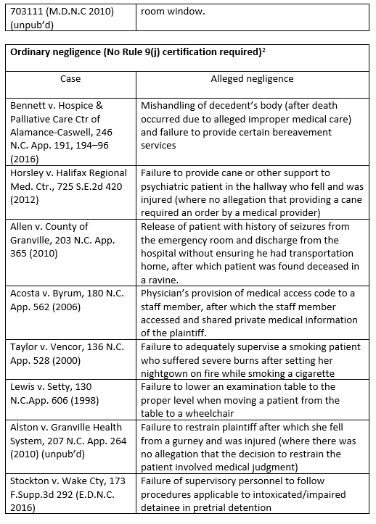
pp. 5-7

Slide 43
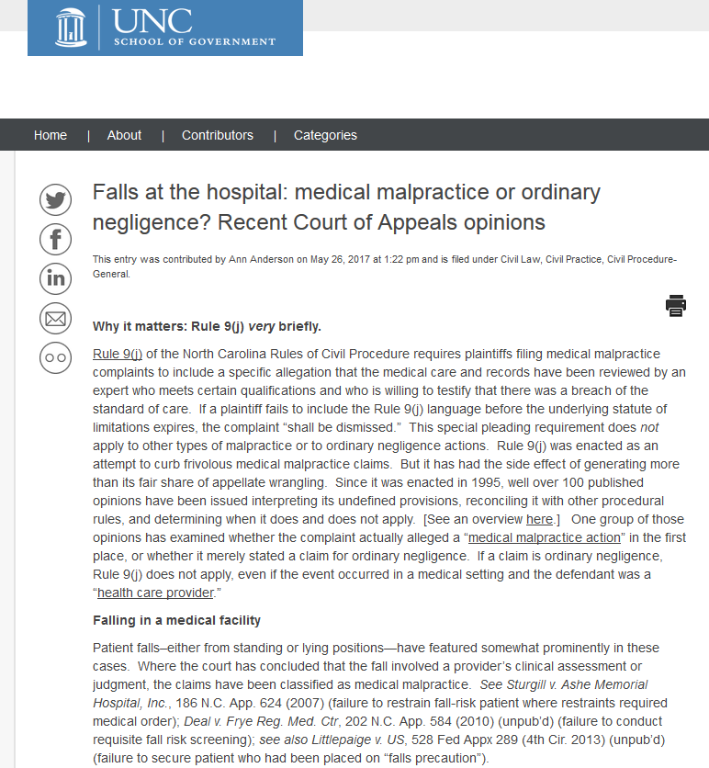
www.civil.sog.unc.edu

Slide 44
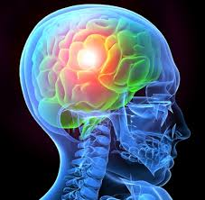
Med mal or ordinary negligence?
Gause v. New Hanover Reg. Med. Ctr. (N.C. App. Dec. 2016)
“[The X-ray] order…necessarily required [the technician] to make a clinical judgment regarding how to administer the x-ray….Whether [the technican] failed to assess Mrs. Gause or inadequately assessed her in choosing to take a standing x-ray, Mrs. Gause’ injury arose from medical malpractice[.]”
COA
No Rule 9(j) certification.
Action dismissed.
AFFIRMED.
Notes:
In its recent opinion in Gause v. New Hanover Reg. Med. Ctr., 795 S.E.2d 411 (Dec. 30, 2016), on the other hand, a Court of Appeals panel unanimously declared that a different type of fall gave rise to a medical malpractice claim. As an X-ray technician was preparing to take chest images of Mrs. Gause from a standing position, the elderly plaintiff fell straight backward, sustaining severe traumatic brain injury. The technician had observed Mrs. Gause before and during her positioning in front of the x-ray machine, but then had turned away to prepare to make the images. Discovery (including the technician’s own testimony) revealed that the technician’s clinical judgment was required in determining whether it was safe to take Mrs. Gause’s x-rays standing rather than seated or lying down. Thus the alleged negligence occurred in the context of “medical assessment or clinical judgment” and was properly classified as a medical malpractice action. Because Mrs. Gause’s complaint did not include a Rule 9(j) certification, the trial court properly dismissed it.

Slide 45
Rule 9(j)

Slide 46
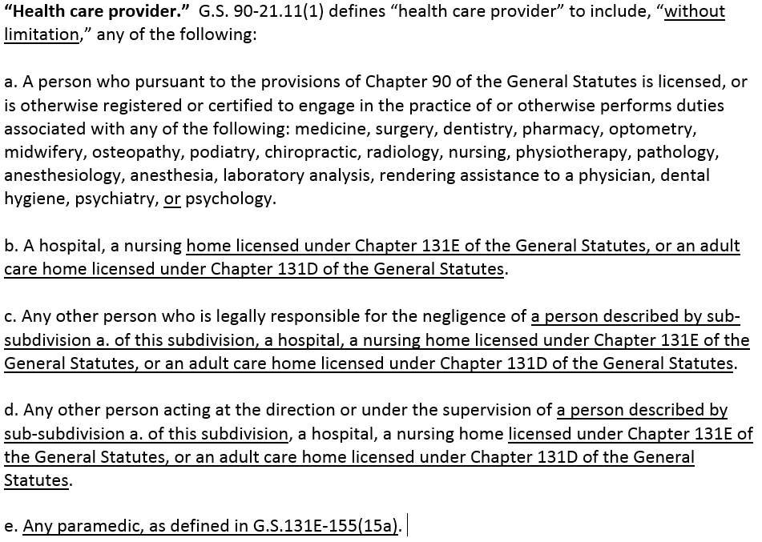
Bennett v. Hospice & Palliative Care Ctr of Alamance-Caswell, 246 N.C. App. 191, 194–96 (2016)
Estate of Baldwin v. RHA Health Services, Inc., 246 N.C. App. 58, 65–67 (2016)

Slide 47
And now let’s talk about when a Rule 9(j) certification is not required at all:
When it’s not “medical malpractice” in the first place.
When the doctrine of res ipsa applies.

Slide 48
Rule 9(j)

Slide 49
Res Ipsa Loquitur
“In order for the doctrine to apply, an average juror must be able to infer, through his common knowledge and experience and without the assistance of expert testimony, whether negligence occurred.”
“Because ‘most medical treatment involves inherent risk and is of a scientific nature,’ the doctrine has had very limited application to medical malpractice actions.”
Notes:
No Rule 9(j) certification is required if “the pleading alleges facts establishing negligence under the existing common-law doctrine of res ipsa loquitur.” “The doctrine of res ipsa loquitur applies when ‘(1) direct proof of the cause of an injury is not available, (2) the instrumentality involved in the accident [was] under the defendant's control, and (3) the injury is of a type that does not ordinarily occur in the absence of some negligent act or omission.’ ” Grigg v. Lester, 102 N.C. App. 332, 333 (1991). For the doctrine of res ipsa to apply, “an average juror must be able to infer, through his common knowledge and experience and without the assistance of expert testimony, whether negligence occurred.” Hayes v. Peters, 184 N.C. App 285, 287–88 (2007).
Because “most medical treatment involves inherent risk and is of a scientific nature,” the doctrine has had very limited application to medical malpractice actions. Id. at 288. The Court of Appeals has encouraged courts to “remain vigilant and cautious about providing res ipsa loquitur as an option for liability in medical malpractice cases other than those cases where it has been expressly approved.” Id. Prior to 2013, case language seemed to limit the doctrine to two limited circumstances: (1) injuries resulting from surgical instruments or other foreign objects left in the body following surgery; and (2) injuries to a part of the patient’s anatomy outside of the surgical field. Id. In Robinson v. Duke University Health Systems, Inc., however, the Court of Appeals stated that the doctrine can apply in other situations as well. 747 S.E.2d 321, 331 (2013), disc. rev. denied, 2014 WL 941986 (March 6, 2014). In a lengthy opinion, the court held that the doctrine was appropriately invoked in a case of a surgical colectomy during which the small intestine was mistakenly reattached to the vagina rather than the rectum. Id. at 334. The court determined that no “understanding of the requisite techniques” was necessary for the jury to determine that negligence occurred. Id. at 332. The court was unpersuaded by arguments regarding the complexities of surgical procedures and the lack of expertise of the average juror in assessing the details of human anatomy in a surgical field. Id. at 332–333. But see Cartrette v. Duke University Med. Ctr., 189 N.C. App. 403 (2008) (unpub’d) (noting that “a layperson would have no common knowledge or experience to determine that [defendants were] negligent in the way a complicated, technical neurosurgery was initiated, performed, or completed”). Robinson generally appears to expand the reach of the res ipsa doctrine in medical malpractice actions. It is, however, the only published case thus far in which the doctrine of res ipsa has been held to apply in the context of Rule 9(j) compliance. Numerous prior published and unpublished cases from the Court of Appeals and North Carolina federal district courts have rejected the use of res ipsa to substitute for compliance with Rule 9(j)’s certification requirement: In the unpublished case of Alston v. Granville Health System, 207 N.C. App. 264 (2010) (reported in table), the court determined that the doctrine applied where a patient was injured falling from a gurney while unconscious in an operating room. The court also held, however, that the case was an ordinary negligence case rather than a medical malpractice case, and therefore a Rule 9(j) certification was not required.

Slide 50
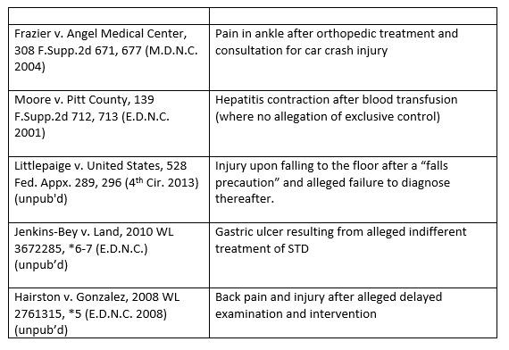
pp. 8-10

Slide 51
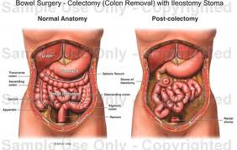
Rule 9(j): “Res Ipsa Loquitur”
p. 8
Robinson v. Duke Univ. (N.C. App. 2013)
Notes:
No medical malpractice liability unless jury finds…

Slide 52
Rule 9(j): “Res Ipsa Loquitur”
Robinson v. Duke Univ. (N.C. App. 2013)
Operation to remove part of s. intestine and reattach to rectum.
Mistakenly misconnected.
Repaired the next morning.
Malpractice action. No Rule 9(j) cert.
Notes:
Medical malpractice; Rule 9(j) and “res ipsa loquitur” Robinson v. Duke Univ., 747 S.E.2d 321 (N.C. App. 2013). During a subtotal abdominal colectomy, a surgical procedure to remove a portion of the lower intestine and reattach the intestine to the rectum using a surgical stapler, the surgeon mistakenly misconnected the intestine to the vagina. (The mistake was discovered and the procedure was corrected the following day, but the plaintiff later complained of difficulty speaking, erratic hand movements, blurry vision, and was eventually diagnosed with psychiatric conversion disorder.)

Slide 53
Rule 9(j): “Res Ipsa Loquitur”
Robinson v. Duke Univ. (N.C. App. 2013)
“res ipsa”
no “understanding of the requisite techniques” was necessary for the jury to determine that negligence occurred.
Summary judgment
for Duke & surgeons
REVERSED
Notes:
The court was unpersuaded by arguments regarding the complexities of surgical procedures and the lack of expertise of the average juror in assessing the details of human anatomy in a surgical field. But see Cartrette v. Duke University Med. Ctr., 189 N.C. App. 403 (2008) (unpublished) (noting that “a layperson would have no common knowledge or experience to determine that [defendants were] negligent in the way a complicated, technical neurosurgery was initiated, performed, or completed”). Robinson appears to expand the potential reach of the res ipsa doctrine in medical malpractice actions. It remains, however, the only published case in which the doctrine of res ipsa has been held to apply in the context of Rule 9(j) compliance. Numerous prior published and unpublished cases from the Court of Appeals and North Carolina federal district courts have rejected the use of res ipsa to substitute for compliance with Rule 9(j)’s certification requirement:

Slide 54
Rule 9(j): “Res Ipsa Loquitur”
Robinson v. Duke Univ. (N.C. App. 2013)
Hayes, Grigg:
Two situations :
Injuries from surgical instruments or other foreign objects left in the body after surgery; and
Injuries to part of the patient’s anatomy outside the surgical field.
NOT LIMITED TO THESE SITUATIONS
Notes:
The general thinking (and interpretation of case law) is that res ipsa might apply in two types of cases. -Hayes, Grigg “generally determined to apply” in only those two situations
However, any limitation of the application of res ipsa loquitur to only these two types of medical malpractice cases is not supported by the plain language of our case law. Although Hayes cautions trial courts in applying res ipsa loquitur in medical malpractice actions involving injuries other than those two categories, Hayes does not hold that these two types of cases are the only ones in which res ipsa loquitur can apply. To the contrary, the plain language of Grigg, cited by Hayes, states:
The common knowledge, experience and sense of laymen qualifies them to conclude that some medical injuries are not likely to occur if proper care and skill is used; included, inter alia, are injuries resulting from surgical instruments or other foreign objects left in the body following surgery and injuries to a part of the patient's anatomy outside of the surgical field.
Grigg, 102 N.C.App. at 335, 401 S.E.2d at 659 (emphasis added). Indeed, our Supreme Court has long held that “where proper inferences may be drawn by ordinary men from proved facts which give rise to res ipsa loquitur ..., there should be no reasonable argument against the availability of the doctrine in medical and surgical cases involving negligence[.]” Mitchell, 219 N.C. at 182, 13 S.E.2d at 245. Thus, defendants' argument that res ipsa is inapplicable in the present case because it does not involve either a foreign object left in the body following surgery or an injury to an area far away from and completely unrelated to the zone of surgery is without merit.

Slide 55
pp. 8-10

Slide 56
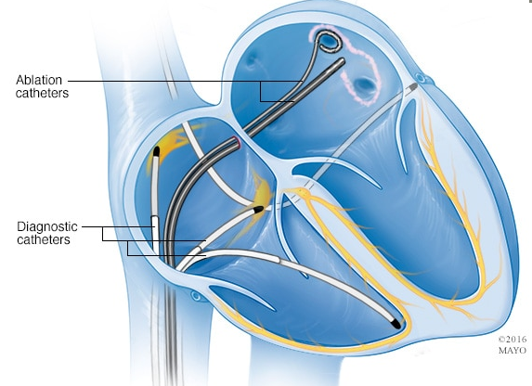
Rule 9(j) and res ipsa loquitur
p. 9
Bluitt v. Wake Forest Univ Bapt. Med. Ctr (COA April 2018)
“The procedures involved in a cardiac ablation, which is a complex medical procedure, are outside of common knowledge, experience, and sense of a layperson; thus, without expert testimony, a layperson would lack a basis upon which to make a determination as to whether plaintiff’s back injury was an injury that would not normally occur in the absence of negligence, or was an inherent risk of a cardiac ablation.”
Not a res ipsa case. Rule 9(j) certification required. Complaint properly dismissed.
Notes:
Ms. Bluitt underwent a cardiac ablation at Wake Forest to correct an irregular heartbeat. She was under general anesthesia (and thus was unconscious) during the procedure. She awoke from surgery to tremendous pain in her lower back, later diagnosed as a third-degree burn. She was treated for the burn with a skin graft. Exactly three years later she sued Wake Forest and the physician for negligence. She did not include a Rule 9(j) certification and instead relied on the doctrine of res ipsa loquitur. The trial judge granted summary judgment in favor of defendants due to Ms. Bluitt’s failure to comply with Rule 9(j). (Defendants’ motion had been supported by four affidavits from cardiac electrophysiologists explaining the risks of the procedure.) The Court of Appeals affirmed the trial court’s order. The court explained that the doctrine cannot apply when expert testimony is necessary to permit a layperson to evaluate whether the facts establish a breach of the standard of care. Here, the defendants demonstrated through testimony of specialists that burns to the back are an “inherent risk of a cardiac ablation, and can occur without negligence on the part of the physician performing the procedure.” The court concluded that the procedures in question were
“outside of common knowledge, experience, and sense of a layperson; thus, without expert testimony, a layperson would lack a basis upon which to make a determination as to whether plaintiff’s back injury was an injury that would not normally occur in the absence of negligence, or was an inherent risk of a cardiac ablation.”

Slide 57
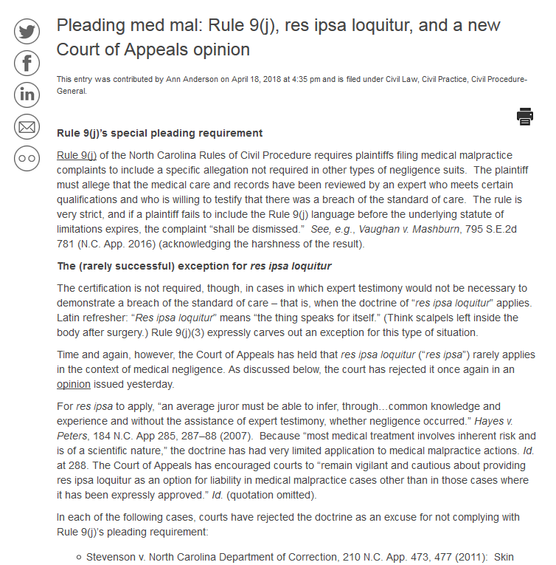
www.civil.sog.unc.edu

Slide 58
Rule 9(j) dismissals - Findings of Fact
“When a trial court determines a Rule 9(j) certification is not supported by the facts, ‘the court must make written findings of fact to allow a reviewing appellate court to determine whether those findings are supported by competent evidence… .”
-Estate of Wooden, NC App 2012
Notes:
whether the conclusions of law are supported by those findings, and, in turn, whether those conclusions support the trial court’s ultimate determination.”
Estate of Wooden v. Hillcrest Convalescent Center, 731 S.E.2d 500, 506 (N.C. App. 2012) (quoting Moore, 726 S.E.2d at 818, in which the Supreme Court stated the rule in the narrower context of determining that a plaintiff was unreasonable in expecting an expert to qualify under Rule 702). Based on the language of Wooden, the trial court should include written findings of fact when ruling that a Rule 9(j) certification is not supported by the facts in the record.

Slide 59
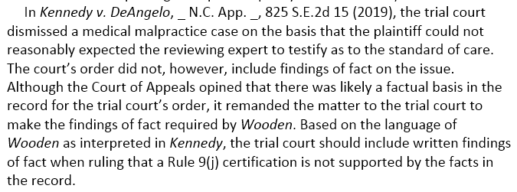
Rule 9(j) dismissals - Findings of Fact
“When a trial court determines a Rule 9(j) certification is not supported by the facts, ‘the court must make written findings of fact to allow a reviewing appellate court to determine whether those findings are supported by competent evidence… .”
-Estate of Wooden, NC App 2012
p. 3
Notes:
whether the conclusions of law are supported by those findings, and, in turn, whether those conclusions support the trial court’s ultimate determination.”
Estate of Wooden v. Hillcrest Convalescent Center, 731 S.E.2d 500, 506 (N.C. App. 2012) (quoting Moore, 726 S.E.2d at 818, in which the Supreme Court stated the rule in the narrower context of determining that a plaintiff was unreasonable in expecting an expert to qualify under Rule 702). Based on the language of Wooden, the trial court should include written findings of fact when ruling that a Rule 9(j) certification is not supported by the facts in the record.

Slide 60
Extension of S/Lims
Upon motion by the complainant prior to the expiration of the applicable statute of limitations, a resident judge of the superior court for a judicial district in which venue for the cause of action is appropriate under G.S. 1-82 or, if no resident judge for that judicial district is physically present in that judicial district, otherwise available, or able or willing to consider the motion, then any presiding judge of the superior court for that judicial district may allow a motion to extend the statute of limitations for a period not to exceed 120 days to file a complaint in a medical malpractice action in order to comply with this Rule, upon a determination that good cause exists for the granting of the motion and that the ends of justice would be served by an extension.

Slide 61
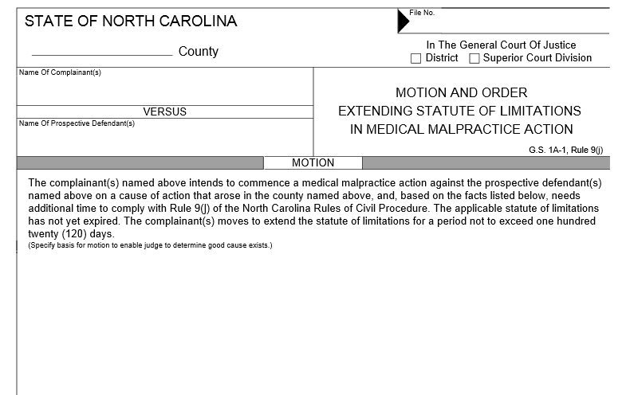
Extension of S/Lims

Slide 62
Extension of S/Lims
No extension in an existing case.
Brown v. Kindred, NC 2010
“Allowing a plaintiff to file a medical malpractice complaint and then wait until after the filing to have the allegations reviewed by an expert would pervert the purpose of Rule 9(j).”
Notes:
No extension in existing case. Once a complaint is filed that does not include a valid Rule 9(j) certification, the court has no authority to grant a 120-day extension in that case to obtain the proper certification: “Allowing a plaintiff to file a medical malpractice complaint and then wait until after the filing to have the allegations reviewed by an expert would pervert the purpose of Rule 9(j).” Brown v. Kindred, 364 N.C. 76, 84 (2010).

Slide 63
Extension of S/Lims
No “piggybacking” with Rule 3 (no 140-day extension).
Carlton v. Melvin, NC App 2010
“Rule 9(j) prevails over Rule 3 in this instance.”

Slide 64
“Reasonably expected”
Complaint dismissed unless…
(1) The pleading specifically asserts that the medical care and all medical records pertaining to the alleged negligence that are available to the plaintiff after reasonable inquiry have been reviewed by a person who is reasonably expected to qualify as an expert witness under Rule 702 of the Rules of Evidence and who is willing to testify that the medical care did not comply with the applicable standard of care; [or]
(2) The pleading specifically asserts that the medical care and all medical records pertaining to the alleged negligence that are available to the plaintiff after reasonable inquiry have been reviewed by a person that the complainant will seek to have qualified as an expert witness by motion under Rule 702(e) of the Rules of Evidence and who is willing to testify that the medical care did not comply with the applicable standard of care, and the motion is filed with the complaint[.]

Slide 65
“Reasonably expected”
Not whether the expert ultimately will qualify, but whether the plaintiff, at the time the pleading was filed, reasonably expected the witness to qualify.
Notes:
Beyond the determination under Rule 9(j) of “reasonable expectation” is the broader issue of an expert’s ultimate qualification to testify. “Whether an expert will ultimately qualify to testify is controlled by Rule 702.” Moore v. Proper, 726 S.E.2d 812, 817 (2012) (citations omitted). A discussion of the cases interpreting the requirements of Rule 702(b) is outside the scope of this chapter.
Reasonably expected to qualify” Unless a plaintiff proceeds under Rule 702(e), the Rule 9(j) certification must allege review by a person “who is reasonably expected to qualify as an expert witness under Rule 702 of the Rules of Evidence.” (See Appendix A for text of Rule 702.) This certification must occur prior to the running of the statute of limitations (or extension pursuant to Rule 9(j)), or the complaint is subject to dismissal with prejudice. Thigpen v. Ngo, 355 N.C. 198, 205 (2002) (“Rule 9(j) expert review must take place before the filing of the complaint.”); Robinson v. Entwistle, 132 N.C. App. 519, 523 (1999) (affirming dismissal where plaintiff admitted in discovery that designated expert did not meet qualifications).
Trial court’s review standard. The question for the court under Rule 9(j) is not whether the expert ultimately will qualify, but whether the plaintiff, at the time the pleading was filed, reasonably expected the witness to qualify: “In other words, were the facts and circumstances known or those which should have been known to the pleader such as to cause a reasonable person to believe that the witness would qualify as an expert under Rule 702.” Grantham v. Crawford, 204 N.C. App. 115, 118–19 (2010) (citations omitted). The question is whether “there is ample evidence in th[e] record that a reasonable person armed with the knowledge of the plaintiff at the time the pleading was filed would have believed” the witness would qualify. Morris v. Southeastern Orthopedics Sports Med. & Shoulder Ctr., 199 N.C. App. 425, 437–38 (2009). Determining what the plaintiff knew or should have known is largely a matter of examining the discovery materials, and
[T]o the extent there are reasonable disputes or ambiguities in the forecasted evidence, the trial court should draw all inferences in favor of the nonmoving party at this preliminary stage of determining whether the party reasonably expected the expert witness to qualify under Rule 702.”
Moore v. Proper, 726 S.E.2d at 817–18. Whether the plaintiff could reasonably expect the witness to qualify as an expert under Rule 702 is a question of law reviewed by the appellate courts de novo. Trapp v. Macchioli, 129 N.C. App. 237, 241 n.2 (1998). The trial court must, however, make findings of fact and conclusions of law when determining plaintiff’s expectation was not reasonable. Moore, 726 S.E.2d at 818. Beyond the determination under Rule 9(j) of “reasonable expectation” is the broader issue of an expert’s ultimate qualification to testify. “Whether an expert will ultimately qualify to testify is controlled by Rule 702.” Moore v. Proper, 726 S.E.2d 812, 817 (2012) (citations omitted). A discussion of the cases interpreting the requirements of Rule 702(b) is outside the scope of this chapter.

Slide 66
“Reasonably expected”
Whether “there is ample evidence in th[e] record that a reasonable person armed with the knowledge of the plaintiff at the time the pleading was filed would have believed” the witness would qualify.
-Morris, NC App 2009
Notes:
Reasonably expected to qualify” Unless a plaintiff proceeds under Rule 702(e), the Rule 9(j) certification must allege review by a person “who is reasonably expected to qualify as an expert witness under Rule 702 of the Rules of Evidence.” (See Appendix A for text of Rule 702.) This certification must occur prior to the running of the statute of limitations (or extension pursuant to Rule 9(j)), or the complaint is subject to dismissal with prejudice. Thigpen v. Ngo, 355 N.C. 198, 205 (2002) (“Rule 9(j) expert review must take place before the filing of the complaint.”); Robinson v. Entwistle, 132 N.C. App. 519, 523 (1999) (affirming dismissal where plaintiff admitted in discovery that designated expert did not meet qualifications).
Trial court’s review standard. The question for the court under Rule 9(j) is not whether the expert ultimately will qualify, but whether the plaintiff, at the time the pleading was filed, reasonably expected the witness to qualify: “In other words, were the facts and circumstances known or those which should have been known to the pleader such as to cause a reasonable person to believe that the witness would qualify as an expert under Rule 702.” Grantham v. Crawford, 204 N.C. App. 115, 118–19 (2010) (citations omitted). The question is whether “there is ample evidence in th[e] record that a reasonable person armed with the knowledge of the plaintiff at the time the pleading was filed would have believed” the witness would qualify. Morris v. Southeastern Orthopedics Sports Med. & Shoulder Ctr., 199 N.C. App. 425, 437–38 (2009). Determining what the plaintiff knew or should have known is largely a matter of examining the discovery materials, and
[T]o the extent there are reasonable disputes or ambiguities in the forecasted evidence, the trial court should draw all inferences in favor of the nonmoving party at this preliminary stage of determining whether the party reasonably expected the expert witness to qualify under Rule 702.”
Moore v. Proper, 726 S.E.2d at 817–18. Whether the plaintiff could reasonably expect the witness to qualify as an expert under Rule 702 is a question of law reviewed by the appellate courts de novo. Trapp v. Macchioli, 129 N.C. App. 237, 241 n.2 (1998). The trial court must, however, make findings of fact and conclusions of law when determining plaintiff’s expectation was not reasonable. Moore, 726 S.E.2d at 818. Beyond the determination under Rule 9(j) of “reasonable expectation” is the broader issue of an expert’s ultimate qualification to testify. “Whether an expert will ultimately qualify to testify is controlled by Rule 702.” Moore v. Proper, 726 S.E.2d 812, 817 (2012) (citations omitted). A discussion of the cases interpreting the requirements of Rule 702(b) is outside the scope of this chapter.

Slide 67
“Reasonably expected”
“[w]ere the facts and circumstances known or those which should have been known to the pleader such as to cause a reasonable person to believe that the witness would qualify as an expert under Rule 702[?]”
-Grantham, NC App 2010
Notes:
Reasonably expected to qualify” Unless a plaintiff proceeds under Rule 702(e), the Rule 9(j) certification must allege review by a person “who is reasonably expected to qualify as an expert witness under Rule 702 of the Rules of Evidence.” (See Appendix A for text of Rule 702.) This certification must occur prior to the running of the statute of limitations (or extension pursuant to Rule 9(j)), or the complaint is subject to dismissal with prejudice. Thigpen v. Ngo, 355 N.C. 198, 205 (2002) (“Rule 9(j) expert review must take place before the filing of the complaint.”); Robinson v. Entwistle, 132 N.C. App. 519, 523 (1999) (affirming dismissal where plaintiff admitted in discovery that designated expert did not meet qualifications).
Trial court’s review standard. The question for the court under Rule 9(j) is not whether the expert ultimately will qualify, but whether the plaintiff, at the time the pleading was filed, reasonably expected the witness to qualify: “In other words, were the facts and circumstances known or those which should have been known to the pleader such as to cause a reasonable person to believe that the witness would qualify as an expert under Rule 702.” Grantham v. Crawford, 204 N.C. App. 115, 118–19 (2010) (citations omitted). The question is whether “there is ample evidence in th[e] record that a reasonable person armed with the knowledge of the plaintiff at the time the pleading was filed would have believed” the witness would qualify. Morris v. Southeastern Orthopedics Sports Med. & Shoulder Ctr., 199 N.C. App. 425, 437–38 (2009). Determining what the plaintiff knew or should have known is largely a matter of examining the discovery materials, and
[T]o the extent there are reasonable disputes or ambiguities in the forecasted evidence, the trial court should draw all inferences in favor of the nonmoving party at this preliminary stage of determining whether the party reasonably expected the expert witness to qualify under Rule 702.”
Moore v. Proper, 726 S.E.2d at 817–18. Whether the plaintiff could reasonably expect the witness to qualify as an expert under Rule 702 is a question of law reviewed by the appellate courts de novo. Trapp v. Macchioli, 129 N.C. App. 237, 241 n.2 (1998). The trial court must, however, make findings of fact and conclusions of law when determining plaintiff’s expectation was not reasonable. Moore, 726 S.E.2d at 818. Beyond the determination under Rule 9(j) of “reasonable expectation” is the broader issue of an expert’s ultimate qualification to testify. “Whether an expert will ultimately qualify to testify is controlled by Rule 702.” Moore v. Proper, 726 S.E.2d 812, 817 (2012) (citations omitted). A discussion of the cases interpreting the requirements of Rule 702(b) is outside the scope of this chapter.

Slide 68
“Reasonably expected”
Complaint dismissed unless…
(1) The pleading specifically asserts that the medical care and all medical records pertaining to the alleged negligence that are available to the plaintiff after reasonable inquiry have been reviewed by a person who is reasonably expected to qualify as an expert witness under Rule 702 of the Rules of Evidence and who is willing to testify that the medical care did not comply with the applicable standard of care; [or]
(2) The pleading specifically asserts that the medical care and all medical records pertaining to the alleged negligence that are available to the plaintiff after reasonable inquiry have been reviewed by a person that the complainant will seek to have qualified as an expert witness by motion under Rule 702(e) of the Rules of Evidence and who is willing to testify that the medical care did not comply with the applicable standard of care, and the motion is filed with the complaint[.]

Slide 69
“Reasonably expected”
“[T]o the extent there are reasonable disputes or ambiguities in the forecasted evidence, the trial court should draw all inferences in favor of the nonmoving party at this preliminary stage of determining whether the party reasonably expected the expert witness to qualify under Rule 702.”
-Moore, NC App 2012
Notes:
Reasonably expected to qualify” Unless a plaintiff proceeds under Rule 702(e), the Rule 9(j) certification must allege review by a person “who is reasonably expected to qualify as an expert witness under Rule 702 of the Rules of Evidence.” (See Appendix A for text of Rule 702.) This certification must occur prior to the running of the statute of limitations (or extension pursuant to Rule 9(j)), or the complaint is subject to dismissal with prejudice. Thigpen v. Ngo, 355 N.C. 198, 205 (2002) (“Rule 9(j) expert review must take place before the filing of the complaint.”); Robinson v. Entwistle, 132 N.C. App. 519, 523 (1999) (affirming dismissal where plaintiff admitted in discovery that designated expert did not meet qualifications).
Trial court’s review standard. The question for the court under Rule 9(j) is not whether the expert ultimately will qualify, but whether the plaintiff, at the time the pleading was filed, reasonably expected the witness to qualify: “In other words, were the facts and circumstances known or those which should have been known to the pleader such as to cause a reasonable person to believe that the witness would qualify as an expert under Rule 702.” Grantham v. Crawford, 204 N.C. App. 115, 118–19 (2010) (citations omitted). The question is whether “there is ample evidence in th[e] record that a reasonable person armed with the knowledge of the plaintiff at the time the pleading was filed would have believed” the witness would qualify. Morris v. Southeastern Orthopedics Sports Med. & Shoulder Ctr., 199 N.C. App. 425, 437–38 (2009). Determining what the plaintiff knew or should have known is largely a matter of examining the discovery materials, and
[T]o the extent there are reasonable disputes or ambiguities in the forecasted evidence, the trial court should draw all inferences in favor of the nonmoving party at this preliminary stage of determining whether the party reasonably expected the expert witness to qualify under Rule 702.”
Moore v. Proper, 726 S.E.2d at 817–18. Whether the plaintiff could reasonably expect the witness to qualify as an expert under Rule 702 is a question of law reviewed by the appellate courts de novo. Trapp v. Macchioli, 129 N.C. App. 237, 241 n.2 (1998). The trial court must, however, make findings of fact and conclusions of law when determining plaintiff’s expectation was not reasonable. Moore, 726 S.E.2d at 818. Beyond the determination under Rule 9(j) of “reasonable expectation” is the broader issue of an expert’s ultimate qualification to testify. “Whether an expert will ultimately qualify to testify is controlled by Rule 702.” Moore v. Proper, 726 S.E.2d 812, 817 (2012) (citations omitted). A discussion of the cases interpreting the requirements of Rule 702(b) is outside the scope of this chapter.

Slide 70
Kennedy v. DeAngelo

Slide 71
Preston v. Movahed
Ratledge v. Perdue

Slide 72
“Willing to testify”
McGuire v. Riedle (2008): Plaintiff had “good faith belief” her physician would be willing to testify, but physician stated (in depo) that he was not willing
Phillips v. Triangle (2002): Expert was willing, but testimony a bit unclear about when he expressed willingness to plaintiff’s attorney
Dismissal affirmed
Dismissal reversed
Notes:
“Willing to testify.” The Rule 9(j) certification must allege review by a person “willing to testify that the medical care did not comply with the applicable standard of care.” The expert must form that willingness by the time the case is filed. In McGuire v. Riedle, 190 N.C. App. 785 (2008), plaintiff’s complaint included a Rule 9(j) certification that his treating surgeon was willing to testify regarding care the plaintiff has received in a prior surgery. Later, during discovery, the surgeon “stated that he never reviewed plaintiff's prior care and was never willing to testify as to any alleged breach of the standard of care.” The Court of Appeals affirmed the dismissal of the case, noting that “medical malpractice complaints have a distinct requirement of expert certification with which plaintiffs must comply.” Id. at 786. The plaintiff’s alleged “good faith belief” regarding the expert’s willingness to testify would not satisfy the requirement. Because the plaintiff “did not present the trial court with an expert who was ‘willing to testify that the medical care did not comply with the applicable standard of care,’” the case was properly dismissed. Id.
A complaint should not, however, be dismissed on this basis unless the record is clear. In Phillips v. A Triangle Women’s Health Clinic, Inc., 155 N.C. App. 372 (2002), the plaintiff’s expert stated in his deposition that, “[w]ell, I probably would have given [plaintiff’s attorney] an idea of whether I thought I should see the case or not. That’s about as far as I could go over the telephone.” Id. at 374. In a later affidavit, the expert stated:
From [counsel’s] prior experience with me, he is aware that I am willing to serve as an expert witness at trial on any case that I review, and at [plaintiff's] trial I would be willing to testify regarding my opinion of the appropriateness of the medical care rendered....My recollection is that in his discussion with me in May 1997, [counsel] read information to me verbatim from the patient's medical records, as well as gave me a factual outline of the medical care rendered according to [plaintiff's] medical records....Based upon the information outlined to me ... I gave [counsel] my opinion that the [injuries to plaintiff were], in my professional opinion, to a reasonable degree of medical certainty, clearly outside the applicable standard of care.
Id. at 374–75. The Court of Appeals held that the expert had never “affirmatively denied” giving his opinion over the phone, and that his later affidavit reflected “no clear contradiction” of his earlier testimony. Id. at 377. Thus the trial court erred in dismissing plaintiff’s claim based on failure to satisfy Rule 9(j). Id.

Slide 73
Constitutionality

Slide 74
civil.sog.unc.edu

