Slide 1
CHIEF DISTRICT COURT JUDGE LEADERSHIP TRAINING
September 20-22, 2017
School of Government, Chapel Hill

Slide 2

roadmap
CDJC as community convener
School Justice Partnerships
Toolbox: Toolkit for School Justice
Values and Vision
Lead with your WHY
Next steps for you
Applying tools to another issue
Legal update
Hot topics

Slide 3
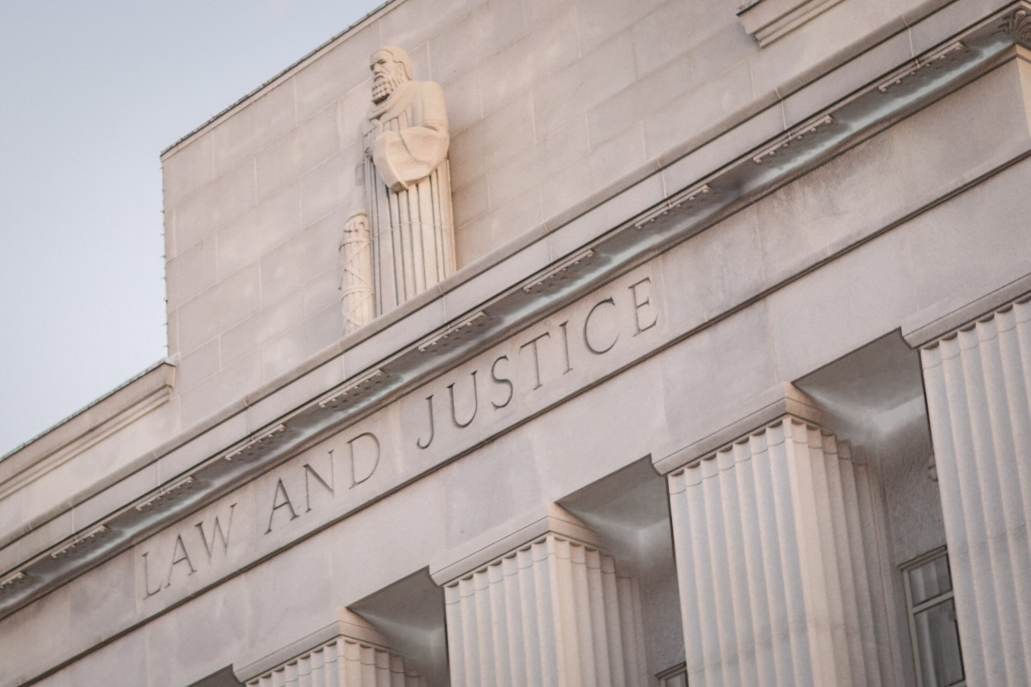
Introduction
What do you see in Juvenile or Criminal Court involving our under 18’s that shouldn’t be there?
Have you ever asked, “Is there a better way?”
Why is this issue important?

Slide 4
CHIEF DISTRICT COURT JUDGE AS COMMUNITY CONVENER
Big picture: what’s happening in your community?
Silos: your experience?
How do you see yourself?

Slide 5
“Our community is ENGINEERED to get the exact results we are getting.”
Dr. Paul Evensen
Founder of Community Systems Group
Director of Strategic Initiatives at the Wyman Center

Slide 6
…because nothing changes if LEADERS don’t change.

Slide 7
Change is hard
Leadership is harder
With opioid crisis, people are dying
So, what has to happen to help leaders change in our communities?

Slide 8
Cross-system partnerships
With you as convener!

Slide 9
The Judge as Convener
Judge Steven Teske: Lightning rod
Court is the crossroads between the systems (common denominator)
Communities increasingly look to us
It’s about leading, not judging
Key in bringing systems together
  Teske says we are the traffic cop

Slide 10
The Judge as Convener
Convening authority
Perceived convening authority

Slide 11
The Judge as Convener
Legitimacy: perceived authority in problem areas
Vision: gets the why and can share
Stakeholder knowledge: actually understands the roles, the systems
Recognizes shared failures
  The Superintendent and I

Slide 12
The Judge as Convener
Teske, quoting Judge Leonard Edwards, Santa Clara CA (NCSC Rehnquist Award Winner for Judicial Excellence 2004)
When parenting fails, when informal community responses are inadequate, our juvenile and family courts provide the state’s official intervention in the most serious cases involving children and families. We are the legal equivalent to an emergency room in the medical profession. We intervene in crises and figure out the best response on a case-by-case basis. In addition, we have to get off the bench and work in the community. WE have to ask these agencies and the community to work together to support our efforts so that the orders we make on the bench can be fulfilled. We have to be the champions of collaboration.

Slide 13
The Judge as Convener
Corpening’s version
We have to get off the bench and work in the community. We have to ask these agencies and the community to work together to support our efforts so that our children do not encounter the juvenile justice system. WE have to be the champions of collaboration. The future of our communities depends on it.

Slide 14
The Judge as Convener
Systemic change happens because of collaborative efforts by all systems’ professionals
Convener must develop shared leadership/power
Convener must overcome conflict and barriers
  Sources of conflict?
  Barriers?

Slide 15
The Judge as Convener
Strategies: NCJFCJ School-Justice Pathways to Juvenile Justice System Project: A Practice Guide (Teske again)
Shared leadership/power
  Co-create and share vision for reform
  Set the example
  Share credit/blame
  Build relationships (get to know them)
  Create open dialogue

Slide 16
The Judge as Convener
NCJFCJ Guide: Overcoming Conflict
  Be inclusive
  Prepare for conflict (and there will be)
  Create open communication on differences: emphasize listening
  Seek areas of agreement
  Take responsibility for what you own
  Focus on results: “What can we do to resolve this?”

Slide 17
The Judge As Convener
The significance of you and your relationships
District 8 experience
Difference between convener and facilitator
You need to convene. You may not need to facilitate.

Slide 18
The Judge as Convener
Cause for pause: can I convene?
Teske and Huff (2011):
“Judges often express legitimate concerns when asked about exercising a role off the bench. Obviously Judges must refer to their state’s judicial ethics rules for guidance. Most states, however, do not prohibit judges from engaging the community if it will promote a better Juvenile Justice System.”
Any concern here?

Slide 19
QUESTIONS?

Slide 20
Keeping Kids In School
Out of Court And Off The Street
Developing School Justice Partnerships

Slide 21
My Goals Today
Share our journey (and mine)
Share our agreement
Discuss implementation
Discuss other diversions
Talk about you and your journey

Slide 22
IT’S ABOUT ME
(SORT OF)

Slide 23
IT’S ABOUT RELATIONSHIPS
(and the big picture)
(with each other and with our students)

Slide 24


Taking Care of Children

Slide 25


Challenges of Inter-Agency Action

Slide 26
WHAT’S AT STAKE HERE?
(where have we been and where are we going?)

Slide 27
History of the Problem
Zero tolerance
Policy shifts: juvenile justice and education
Law enforcement in schools
Columbine
Societal trend toward litigation
Who is affected?
  Suspensions?
  Court involvement?

Slide 28
Why Is This Important?
We’ve criminalized adolescent behavior
Research on suspensions
Phillippi’s comparison: one to court and one not
Correlation to gang activity
And yes, the school to prison pipeline

Slide 29
Impact of Broad Zero Tolerance Policies on School Campus

Slide 30
Adolescent Brain Research
Frontal lobe of brain filters emotion into logical responses is not developed until age 25.
Kids are neurologically wired to do stupid things!
Kids are still under neurological construction.
Kids are being hard-wired and need positive influences such as school.

Slide 31
School Connectedness
School connectedness is a strong protective factor against delinquency. US Surgeon General. (2001). Youth Violence: A Report of the Surgeon General.
School connectedness is linked to lower levels of substance abuse, violence, suicide attempts, pregnancy, & emotional distress. Journal of School Health 72 (4).
OSS of elementary & middle school students contributes to drop-out rates. Predictors of Suspension & Negative School Outcomes: A Longitudinal Investigation (2003)

Slide 32
Why Is This Important?
Research shows a strong link between court referrals and dropout rates
Student arrested in high school is twice as likely to drop out
Student who appears in court during high school is four times as likely to drop out
Sweeten, Gary, Who Will Graduate? Disruption of High School Education by Arrest and Court Involvement. 24.4, Justice Quarterly, 462-480 (December 2006

Slide 33
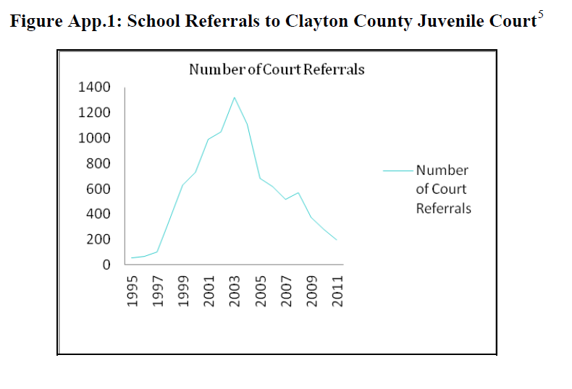
A Solution

Slide 34
New Hanover County Journey
Judge Teske and me
My superintendent and me
Assemble the team
Strategic planning day
The search for the “why”
18 months of discussions
Data review: where did we start?

Slide 35
We Agreed
Purposes
Discipline factors
Focused acts
Graduated response to misconduct
(PBIS model)
It was important to keep kids in school, out of court and off the street

Slide 36
Our Team
Chair, Board of Education
Superintendent of Schools
Deputy Superintendent
Student Support Services
Behavioral Specialist
School Safety Lead
Principal
Chief District Court Judge
District Attorney
Sheriff
SRO Supervisor
Chief of Police
Probation
Public Defender
Juvenile Services
Dept. of Social Services
Mental Health
Clergy
Parents
Professor of Education
Community Justice Services

Slide 37
Your Team
Who should we have included?
Who else/different do you need?
  What is “the why”?
  Whose work intersects the why?
  Decision makers
  More tomorrow

Slide 38
Purposes
Schools and law enforcement share responsibility for school safety and must work together with complimentary policies and procedures with the goal of a safe learning environment for everyone. This document expresses the agreement of the parties for responding to non-emergency school disruptions.
It strives to ensure a consistent response to incidents of student misbehavior, clarify the role of law enforcement in school disciplinary matters, efficiently utilize alternative support services and reduce involvement of law enforcement and court agencies for minor misconduct at school and school-related events.
While this Agreement deals with the response to non-emergency school disruptions, the parties hereto also acknowledge the importance of cooperation between school officials and law enforcement in response to emergency and safety issues.

Slide 39
Purpose
To truly address behavior
when and where it happens
Instead of pushing the behavior
out of school and never actually addressing it

Slide 40
Purpose
To return to an approach of discipline (to teach)
as opposed to punishment

Slide 41
Foundations of the Agreement
The vast majority of student misconduct can be best addressed through classroom, in-school, family and community strategies and maintaining a positive climate within schools rather than by involvement of the justice community.
The response to school disruptions should be reasonable, consistent and fair with appropriate consideration of relevant factors such as the age of the student, the nature and severity of the incident and the impact of the conduct on the learning environment.

Slide 42
Foundations of the Agreement
Students should be held accountable for their actions. When appropriate, a graduated response to minor misconduct that provides a continuum of services and increasingly more severe sanctions for continued misbehavior should be used.
Disruptive students, who do not commit more serious offenses, should receive appropriate redirection and support from in-school and community resources prior to the consideration of the involvement of the law enforcement, or referral to court. This does not excuse compliance with mandatory reporting laws and policies.

Slide 43
Discipline Factors
Age, health, risks, needs and disability or special education status of student
Intent, context, prior conduct and record of behavior
Previous interventions
Student’s willingness to repair harm
Parents’ willingness to address issues
Seriousness of incident and degree of harm
Effect on the educational environment by student’s continued presence in school

Slide 44
Focus Acts
Affray
Simple assault
Disorderly conduct
Misdemeanor larceny
Simple possession of marijuana
Possession of drug paraphernalia
Possession or smoking cigarettes under age
Damage to property
Possession/use of alcohol
Key: 2 in school year before charging

Slide 45
Now For The Real Work
Agreement signed: who joined us
Administrative Office of the Courts
Rollout
Training
Progress monitoring team
Data, data, data
On going training

Slide 46
First Year Results
CATEGORY
Arrests/citations
Juvenile complaints
Petitions approved
Teen court
School action
(Schools only)
2014/2015
245 STUDENTS
53
269
148
37
0
2015/2016
390 STUDENTS
54
141
65
73
190

Slide 47
MINDSET SHIFT

Slide 48
Supports
Teen court
16/17 pre-arrest diversion
  Assessment
  Community service
  Case management services
  Mock sentencing

Slide 49
Building Effective Cross-Systems Collaboration
The why
The who
  Who participates?
  Who leads?
The how

Slide 50
The Why
Underlying purposes: your reason(s) for doing the work
Shared some reasons for the work earlier
More this afternoon on why

Slide 51
The Who: Action Step 1
Stakeholder group
  Who votes/who advises
  Create a name
Convener(s)
Facilitator

Slide 52
The How: Action Step 2, Focus Acts
Goal: what school related offenses are we not going to refer to court?
Identify exceptions, if any
Develop clear guidelines defining the role of SROs on campus

Slide 53
Action Step 3: Identify Responses
Goal: what accountability and behavior modification measures do we have or can we acquire in response to focus acts?
Make a list!

Slide 54
Action Step 4: Graduated Responses
Goal: when do we refer a student to court?
How can we respond to first focus act?
How can we respond to second focus act?
How can we respond to third focus act?
  Is referral to court really necessary?
  What else can we do to address behavior?
  PBIS model

Slide 55
Action Step 5: Quality Control
How are we going to monitor intake of referrals for MOU compliance and to measure performance and outcomes?
What will be measured?
What data will be collected?
Who collects and measures?
Who provides oversight?
How often will the group review?
Who provides training and when?

Slide 56
Action Step 6: Interagency Agreement
Who will draft?
Signing date?
How will the agreement be promoted?

Slide 57
Action Step 7: Bridging (Post Agreement)
Goal: how will we respond to students who need more?
  Develop direct referral system to clinical or other involved services
    Problem?
  Expand mental health services delivered in schools
  Identify funding streams

Slide 58
Questions?

Slide 59
Thank You
J.H. Corpening, II
Chief District Court Judge, 5th District
Julius.h.corpening@nccourts.org

