Slide 1
What Judges Do
An Introduction to the Judicial Branch in North Carolina

Slide 2
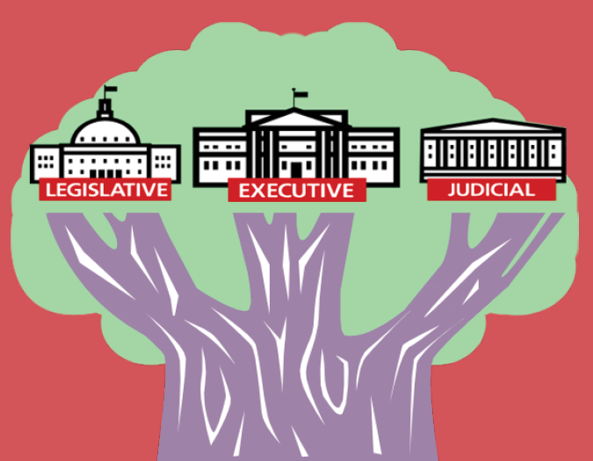
Three Branches of Government
Legislative Branch – Makes the law
Executive Branch – Enforces the law
Judicial Branch – Interprets and applies the law
“ The accumulation of all powers, legislative, executive, and judiciary, in the same hands...may justly be pronounced the very definition of tyranny.”
James Madison
Notes:
Briefly highlight the three branches and the corresponding responsibilities of each. Define “interprets” as to explain the meaning of….

Slide 3
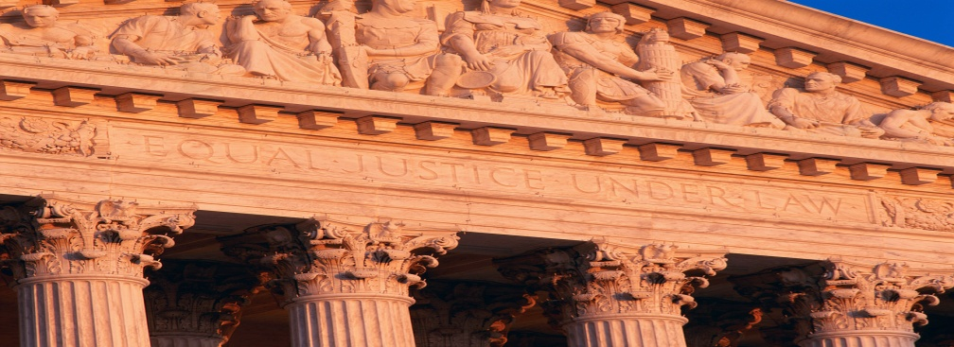
Judicial branch
The judicial branch interprets and applies the law.
Cases have to be brought before the courts. Courts do not reach down and find controversial issues to address.

Slide 4
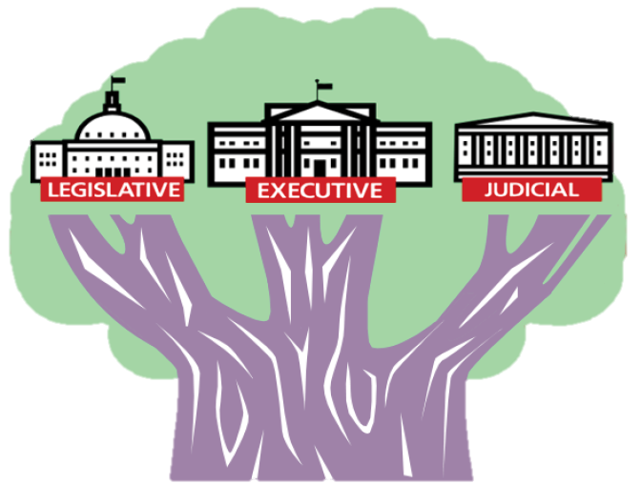
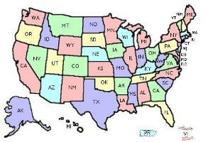
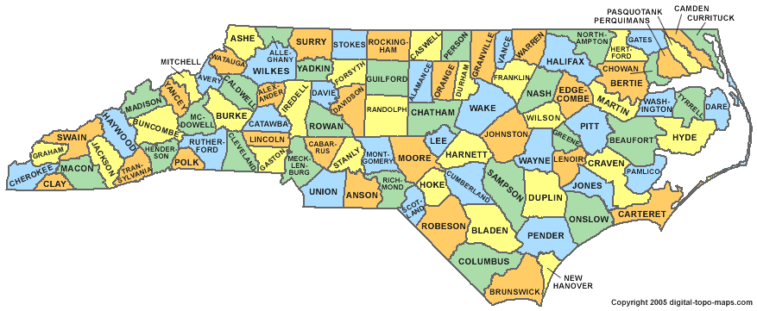
Two Court Systems
Federal
State
The judicial branch is divided into two parallel court systems: federal courts and state courts.
Notes:
The U.S. Constitution created a governmental structure known as federalism that distributes powers between the national and state governments.
http://www.uscourts.gov/educational-resources/get-informed/federal-court-basics/why-two-courts-systems.aspx

Slide 5
Judicial Branch
What is the role of the judicial branch?
The role of the judicial branch is to:
Resolve disputes through a legal process;
Interpret and apply the law;
Determine if a law is unconstitutional.
Notes:
America's courts play a crucial, unique role in our democracy. They resolve criminal and civil cases, and they protect our constitutional rights. The role of the judicial branch is to resolve disputes through a legal and fair process. The courts also have the duty of interpreting the law (or statutes etc) as well as determining if a law is unconstitutional if a party brings the case to court. (Give an example of interpreting the law here or later in the presentation. Ex: could use No Vehicles in the Park – ). Sometimes cases or issues that come before the courts to determine their constitutionality are controversial and emotionally charged. Judges need to be neutral and apply the law in making their decisions. If a law is determined to be unconstitutional, components of the law may be redrafted by the legislative branch to ensure the specific problems are addressed. Cases have to be brought before the courts in the United States to challenge the constitutionality of a law. In many countries, a Constitutional Court previews a law before it is finalized to determine if it is constitutional.

Slide 6
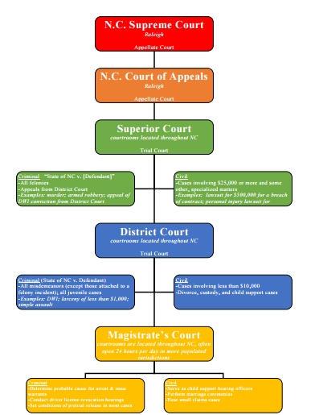
Types of Courts
Appellate Courts
Trial Courts

Slide 7
Trial Courts and Appellate Courts
The role of the courts is to interpret and apply the law.
Trial Judges
Appellate Judges
Preside over civil and criminal trials and hearings.
In court, judges make decisions and rule on testimony and evidence.
Judges also instruct jurors on applicable law.
If no jury is present, the judge decides the case based on the law and the evidence as presented, relying on the judge's knowledge and expertise in the law.
Review cases on appeal from the trial courts, with a focus on questions of law.
Read briefs and hear oral argument on issues of legal merit.
Determine whether errors of law occurred in the trial court; make decisions based on legal arguments of how the law should be applied and interpreted.
Author the opinion of the court, for both the majority and minority.
Notes:
Briefly highlight the role of judges and differentiate the role of trial judges from appellate judges.

Slide 8
Judicial Decision-Making
Judges should be fair and impartial in applying the law.
Judges must follow the law:
  US and State Constitutions
  Case law/Precedent
  Statutory Law*
  Sentencing guidelines*
  Court Procedures/Rules
  Code of Judicial Conduct
Notes:
Highlight the accountability of judges and how they make their decisions.

Slide 9
What a Judge doesn’t do
Judges are not law enforcement officers (that would be the executive branch). A judge is not a prosecutor (that would also be the executive branch). Judges don't arrest people or try to prove them guilty.

Slide 10
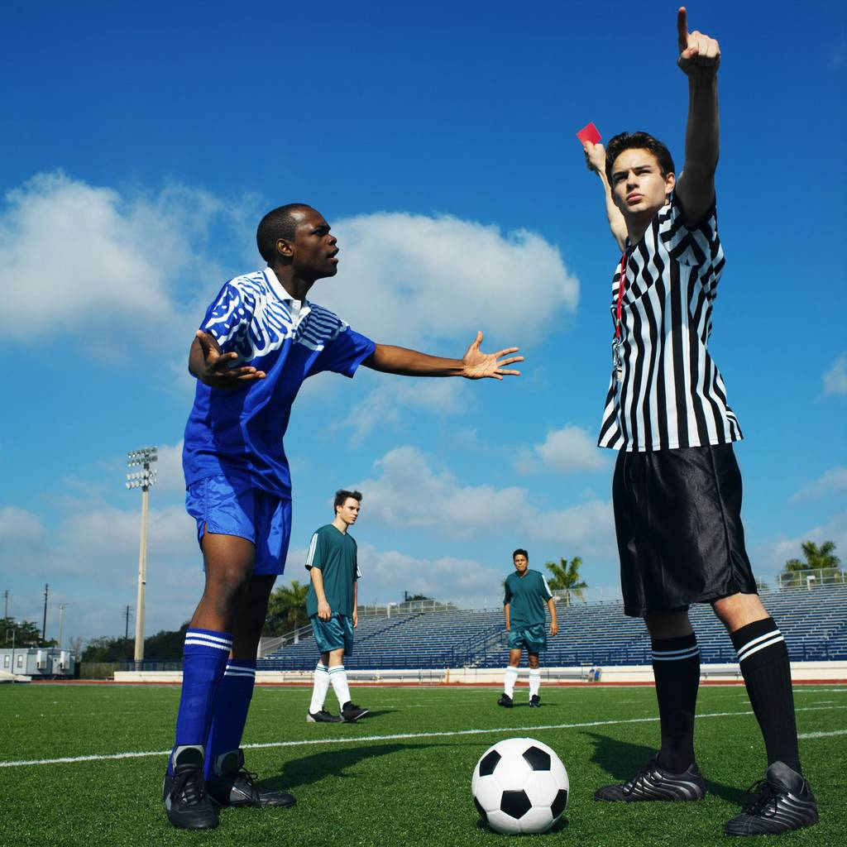
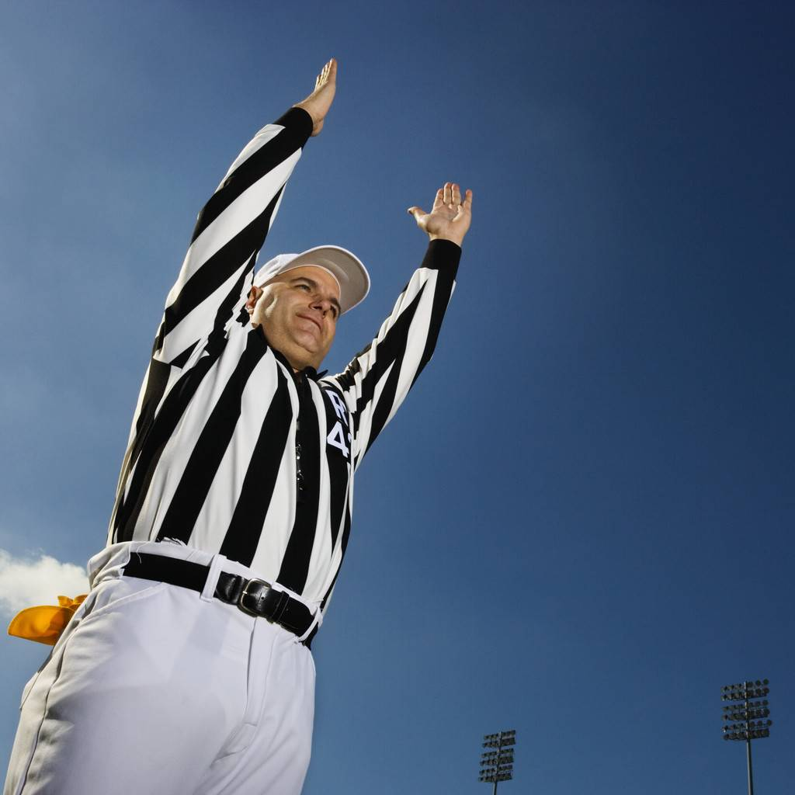
Following the rules
When you go to a football, baseball or basketball game, or a soccer tournament, or any sports event, what do you expect from the referee or umpire?
Notes:
Compare judges to a referee or umpire. Judges do not make the laws as referees do not make the rules. But they have to apply the law in their ultimate decisions.
Just as a referee has to apply the NFL rules when calling a play. What characteristics do you want to have in a referee to a game?

Slide 11

Facts and law
Judges are sometimes compared to umpires in baseball or referees in football or basketball. Their role is to see that the rules of court procedures are followed by both sides. They should rule, according to the facts and law—without regard to which side is popular (no home field advantage), without regard to who is "favored," without regard for what the spectators want, and without regard to whether the judge agrees with the law.

Slide 12
Something to think about…
How are judges different from other elected officials?

Slide 13
How are judges different from other elected officials?
  Other elected officials make decisions based on the needs/desires of their constituents or voters, their own beliefs, or their political party’s agenda.
  Judges must
  follow the law
  and should
  not be influenced
  by politics, special interest groups, money, public opinion or their own personal beliefs.
  They should be fair and impartial.
Notes:
So that is what the courts do…. now let’s examine how judges are different from other elected officials in our governmental structure. What do you think….how are judges different from other elected officials? Differentiate between judges and other elected officials such as legislators. Make sure the audience understands that this is the way our system is designed.

Slide 14
The Role of Judges

Slide 15

Prior to the American Revolution….
Notes:
Before the American Revolution, courts in the colonies were seen as instruments of oppression. Juries could be locked up until they reached the "right" decision. Judges were seen as puppets of the king.

Slide 16

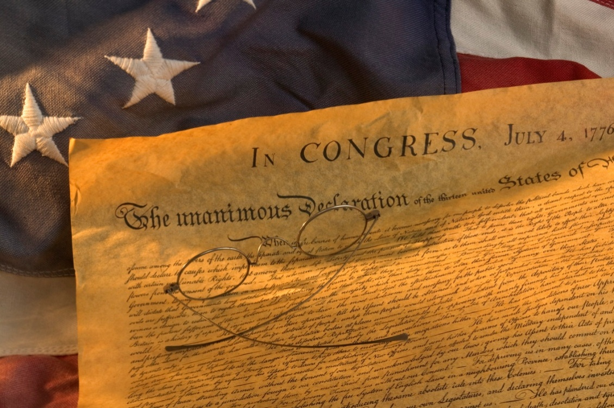
How it all started…
“He (King George III) has made Judges dependent on his Will alone for the tenure of their offices, and the amount and payment of their salaries.”
Colonial
Era
Judges selected by the King.
Colonists outlined complaints in the Declaration of Independence citing how the King abused power and controlled the judiciary.
Notes:
Why would this be a problem?
So if a judge ruled against what the King wanted, then they would lose their jobs. The King would just select new judges that would rule the way he wanted. After a while, what would happen?
Judges would no longer base decisions on the rule of law but rather on what the King desired!
If judges ruled based only on the desires of the King (or the Legislature or the President or the Governor) then how would our government be different?

Slide 17
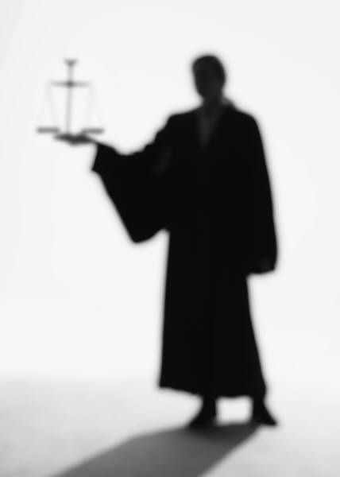
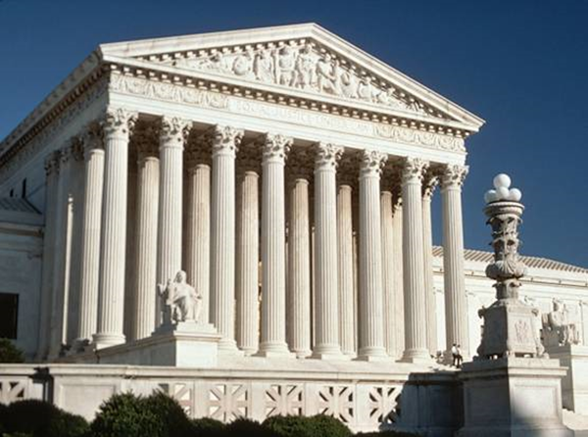
Characteristics of Judges
When you walk into the courtroom and face the judge…
…what qualities or qualifications are most important to you?
Notes:
Ask participants now to consider the qualities and characteristics as well as qualifications they want to see in judges. No matter what the case, when you walk into the courtroom to face a judge, what qualities or characteristics are most important to you?
Can be done as a large group or in small group discussions.

Slide 18
Characteristics of Judges
What characteristics are most important to you?
  Legal/Judicial Job Experience
  Educational background
  Character/ Ethics
  Disciplinary record as a judge or lawyer
  Service to the community
  Respect of colleagues
  Open minded
Knowledge of the law
Impartial/Unbiased
Fair
Attentive
Respectful/Understanding
Honesty/Integrity
Professionalism
What else would you add?
Notes:
Then in small groups have them come up with their top three choices for the group. Each group will present their responses. The presenter will tally votes on chart paper at the front of the room. Then highlight the top three choices for the full class.

Slide 19
The Role of Juries
Judges make decisions based on the law and ensure court rules and procedures are followed.
Juries are the trier of fact.

Slide 20
Importance of jurors
Right to trial by jury is a constitutional right
Appears in both the US Constitution and Bill of Rights
Essential to democracy
Most direct participation in government that most people may have.
Critical role in the administration of justice.

Slide 21
NC Constitution Article 1
Sec. 24. Right of jury trial in criminal cases.
No person shall be convicted of any crime but by the unanimous verdict of a jury in open court, except that a person accused of any criminal offense for which the State is not seeking a sentence of death in superior court may, in writing or on the record in the court and with the consent of the trial judge, waive jury trial, subject to procedures prescribed by the General Assembly. The General Assembly may, however, provide for other means of trial for misdemeanors, with the right of appeal for trial de novo. (2013-300, s. 1.)
Sec. 25. Right of jury trial in civil cases.
In all controversies at law respecting property, the ancient mode of trial by jury is one of the best securities of the rights of the people, and shall remain sacred and inviolable.

Slide 22
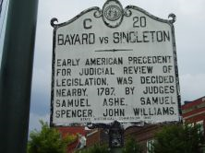
Judicial Review
Bayard v Singleton is a landmark North Carolina court case that set precedent for the exercise of judicial review. The court’s acknowledgement that legislatures could not make laws that violated state constitutions, and the case’s eventual decision, angered many on both sides of the argument.
Notes:
Bayard v. Singleton, a landmark North Carolina court case that set a precedent for the exercise of judicial review, was decided in New Bern in November 1787. In that year, Elizabeth Cornell Bayard filed suit to reclaim lands and property of her father, Samuel Cornell, which had been confiscated at the close of the American Revolution because of Cornell’s loyalist sympathies. The property had been purchased in 1784 for £2,160 by New Bern merchant Spyers Singleton.
Cornell, a New Bern merchant and member of William Tryon’s Royal council, and perhaps the wealthiest man in North Carolina on the eve of the Revolution, had fled the colonies in April 1775 for London. In December 1777 he attempted to return, but was refused the right to land at New Bern when he would not take a loyalty oath to the United States. He then transferred his property to his wife and daughter in order to avoid confiscation under the restrictions that had been placed upon Loyalist properties. Nevertheless, his landholdings were confiscated, with the proceeds from the sale of Cornell’s house reportedly paying for the expenses of the North Carolina delegates to the Constitutional Convention in Philadelphia.
Attorney and future governor Samuel Johnston filed Mrs. Bayard’s lawsuit for her, assisted by fellow future governor William R. Davie. Singleton retained the services of former governor Abner Nash and preeminent attorney and future United States Supreme Court Justice Alfred Moore. Singleton apparently attempted to hire James Iredell. However, Iredell was opposed to the confiscation acts in principal and refused to actively participate.
Bayard’s attorneys argued that the 1785 confiscation acts passed by the state violated a provision set forth in the state’s 1776 constitution that guaranteed anyone a trial by jury in a case involving the potential of loss of landholdings or property. The case was heard by the court of conference, the forerunner to the North Carolina Supreme Court, by judges Samuel Ashe, Samuel Spencer, and John Williams. The court was faced with a troubling situation. Although it appeared clear that the confiscation acts did indeed violate the state constitution, there was no real precedent in the 1780s for a court to refuse to enforce a legislative act. Abner Nash moved to have the case dismissed, but the court chose to delay their decision, awaiting a hopeful out-of-court settlement and providing time for the General Assembly to repeal the acts.
The Assembly chose not to repeal the confiscation acts during the November 1787 session but concluded that the court had the right to hear the case. In response, Iredell published To the Public, proclaiming the right of judicial review. The court ultimately took the case, and reluctantly agreed that they could not enforce an act that violated the state constitution, thus sending the case into the trial phase. Nevertheless, the court decided quite controversially against Bayard after finding a loophole in the prosecution’s case, stating that Cornell was actually an alien and therefore could not have owned land in the first place.
The court’s acknowledgement that legislatures could not make laws that violated state constitutions, and the case’s eventual decision, angered many on both sides of the argument. Richard Dobbs Spaight, a signer of the Constitution, denied openly in the press that the courts had any right to deem a legislative action unconstitutional. Nevertheless, the Bayard v. Singleton opinion of the court was widely published and distributed to attorneys, setting a precedent for judicial review within the American legal system.
References:
William S. Powell, ed., Dictionary of North Carolina Biography, I, 121-122, and V, 352-353—sketches by Eva Burbank Murphy
William S. Powell, ed., Encyclopedia of North Carolina (2006)
Hugh T. Lefler, ed., North Carolina History as Told by Contemporaries (1934)
Blackwell P. Robinson, William R. Davie (1957)
Willis P. Whichard, Justice James Iredell (2000)
The court’s acknowledgement that legislatures could not make laws that violated state constitutions, and the case’s eventual decision, angered many on both sides of the argument.

