Slide 1
Finding Your Why
Chief District Court Judge Leadership Training
September 20-22, 2017
School of Government, Chapel Hill

Slide 2
Where we’ve been
Reviewed leadership lessons from 9 years
You as a convener
Relationships
Case study from New Hanover
Facilitation skills
Stakeholder mapping
Technical assistance tools

Slide 3
But what drives you?

Slide 4
We need to find your why

Slide 5
Finding your Why
Three words
What
How
Why

Slide 6
The What
Easy to be task oriented and focus on …..
THE WHAT

Slide 7
The What
instruction
successful event
DONE!

Slide 8
The What
Emmett can help

Slide 9
The What

Slide 10
The How
Lots of leaders get the What
Less get the How
THE HOW

Slide 11
The How
advice
successful event
DONE!

Slide 12
The How
The Master Builder can help

Slide 13
The How

Slide 14
The Why
Most start with the what

Slide 15
The Why
Inspired leaders start with the Why: Lead inside out

Slide 16
The Why
Apple
Gateway, Dell

Slide 17
The Why

Slide 18
The Why

Slide 19
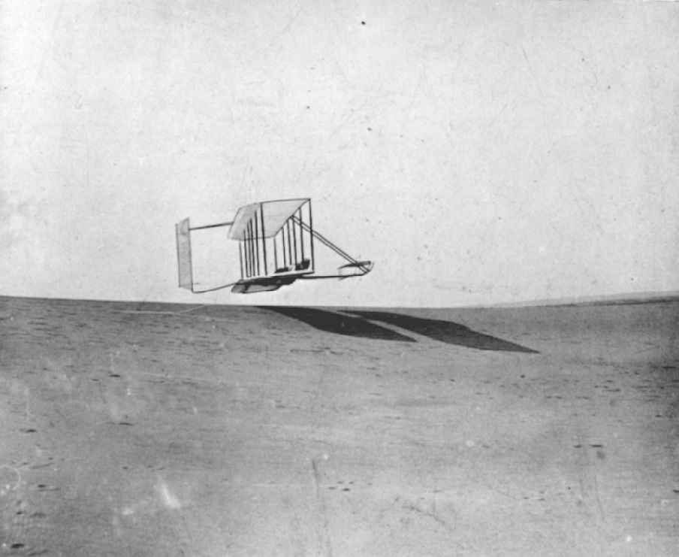
The Why

Slide 20
The Why

Slide 21
The Why
Emmett (son) can help

Slide 22
The Why

Slide 23
So, what’s your why?
Let’s stop
Reflect
Write it down

Slide 24
Time to share

Slide 25
Have You Found It?
Find it
Lead inside out
Change lives

Slide 26
Questions?

Slide 27
Next Steps
Identify your team
Convene, ask for commitment
Identify meeting place: not the courthouse
The plan for going statewide
Train the trainer for those interested

Slide 28
Next Steps
Logistics
Room set up
Tips for starting a meeting
Agendas
Handouts
Time allocation
Facilitator/convener

Slide 29
Questions?

Slide 30
Thank You
J.H. Corpening, II
Julius.h.corpening@nccourts.org

