Slide 1
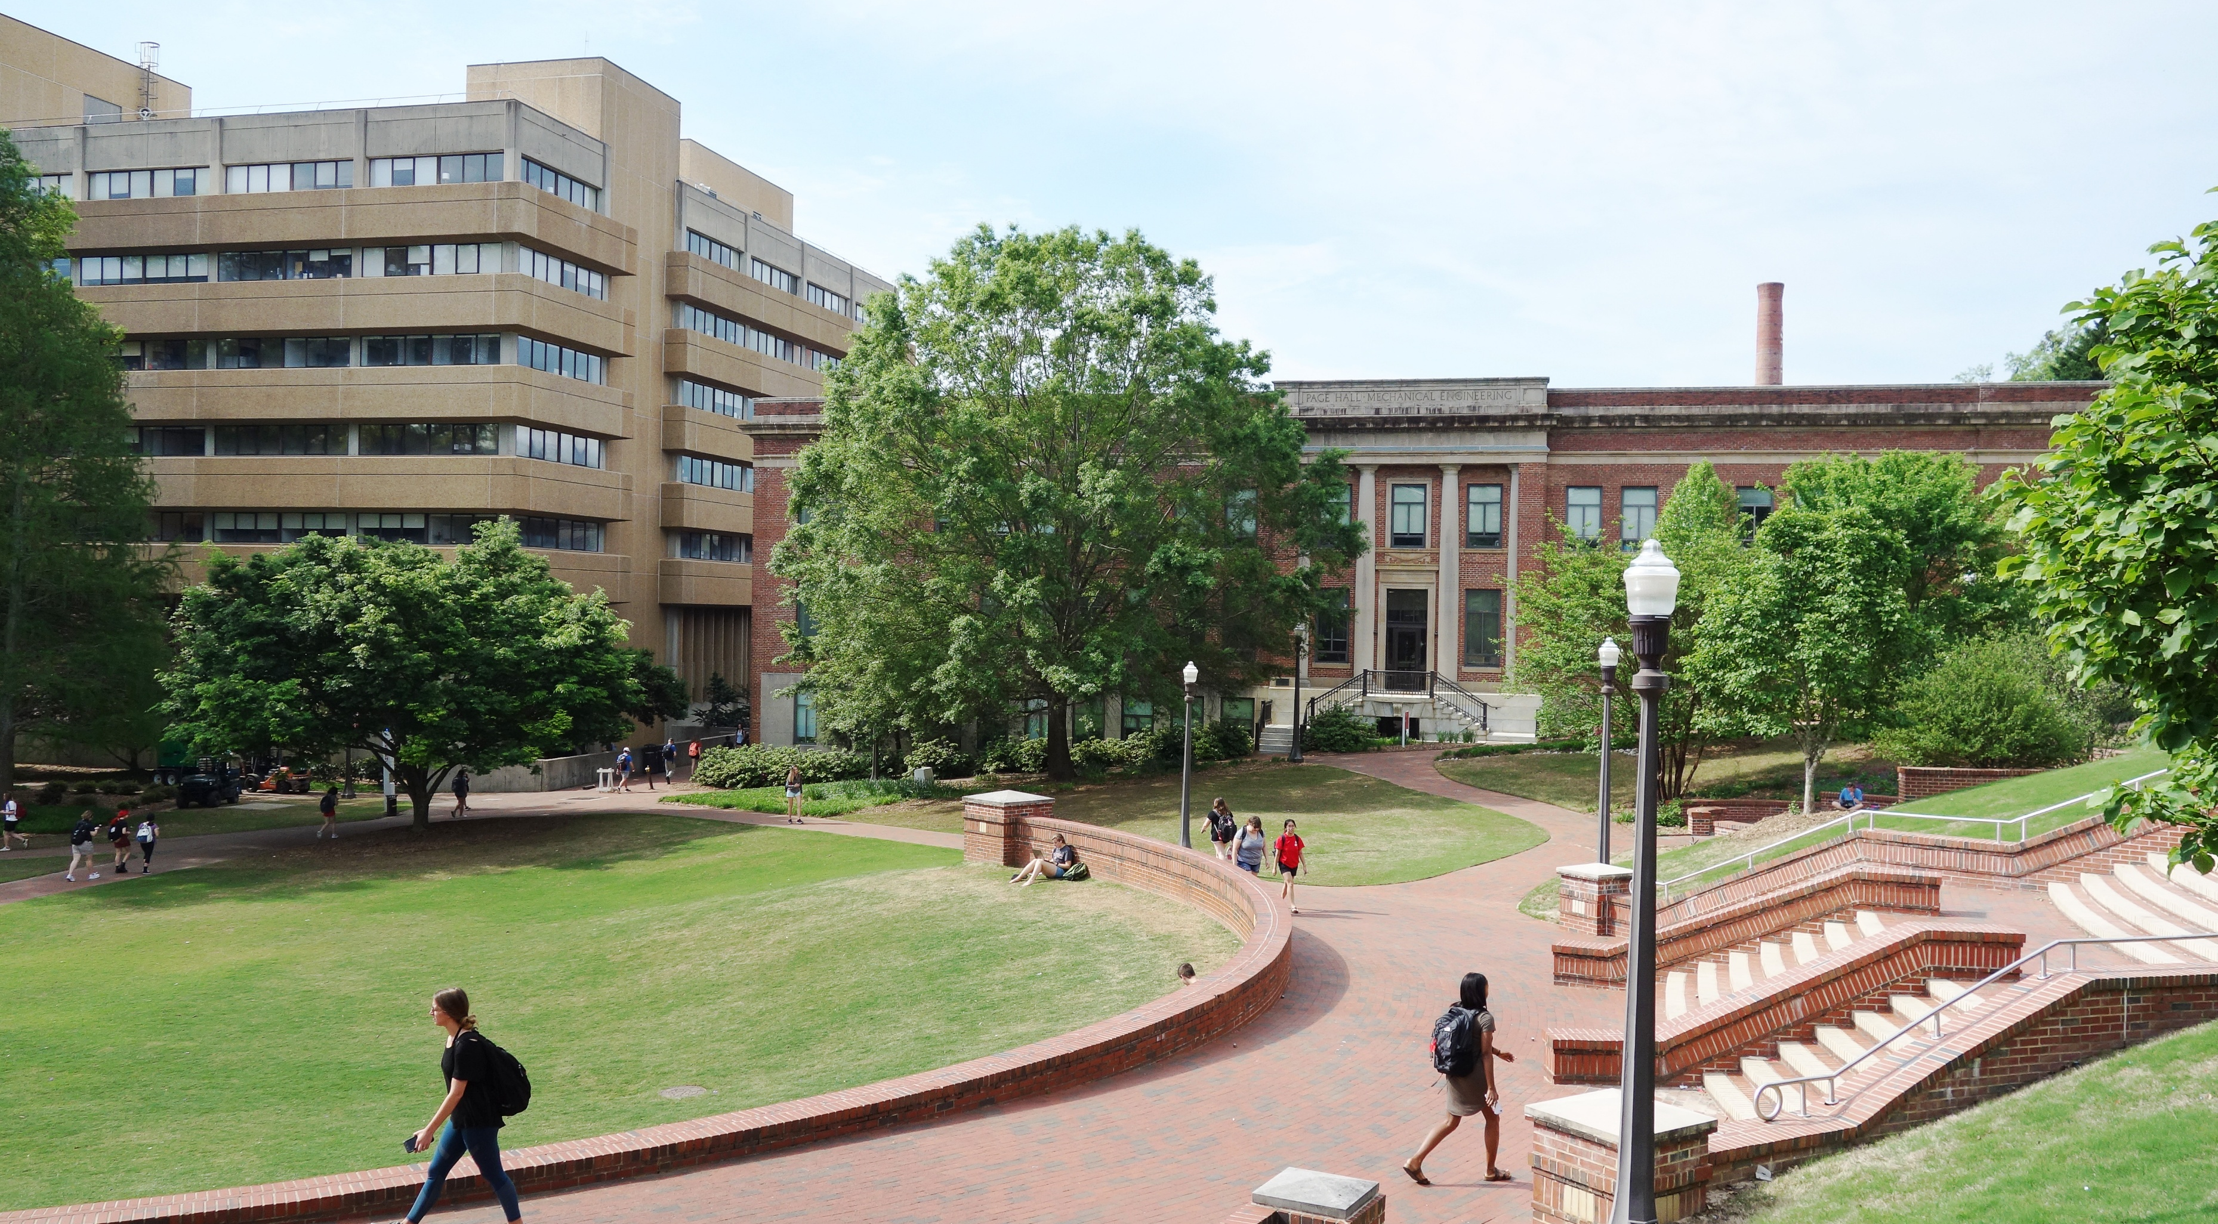

WELCOME
BOARDS OF TRUSTEES

Slide 2
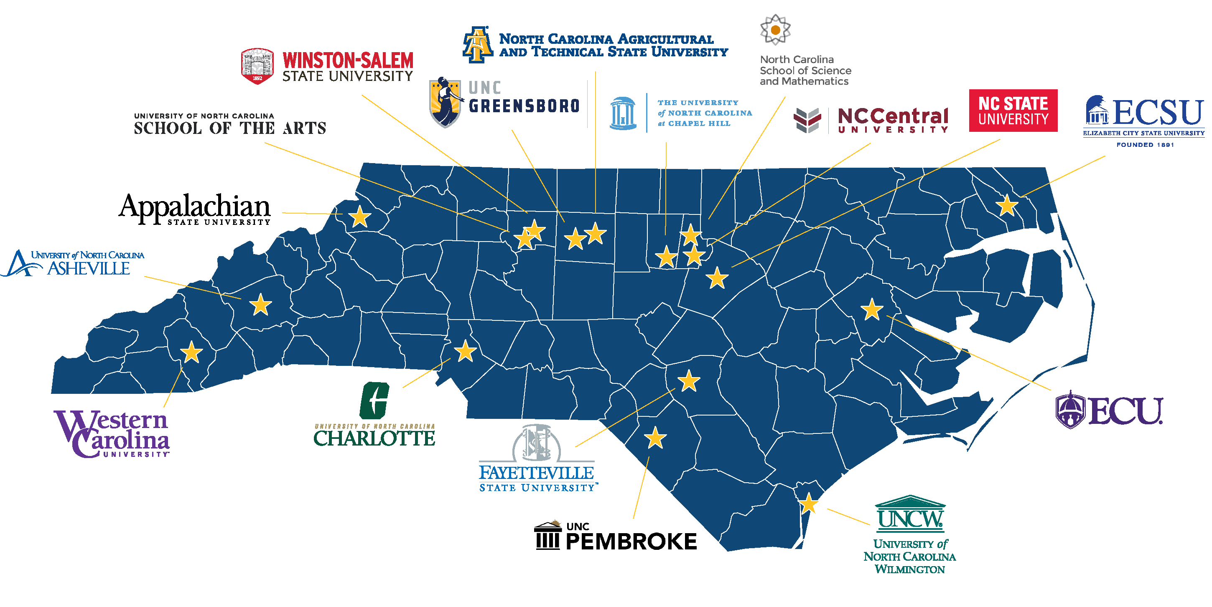
256,438
17
STUDENTS ENROLLED
INSTITUTIONS

Slide 3





Boards of Trustees Responsibilities
Tuition and fees requests; all-funds budget; capital projects
Institutional risk management / compliance monitoring
Strategic planning & implementation
(The mission)
Faculty tenure & promotion
Naming of buildings & programs

Slide 4




Leadership Principles for Trustees
Understand governance
Lead by example
Think strategically
Support students and institutions

Slide 5
Governance
House
Senate
University of North Carolina
Board of Governors
System President
24 Members (12 House, 12 Senate)
System Chancellors
17 Campus Boards of Trustees

Slide 6




Slide 7




Strategic Plan
Access
Student Success
Affordability & Efficiency
Economic Impact & Community Engagement
Excellent & Diverse Institutions
Increase access for underserved populations
Increase undergraduate and graduate student success
Increase affordability
Increase contribution to the state’s critical workforces
Improve the employee experience
Increase university productivity
Improve student mental health
Increase research productivity
Improve faculty and staff retention
Increase military partnerships

Slide 8

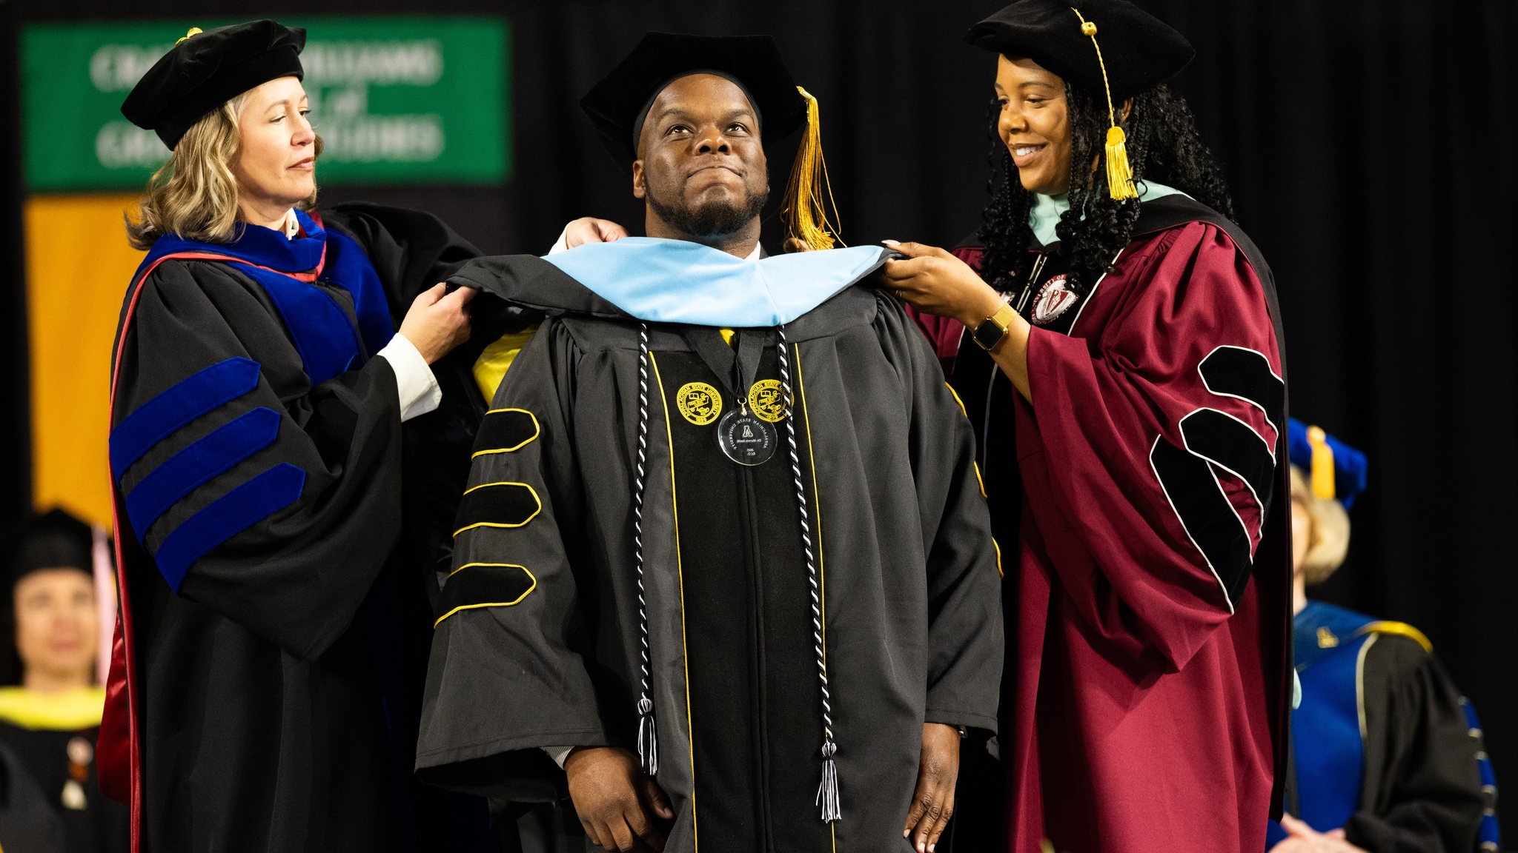

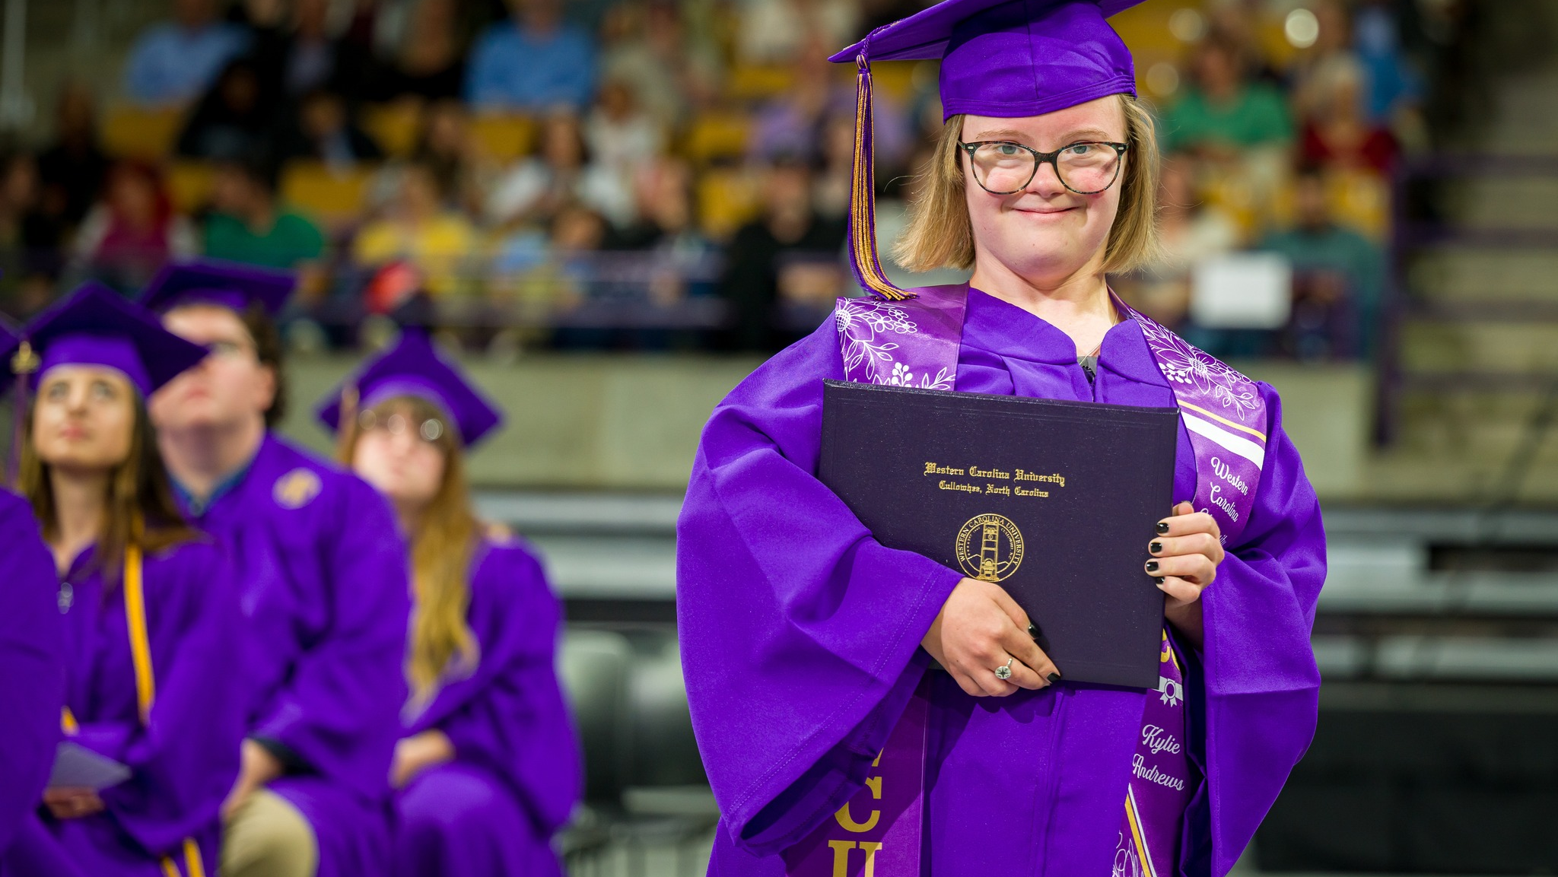
Core Performance Metrics
Four-year graduation rate
55% 2020-21 | 56.9% 2023-24
for first-time, full-time freshmen.
Undergraduate degree efficiency
24.7 2020-21 | 24.7 2023-24
or the number of degrees awarded per 100 FTE students, including part-time and transfer students.

Slide 9
Core Performance Metrics
First-time student debt at graduation
$12,785 2020-21 | $9,924 2023-24
accrued by in-state students at their institution.
Transfer student debt at graduation
$11,402 2020-21 | $8,919 2023-24
accrued by NCCCS and UNC System transfer students at their current institution.
Notes:
debt accrued at current institution for NCCCS and UNC System transfer students

Slide 10

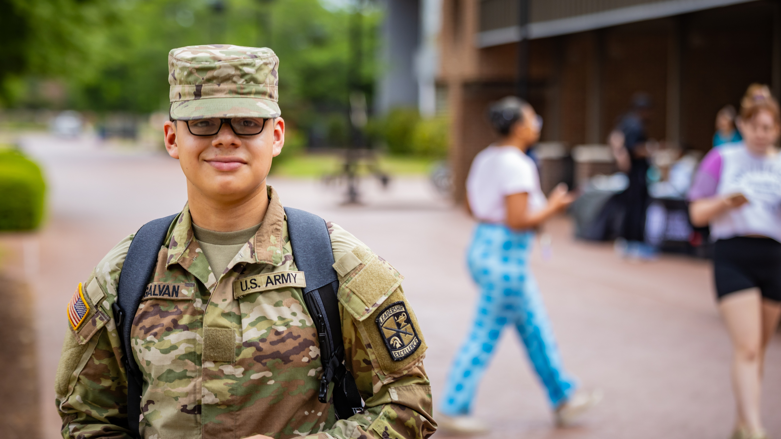


More Performance Metrics
Health sciences/ STEM degrees and certificates
26,451 2020-21 | 28,352 2023-24
Graduates who go on to work in NC public schools
4,618 2020-21 | 6,127 2023-24
Military enrollment
20,455 2020-21 | 22,197 2023-24

