Slide 1

The NC Water Allocation Study : a report for city and county attorneys
Notes:
Study background

Slide 2
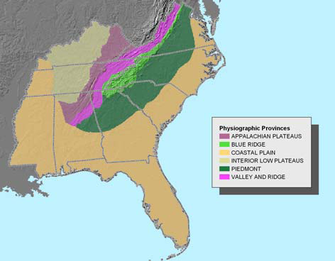

Our (region’s) big water challenge: growth in areas lacking water storage
A huge percentage of the South’s population, growth and economic prospects lies in the piedmont . . .
. . . a region with good average precipitation, but small streams and low yields from groundwater .
Ralottanham
Result: low resilience; high susceptibility to drought; almost certain escalation in conflict over water unless growth stops.

Slide 3
Want conflict over water quantity?
Litigation over releases from Randleman Lake
Land use issues around proposed Little River reservoir
Va Beach transfer from Roanoke
Public concern over new Boone intake
Eno voluntary CUA
Disagreements over Kerr water supply
TVA lake level issues
Central coastal plain CUA
Concern about inflows and intakes around Falls Lake
Cone of depression in lower Cape Fear
Concern about Atlanta’s water needs
Litigation over IBT to Concord/Kannapolis
Fight over Alcoa dams on Yadkin
Intake and allocation disputes at Lake Jordan

Slide 4
Conflict will increase:
Water consumption in the Southeast
Water consumption in the Southeast grew 15% from 1990 to 2000, compared with 2% nationwide.
The population rose by 20% from 1990 to 2000 vs.13% in the rest of the country.
By 2030, daily water use in NC will increase by 35%.
Projected growth in the Southeast from
1990 to the near future.
US EPA

Slide 5
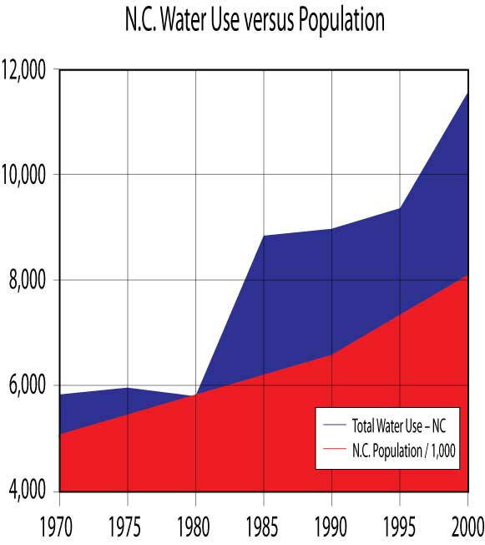
?
Conflict will increase:
Water consumption in NC
Notes:
Where will water use go as population continues to rise? We have some ability to control that, but only the rate of increase.

Slide 6
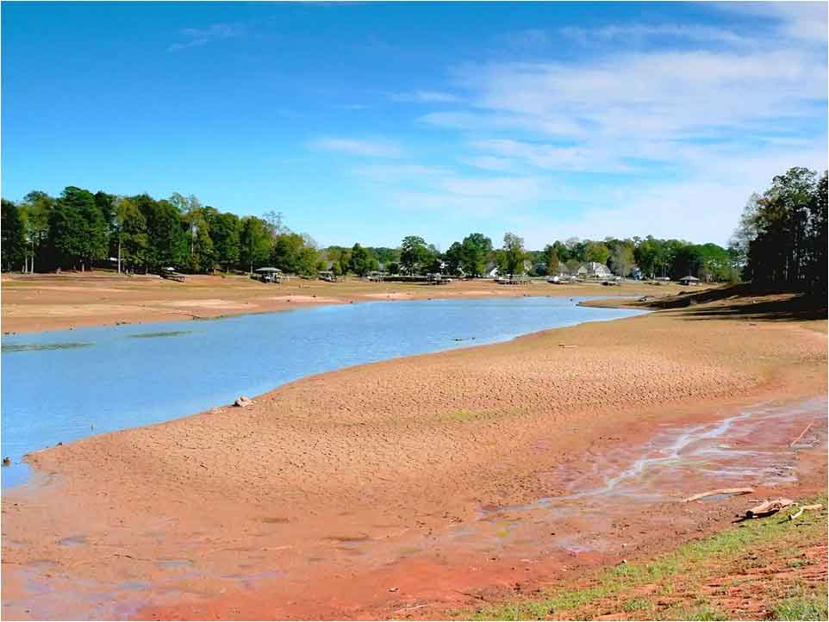
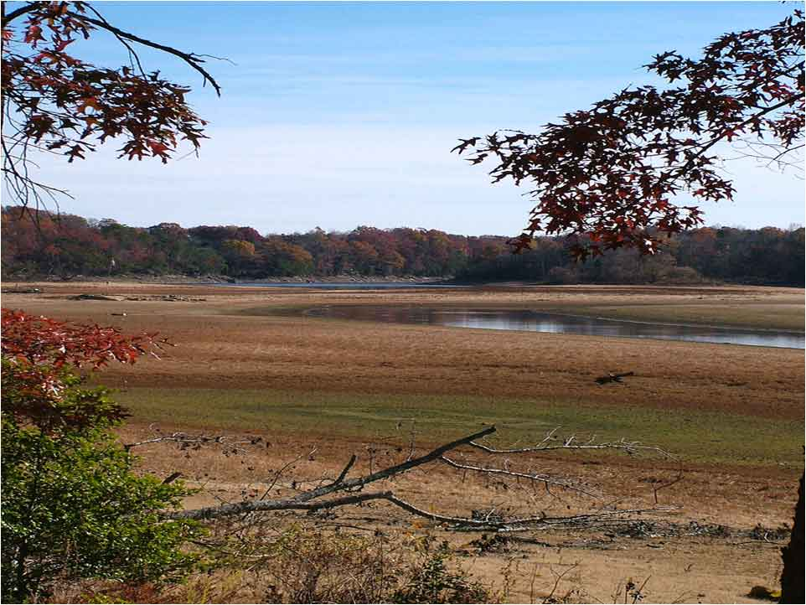
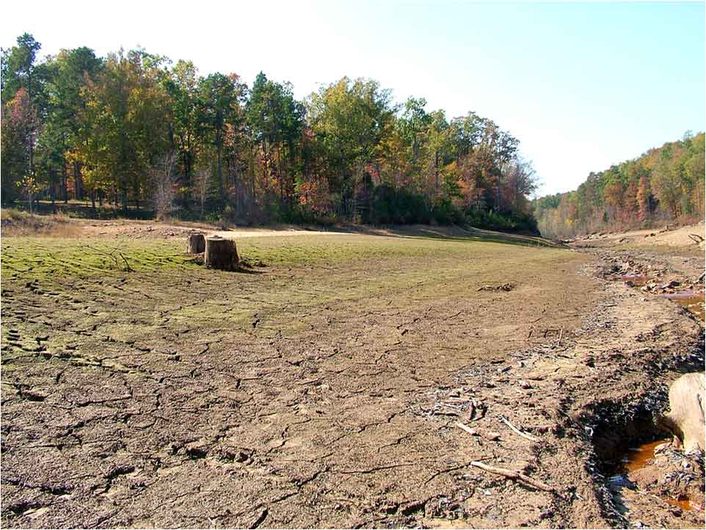
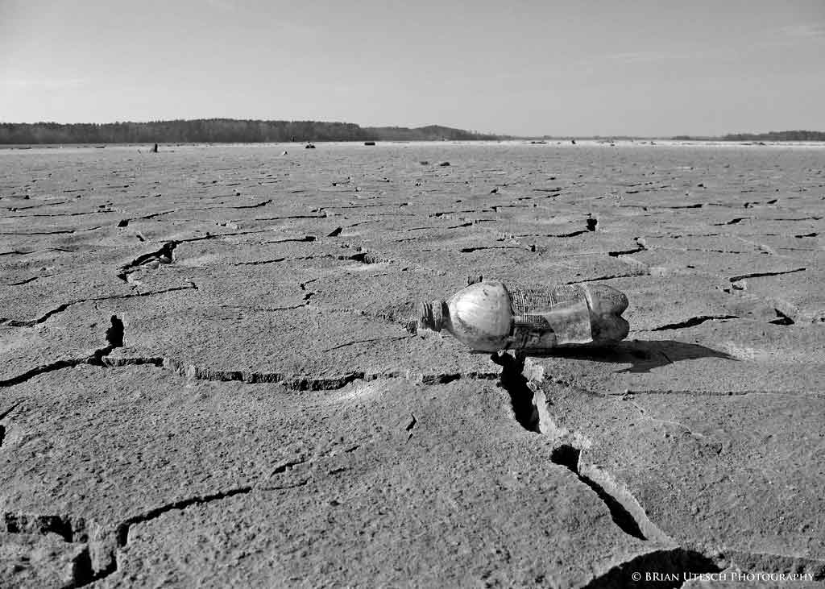
Good precipitation, low resilience
Rocky Mount’s water reservoir
September 2007
Lake Michie, Durham County
October 2007
Little River, Durham County
October 2007
Falls Lake
December 2007
Notes:
Study not triggered by drought, but droughts of the last 8 years bring the long-term problem into focus.

Slide 7
What problems does this raise at the state (and regional) level?
Scenario 1: Stream dries up from withdrawals
Scenario 2: Wells dry up from withdrawals
Scenario 3: City overcommits
Scenario 4: No good local new supply options

Slide 8
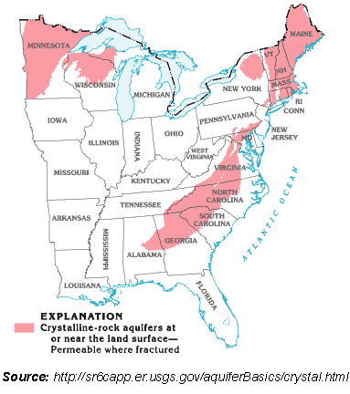
Other regions are better prepared to handle water conflict
Great Lakes Compact
Global context: severe water shortages in many places, including southwestern U.S., will make assured fresh water THE critical economic asset
Institutional context: Carolinas are behind in water management
SuSusquehanna, Delaware Compancst
TVA
Water management districts

Slide 9
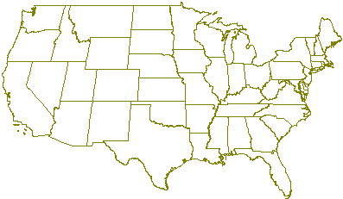
WAS recommended solution: establish water budgets and appropriation (permit) process to keep withdrawals within budget
Prmt
Prmt
Prmt
Prmt
Prmt
Western prior appropriation system controls water withdrawals
Prmt
Prmt
Prmt
Prmt
Prmt
Prmt
Prmt
Prmt
Prmt
Prmt
Prmt
Prmt
Prmt
Prmt
Prmt
In most of the east, outside the Carolinas and Alabama, a permit system for large withdrawals helps control water conflict.

Slide 10
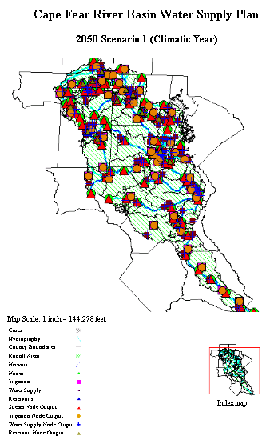
Models can help ensure adequate water supply and avoid all four problem scenarios.
River basin models
We need to build the legal and institutional framework to use these models and ensure an adequate water supply
The report explains how we recommend doing this….

Slide 11
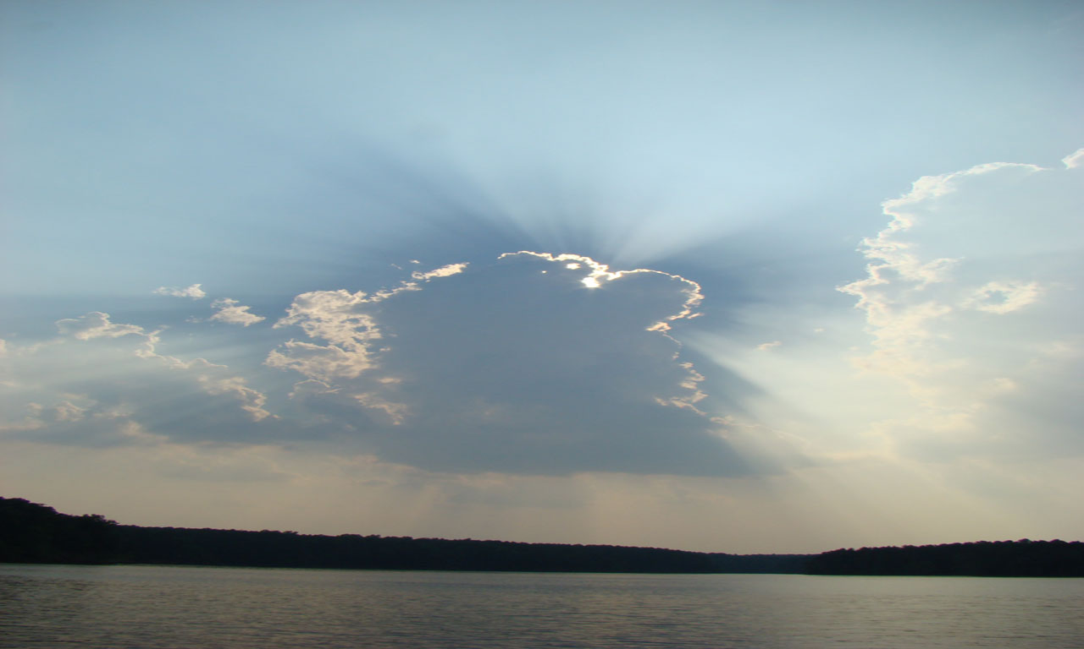
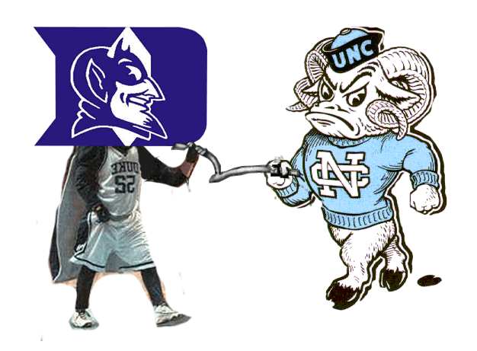
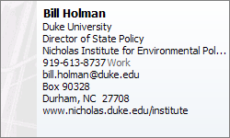

For the full report and to leave your comments, go to the Water Wiki:
http://water.unc.edu
Falls Lake
June 2008

