Slide 1
Water Management Regulatory Programs
Interbasin Transfer, Drought Management and Capacity Use
William Kreutzberger/CH2M HILL
(bill.kreutzberger@ch2m.com)
2009 Summer Conference
NC Association of Municipal Attorneys
Atlantic Beach, NC
August 1, 2009

Slide 2
Agenda
NC IBT Law
  Background
  IBT Process (Until 2007 changes)
Drought Management
  2007 Rules
  2008 Legislative Changes
Capacity Use Area
  Background
  Central Coastal Plain CUA
W112002002CLT

Slide 3
“Water links us to our neighbor in a way more profound and complex than any other."
-John Thorson

Slide 4
State Regulations
Interbasin Transfer Act
Water Use During Drought Regulations
Water Use Act
Water Withdrawal Registration
State Environmental Policy Act
Division of Environmental Health Approval
Section 401 Water Quality Certification
Dam Safety Law
Notes:
I usually go over a more complete list even if I don’t talk about all of them.

Slide 5
What is an interbasin transfer?
An interbasin transfer is…
...the movement of surface water from one river basin into another.
- NC Division of Water Resources

Slide 6
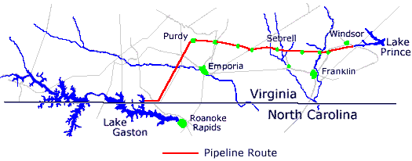
The image most people have when they think about interbasin transfer!
Notes:
I usually start IBT with these 2 slides on how people preceive IBT vs the reality.
76 mile pipeline 60 mgd capacity.

Slide 7
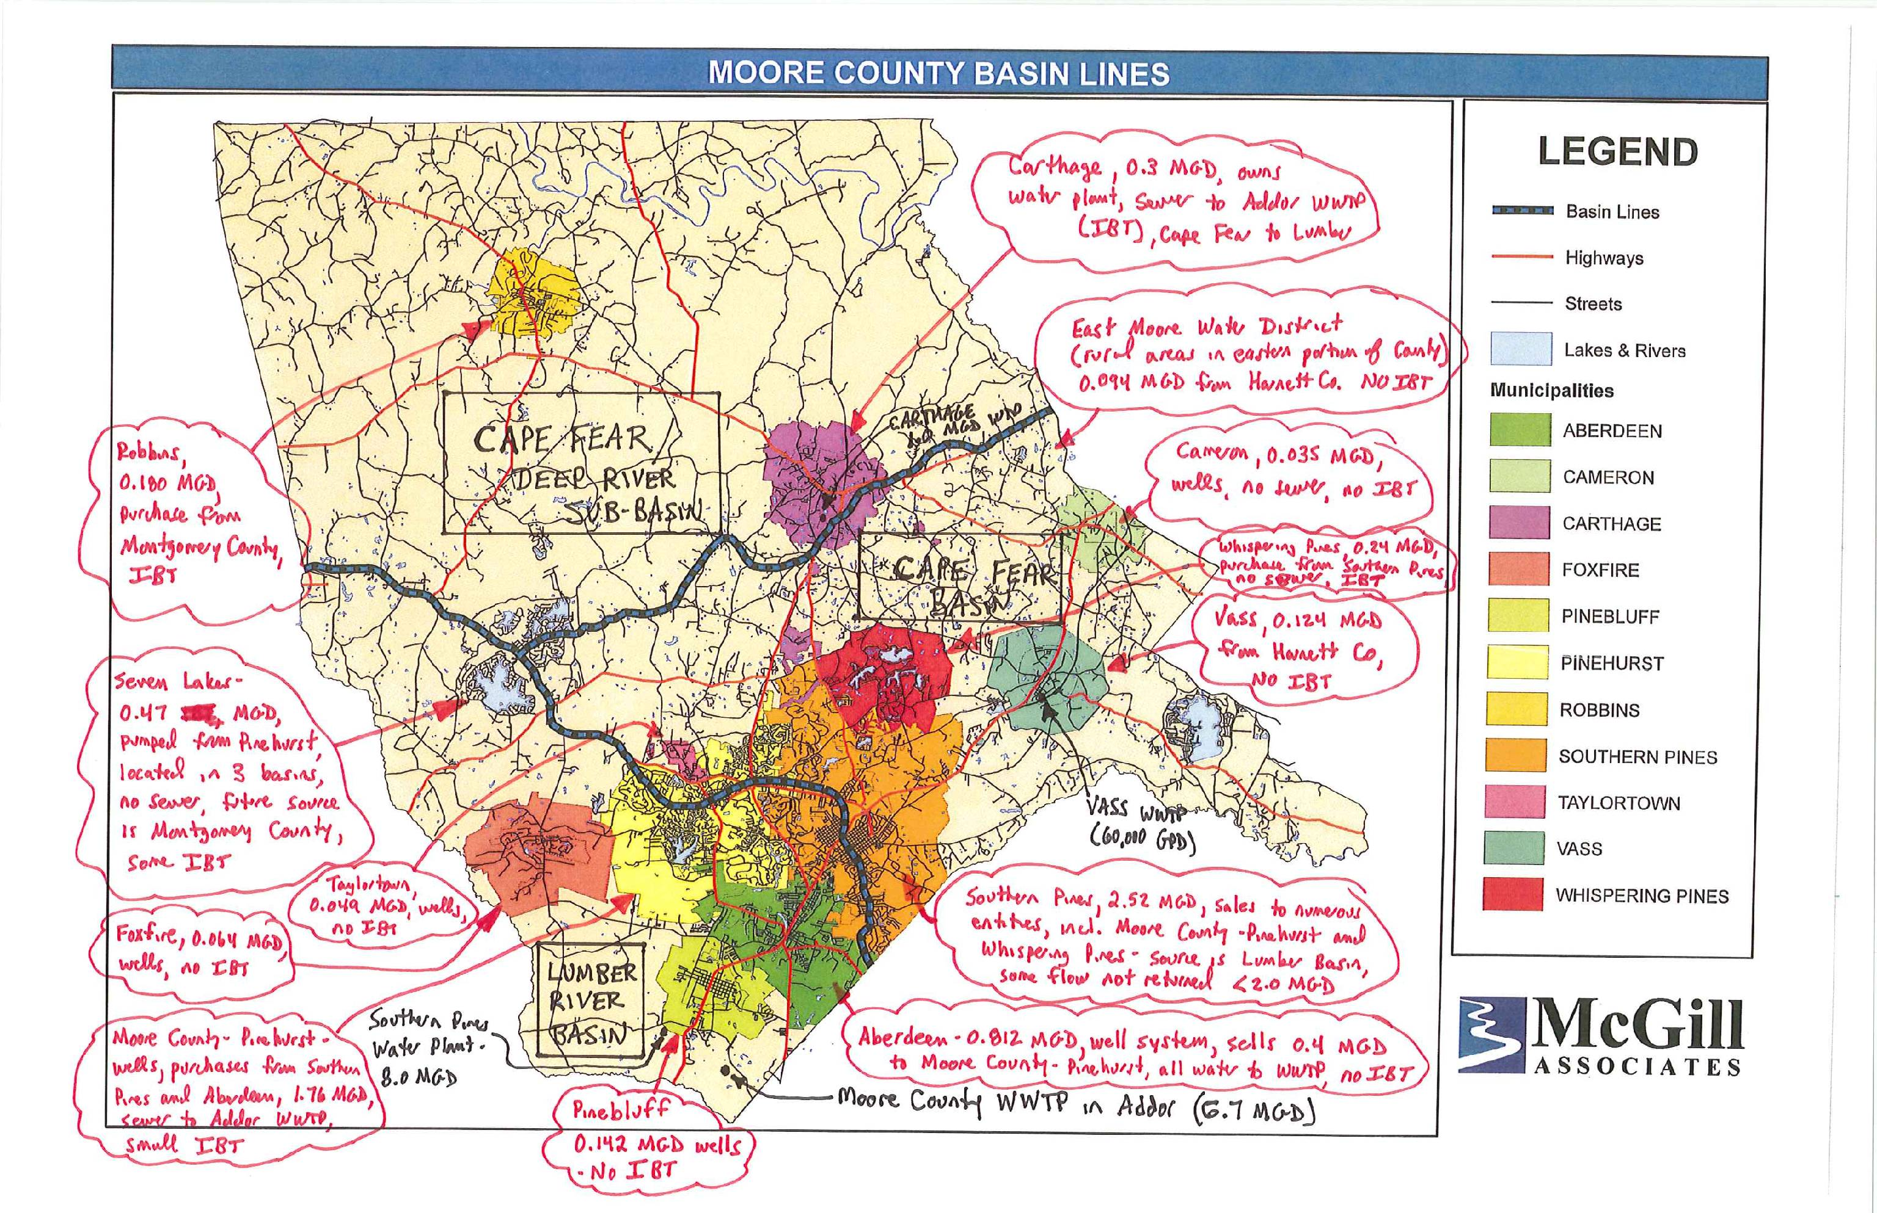
Reality of Most IBTs – Complex and Many Interconnections
Notes:
The NC reality (I suspect the same is true in SC).
Real example of a work product that DWR received for the Moore County Water & Sewer Master Plan (Pinehurst) Multiple interconnections 3 basins. (Lumber flow into SC).
Bill I realize you might not want to use a figure from McGill.

Slide 9
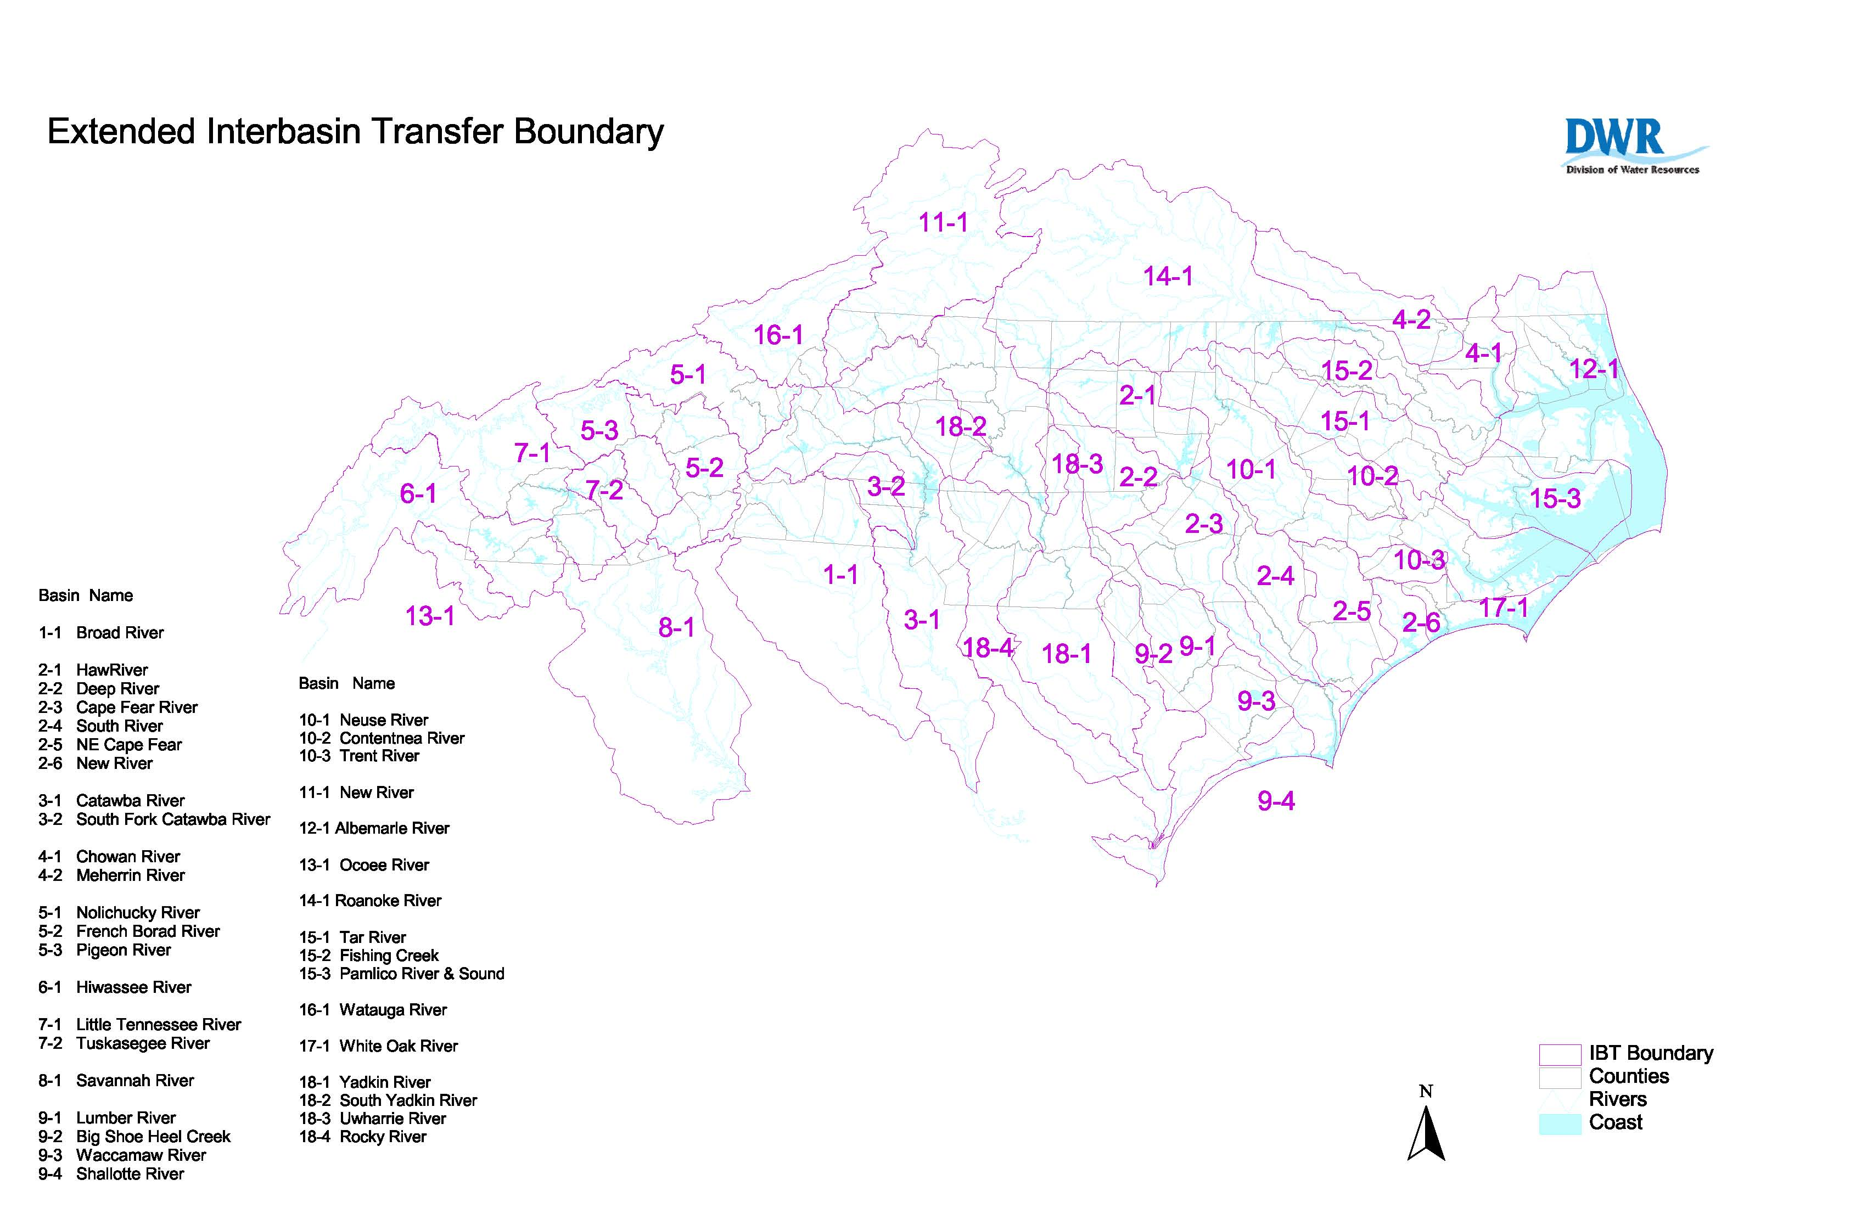
Notes:
Suggest dropping one of the IBT maps and replacing it with the extended boundaries map.

Slide 10
NC IBT General Information
Based on General Statute requirements dating back to 1988
Significant amendments in 1993, 1998, and 2007
Transfers based on 38 subbasins
State Environmental Policy Act (SEPA) Process required
Required information in Water Supply Plan Updates
  Plans required every 5 years since 1992
Burden of proof on applicant that benefits of IBT outweigh detriments
Certificate has no time limit
IBT typically based on a 30 year projection of water use

Slide 11
How much are you allowed to transfer?
The amount granted by an Environmental Management Commission (EMC) certificate
OR
Without a certificate, the larger of:
  Up to 2 million gallons per day (mgd)
  July 1, 1993 maximum day capacity to transfer (“grandfathered” capacity)
  1.25 times 1993 average daily transfer (ADT)
Transfer Regulation is based on Maximum Day!!!

Slide 12
Examples of Transfers

Slide 13
Existing IBTs Overview – North Carolina
Over 100 IBTs identified
  Range from <0.01 mgd up to 785 MGD
  85 of these are less than 2 MGD
  Grandfathered amounts have been officially determined for 21 IBTs
Four certificates issued
  Authorizing 6 transfers

Slide 15
Issued IBT Certificates
Piedmont Triad Regional Water Authority
  30.5 MGD transfer from the Deep River basin to the Haw River and Yadkin River basins
  Approved December 1991
Towns of Apex, Cary, Morrisville and Wake County
  24 MGD transfer from the Haw River basin (Cape Fear) to the Neuse River basin
  Approved July 2001
Charlotte-Mecklenburg Utilities
  33 MGD transfer from the Catawba River basin to the Rocky River basin
  Approved March 2002
Cities of Concord and Kannapolis
  10 MGD from the Catawba River basin to the Rocky River basin
  10 MGD from the Yadkin River basin to the Rocky River basin
  Approved January 2007

Slide 16
NC IBT Certificate Approval Process Prior to 2007 Amendments
Process requires 4 to 6 years

Slide 17
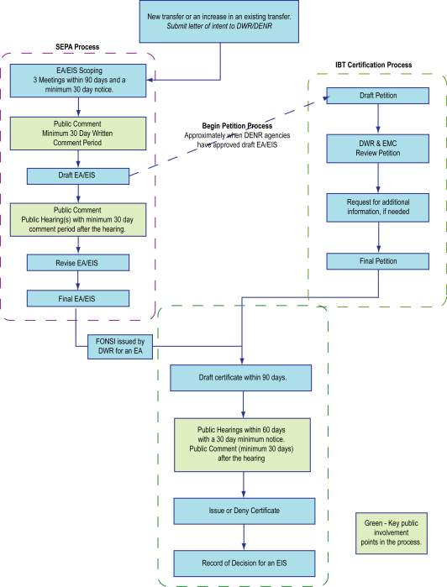
2007 Amendments to IBT Statute
Defined relationship of SEPA process to Certificate Process
Additional public notice
Changes to decision criteria
Draft Certificate before last public review
Mediation process
Authorized Water Supply Study
Time? - >4 years

Slide 18
NC and Adjacent State Notification
Who Will Be Notified
Newspaper of general circulation
  Upstream and downstream of the withdrawal.
  Each city or county in the source drainage basin.
First-Class or Electronic Mail
  Governing County or City bodies in the source and receiving basins.
  Governing County or City bodies upstream or downstream of the withdrawal point.
  Persons with a registered withdrawals and transfers in the source basin.
  Persons holding an interbasin transfer certificate in the source basin.
  Persons holding a NPDES discharge permit upstream or downstream of the withdrawal.
  All state water management, water use, and environmental protection agencies and the office of the governor upstream or downstream of the withdrawal point.
  Any person who submits to the applicant a written request to receive notices.
Notes:
I usually like to show the extend of the notice required.

Slide 20
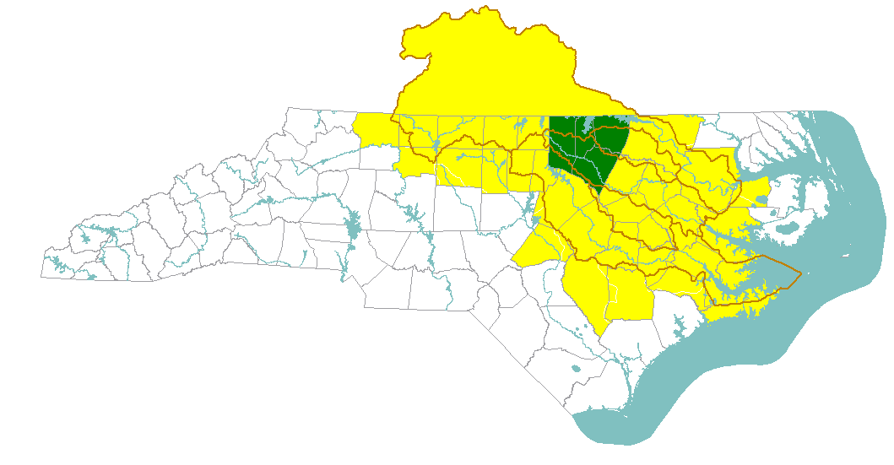
Kerr Lake Regional Water System
Public Notice Requirements
14-1 Roanoke River Basin
15-1 Tar River Basin
15-2 Fishing Creek River Basin
10-1 Neuse River Basin
14-1
15-2
15-1
10-1
KLRWS Notice Requirements:
36 NC Counties/ 23 VA Cities and Counties
37 NC Newspapers
119 NPDES permit holders
45 registered withdrawals
Notes:
REMOVE THIS SLIDE

Slide 21
Drought Management Requirements
Session Law 2008-143 – Act to Improve Drought Preparedness and Response
  Goals to improve water use data, reduce drought vulnerability and allow quicker response to water shortage emergencies
Major provisions related to:
  Water use reporting
  Agricultural water use estimates and reporting
  Water shortage emergency provisions
  Water shortage response plans/drought response
  Water system reporting during drought
  Water system efficiency
  Water reuse policy
  Enforcement
  Gray water use
  Drought mitigation projects
  Drought management advisory council (DMAC)
  Studies

Slide 22
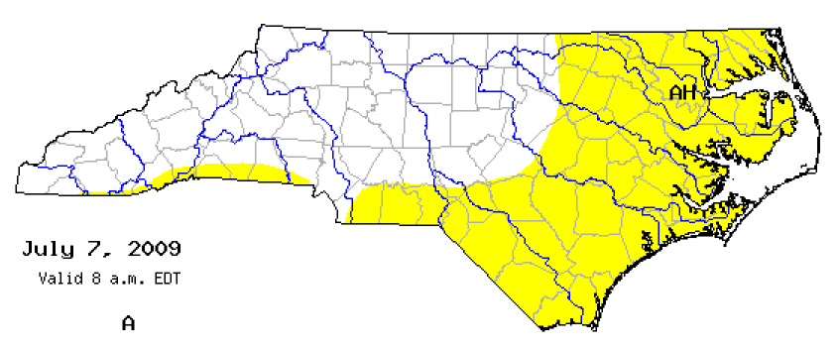
Drought Status Comparisons

Slide 23
Water Use Reporting
Key requirements
  Shorter time for registration of water withdrawal
  Requirement for Dept. of Agriculture to survey water use annually on a county and watershed basis
  Allows DENR to require weekly water use reporting under extreme and exceptional drought conditions

Slide 24
Water Shortage Emergency Provisions
Recommendation of emergency moved from Environmental Management Commission to DENR Secretary
Allows declaration after consultation with water system – no formal request required
Eliminates public hearing
Requires water systems with excess water to share
Allows rules governing conservation and water use for both receiving and supplying water system
Restricts compensation to no more than 110% of retail water cost
Both receiving and supplying water systems can install emergency water lines

Slide 25
Water Shortage Response Plans
Required as part of Local Water Supply Plan Updates (every 5 years) since 2002
2007 EMC rules with requirements for WSRPs
Session Law 2008-143
  Requires plans to have DENR approval
  Givers DENR authority to require implementation of conservation measures in a drought
  Include criteria
    Tiered levels of water conservation measures and other actions based on drought severity with specific triggers required
    Plan must meet EMC rules
    Plan cannot regulate private wells
    Plan presumed approved until DENR notification
    Lack of submitted plan must meet EMC default provisions

Slide 26
Other Provisions
Water efficiency measures
  Separate meters for new irrigation systems
  Must meet criteria for loan eligibility
Policy of Water Reuse
  Recognizes reuse as safe
  Directs EMC to promote reuse
Enforcement Provisions
  Civil penalty of up to $10,000 per month
Requires electronic submittal of SDWA reports
Provisions for Gray Water Use
Addition of drought mitigation projects as being eligible for loan funds
Drought Management Advisory Council changes relate to member eligibility

Slide 27
Capacity Use Areas
Authorized under the Water Use act of 1967
Environmental Management Commission can delineate capacity use areas if aggregate uses of groundwater and/or surface water
  have developed to the extent that regulation is necessary, or
  exceed or threaten to exceed ability for replenishment
Upon designation of CUA, requires EMC to develop rules for regulation of water use
Allows permits for water use within CUAs

Slide 28
Central Coastal Plain CUA
Designation for 15 County area effective August 1, 2002
Permits required for groundwater users >100,000 gpd
Annual registration and reporting for groundwater users >10,000 gpd
16 year plan for reducing withdrawals from the cretaceous aquifer
  Phased reductions
Frequent updates on progress to the EMC

Slide 29
Additional Information Links
Interbasin Transfer http://www.ncwater.org/Permits_and_Registration/Interbasin_Transfer/
Drought & 2008 Drought Bill http://www.ncwater.org/drought/
Water Shortage Response Plans - http://www.ncwater.org/Water_Supply_Planning/Water_Shortage_Response_Plans/
Central Coastal Plain Capacity Use Area http://www.ncwater.org/Permits_and_Registration/Capacity_Use/Central_Coastal_Plain/
Notes:
I usually find it help to provide links for finding additional information.

Slide 30
Agenda Review
NC IBT Law
  Background
  IBT Process (Until 2007 changes)
Drought Management
  2007 Rules
  2008 Legislative Changes
Capacity Use Area
  Background
  Central Coastal Plain CUA
W112002002CLT

Slide 31
“The society which scorns excellence in plumbing as a humble activity and tolerates shoddiness in philosophy because it is an exulted activity will have neither good plumbing nor good philosophy...neither its pipes nor its theories will hold water.”
- John W. Gardner (1912 - 2002)

Slide 32
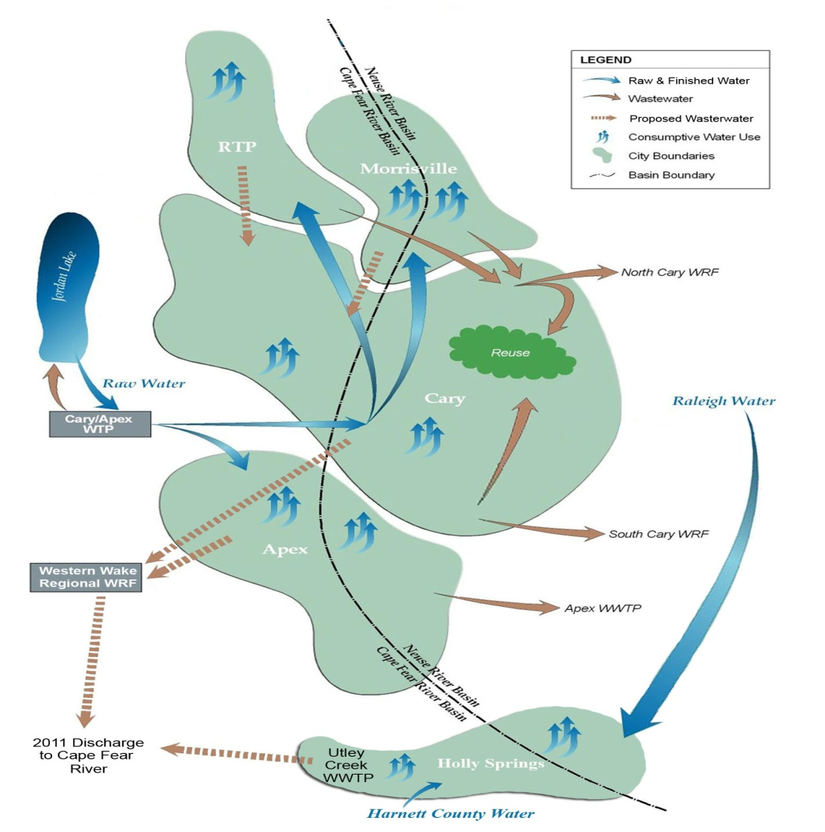
Discussion and Questions

