Slide 1
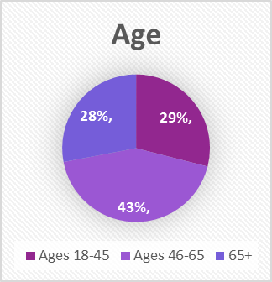

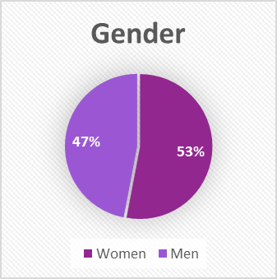
Public Policy Institute
2016 Haywood County Land Use Survey
I. Survey Procedures
- Phone poll, random sample of registered voters
- 817 Respondents
- called over March 18-20
- sample generally mirrors County demographics

Slide 2
II. County Issues
Notes:
From a set list

Slide 3
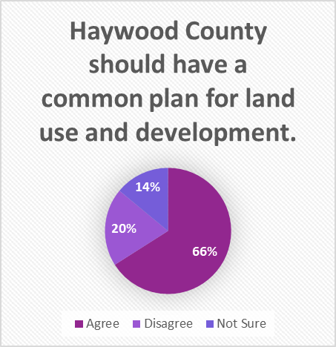
III. Common Plan for Land Use

Slide 4
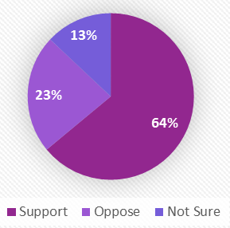
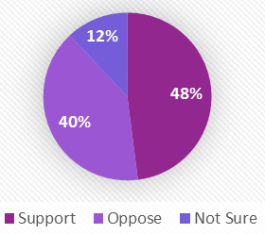
IV. Additional Industrial, Residential, Commercial Regulations
14%
36%
Support for Additional Industrial Development Regulations
Support for Additional Commercial Development Regulations
Support for Additional Residential Development Regulations

Slide 5
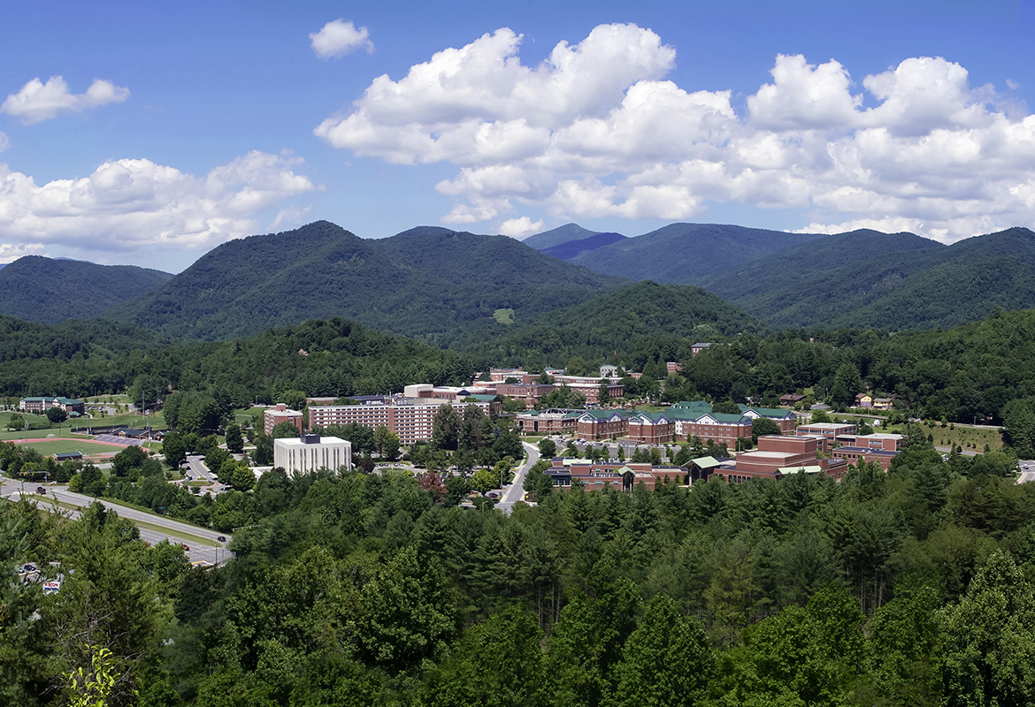
Questions?
Thank you!
Public Policy Institute
Western Carolina University
ppi@email.wcu.edu

