Slide 1
Regulating Employee Use of Social Media
Health Directors Legal Conference
April 26, 2012
Diane M. Juffras
School of Government
UNC- Chapel Hill

Slide 2
Issue #1:
May a public employer monitor employee use of employer computers to access social media sites?

Slide 3
Issue #2:
May a public employer view employee postings on social media sites?

Slide 4
Issue #3:
May public employers regulate employee speech on social media sites?

Slide 5
Issue #1:
May a public employer monitor employee use of employer computers to access social media sites?

Slide 6
Fourth Amendment
Privacy
Reasonable expectation of privacy
Special needs exception

Slide 7
A search by a government employer is justified “when there are reasonable grounds for suspecting that the search will turn up evidence that the employee is guilty of work-related misconduct, or that the search is necessary for a non-investigatory work-related purpose . . . .” O’Connor v. Ortega

Slide 8
Issue #2:
May a public employer view employee postings on social media sites?

Slide 9
Public pages?
No reasonable expectation of privacy
Private pages or postings?
Only available to “friends” or other authorized users or viewers
Reasonable expectation of privacy

Slide 10
Electronic Communications Privacy Act
Federal Wiretap Act
Stored Communications Act
Prohibits unauthorized access to any wire or electronic communication in electronic storage.
Statute provide both criminal and civil money penalties for its violation.
Applies to unauthorized employer access of employee e-mails, private employee profiles and postings on social media sites and posting on internet chat rooms.
No notice exception.

Slide 11
Electronic Communications Privacy Act
Stored Communications Act
Prohibits unauthorized access to any wire or electronic communication in electronic storage.
Statute provide both criminal and civil money penalties for its violation.
Applies to unauthorized employer access of employee e-mails, private employee profiles and postings on social media sites and posting on internet chat rooms.
No notice exception.

Slide 12
Employer exception

Slide 13
Issue #3:
May public employers regulate employee speech on social media sites?

Slide 14
Speech:

Slide 18
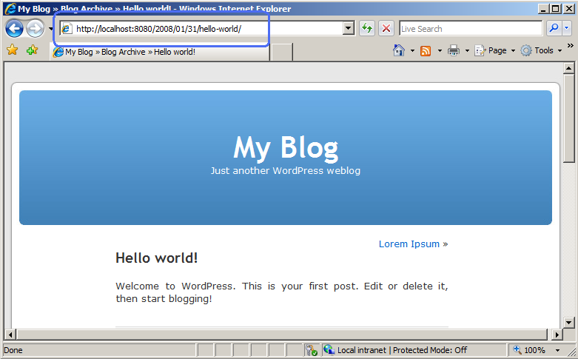

Slide 19
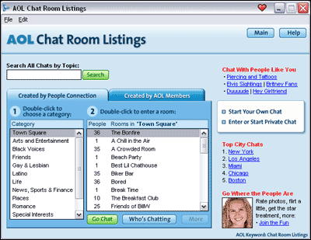

Slide 20
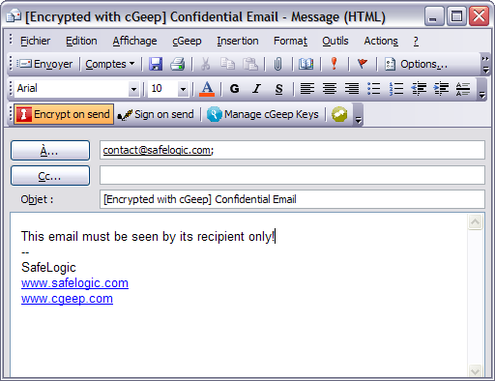

Slide 21
It’s all speech

Slide 22
The 1st Amendment and Public Employees
The Garcetti Test

Slide 23
Speech part of job duties?
“YES”
Not protected

Slide 24
“NO”
The Pickering balancing test

Slide 25
Citizen?
A matter of public concern?

Slide 26
“NO”
Not protected

Slide 27
“YES”
Whose interests are greater ?

Slide 28
Hi, I’m Tiffany and I’m a firefighter with Savannah Fire and Rescue.
Marshall v. Mayor and Alderman of the
City of Savannah, Georgia,
2010 WL 537852 (11th Cir. 2010)

Slide 29
The Drunken Pirate Student Teacher
Snyder v. Millersville University, 2008 WL 5093140 (E.D.Pa. 2008)

Slide 30
Can you prohibit employees from joining Facebook or other social media sites during off-duty hours?

Slide 31
Can you prohibit employees from blogging on their own time?

