Slide 1
Social Media
in the
Public Sector

Slide 2

Got Tweet?
A Lil’ Mash-up?
Do You Check-in?
Welcome to the World of Government 2.0

Slide 3

RU ReD 4 gNR8N c
Connected
Creative
Creator & Consumer
www.lingo2word.com

Slide 4

“Facebook will be dead”

Slide 5
HW Social RU?

Slide 6





Social Networks
Empower the People
Notes:
away from Web 2.0 concepts and social networks is one area where that is especially true. Most avoid social networks because of things they have heard, not because of true facts. In reality, local government should embrace the tools of social networking. Sites like Facebook, Flickr, and YouTube provide opportunities for local government to share information and ideas at almost no cost. They provide a good area to recruit new employees and to involve young adults in government. Internally, tools like SharePoint, provide a place to carry out all phases of projects in a very open and user friendly environment.

Slide 7















Crowd Sourcing
#Hashtags
Notes:
away from Web 2.0 concepts and social networks is one area where that is especially true. Most avoid social networks because of things they have heard, not because of true facts. In reality, local government should embrace the tools of social networking. Sites like Facebook, Flickr, and YouTube provide opportunities for local government to share information and ideas at almost no cost. They provide a good area to recruit new employees and to involve young adults in government. Internally, tools like SharePoint, provide a place to carry out all phases of projects in a very open and user friendly environment.

Slide 8

the communication medium of choice
Social
LinkedIn has users on
every continent
Media
Social networking is now
more popular
than e-mail*
Global time spent on social media is up
82%
over last year*
Every minute,
24 hours
of video is uploaded to YouTube
Last year,
Tweets grew
1400%
Facebook’s greatest growth has come from people aged
35-49*
*Source: Nielson Online

Slide 9
Who
Is Using Social Media?
N=134
In the old world, I just did a survey. In the new world, I'm listening to every
water cooler conversation out there. - Jim Sterne, Target Marketing Inc.
“
”

Slide 10
Not
Created Equal
Domain | Opportunity | Facebook | Twitter | LinkedIn | YouTube
Marketing | Building Positive Brand Image | ☑ | ☑ |  | ☑
 | Increasing Mind Share | ☑ | ☑ |  | ☑
 | Gaining Customer Insights | ☑ | ☑ | ☑ | ☑
Sales | Gaining Sales Insights | ☑ | ☑ | ☑
 | Increasing Revenue | ☑ | ☑ | ☑
 | Customer Acquisition | ☑ | ☑ | ☑
Service | Customer Satisfaction | ☑ | ☑ | ☑ | ☑
 | Increasing Customer Retention | ☑ | ☑ | ☑
 | Reducing Cost of Service | ☑ | ☑ | ☑
☑
Proven
Useful*
☑
Potentially Useful
*Proven useful by statistical analysis of real-world implementations

Slide 11
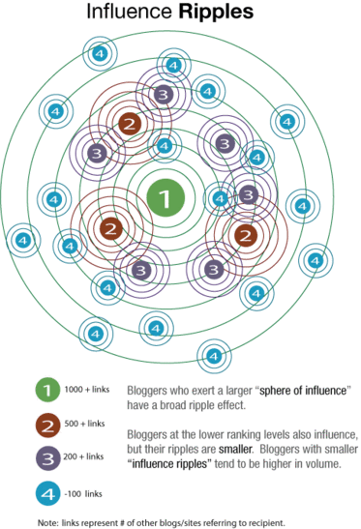
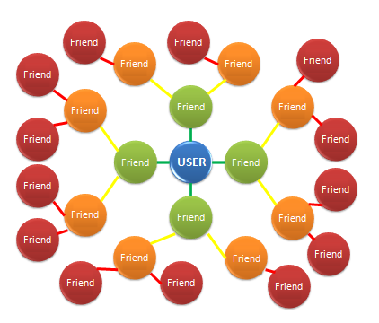
Social Networks create the
Friend-of-a friend (FOAF) trust model
Info-Tech Insight:
Organizations need to be aware of the fact that customers are more likely to trust an opinion of a product or service of someone within their FOAF model than statements made by the company itself.
Influence Ripples
http://darmano.typepad.com/logic_emotion/2006/08/influence_rippl.html

Slide 12

What else are you using?

Slide 13
HW Social
DY rly wan2B?
(legal issues)

Slide 14
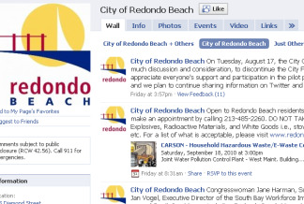
Redondo Beach quits Facebook, citing legal concerns
Redondo Beach does about face on Facebook
Redondo To "De-Friend" Residents on Facebook
Redondo Beach’s city attorney Mike Webb told the Daily Breeze newspaper that he’ll leave it to the courts to work out these and other considerations, adding, “I would just prefer that the case law not have city of Redondo Beach in the title.”

Slide 15
Legal Concerns
Can we delete comments?
Can we restrict employees, candidates from commenting?
Must we archive comments, twitter posts, blog posts?
Is everything a public record?

Slide 16

Free Speech “Forum” Analysis

Slide 17
Type of Forum Determines Government Control of Speech
Traditional Public Forum
Open to all types of expression
Government limited to regulating time, place and manner
Non Public Forum
Not open for public expression
Limited or Designated Forum
Government opens a nonpublic forum for specific purpose and defines acceptable use
Government can deny all access

Slide 18
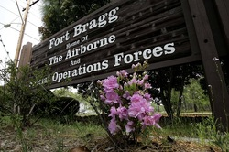

Is a Government Facebook page more like a public park or a military base?

Slide 19
Rules of the Game:
Limited/Designated Forum
Government defines purpose and allowed expression.
Courts defer to government’s choices if rational in relation to the stated purpose.
Viewpoint discrimination is always prohibited.

Slide 20
Public Comment Policies
Examples – Purpose
The purpose of this site is to present matters of public interest in Fairfax County, including its many residents, businesses and visitors.
We encourage you to submit your questions, comments, and concerns, but please note this is a moderated online discussion site and not a public forum.

Slide 21
Examples - Comments
Once posted, the County reserves the right to delete submissions that contain:
  (i) vulgar language;
  (ii) personal attacks of any kind;
  (iii) offensive comments that target or disparage any ethnic, racial, or religious group.

Slide 22
Examples (Continued)
Further, the County also reserves the right to delete comments that are:
  (i) spam or include links to other sites;
  (ii) clearly off topic; [Var. Clearly off topic, and/or disruptive]
  (iii) advocate illegal activity;
  (iv) promote particular services, products, or political organizations;
  (v) infringe on copyrights or trademarks;
  (vi) use personally identifiable medical information; We recommend you not share any of your medical information on our Facebook Pages.

Slide 23
Legal Concerns
Can we delete comments?
Can we restrict employees, candidates from commenting?
Must we archive comments, twitter posts, blog posts?
Is everything a public record?

Slide 24
You be the judge:
Comment: Mayor Jones is a corrupt official. Should be impeached!
Comment: God bless our elected officials. They should pray at meetings so that God will guide their judgment.
Comment: Legislators need to go home – time to adjourn and stop spending tax money on meals and per diem!

Slide 25
You be the judge:
Comment: I’m a citizen and a county worker. No one knows better than I do how misguided these elected officials are.
Comment: As a city employee, I can attest to the great job our police chief is doing. Fellow citizens – show your support!

Slide 26
You be the judge:
Comment: For more about the upcoming garden tour, go to http://bloomingtime.org
Comment: Want to know the real story about who’s getting the contracts and why? Meet your fellow concerned citizens @ http://getreal.org

Slide 27
Examples: Disclaimer
Please note that the comments expressed on this site do not reflect the opinions and position of the Fairfax County government or its officers and employees.
Posts and comments to and from this site, in connection with the transaction of public business, are subject to the North Carolina Public Records Law and may be disclosed to third parties

Slide 28
Other Public Records Issues
Records retention: Content, not location governs. Archiving requirements apply – consult your state’s policies.
Citizen information (email addresses; Facebook and Twitter contacts) may become public when posted on government sites.
Candidate/Political pages may have both public and private aspects.

Slide 29
Blog Posts on Social Media
Coates Canons Local Government Law Blog
Free Speech Rights in Government Social Media Sites
The First Amendment and Facebook Rants: A Case Example
Texting While Meeting: Is it Illegal for Local Government Officials?

Slide 30
Facebook Postings and
Public Records Guidelines

Slide 31
Basic Information
Government Facebook postings are public records.
The retention period for the record is determined by the content of the posting (not the type of media).
  The schedule related to website retention does not apply to Facebook postings.
Most Facebook postings will be of short-term value or considered under the Routine Correspondence and Memoranda.
Retention requirements under litigation holds (e-discovery) are different than public records requirements.
Metadata associated with social media postings remains a concern, as most archiving methods do not capture it.

Slide 32


Examples of Facebook Postings and Retention Requirements

Slide 33
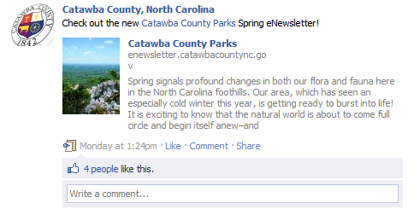
“Short-Term Value” or “Routine Correspondence and Memoranda” Categories
The “likes” would either be considered public records of “Short-Term Value or “Routine Correspondence and Memoranda” per the County/Municipal Agency retention schedules. The record can be destroyed when administrative value or reference value ends.
County/Municipal Management Schedule: pages x and 3

Slide 34
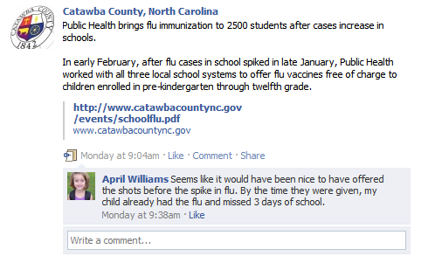
Citizen Complaints & Service Requests
This comment could be considered a citizen complaint and would be categorized under “Citizen Complaints and Service Requests”. The record can be destroyed one year after resolution of the complaint.
County/Municipal Management Schedule: page 3

Slide 35
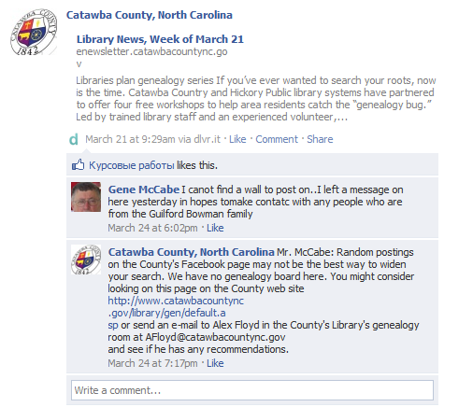
Citizen Complaints & Service Requests
This comment may be considered a citizen request and would be categorized under “Citizen Complaints and Service Requests”. The record can be destroyed one year after resolution of the request.
County/Municipal Management Schedule: page 3

Slide 36
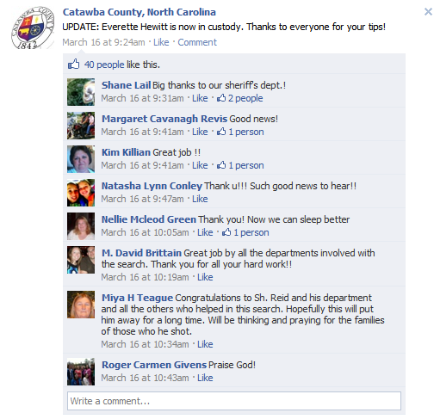
Correspondence and Memoranda
The comments and “likes” would either be considered public records of “Short-Term Value or “Routine Correspondence and Memoranda” per the County/Municipal Agency retention schedules. The record can be destroyed when administrative value or reference value ends.
County/Municipal Management Schedule: pages x and 3

Slide 37
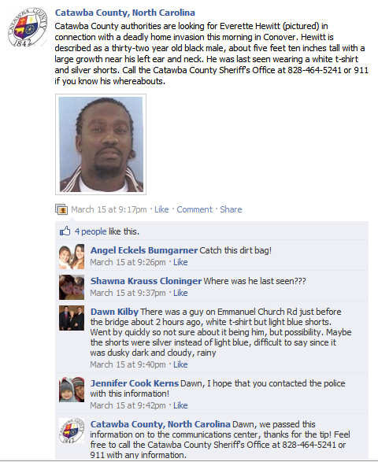
Public Safety “Daily Bulletins”
The nature of this posting and the citizen tips would be considered “Daily Bulletins” per the County Sherriff’s and Municipal Law Enforcement retention schedules. The record can be destroyed when administrative value or reference value ends.
County Sherriff’s Schedule: page 50
Municipal Law Enforcement Schedule: page 63

Slide 38
The “C’s” for
Web 2.0 Investments
Clear on the intent
Cognizant of the effort required
Committed to continued support & maintenance
Cautious of unintended consequences
Create policies prior to implementation

