Slide 1
Citizen Survey Results
Tying it Back to the Strategy
Beth Schrader
Strategy & Policy Manager
Administration - County Manager’s Office
February 8, 2013

Slide 2
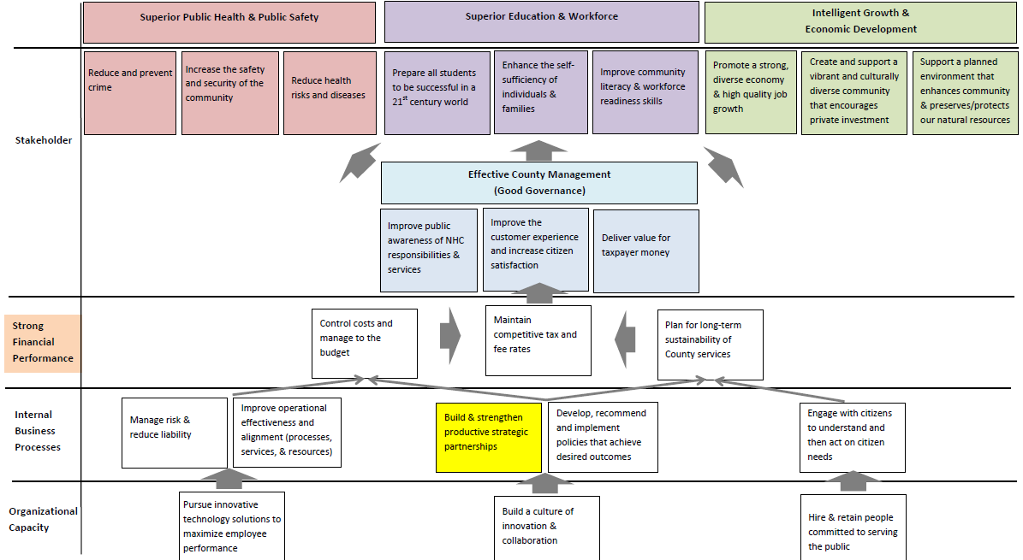
December 3, 2012

Slide 3
What Did We Learn?
Citizen priorities not necessarily where County performs best
Citizens generally happy with quality of life, but less consensus on satisfaction with County services
County needs to evolve to meet citizens where they are / how they want to communicate and do business
Administration – County Manager’s Office
February 8, 2013

Slide 4
Priority vs. Performance
High
Immediate Opportunity:
Plan & Invest Now
(Potential Under Allocation of Resources?)
Foundational / Givens:
Primary Focus Areas
Strategic Priority
Mid to Long Term
Opportunity:
Research & Plan
Foundational:
Must Haves
(Potential Over Allocation of Resources?)
Low
Low
High
Administration – County Manager’s Office
February 8, 2013

Slide 5
Survey Results Profile
Administration – County Manager’s Office
February 8, 2013

Slide 6
What Did The Verbatim Responses Say?
One (1) thing would like to see done to improve NHC
Improve traffic / Road repair / Road safety 25%
Reigning in spending / Not raising taxes 12%
Improve schools 8%
Economic development / Jobs 8%
Services most important for NHC to Provide
Emergency services (Sheriff, Fire, 911, EMS) 20%
Quality schools 13%
Parks / Recreation 12%
Administration – County Manager’s Office
February 8, 2013

Slide 7
Strong Economy / High Quality Job Growth
Most frequently selected priority (31% of respondents)
Lowest rated county service for effectiveness
To drive economic growth, need to nurture and encourage businesses to stay, expand, or relocate here
Strategies: Move from recruiting outside companies to building robust clusters. Take a portfolio perspective - upgrade existing and broaden to new; Focus on job quality / increasing prosperity.
Administration – County Manager’s Office
February 8, 2013

Slide 8
Planned Environment Builds Community and Preserves Natural Resources
Land use planning tied as lowest rated county service
Low Planning & Inspection department satisfaction scores
Business owners rank this attribute lowest overall
Strategies: Concurrence; Increase % of affordable housing to make attractive to young professionals; Support access to greenway and parks.
Administration – County Manager’s Office
February 8, 2013

Slide 9
Strategic Measures & 2016 Targets
Promote a strong, diverse economy & high quality job growth
- Create 6,000 – 8,000 new jobs in targeted industry clusters (Determined by elected leaders, i.e. plan and policy)
- Increase average weekly wage by 10%
- 75% of housing (rental), 40% of housing (own), and 80% of commercial new development done with available infrastructure (infill)
- 10% of new housing units affordable to population earning less than 80% of the then average median income
- Increase % of residents living within ½ mile of dedicated park, public beach, or greenway trail by 5%
- Increase tax base by $1 billion due to direct investment - Establish baseline Quality of Place Index (economic, environment, housing, transportation, education, social / cultural)
Support a planned environment that enhances community & preserves / protects our natural resources
Create and support a vibrant and culturally diverse community that encourages private investment
Administration – County Manager’s Office
February 8, 2013

Slide 10
Prepare Students to be Successful in 21st Century
Significantly different perception of quality when comparing K-12 program vs. community college
Community college received high overall ratings; Strong agreement among respondents
K-12 has much greater opportunity for improvement; Greater variability in responses
Strategies: Focus on preparing children zero to 5 years old in five development areas needed to be ready for Kindergarten; Encourage timely completion of post-secondary programs to add to pool of qualified workers and free up space for new students.
Administration – County Manager’s Office
February 8, 2013

Slide 11
Strategic Measures & 2016 Targets
- 80% of entering kindergarteners are “Ready for School”
- 65% of students at local public institutions complete post secondary or
trade/technical skills programs within 125% of normal time required
- Establish Community Literacy Index (volunteerism, participation in political process, adult literacy rate, attendance at cultural / community events)
- Increase the level of employment (or educational) participation by veterans
and dislocated workers by 5%
Prepare all students to be successful in a 21st century world
Improve community literacy & workforce readiness skills
Enhance the self-sufficiency of individuals & families
Administration – County Manager’s Office
February 8, 2013

Slide 12
Increase Safety & Security
Some opportunity to improve perception of safety and security based on community self-perception
Sheriff’s Office service delivery generally rated well
911 and Fire Services received outstanding marks; 911 also scored well for dispatching assistance quickly
Strategies: Reduce / prevent property crimes; Focus on reducing juvenile recidivism to prevent graduation to more serious crimes and / or adult criminal activity / life; Create and meet emergency response standards based on hazard risk and location.
Administration – County Manager’s Office
February 8, 2013

Slide 13
Strategic Measures & 2016 Targets
- Part II crimes per 1000 ≤ comparable urban peer NC counties
- Reduce % juvenile offenders re-adjudicated or convicted within 1 year by 5%
- Increase % of residents who agree / strongly agree feel safe and secure in the community by 8%
- Decease traffic accidents / crashes with pedestrian and bicycles on unincorporated roads by 5%
- 90% of emergency responses within the unincorporated area meet the County “effective response standard”
- Reduce incidence of repeat abuse by <5% (adults) and <7.1% (children)
- Establish Emerging Health Issues Index baseline (tobacco use, injuries, communicable and sexually transmitted disease, adolescent pregnancy, 2 year olds up to date with vaccinations)
- Reduce adult obesity rate 5%
- Reduce child (2-18) obesity rate by 8.4%
Reduce and prevent crime
Increase the safety and security of the community
Reduce health risks and diseases
Administration – County Manager’s Office
February 8, 2013

Slide 14
Improve Customer Satisfaction
At a Department level, overall ratings are driven by:
Being served in a timely manner (38%)
Being given the correct information (33%)
Being treated with respect is important, but this alone cannot overcome slow service and / or inaccurate information.
Strategies: Improve timeliness of service and frequency providing the correct information the first time.
Administration – County Manager’s Office
February 8, 2013

Slide 15
Strategic Measures & 2016 Targets
- All departments have an avg. rating of 5.0 or higher for timely service
- Increase by 10% citizens agree / strongly agree that NHC provides quality services
- Increase by 10% citizens agree / strongly agree NHC is effective & efficient
- Increase by 10% citizens agree / strongly agree that NHC spends my tax dollars wisely
Improve the customer experience and increase citizen satisfaction
Deliver value for taxpayer money
Administration – County Manager’s Office
February 8, 2013

Slide 16
Focus on the Bottom Line
Citizens are concerned about budget and spending
Citizens want to keep taxes low
Strategic Measures & 2016 Targets
- Year-over-year % growth in expenses less than % growth in CPI-U South
- % change between Adopted and final Actual budget ≤ 3.75%
- 50% of new discretionary programs self-funded or with dedicated (non- property-tax) funding source identified
- Increase by 10% citizens agree / strongly agree NHC is effective & efficient
Control costs and manage to the budget
Plan for long-term sustainability of County services
Administration – County Manager’s Office
February 8, 2013

Slide 17
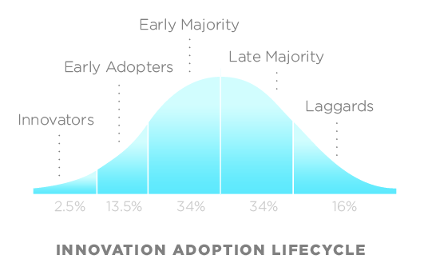
Lastly, The Future is Now
In NHC, the digital divide has largely been crossed
Blurring device boundaries
Growth of mobile devices / multiple device usage
<10% do not use internet at all
Age independent
Increasing user sophistication
How / where seek information
Administration – County Manager’s Office
February 8, 2013

Slide 18
Potential Implications
Changing citizen expectations (responsiveness, access to services, involvement / participation)
Evolving communication patterns & business models to reflect how citizens want to communicate and do business
Need for technology investments to bring NHC in step with current trends & move to where future is heading
Will require reimagining business models
Administration – County Manager’s Office
February 8, 2013

Slide 19
Questions?
Administration – County Manager’s Office
February 8, 2013
Slide 19

