Slide 1
Town of Columbus
Co-op Objective: Visibility and Public Relations

Slide 2
Contents
Purpose
Initialization of project
  Survey
    Polk County High School
    Laurel Hurst & Tryon Estates Retirement Communities
    Ashley Meadows, Highwood, and Ridge Oak Apartment Complexes
Survey Results
Conclusion
Recommendations

Slide 3
Purpose
The purpose of the Visibility and Public Relations project is to seek out ways to encourage citizen attendance at public body meetings, and to promote public participation in current and future committee organizations.

Slide 4
Initialization of Project
Survey

Slide 5
Survey
In order to encourage public attendance at Town Council Meetings, and other municipal board meetings, I needed to know why attendance was so low. I began by asking the following questions:
  Was it the day or time?
  Was it the location?
  Did people feel uncomfortable speaking in public?
  Were there citizens that “bullied” others into silence, thus causing citizens to refrain from attending at all?
  Was there something that the council members and town staff were completely oblivious to – that would make citizens not want to attend the meetings?

Slide 6
Survey
Surveys would be available at all times in the following locations: Town of Columbus Website, Columbus Town Hall, Columbus Post Office, Womack Administration Building (Tax Collector’s Office), Polk County Library, and Mountain 1st Bank.
After brainstorming over survey questions, the following survey was cleanly formatted and sent to the Town Manager for approval:

Slide 7
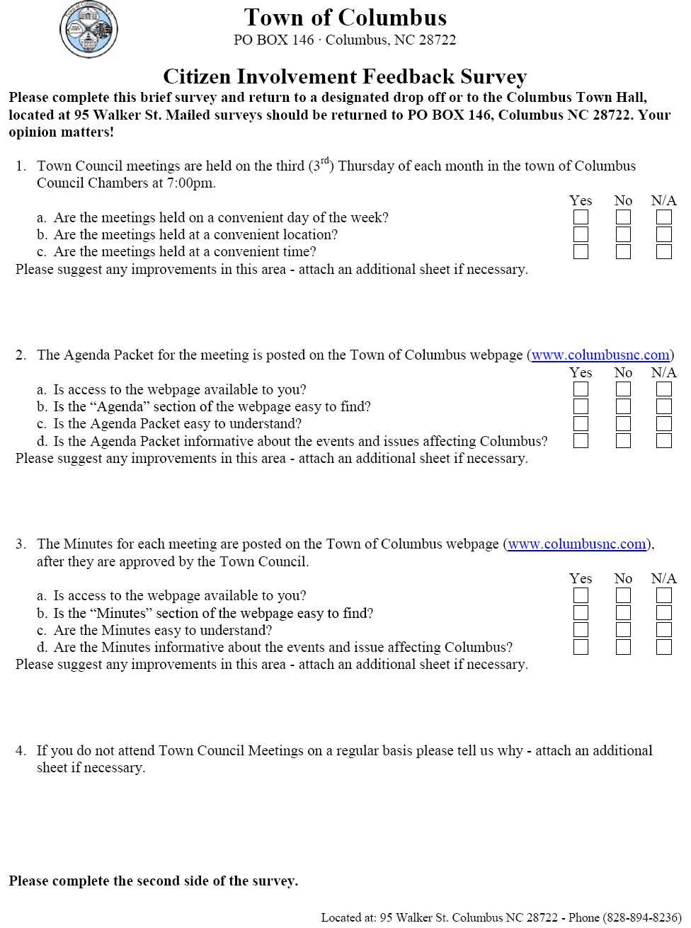
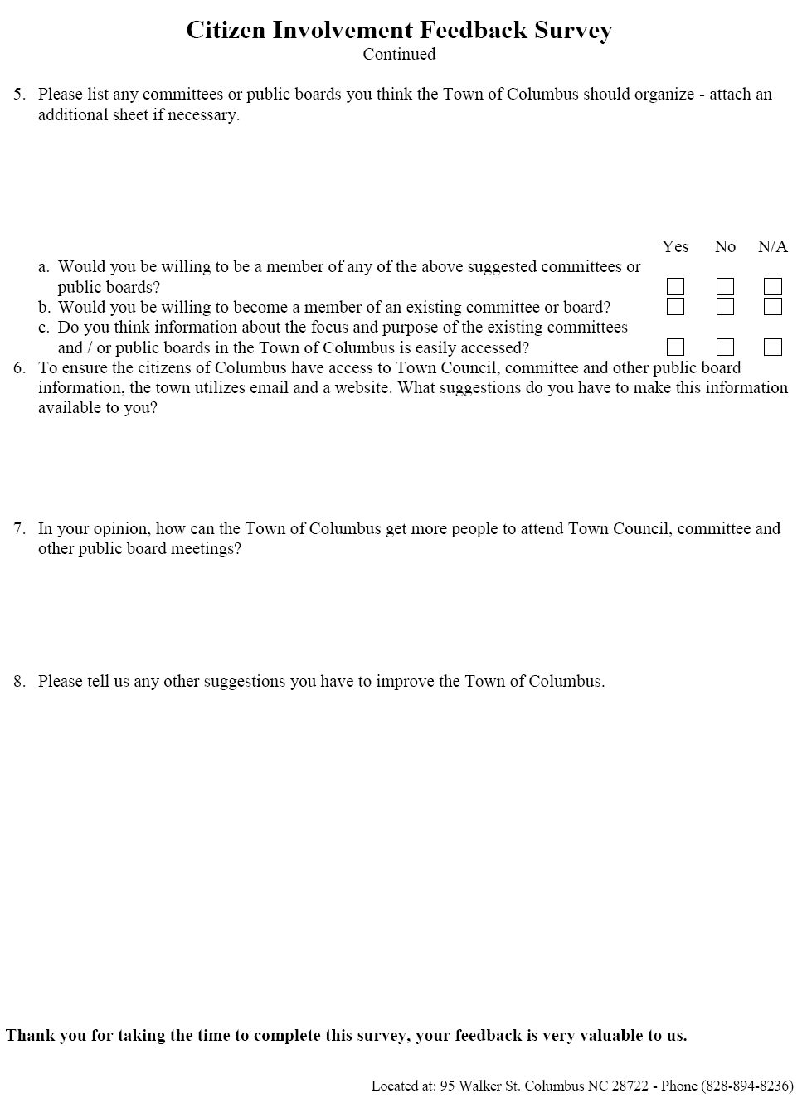
Pg 1
Pg 2

Slide 8
Survey
The first phase of the survey would be an initiative to contact the Polk County High School.
  See if it would be permissible for us to send them the blank survey, and ask them to display it for students to complete
  Blank forms and a collection box would be sent to the school to be placed in conspicuous areas
  Completed forms could be gathered in a central collection box, and an employee of the town could retrieve the box at a specific time
Objective
  Fresh, creative ideas from a younger generation with a firm understanding of the potential of modern technology
  An interest and encouragement from the teachers
  An interest and encouragement from the parents, with a possible outcome of feedback from parents as well as students.

Slide 9
Survey
The second phase of the survey would be an initiative to contact the Laurel Hurst and Tryon Estates Retirement Communities
  See if it would be permissible for us to send them the blank survey, and ask them to distribute it for retirees to complete
  Blank forms and a collection box would be sent to the offices to be placed in conspicuous areas or given to the residents
  Completed forms could be gathered in a central collection box, and an employee of the town could retrieve the box at a specific time
Objective
  Understanding of an older generations needs who do not have a firm understanding of the potential of modern technology
  An understanding of the limitations of these citizens – hearing and seeing disabilities, inability to travel, etc.
  An interest and encouragement from the caregivers, with the possibility of feedback from caregivers

Slide 10
Survey
The third phase of the survey would be an initiative to contact Ashley Meadows, Highwood and Ridge Oak Apartments
  See if it would be permissible for us to send them the blank survey, and ask them to distribute it for citizens to complete
  Blank forms would be sent to the office managers to be placed in conspicuous areas or placed in personal boxes
  Completed forms could be gathered in the apartment complex office, and an employee of the town could retrieve the box at a specific time
Objective
  Fresh, creative ideas from the every day, working citizens living within, and just outside of city limits

Slide 11
Survey
Surveys were distributed via email and paper copies on Monday 3/12/12.
  Distribution included: blank survey, secured pen, and a collection box.
Responses were collected starting on 3/14/12.
100 surveys were distributed with boxes in the designated areas
  12% were returned with citizen feedback
60 surveys were directly sent to local retirement communities
  0% were returned with citizen feedback
Surveys were redacted on Friday 3/30/12.

Slide 12
Survey Results
Survey results were less than ideal. I was expecting a much higher response from citizens based on ease and availability of the survey, and based on the idea that citizens would be willing to voice ideas and opinions for improvement.
The following results are based on the 12% of responses received from citizens.

Slide 13
Survey Results
  Question 1a – Are meetings held on a convenient day of the week?
    Overall citizens felt that they were held on a convenient day, with 56% yes
    22% no
    22% with no opinion
  Question 1b – Are meetings held at a convenient location?
    The overwhelming majority of citizens felt that they were held at a convenient location with 89% yes
    11% no
    0% with no opinion

Slide 14
Survey Results
  Question 1c – Are meetings held at a convenient time?
    The majority of citizens felt that they were held at a convenient time, with 73% yes
    18% no
    9% with no opinion
  Question 1 also asked for suggestions for improvements in this area – there were no comments.

Slide 15
Survey Results
  Question 2a – Is access to the webpage available to you?
    The majority of citizens have access to the webpage, with 67% yes
    22% no
    9% with no opinion – inferred to
    mean that internet access is
    unavailable to them.
  Question 2b – Is the “Agenda” section of the webpage easy to find?
    The overwhelming majority of citizens feel it is easy to find with 86% yes
    14% no
    0% no opinion

Slide 16
Survey Results
  Question 2c – Is the Agenda Packet easy to understand?
    The overwhelming majority of citizens feel it is easy to understand, with 86% yes
    14% no
    0% with no opinion
  Question 2d – Is the Agenda packet informative?
    The overwhelming majority of citizens feel it is easy to find with 86% yes
    14% no
    0% no opinion

Slide 17
Survey Results
  Given the exact same figures for questions 2b through 2d, it can logically be deduced that each citizen who attempted to obtain a copy of the agenda packet from the web page –
  Found it easy to navigate the website to find the Agenda Packet information
  Found the information within the Agenda Packet to be understood – we should continue to use the same format and level of writing.
  Since the citizens were able to understand the information within the Agenda Packet, they then found the material presented to be informative.
  Question 2 also asked for suggestions for improvements in this area – again there were no comments.

Slide 18
Survey Results
  Question 3a – Is access to the webpage available to you?
    The majority of citizens have access to the webpage, with 56% yes
    33% no
    11% with no opinion – inferred to
    mean that internet access is
    unavailable to them.
  Question 3b – Is the “Minutes” section of the webpage easy to find?
    The majority of citizens feel it is easy to find with 72% yes
    14% no
    14% no opinion

Slide 19
Survey Results
  Question 3c – Are the Minutes easy to understand?
    The majority of citizens feel it is easy to understand, with 72% yes
    14% no
    14% with no opinion
  Question 3d – Are the Minutes informative?
    The majority of citizens feel it is informative, with 72% yes
    14% no
    14% no opinion

Slide 20
Survey Results
  The discrepancy between the figures for 2a and 3a are due to one citizen not completing the survey.
  The difference in the yes answers regarding the Minutes at 72% and the Agenda Packet at 86% gives rise to two questions:
  Is it easy for citizens to navigate from the Agenda Packet section of the webpage to the Minutes section?
  Can this show a lack of understanding of the information contained within the minutes and how this information applies to the public?
  Once again the data consistently flows from question 3b to 3d, as it did with questions 2b and 2d. The same logical conclusions can be made about the Minutes as was made in regards to the Agenda Packet
  Citizens found it easy to navigate, understandable, and informative
  Question 3 also asked for suggestions for improvements in this area – one citizen commented with “No computer”

Slide 21
Survey Results
  Question 4 was not a statistical question, however most citizens answered the question in similar fashion:
  If you do not attend Town Council Meetings on a regular basis please tell us why
  Work late hours
  Have to work
  Work Schedule
  Lack of time

Slide 22
Survey Results
  Question 5a – Would you be willing to be a member of any of the above suggested committees or public boards?
    Citizens are really not interested in participation with a 38% no opinion
    37% no
    25% yes – two citizens
  Question 5b – Would you be willing to become a member of an existing committee or board?
    The majority of citizens are not willing to serve on a board, with 72% no
    14% yes
    14% no opinion

Slide 23
Survey Results
  Question 5c – Do you think information about the focus and purpose of the existing committees and/or public boards in the Town of Columbus is easily accessed?
    The slight majority of citizens feel it is not easy to access, with 43% no – this might be an opportunity for improvement.
    29% with no opinion
    28% yes

Slide 24
Survey Results
  Question 5 also asked to list any committees or public boards you think the Town of Columbus should organize – the following were responses by citizens:
  We need a tornado or warning system shelter information
  Youth involvement programme [sic].

Slide 25
Survey Results
  Question 6 was not a statistical question
  To ensure the citizens of Columbus have access to Town, Council, committee and other public board information, the town utilizes email and a website. What suggestions do you have to make this information available to you?
  Post Office information bulletin board
  Letter, phone call, etc
    The idea of posting information on the Post Office bulletin board is a very viable option. We could post a copy of the agenda, meeting notices, proclamations, etc. This could be a low cost way of reaching several of our citizens at the same time.
    Building off of this suggestion, we are now posting copies of this information on our outside board to improve communication.

Slide 26
Survey Results
  Question 7 was not a statistical question
  In your opinion, how can the Town of Columbus get more people to attend Town Council, committee and other public board meetings?
  Columbus has older citizens who do not get out at night.

Slide 27
Survey Results
  Question 8 was not a statistical question
  Please tell us any other suggestions you have to improve the Town of Columbus
  Keep clear of corrupt politicians and lawyers
  Parking is an issue during the day
  I am to[sic] busy to take time out to go to meetings
  Have the Town to mow the sides of the streets and roads more often.

Slide 28
Conclusion
A 12% response is both a positive result, and at the same time, a negative result.
The positive aspect of this response rate can be hypothesized to mean that citizens don’t feel there are pressing issues to warrant involvement, the Town Council and administrative staff are doing a satisfactory job, and that town affairs are running smoothly, but citizens will respond if there is a controversial issue.
The negative aspect is the rate itself. I believe had a professional service handled the survey, by directly contacting each citizen within the town limits, the statistical results would have different numbers. However, I do believe the essence of the reasons why citizens are not more involved is simply - quoting one citizen - a “lack of time”.

Slide 29
Recommendations
Our webpage, notations on the water bills, and rare cases of sending formal letters, still seems to be the most effective way to communicate.
Other areas that I was researching were web conferencing, teleconferencing, podcasting, video web casting, and even utilizing our local radio station.
Given the low level of interest or desire to participate by our citizens, I do not feel the cost of implementing any of these ideas would justify the level of participation.
However, I have noticed that several of our utility customers carry “smart phones”, and I would like to recommend looking into obtaining an App for the Town of Columbus.

