Slide 1
Essential Information About Drinking Water
Notes:
Instructions:
Instructions or suggestions for how to use these slides are italicized. The script for the slide is in plain type.
Communities may add local information such as community name and date to the subhead section of the slide.
The speaker should self-introduce or be introduced by a planning team member.
Script begins here:
This presentation includes basic information about drinking water, including drinking water sources and drinking water systems. We will briefly touch on drinking water regulation – the laws that are intended to keep drinking water safe, and the agencies responsible for enforcing those laws. Before we get into those topics, let’s take a moment to consider why drinking water is important.

Slide 2
Why drinking water?
Everyone needs water!
Incidents affect residents, businesses, government
Every local government can reasonably anticipate that they will experience an incident of some type
Source: U.S. Centers for Disease Control and Prevention
Notes:
The importance of drinking water may seem obvious. Everyone needs it. It is essential for health and sanitation.
If our community experiences an incident that affects drinking water, there is the potential for everyone in the community to be affected: residents, businesses, facilities such as schools or hospital, and local government as well.
Incidents affecting drinking water occur frequently in North Carolina. We may not be able to predict exactly when or how a drinking water incident will occur in our community, but we can reasonably anticipate that something will happen, so it’s important to prepare.

Slide 3
Drinking Water Incidents
Notes:
I have used the term “drinking water incidents,” so I want to explain what I mean by that.

Slide 4
What is an incident?
A situation in which a hazard, natural or human-made, threatens the safety of drinking water
Data from the Drinking Water Working Group survey of North Carolina stakeholders, February-March 2019. 76 respondents reported 247 incidents.
Notes:
I am using the term “drinking water incident” to mean a situation in which a hazard, either natural or human-made, threatens the safety of drinking water. I am not referring to daily operations or treatment processes for drinking water, but other things that happen to create a risk to the water we drink.
In the spring of 2019, the UNC School of Government’s Drinking Water Working Group surveyed local government officials and utilities in North Carolina about their experiences with drinking water incidents. This pie chart illustrates the types of drinking water incidents that survey respondents reported.
In response to the question, have you had an incident in your community, and if so what type, 76 respondents identified 247 separate incidents. As you can see, about one-third of these incidents were associated with water main breaks or other infrastructure failure. 18% were attributed to power outages, and another 18% to flooding. Groundwater contamination accounted for another 11% of the incidents that were reported, wastewater overflow for 9%, and industrial discharges for 8%.

Slide 5
Water main break
Orange Water & Sewer Authority (OWASA), November 2018
Customers asked to conserve water for 24 hours
Boil water advisory in effect for 31 hours
8 hours to repair
Schools closed and some local government services suspended
System lost 9.5 million gallons of water, dropping storage to near-emergency levels
Source: CBS 17 News
Notes:
Here are a couple of examples of common drinking water incidents. We saw that water main breaks were one of the most commonly reported drinking water incidents, representing about a third of all incidents. A recent example of this type of incident comes from Orange Water and Sewer Authority (OWASA), which experienced a major water main break in Carrboro, NC in November 2018. This break affected residents, businesses and government in both Carrboro and Chapel Hill. All of OWASA’s customers were asked to conserve water for a 24-hour period. The utility also issued a boil water advisory for 31 hours. The Chapel Hill-Carrboro City Schools closed, and some local government services had to be suspended for the duration of the incident.
Due to the pipe’s depth and its location within the pipe network, it took eight hours to repair. In that time, the system lost 9.5 million gallons of water, and OWASA’s storage levels dropped to near-emergency levels. An independent review found that the water main break was caused by a manufacturing defect in the section of pipe that broke.

Slide 6
Flooding after Hurricane Florence
September 2018, Hurricane Florence made landfall
Animal waste, wastewater system overflows contaminated wells
NC DHHS advised residents not to drink from flooded wells until they could be tested and disinfected
Subsequently provided free testing in 23 counties
Source: The Virginian-Pilot Online
Notes:
Another example of a drinking water incident was the flooding associated with Hurricane Florence, which made landfall near Wrightsville Beach, NC in September 2018. The flooding associated with the storm damaged infrastructure and spread farm animal waste, septic system overflows, and raw sewage over a broad region. These types of discharges can lead to the contamination of private drinking water wells.
It is estimated that there are more than 330,000 private drinking water wells in the counties that were declared disaster areas from Florence.
In the immediate aftermath of the storm, the North Carolina Department of Health and Human Services advised residents not to drink from flooded wells until they could be tested and disinfected. Residents needed alternative water sources, as well as information about how to disinfect their wells and arrange for testing. Disaster relief organizations helped with bottled water. Subsequently, NC DHHS provided free testing in 23 counties. About 15% of those tests came back positive for E. coli or fecal coliform, pathogens that can cause gastrointestinal illness.
There is not a lot of regulation of private drinking water wells in NC. Wells must receive permits from the local health department when first constructed, but there is no ongoing oversight. Well owners are responsible for ensuring that their well water remains safe to drink. Therefore, local governments are a primary source of information for well owners when incidents like this occur.

Slide 7
Drinking Water Sources and Systems
Notes:
Now let’s look at drinking water sources and systems.

Slide 8
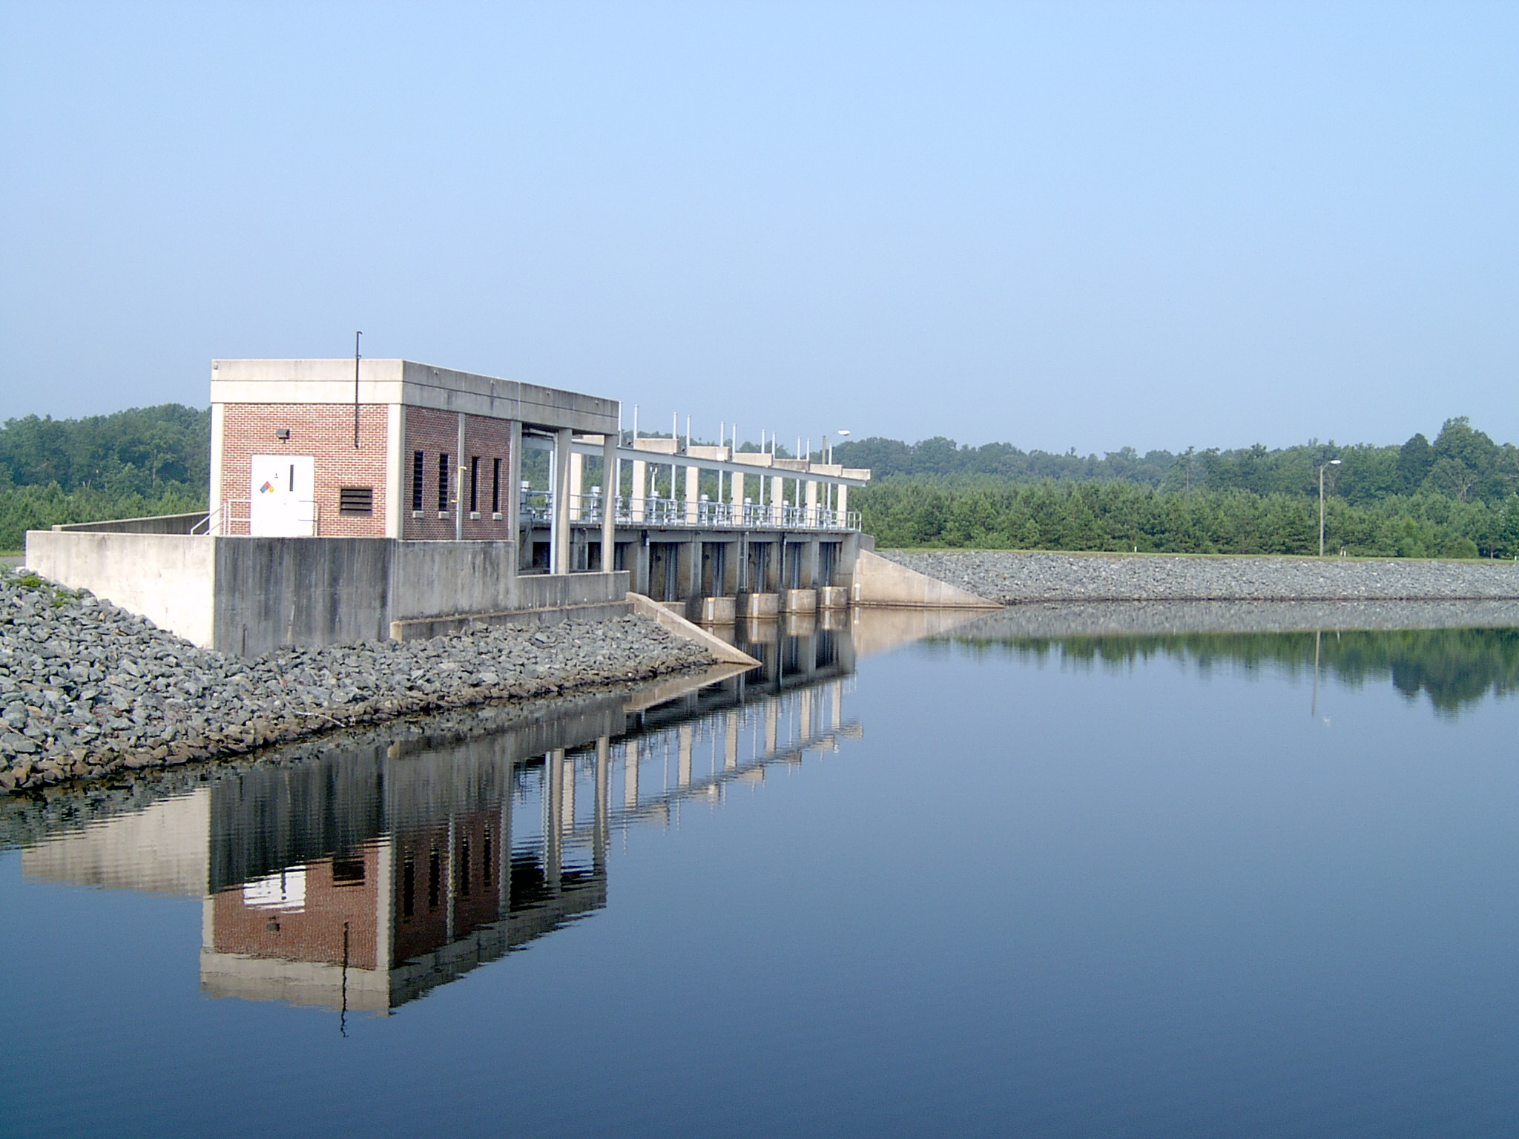
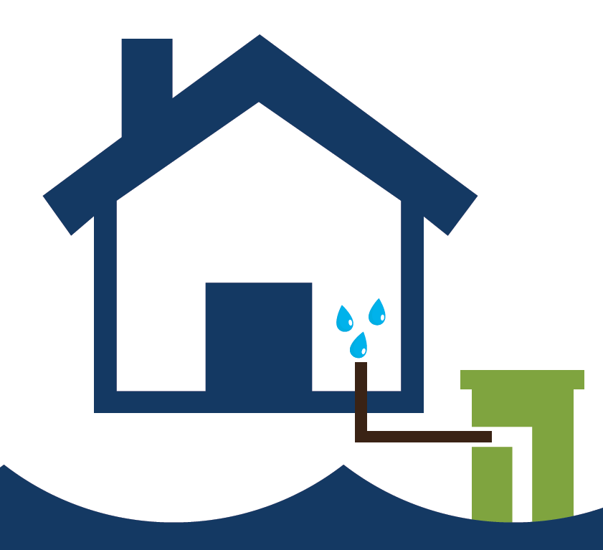
Sources
SURFACE WATER
GROUND WATER
Collects on the ground and in bodies of water such as lakes and rivers
Rainfall is absorbed into the ground and seeps through porous spaces until it reaches a dense barrier of rock
Source: U.S. Geological Service
Source: N.C. Division of Public Health
Notes:
Drinking water may come from either surface water or groundwater.
Surface water is water that collects on the ground and in bodies of water such as lakes, rivers, or reservoirs.
Ground water comes from underground sources that are formed when rainfall is absorbed into the ground and seeps downward through porous spaces until it reaches a dense barrier of rock.

Slide 9
Public Water Systems
Community water systems: same population, year-round
Non-community water systems:
Transient: at least 25 people, at least 60 days per year, but not the same people
Example: Gas station
Non-transient: at least 25 of the same people for at least 6 months a year, but not year-round
Example: School with its own system
Source: Centers for Disease Control & Prevention
Notes:
Drinking water may be supplied by a public water system or a private well. Let’s look at public water systems first. Public water systems may use either surface water or groundwater.
Public water systems and utilities are divided into community and non-community systems. A community water system supplies water to the same population year-round. This is probably what you think of when you think of a drinking water utility.
Non-community water systems are divided into two sub-categories: transient and non-transient:
Transient systems supply water to at least 25 people at least 60 days per year, but not on a regular basis and not to the same group of people. For example, a gas station or campground may operate a transient non-community water system.
Non-transient systems provide drinking water to at least 25 of the same people for at least six months a year, but not year-round. For example, a school with its own water system may be a non-transient non-community water system.
The graphic on the slide illustrates the different types of public water systems. These distinctions matter when we for purposes of drinking water regulation, which we will consider briefly later in this presentation. There are approximately 6000 regulated public water systems in North Carolina.

Slide 10
Private Drinking Water Wells
Typically supply water to individual residences
Significant source of drinking water in North Carolina
Notes:
Private drinking water wells typically supply water to individual residences. The source water for wells is groundwater.
Private wells are a significant source of drinking water in North Carolina.

Slide 11
Drinking water in North Carolina, 2015
Source: United States Geological Survey, Water Use Data for North Carolina 2015, at https://waterdata.usgs.gov/nc/nwis/wu.
Notes:
In North Carolina, it is estimated that nearly one-quarter of the population gets its drinking water from a private drinking water well. Nationally, only about 10% of the population relies on wells.

Slide 12
Drinking Water Regulation and Safety
Notes:
There are state and federal laws regulating drinking water safety. The laws that apply vary depending on the type of water system. Public water systems are subject to much more regulation than private drinking water wells.

Slide 13
Public Water Systems: SDWA
Public water systems are regulated by the federal Safe Drinking Water Act (SDWA).
U.S. Environmental Protection Agency (EPA) sets standards for:
Drinking water treatment techniques
Maximum contaminant levels (MCLs)
Monitoring and reporting by public water systems
Enforcement delegated to N.C. Department of Environmental Quality, Public Water Supply Section
Notes:
Public water systems are regulated by the Safe Drinking Water Act, a federal law also known by the acronym SDWA.
The Safe Drinking Water Act gives the US Environmental Protection Agency the authority to set standards for public water systems. As a reminder, the chart on the slide shows the different types of public water systems. All of these are subject to SDWA regulations.
The EPA sets standards for a number of issues and activities, including:
Drinking water treatment techniques;
Maximum contaminant levels, also known as MCLs. As the name suggests, these standards set the maximum amount of a contaminant that is allowed in drinking water; and
Different types of monitoring and reporting that public water systems must undertake.
EPA delegates enforcement of this law to states and tribes. In North Carolina, the Department of Environmental Quality’s Public Water Supply Section is responsible for enforcing the SDWA.

Slide 14
Private Drinking Water Wells
No federal regulation
North Carolina local health departments inspect and permit newly constructed wells
Well owners are responsible for maintaining wells and ensuring their water is safe to drink
Notes:
There is no federal regulation of private drinking water wells.
In North Carolina, local health departments inspect and permit newly constructed wells. There is no ongoing oversight or testing that is required by law. It is up to well owners to maintain their wells and ensure their water is safe to drink.

Slide 15
References
Notes:
The following references were used in this presentation.

Slide 16
References
U.S. Centers for Disease Control and Prevention, Drinking Water Resources, at https://www.cdc.gov/healthywater/drinking/index.html
U.S. Environmental Protection Agency, Basic Information about Your Drinking Water, at https://www.epa.gov/ground-water-and-drinking-water/basic-information-about-your-drinking-water
North Carolina Department of Environmental Quality, Public Water Supply Section, at https://deq.nc.gov/about/divisions/water-resources/drinking-water
North Carolina Division of Public Health, On-Site Water Protection Branch, Private Water Supply Wells Program Resources, at https://ehs.ncpublichealth.com/oswp/wells-resources.htm
U.S. Department of the Interior, U.S. Geological Survey Water Use Data for North Carolina, at https://waterdata.usgs.gov/nc/nwis/water_use/
Notes:
Instructions: It is not recommended that the speaker read this slide. Please allow listeners to view it briefly, then proceed to the final slide.

Slide 17
drinkingwater.sog.unc.edu
Notes:
This presentation was made available through the North Carolina Drinking Water Incident Response Toolkit, which is available online at drinkingwater.sog.unc.edu.
The NC Drinking Water Incident Response Toolkit is a project of the UNC School of Government’s ncIMPACT Initiative. It was made possible with funding from the NC Policy Collaboratory.

