Slide 1
Finance Issues During COVID-19: April 24 Update
Sharon Edmundson, Department of State Treasurer
Greg Allison, UNC-CH School of Government
Kara Millonzi, UNC-CH School of Government

Slide 2
Announcements
Please keep your device muted
Type questions and comments in chat box
If call drops, wait a minute and log back in/call back
Recording and slides will be posted

Slide 3
Agenda
DST Update
Budgeting
Utilities
Financial Reporting
Employees

Slide 4
DST Update
Sharon Edmundson

Slide 5
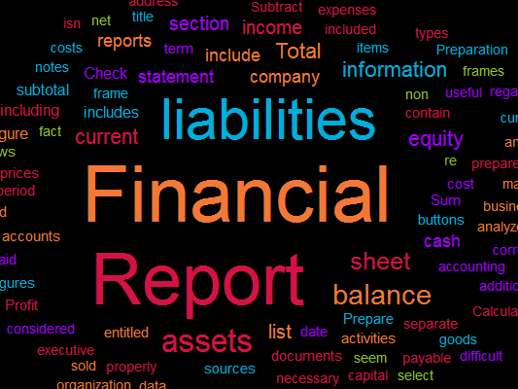
Financial Reporting
Latest GASB actions
Potential impacts on financial reporting
Audit impact?
CPE issues?

Slide 6
Budgeting

Slide 7
Process
By April 30: budget requests to budget officer
By June 1: proposed budget submitted to board
At least 10 days public notice
Hold Public Hearing
By July 1: board adopts budget

Slide 8
Public Hearing
Hold electronic/remote public hearing
Treat it the same as public comment period
Encourage citizens to submit questions/comments in writing
Allow for real-time submittal if possible
Wait until late June (or later) to hold hearing in person
May still be subject to State restrictions on gatherings

Slide 9
Public Notice
Must file copy of proposed budget in clerk’s office
Only applies to actual budget ordinance, not whole budget document
If clerk’s office still open, consider ways to avoid multiple people touching same document
May limit hours that office open
May limit number of people in office
If clerk’s office not open, consider posting copy on door
Post to website and use social media

Slide 10
Interim Budgets
DST blog post
Tool to allow unit to maintain normal operations
Cannot levy taxes or change fees
Check in with whoever prints tax bills on timing

Slide 11
Budget Amendment Flexibility
Broad authority to amend budget ordinance at any time
But,
Cannot change tax rate
Cannot change board member compensation
Very limited authority to reduce appropriations to schools

Slide 12
Utilities

Slide 13
EO 124
As of March 31, 2020, may not disconnect residential water, wastewater, natural gas, or electronic utilities for nonpayment or late payment
If delinquency occurs on residential account between March 31, 2020 and June 1, 2020, may not impose late penalty of any type
Must allow payment plan for residential customers who go delinquent between March 31, 2020 and June 1, 2020
Must notify customers of EO 124 requirements
Reporting requirement?

Slide 14
Payment Plans
According to EO, must allow 6 months to pay after EO terminates
Options
Wait to set up payment plan terms until EO terminates then divide amount owed by 1/6th
Start delinquent customers on payment plan now and set minimum payment or % payment amount
Set out aspirational payment plan now and then formalize when EO terminates
Communicate as clearly as possible with customers
Consider possible incentives (”carrots”) to compel customers to make payments

Slide 15
Requires governing board action
May furlough everyone or only some
May make decisions by department, activity, or any other rational basis
Follow your furlough policy, if you have one
May furlough exempt and nonexempt employees
May allow furloughed employees to use comp time, vacation, and sick leave to continue to receive pay (follow your policy)
Provide clear guidance to employees about length of furlough period, whether and how they could be called back to work during furlough period, and when you expect furlough to end

Slide 16
https://canons.sog.unc.edu/furloughing-employees-during-the-covid-19-crisis/

