Slide 1
Managing Stress During COVID-19: Working and Living Better in Uncertain Times
UNC School of Government’s ‘Leadership Amid Crisis’ series
April 2020
Korrel Kanoy, PhD, Presenter
kkanoy@developmentalassociates.com

Slide 2
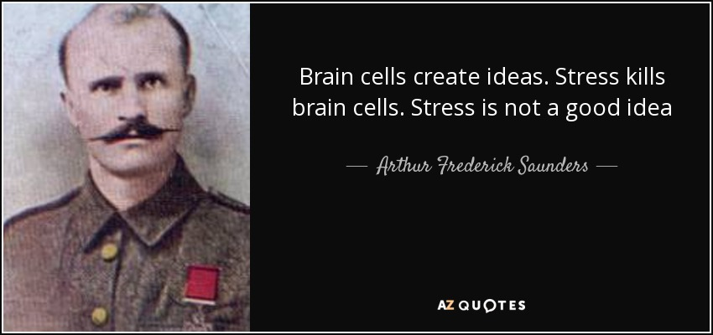
The opposite of stress is death. -- Hans Selye --
There cannot be a crisis next week. My calendar is already full. --- Henry Kissinger ---

Slide 3
STRESS and STRESS TOLERANCE
Stess(ors)- Any
demand made on us
Positive- go out to eat
Negative – deal with conflict
Stress Tolerance: Ability to withstand adverse events and conditions without “falling apart”
Notes:
EXERCISE 10: MANAGING YOUR STRESS

Slide 4
Managing Your Reactions to Stress During COVID-19
Analyze WHY It’s A Threat!
Deploy Resources
This Photo by Unknown Author is licensed under CC BY-SA

Slide 5
COPING: ANALYZE THE THREAT
ASK: Why or how does
this event threaten me?
(e.g., lack of time, skills, support)
DETERMINE: Am I over-reacting?
Ask: What is likely to happen (instead of imagining the worst possible).
Apply the 10-10-10 Rule:
Will this stressor still exist in 10 hours, 10 days, 10 weeks, 10 months, 10 years?
Then, make sure your level of reaction matches the severity of the stressor.

Slide 6
COPING: USE YOUR RESOURCES!
Time – tips for working at home
Money – what can I buy that
will help?
Social Support – Who can
I talk to? How can my family
help?
Expertise Support – What
can I delegate? Who can
contribute knowledge or time?
Planning Ahead – Expect challenges!
Tips for working at home

Slide 7
Short Term and Long-Term Coping Strategies
IN THE MOMENT- NOW!
Reframe the situation
Take a 5-minute walk
Stretch for 5 minutes
Do mindfulness for 5 minutes
Deep breathing
Use the 10-10-10 approach
Do 25-50 jumping jacks! Physical activity calms the body.
LONG-TERM: PROTECT YOUR HEALTH
Sleep/nap
Diet
Exercise
Meditation/Prayer
Social Support/Friends

