Slide 1
Public Mental Health Services in North Carolina
Mark Botts, JD
Associate Professor of Public Law and Government
School of Government
UNC Chapel Hill
botts@sog.unc.edu
919-962-8204
919-923-3229

Slide 2
Community-based service system
Area Authority
Local Management Entity (LME)
Managed Care Organization (MCO)

Slide 3
State Government Role
DHHS
  Services—14 state-operated facilities (2,800)
  Funds for community-based services
    DMA—Medicaid money (insured)
    DMH/DD/SAS—Non-Medicaid funds (uninsured)
  Oversight of community-based system
General Assembly—policymaker
  Organization and Structure
  Funding
  Eligibility

Slide 4
What Is an Area Authority and What does It do?

Slide 5
What is an area authority?
An area authority is a local political subdivision of the state
Within the public system of MH/DD/SA services an area authority is the locus of coordination among public services for clients of its catchment area
G.S. 122C-101, -116.

Slide 6
How are they established?
A county must establish an area authority
A county must provide MH/DD/SA services through an area authority
With DHHS Secretary approval:
  A county may “disengage” from one LME and “realign” with another
  Two area authorities may consolidate (merge) to create one larger area authority
G.S. 122C-115.

Slide 7
Who Governs the LME?
Boards of county commissioners within the LME’s catchment area shall appoint governing board members according to a plan
  jointly adopted by the counties and
  that describes the board composition, appointment, and selection process
LME board statute requires
  At least 11 and no more than 21 voting members
  11 prescribed categories of professional and constituent representation
                G.S. 122C-118.1, 122C-115.2

Slide 8
Governing Board Duties
Determine the needs of area authority clients
Annually assess the area authority’s ability to meet those needs.
Submit to DHHS and BOCCs
  Quarterly service delivery reports that assess the quality and availability of services
  Annual report that assesses progress in achieving service goals and plans

Slide 9
What does an area authority do?
Responsible for the management and oversight of the public system of MH/DD/SA services at the community level.
Must plan, develop, implement, and monitor services within a specified geographic area to ensure expected outcomes for consumers within available resources. G.S. 122C-115.4

Slide 10
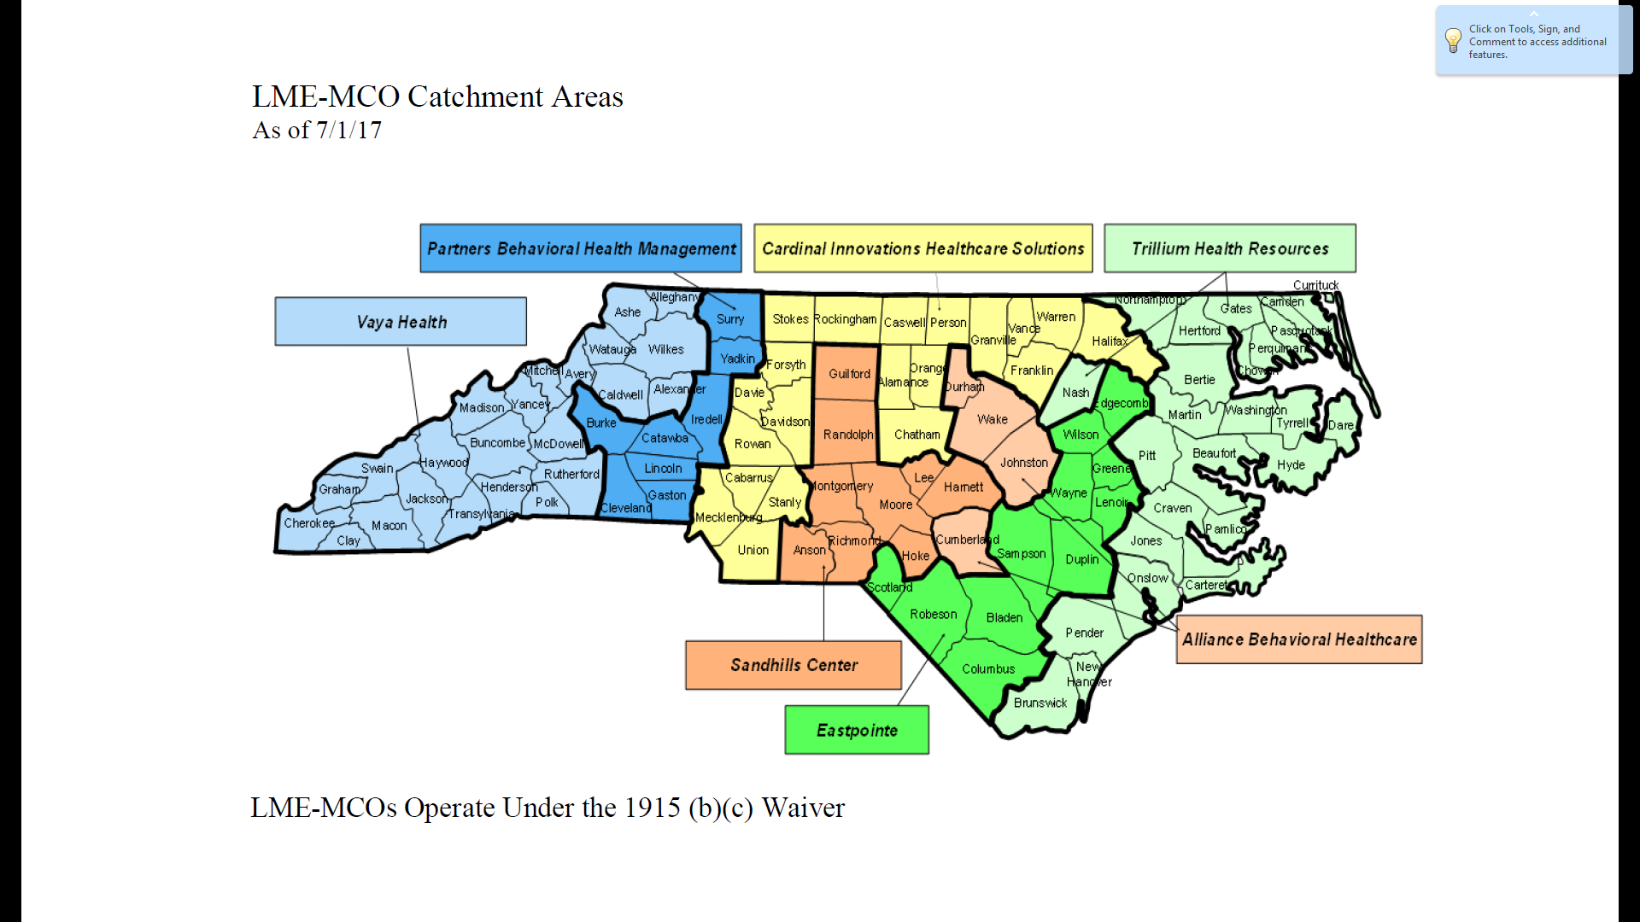

Slide 11
Who Pays for Services?
Smoky Mountain Center
FY 2015-16 Budgeted Revenues By Source

Slide 12
Where Does the State and Federal Money Go?
Smoky Mountain Center
FY 2015-16 Budgeted Medicaid/State/Federal Revenues

Slide 13

Agency Functions and Mission
Personnel
Budget and finance
Consumer affairs
Information management
Services
  Access
  Provider relations
  Service management
  Quality management
  Community collaboration
To efficiently provide necessary and effective services to eligible people within available resources

Slide 14
Who is eligible and who receives services?
Medicaid enrollees
  22.7% of North Carolinians
  16% of enrollees receive services
Uninsured
  13.6% of North Carolinians
  8% of the uninsured receive services
Prevelance (in need of services)
  1,075,000
  47% of these (475,000) receive services
Notes:
Medicaid enrollees—1.9 million—22.7% of the state population
$1.9 billion
Uninsured—1.1 million—13.6% of population
$233 million state, $60 million county

Slide 15
Service Management
Approve specific services to
individual consumers—“service authorization”
Evaluate the medical necessity, clinical appropriateness, and effectiveness of services according to state criteria—“utilization management”
Monitor individual care decisions at critical treatment junctures to assure effective care is received when needed—“care coordination”
Notes:
7.4 Utilization Management:
29
Utilization Management Program: PARTNERS shall have a Utilization Management Program that is consistent
with the requirements of 42 C.F.R. 456 and 42 C.F.R. 438, Subpart D. The Utilization Management Program
shall include a written Utilization Management Plan which describes the mechanisms used to detect
underutilization of services as well as overutilization. The written Utilization Management Plan shall address
procedures used by PARTNERS to review and approve requests for medical services, and shall identify the
clinical criteria used by PARTNERS to evaluate the medical necessity of the service being requested.
PARTNERS shall ensure consistent application of review criteria and shall consult with requesting providers when

Slide 16



Service Management
LME
Eligible individual?
Covered service?
Based on clinical assessment?
Medically necessary?
Qualified provider?
Evidence that treatment helps?
Other needed services?
Outcomes over time?
LME
Provider
Notes:
Processes or techniques used by an entity that delivers, administers and/or assumes risk for health care services to control or influence the quality, accessibility, utilization, costs or outcomes of services provided to a defined enrollee population.

Slide 17


Managing Care
Managing the quality of care
Managing the cost of care
LME
Doctor Patient

Slide 18
Quality Management
Analyze data on access, service authorization, and claims payment for:
  high cost/high need consumers
  utilization of various services in the service array
  gaps in the service array
  consumer access, initiation, engagement and retention
The foregoing list is only a sample
of the many QM activities that
LMEs must engage in.
Notes:
DMH Contract---3.5. Analysis of Data (LME-MCO Data and Community Care of North Carolina
(CCNC) )
Exchange information with CCNC to inform decision-making on consumer access, initiation, engagement, retention, continuity of care, and other areas

Slide 19
Community Collaboration
LME must establish and maintain effective collaborative working relationships with other public agencies, health care providers, and human services agencies
Must build a community collaborative of crisis/emergency stakeholders that engage in and support crisis prevention and stabilization, and that engages individuals into services after a crisis event

Slide 20
Collaborative Context
LME-MCO
Social Services
Juvenile Justice
Schools
Others
Health Care Providers
Courts

Slide 21
What Does the Future Look LIke?

Slide 22
Medicaid Reform—S.L. 2015-245
  Private health plans enter into prepaid, capitated contracts with the state
  For the delivery of all Medicaid and NC Health Choice services—physical health services, prescription drugs, long-term care and supports, and behavioral health services—“whole care”
  To all Medicaid and NC Health Choice aid categories—“enrollees” (except those dually eligible for Medicaid and Medicare)
  In a specified geographic region defined by the State— “catchment area”

Slide 23
What happens to LME-MCOs?
4 years after contracts begin—LME/MCOs stop managing Medicaid behavioral health services
  or
Create “tailored plans” for a defined special needs population—public or non-profit entities separately manage population that has high need for behavioral healthcare
and
  Permit LME/MCOs to compete for MCO contracts to manage both physical and behavioral healthcare for the special needs population.

Slide 24
When LME/MCOs lose Medicaid contract?
What happens to the State funding for the indigent and uninsured who are not eligible for Medicaid? | What happens to the non-Medicaid functions of an LME/MCO?
 | Local service planning with stakeholders Collaborative working relationships with other public agencies Community collaborative of crisis/emergency stakeholders Coordinate services to juveniles in the juvenile justice system Perform multidisciplinary evaluations
LME-MCO
Social Services
Juvenile Justice
Schools
Others
Health Care Providers
Courts

Slide 25
Policy Issues
Integrated Care
Medicaid Expansion/Funding Uninsured
Workforce Development
Inpatient Expenditures

Slide 26

Questions?
Mark Botts
  919.962.8204
  botts@sog.unc.edu

