Slide 1
Concurrent Session I: Public Health
Jill Moore, JD, MPH
March 2018

Slide 2
Game plan
Public Health Concurrent I
Regulatory Process
Local Boards of Health
Public Health Remedies
Public Health Concurrent II
HIPAA Highlights for Administrators
Hot Topics in Public Health Law

Slide 3
Regulatory process

Slide 4
NC Rulemaking Process
Legislature authorizes a rulemaking body to adopt rules
Due process requires public notice and opportunity to comment on the rule before it is adopted
Publication, hearings, comment period
Rule-making body adopts rule(s)
Rules Review Commission approves or objects
Legislature may disapprove (reject) the rule
If rule takes effect, it has “force of law”

Slide 5
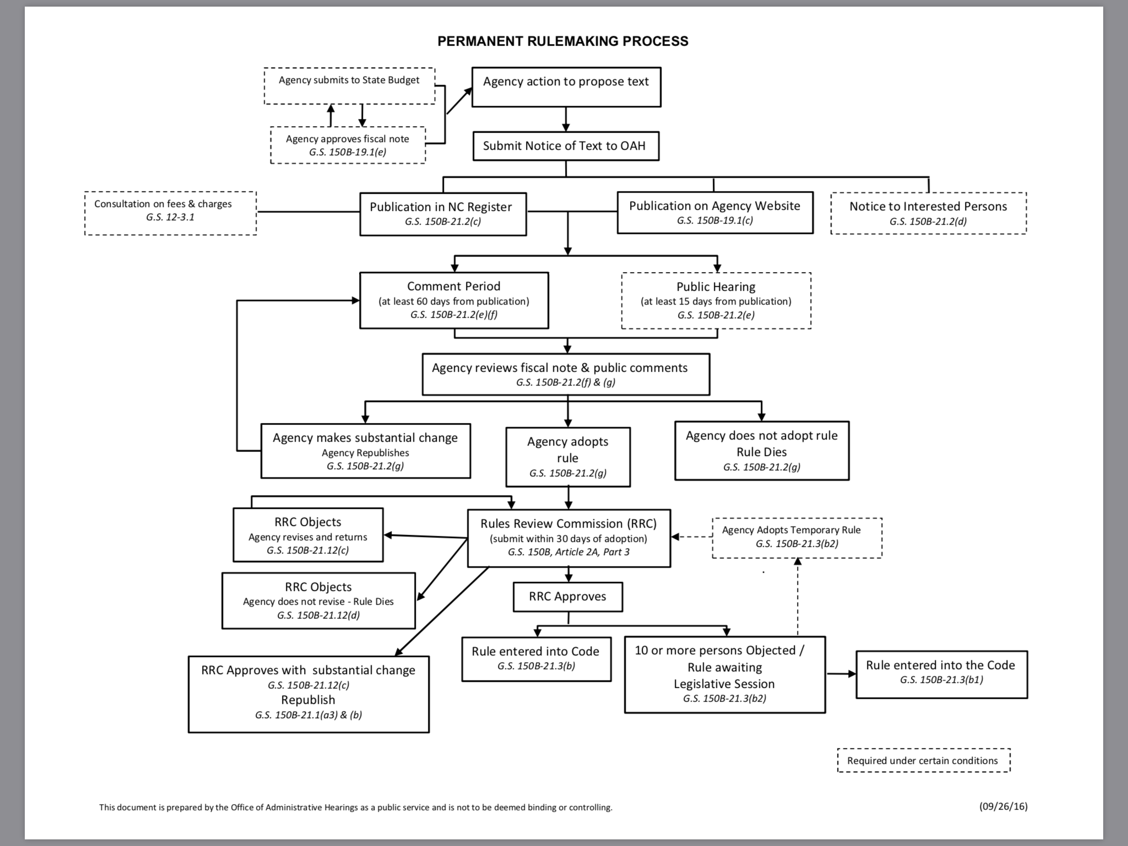

Slide 6
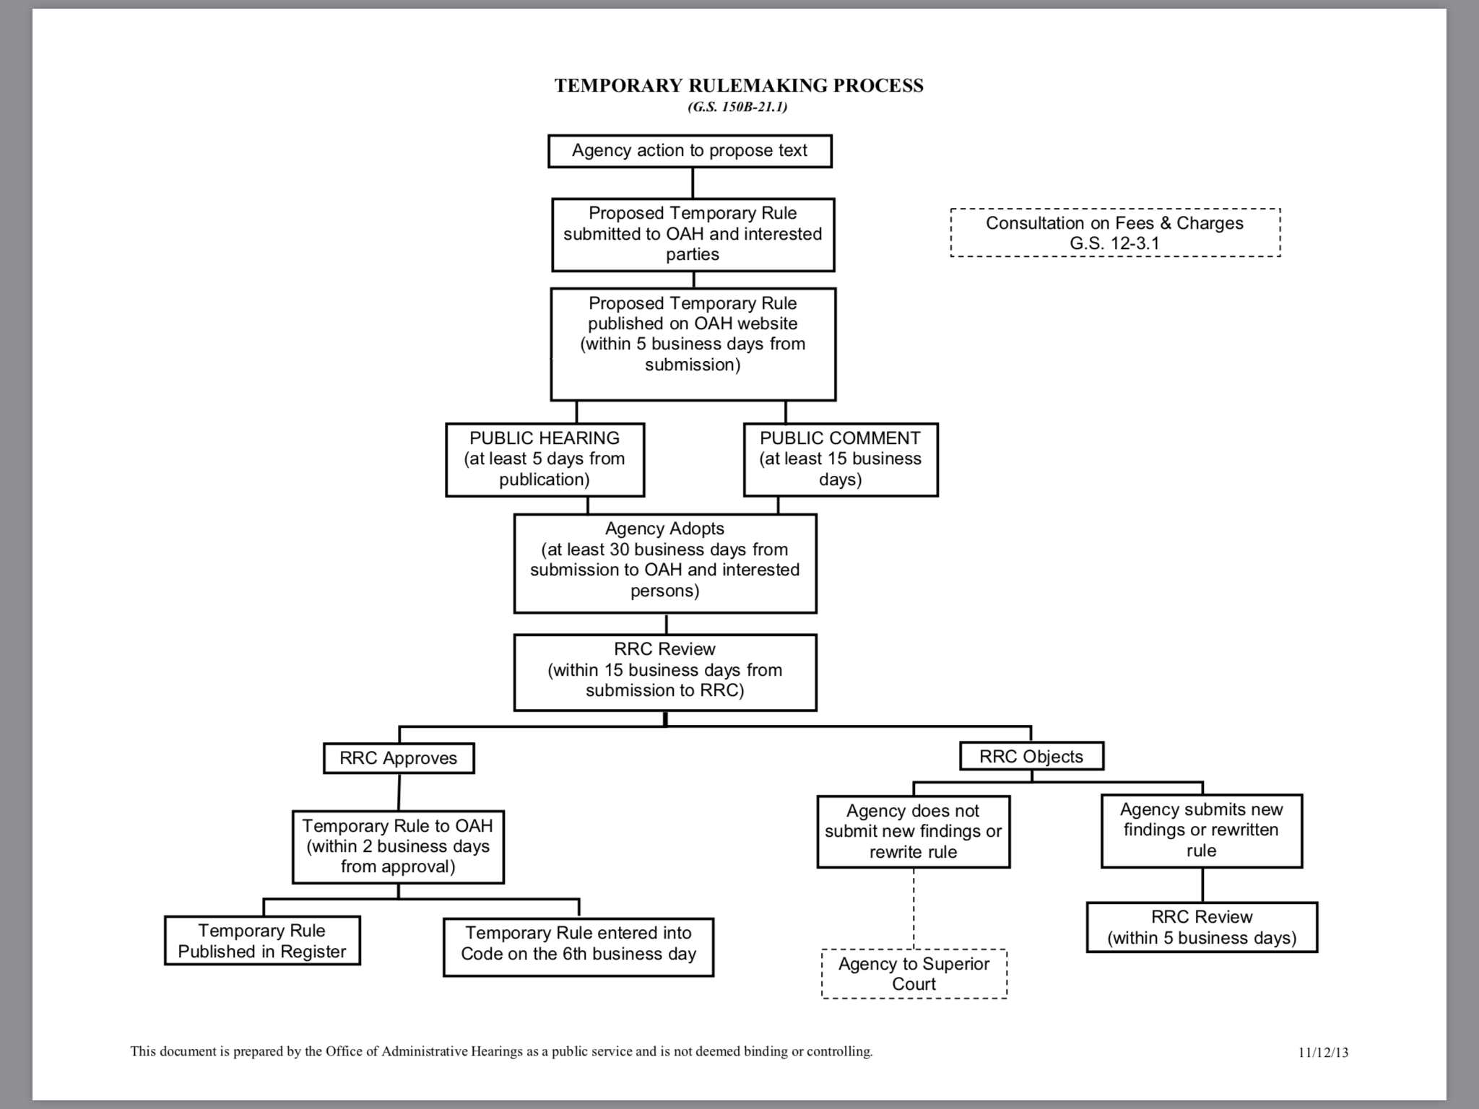

Slide 7
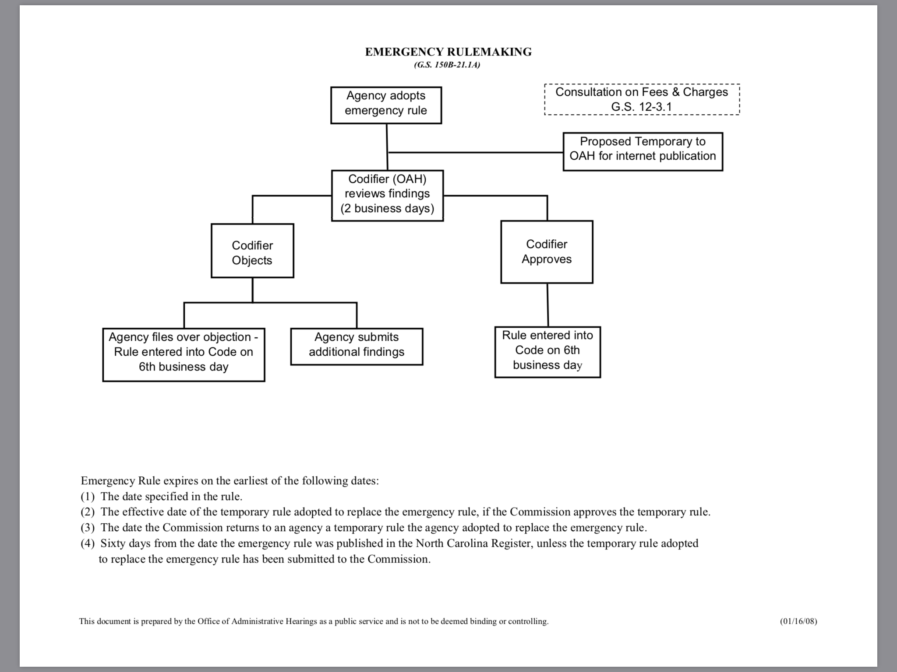

Slide 8
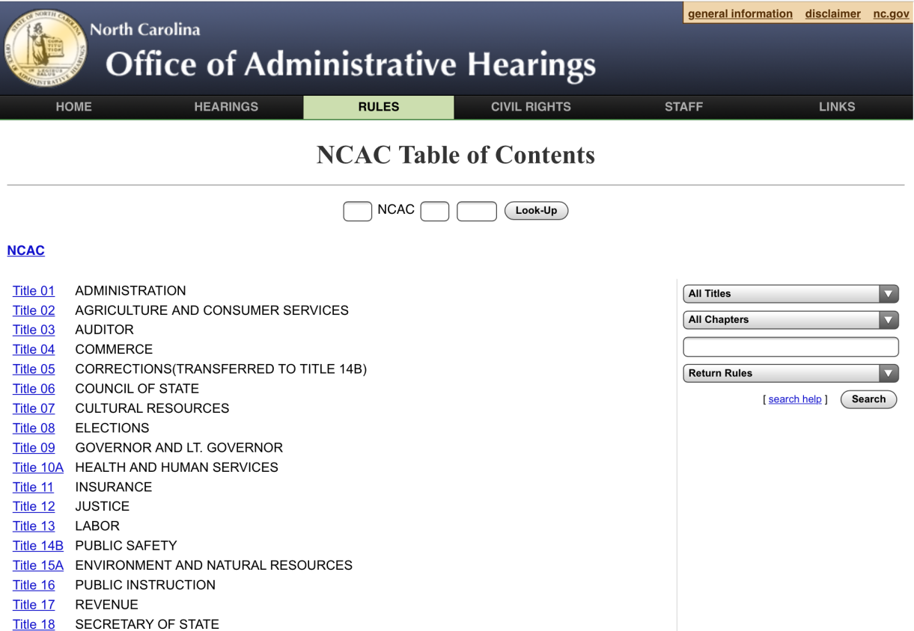
NC Public Health Statewide Rules
Adopted by NC Commission for Public Health
NC Administrative Code (NCAC)
Environmental health rules: Title 15A, Subchapter 18A
Other public health rules: Title 10A
Citation example: 15A NCAC 18A. 2650
On-line at http://reports.oah.state.nc.us/ncac.asp

Slide 9
Interpreting Rules for Practice
Agency policies or guidance regarding how laws will be enforced
Example: Position statements

Slide 10
State Tort Claims Act (STCA)
Claim against local employee can be brought under STCA if:
Local employee authorized to enforce state rules
Claim of negligence arises out of enforcement of state rules
Local employee acting within scope of role as state agent when negligence occurred
AG’s office defends claims
Only if state rules involved
Local rules → local attorney
State pays damages if state rules involved
Issue: No budget line item;
Expect local government to be asked to contribute

Slide 11
Local Boards of Health

Slide 12
Local health department | Local board of health | Local health director
County health department | County board of health or BOCC* | Local health director
District health department | District board of health | Local health director
Consolidated human services agency | Consolidated human services board or BOCC* | Consolidated human services director**
Public health authority | Public health authority board | Public health authority director
Public hospital authority (Cabarrus only) | Public hospital authority board | Public hospital authority director
* Board of county commissioners may assume powers & duties of board
** CHS director must appoint person with local health director education/experience

Slide 13
Types of Local Public Health Agencies and Boards as of February 2018
County health department with county board of health
County health department governed by board of county commissioners
District health department with district board of health (6 districts delineated by different shades of purple)
Consolidated human services agency with consolidated human services board
Consolidated human services agency governed by board of county commissioners
Public health authority with public health authority board
Public hospital authority with hospital board authorized to act as board of health

Slide 14
Local Board of Health
Membership (if appointed)
Powers and duties
County commissioner
Physician
Dentist
Optometrist
Veterinarian
Registered nurse
Pharmacist
Professional engineer
3 general public members
Make policy for local public health agency
Adopt local public health rules
Adjudicate disputes regarding local rules or locally imposed public health administrative penalties (fines)
Impose local public health fees
Satisfy state accreditation requirements for local boards of health

Slide 15
Board of Health Rulemaking
“A [board of health] shall have the responsibility to protect and promote the public health. The board shall have the authority to adopt rules necessary for that purpose.”
G.S. 130A-39

Slide 16
What is a local public health rule?
A local law that is necessary to protect or promote public health, and that is adopted by the local board of health or other body authorized by law to exercise the powers and duties of a board of health.
Applies to jurisdiction covered by the local board, including within municipalities.
Has the “force of law” – there are legal means to enforce the rule against those who do not comply.

Slide 17
Who makes local public health rules?
Authorized to make PH rules
Not authorized to make PH rules
County board of health
District board of health
Consolidated human services board (if consolidated agency includes public health)
Public health authority board
Board of county commissioners if and only if it has assumed the powers and duties of the board of health or consolidated board under G.S. 153A-77(a)
A board of county commissioners that has not assumed the powers and duties of board of health or consolidated board
May address some PH issues through ordinance authority, but that’s different from PH rulemaking
Advisory boards or committees, including those required by G.S. 153A-77(a)

Slide 18
What can a public health rule do?
Prohibit residents from doing something or
Require residents to do something

Slide 19
What can a public health rule address?
Basic statutory requirement: Protection and promotion of the public health
Limitations on subject matter:
Statutory
Peedin test
State preemption of local authority

Slide 20
Peedin test
A board of health rule must:
Be related to the promotion or protection of health,
Be reasonable in light of the health risk addressed,
Not violate any law or constitutional provision,
Not be discriminatory, and
Not make any distinctions based on policy concerns traditionally reserved for legislative bodies.
City of Roanoke Rapids v. Peedin, 124 N.C. App 578 (1996)

Slide 21
Statutory limitations
No local rules concerning the issuing of grades and permits to food and lodging facilities. G.S. 130A-39(b).
Local rules for on-site wastewater management must be as stringent as state rules and approved by state. G.S. 130A-39(b); 130A-335(c).
Local rules regarding smoking in public places must abide by statutory restrictions and must be approved by county commissioners. G.S. 130A-498.

Slide 22
Interaction with state laws
If a local board adopts a rule addressing an issue that state law already addresses, local rule might be preempted.
Some areas simply off-limits to local regulation.
However, state law specifically allows more stringent local public health rules on some subjects regulated by state public health rules.
May not have a less stringent local rule.
More stringent local rule may be allowed if required to protect the public health. G.S. 130A-39(b).

Slide 23
What if state has a regulatory scheme?
If there is a complete and integrated regulatory scheme, board must explain why more stringent local rules are needed to respond to local health need.
Craig v. County of Chatham, 356 N.C. 40 (2002)

Slide 24
What is the procedure?
Is the rule within the board’s rulemaking authority?
Statutory authority and limitations
Preemption
Peedin test
Can you make the public health case?
Relationship to protection/ promotion of health
Rationale for more stringent local provisions (if applicable)
Are you ready to give notice of rulemaking?

Slide 25
Two laws require notice
Open meetings law
BOH rulemaking law

Slide 26
Notice under open meetings law
Regular board meetings – meeting schedule must be filed in place where public may access (such as with county clerk), and posted on website
Special meetings - at least 48 hours’ advance notice on website and principal bulletin board, plus provide directly to anyone who has previously asked to be notified of meetings

Slide 27
Notice required by rulemaking law
Different from open meeting notice; must be provided in addition to open meeting notice
Applies to:
Adoption of new rules
Amendment of existing rules
Repeal of existing rules

Slide 28
Notice required by rulemaking law
10 days
Ten days before proposed action:
Make rule available in county clerk’s office
Publish a notice in a newspaper of general circulation stating:
Substance of proposed rule or a description
Proposed effective date
That copies are available at the health department
G.S. 130A-39(d)

Slide 29
Rule versus ordinance
 | Local PH Rule | County Ordinance
Who makes it? | Local board of health (or other body that has board of health powers & duties) | Board of county commissioners
Where does it apply (territorial jurisdiction)? | Throughout jurisdiction, including in municipalities | Unincorporated areas of county only (unless municipalities agree to be governed by it)
What may the subject matter be? | Protection and promotion of public health (some limitations apply) | Variety of matters, including some relating to public health
Enforcement | Public health remedies in Ch. 130A | Broader authority to impose administrative fines or make violation an infraction

Slide 30
BOH Adjudications
Someone is aggrieved by a local health department’s interpretation or enforcement of a local rule, or the imposition of a local administrative penalty, so they appeal to the BOH, which acts as a court
Procedures are in GS 130A-24
Key points:
Applies to local actions
Follow procedural requirements to the letter
Get help from attorney

Slide 31
BOH-Imposed Fees
Boards of health may impose fees for some services
Fees must be based on a plan that is:
Recommended by the local health director,
Approved by the board of health, and
Approved by county commissioners

Slide 32
Limitations on fees
No fees when health department is acting as agent of the state (most EH programs)
Exceptions: on-site wastewater, swimming pools, tattooing regulation, local program for inspecting & permitting drinking water wells
Regulatory fees must be reasonable (cost-based)
Clinical fees generally reflect Medicaid reimbursement rates – patients may not be charged for some clinical services

Slide 33
Limitations on fees
NC public health laws (Ch. 130A)
Other laws
No fees for:
Sickle cell testing & counseling
Testing and treatment for TB and STDs
HIV testing and counseling (but not treatment)
Limitations on fees for required childhood immunizations
No cost to children from families that:
Have incomes below 200% FPL, and
Are uninsured or underinsured
Examples:
Title VI: No fees for language assistance
HIPAA: Limits on fees for copies of medical records

Slide 34
Public health remedies

Slide 35
How do you get people to comply with public health laws?
Usually seek voluntary compliance first—educate, persuade.
If that doesn’t work, NC law provides several public health remedies – that is, legal means for enforcing the public health laws.

Slide 36
Public Health Remedies
Injunction
Public health nuisance
Administrative penalties
Imminent hazard
Embargo
Permit Actions
Misdemeanor Charge
Infraction (smoking only)

Slide 37
Questions about remedies
What is a particular remedy?
When may it be used?
What is the process for using it?
When should it be used?
What if it doesn’t produce the desired result?

Slide 38
Imminent Hazard – G.S. 130A-20
Procedure
Determine and document that an imminent hazard exists, referring to the statutory definition of “imminent hazard”: a situation that, if no immediate action is taken, is likely to cause: An immediate threat to human life, or An immediate threat of serious physical injury, or An immediate threat of serious adverse health effects, or A serious risk of irreparable damage to the environment. Local health director or state health director decides whether to issue an abatement order or directly abate the imminent hazard. Order: The order may be issued to the owner, lessee, operator, or other person in charge of the property, and may direct the owner to take the action(s) necessary to abate the hazard. Abate: If the director chooses to abate instead, he or she must first notify (or make a reasonable attempt to notify) the owner, lessee, operator, or other person in charge of the property. After the notification (or reasonable attempt) is made, the director is authorized to enter the property and take any action necessary to abate the imminent hazard. All actions by the health director should be documented with the date and time noted. If the director chooses to abate, the costs of abatement should be documented. If the health director elects to abate the imminent hazard, rather than ordering abatement, the health department will incur the costs of abatement but ordinarily will have a lien on the property for recovery of the costs. However, the lien may be defeated in either of two circumstances: If it is shown that an imminent hazard did not exist at the time of the abatement, or Even if an imminent hazard did exist, if the owner, lessee, operator, or any other person against whose property the lien has been filed can demonstrate that he or she was not culpable in the creation of the imminent hazard.
Summary
An imminent hazard is a situation that, if no immediate action is taken, is likely to cause an immediate threat to human life, or an immediate threat of serious physical injury or serious adverse health effects, or a serious risk of irreparable damage to the environment.
After determining that an imminent hazard exists, a health director may either issue an abatement order, or take direct action to abate the hazard.
If the director elects to abate rather than order abatement, the health department will incur the costs. Ordinarily the department will have a lien on the property for the costs, but the lien may be defeated in some circumstances.

Slide 39
Injunction (G.S. 130A-18)
What
A court order telling a person to stop doing something
When
When a person violates a NC public health statute or rule, or a local board of health rule
How
Determine and document specific violation
Local health director seeks injunction in Superior Court
Work with department attorney or AG
TRO, preliminary injunction, permanent injunction

Slide 40
Misdemeanor (G.S. 130A-25)
What
Criminal charge for violating public health laws
When
When a person violates any NC public health statute or rule except those pertaining to smoking in public places
How
Determine and document specific violation
Class 1 misdemeanor (see G.S. 14-3)
Initiate charge with magistrate in county where violation occurred
Prepare for trial in District Court
Consult with attorneys (assistant DA, department)

Slide 41
Public health nuisance (G.S. 130A-19)
What
An order directing a property owner or other person in charge of the property to abate a public health nuisance
When
When the health director determines a public health nuisance exists on the property
How
Determine and document existence of public health nuisance
If person does not comply, ask Superior Court to enforce
Local health director issues abatement order

Slide 42
What do those terms mean?
Public health nuisance
Not defined in statute
Abate
Not defined in statute
What to consider:
Elements to consider:
Situation on property
That interferes with the health of the public
In a way that is both substantial and unreasonable
Specific actions
That are necessary
To terminate or reduce the public health problem

Slide 43
Imminent hazard (G.S. 130A-20)
What
Legal authority to act or order action to abate an imminent hazard
When
When health director determines there is a situation that requires immediate action to avoid an immediate threat to human life, an immediate threat of serious physical injury or serious adverse health effects, or a serious risk of irreparable damage to environment
How
Determine and document existence of imminent hazard
Local health director may choose: order person in charge of property to abate, or directly abate the imminent hazard

Slide 44
What do those terms mean?
Imminent Hazard
Defined in G.S. 130A-2
Abate
Not defined in statute
What to consider:
Immediate threat to human life, or
Immediate threat of serious physical injury, or
Serious risk of irreparable damage to environment
Specific actions
That are necessary
To terminate or reduce the threat or risk that the situation creates
A situation that is likely to cause:
Immediate threat of serious adverse health effects, or

Slide 45
Imminent hazard: order vs. abate?
Order
Issue abatement order to person in charge of property
Abate
Make reasonable attempt to notify person in charge of property that abatement will occur
Order should direct person to take specific actions to abate the imminent hazard
Take actions to abate
Health department will incur costs up-front but ordinarily acquires lien on property

Slide 46
Public health nuisance (G.S. 130A-19)
Remedy
An order directing a property owner or other person in charge of the property to abate a public health nuisance
May be used
When the health director determines a public health nuisance exists on the property
Process
Determine and document existence of public health nuisance
If person does not comply, ask Superior Court to enforce
Local health director issues abatement order

Slide 47
Administrative penalties (G.S. 130A-22)
What
Monetary fine imposed for violation of certain public health laws
When
May be imposed by state agency for violations of state OSWW laws, or state lead certification laws
How
Determine and document violation & recommend penalty be imposed
May be imposed by local health director for violations of local OSWW rules, or state or local smoking statutes or rules
Consult relevant state laws for procedures to follow and maximum amounts of penalties (vary by program and violation)

Slide 48
Smoking law violations
Written notice of violation
Written notice of violation, notify administrative penalties possible
Administrative penalty of up to $200 per violation

Slide 49
Permit actions (G.S. 130A-23)
What
Procedure for suspending or revoking a permit
When
When there is a violation of the statutes, regulations, or a condition placed upon a permit or
How
Intent to suspend or revoke: notice, opportunity for hearing
When a permit was issued based upon incorrect or inadequate information that materially affected the decision to issue the permit
Immediate revocation or suspension: determine violation presents imminent hazard, give notice of immediate revocation or suspension

Slide 50
What do those terms mean?
Due process
Notice & opportunity to be heard
Imminent hazard
A situation which, if no immediate action is taken, is likely to cause:
Intent to suspend or revoke:
Advance notice of intent
Administrative hearing on request
Immediate suspension or revocation allowed if imminent hazard
No advance notice
After-the-fact opportunity to appeal
immediate threat to human life
immediate threat of serious physical injury
immediate threat of serious adverse health effects; or
serious risk of irreparable damage to the environment

Slide 51
Rules of thumb for permit actions
Suspend
Revoke
If problem can be fixed
If problem can’t be fixed
Sometimes the law dictates immediate suspension or revocation

Slide 52
Embargo (G.S. 130A-21)
What
An order to detain food or drink that is adulterated or misbranded
When
Public health’s embargo authority applies only to establishments that are regulated by public health laws, or that are the subject of a communicable disease investigation
How
Affix tag to embargoed item(s)
Public health officials with embargo authority: state EH agency (including regionals), local health director in consultation with regional specialist
Warn all persons not to remove or dispose of item(s) without permission
Petition a court for a condemnation order

Slide 53
What do those terms mean?
Adulterated
Contains something injurious to health
Misbranded
False or misleading label
Diseased, contaminated, filthy, putrid, decomposed, otherwise unfit to be food
Kept in conditions that have allowed it to become contaminated or otherwise unwholesome or injurious to health
Full description in GS 160-129
“Sell by” date removed, obscured, altered
Full description in GS 160-130
Imitation and not labeled as such
Missing or incomplete label

Slide 54
Contact information
Jill D. Moore, JD, MPH
UNC School of Government
919-966-4442
moore@sog.unc.edu
www.ncphlaw.unc.edu

