Slide 1
Intro 1
Module 6: Contracts, Part 2
Putting Branches on Your Tree

Slide 2
Learning Contract Law

Slide 3
How to Analyze a Contracts Case
Is there a contract?
Who are the parties to the contract?
What are its terms?
Did defendant breach the contract?
What damages is plaintiff entitled to recover?

Slide 4
Putting Branches on Your Tree
Criminal sanctions/punitive damages
Agency
Statute of Frauds (K must be written)
Coercion/fraud
Frustration of purpose
Capacity to consent (minors/incompetents)
Specific performance
Consideration
Unconscionability
Compensatory damages
Apparent authority
Power of attorney
Contract to commit a crime
Impossibility of performance
Parol Evidence Rule
Special rules for special kinds of contracts

Slide 5
Contract?
Capacity to consent?
Supported by consideration?
Parties
Party represented (or apparently represented) by agent? (Caution spouses, businesses)
Terms
Determining terms: Best Evidence Rule & Parol Evidence Rule
Implied terms: UCC/Implied warranties
Offer & acceptance/not mere negotiations
Illegality?
“Consent” attained by coercion or fraud?
Joint and several liability
Consumer Protection Reach-In: RISA
Missing Terms: Void contract or fill-in blank with “reasonable”?
Materiality requirement/”time is of the essence”

Slide 6
“Under the [Best Evidence] Rule, a document is considered the “best evidence” of its contents; secondary evidence of the contents will generally be excluded if the document itself can be produced.”
Parol Evidence Rule: We’re going to enforce the agreement of the parties based on what they’ve written down.

Slide 7
Can you hear this evidence?
Action for money damages arising out of breach of contract for construction of gazebo. The written contract between the parties is detailed with regard to the finished product, and the gazebo complies with all written terms of the contract. The contract is silent, however, on the number of sides the gazebo should have. The completed gazebo has five sides, but the plaintiff wants to testify that she specified six sides during contract negotiations and that defendant responded by saying, “Sure, no problem!” The defendant says he has no memory of this and argues that you should go by what’s written down.

Slide 8
Implied Warranty of Merchantability: Air conditioners cool the air.
Applies only to merchants. Excluded by “As Is.”
Implied Warranty of Fitness for a Particular Purpose: “Are these the right running shoes if I’m training for a marathon?”
Don’t forget express warranties! Distinguish “puffery.”
Re UCC Art. 2: Contracts for the sale of goods must be written if for $500+ and 4-year S/L applies.

Slide 9
“Under the [Best Evidence] Rule, a document is considered the “best evidence” of its contents; secondary evidence of the contents will generally be excluded if the document itself can be produced.”
Parol Evidence Rule: We’re going to enforce the agreement of the parties based on what they’ve written down.

Slide 10
Retail Installment Sales Act: GS Ch. 25A (Small Claims Law pp. 81-84)
Regulates purchase of consumer goods on installment plan.
Detailed handout available on website under Module 6/Additional Resources
Example of RISA rule:
§ 25A-8. "Finance charge" defined. (a) "Finance charge" means the sum of all charges payable directly or indirectly by the buyer and imposed by the seller as an incident to the extension of credit.”
Loan fee, credit report, service fee, time-price differential, credit life insurance payable to seller, . . .

Slide 11
Breach
Frustration of purpose
Remedy
Compensatory damages: Non-breaching party returned to position K’d for
Liquidated damages clause enforceable if reasonable & not penalty
Impossibility of performance
Other party breached first (recission)
Waiver
Duty to mitigate

Slide 12
Breach
Frustration of purpose
Impossibility of performance
Other party breached first (recission)
Waiver

Slide 13
Remedy
Compensatory damages: Non-breaching party returned to position K’d for
Liquidated damages clause enforceable if reasonable & not penalty
Duty to mitigate

Slide 14
Liquidated damages clause
“Tenant understands that no pets are allowed on the rental property and that if tenant is found to have a pet on the premises – whether visiting or not, and regardless of the type of animal involved – tenant agrees to pay a $500 non-refundable pet fee to be applied to the length of the tenancy up to that point and to immediately remove the animal.”

Slide 15
Remedy
Compensatory damages: Non-breaching party returned to position K’d for
Liquidated damages clause enforceable if reasonable & not penalty
Attorney fees if (1) provided for in contract, and (2) authorized by statute
Pre-judgment & post-judgment interest
Duty to mitigate

Slide 16
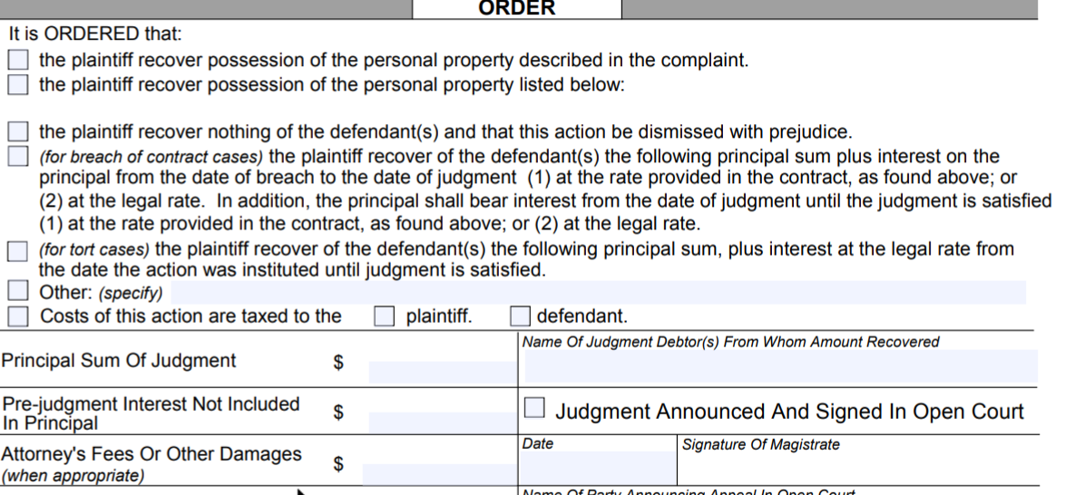

Slide 17
Contract Problem for Discussion Groups
Breach of contract case brought by Mr. Jones, who testifies that he made an interest-free loan to Ms. Smith in the amount of $1500 in exchange for her promise to hire him to harvest her soybean crop when it was ready. When the time came, however, Ms. Smith did the job herself.
Mr. Jones is suing for $200 lost profit.
Ms. Smith testifies that Mr. Jones stated, “I can lend you the money -- how about when harvest time rolls around, you think of me?"
She says she attempted to hire Mr. Jones, but that he told her he couldn't get to the job for at least 2 weeks, and that she couldn't wait that long.
Mr. Jones offers rebuttal testimony that he actually said, "I can lend you the money, and when harvest time rolls around, call me and I'll come harvest it for you, and give you a good price, too."
Also, when Ms. Smith called him, he told her he was pretty busy for the next couple of weeks, but he'd see if he could shift the schedule around. The very next day she did the job herself.
Did Ms. Smith breach the contract?

Slide 18
In our next episode . . .

Slide 19
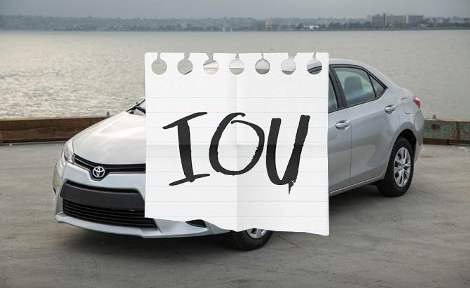
Also starring !!!!!
Motor Vehicle Liens

