Slide 1
Regulation of Short Term Rentals and Occupancy Tax Basics
Chris McLaughlin Rebecca Badgett

Slide 2
Agenda
1.
2.
Market Context
Step-by-step Guide to Effective STR Regulation
3.
4.
A look at other jurisdictions
Transient Occupancy Tax

Slide 3
Charming Charleston Carriage House
$100 per night.

Slide 4
So many choices! MisterBnb,
Evergreen Club (over 50)

Slide 5
Market Overview
Partial Home 13%
Entire Home 83%
Unknown 4%
Single Family 75%
Multi Family 19%
Unknown 6%

Slide 6
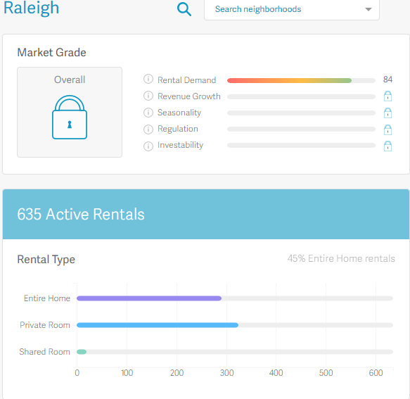
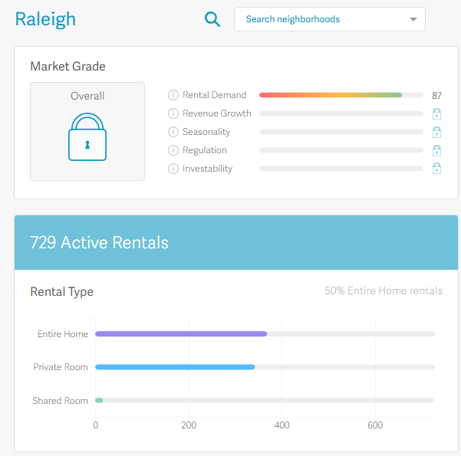
April 2018
June 2018

Slide 7
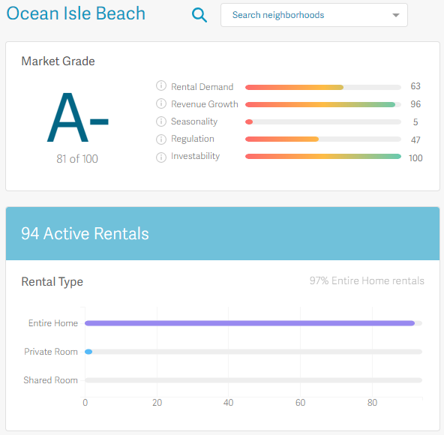
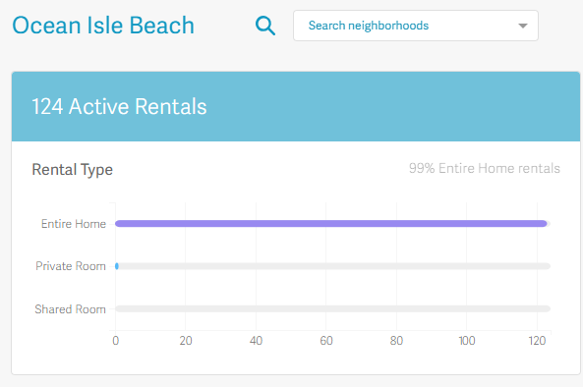
April 2018
June 2018

Slide 8
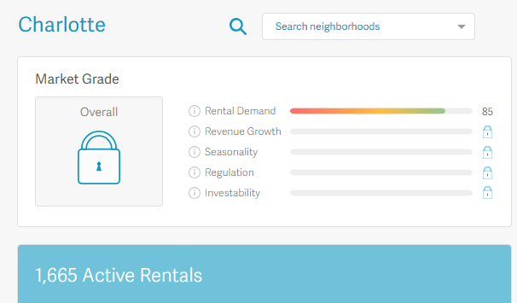
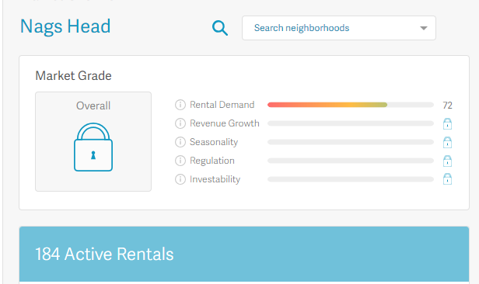

Slide 9
NC STR Market
NC residents who rented out their homes on Airbnb in 2017 made $97 million
Asheville: 20 million. 160,000 guests
Charlotte: $8.7 million
Wilmington: $3.9 million
Raleigh: $3.8/Durham: $2.3
Boone: $2.3

Slide 10
Preemption By State

Slide 11
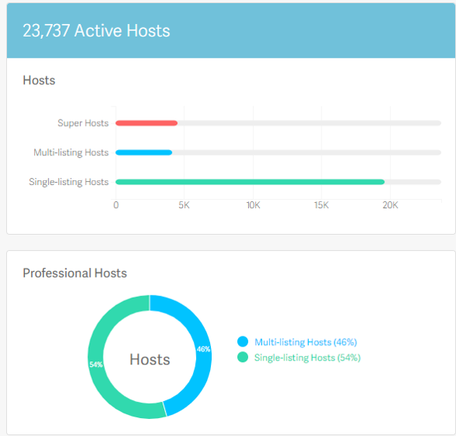
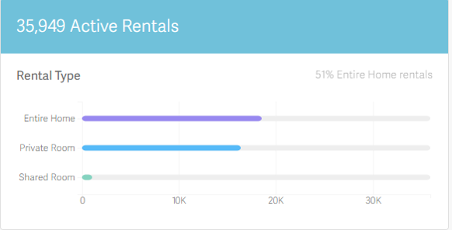
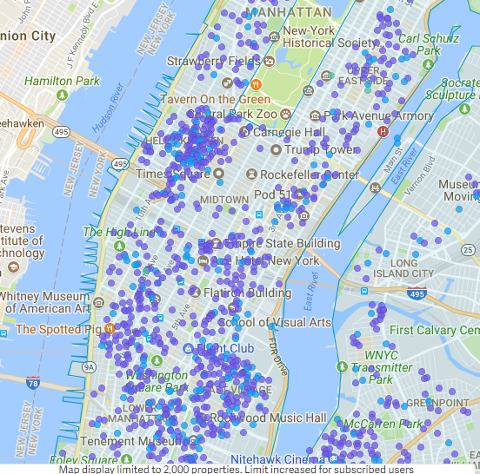
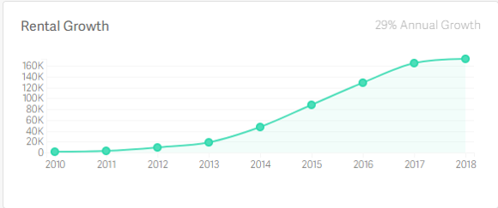
New York, New York

Slide 12
Arizona. Wisconsin. Idaho. Florida
A COUNTY MAY NOT PROHIBIT VACATION RENTALS OR SHORT-TERM RENTALS, RESTRICT THE USE OF VACATION RENTALS OR SHORT-TERM RENTALS OR REGULATE VACATION RENTALS OR SHORT-TERM RENTALS BASED SOLELY ON THEIR CLASSIFICATION, USE OR OCCUPANCY.
A COUNTY MAY REGULATE VACATION RENTALS IF THE REGULATION IS NARROWLY TAILORED TO PROTECT THE PUBLIC HEALTH AND SAFETY
PROTECTION OF THE PUBLIC’S HEALTH AND SAFETY CAN INCLUDE RULES AND REGULATIONS RELATED TO FIRE AND BUILDING CODES, HEALTH AND SANITATION, TRANSPORTATION OR TRAFFIC CONTROL, SOLID OR HAZARDOUS WASTE AND POLLUTION CONTROL.

Slide 13
What does this mean to you?
Complete bans on STRs or over-regulation may draw unwanted legislative attention and result in the legislature taking preemptive measures that would limit local authority to regulate

Slide 14
Two Components of STRs
Land Use Enforcement
Occupancy Tax Collection
May choose to operate on a complaint-driven basis
Use existing regulations to handle issues (nuisance, noise)
Adopt reasonable regulations specific to STRs
Honor system without additional collection efforts
Proactive approach to ramp up enforcement

Slide 15
North Carolina: Authority To Regulate
Regulation Allowed: Police Powers
Concerns:
Unlawful to regulate ownership of property
Permitting violates G.S. 153A-364 and/or G.S. 160A 424
NC Vacation Rental Act bans local governments from prohibiting STR’s
No evidence that the Vacation Rental Act was intended to preempt local regulation

Slide 16
Steps To Effective STR Regulation
Research & Data Gathering
Defining Planning Objectives
Ordinance Drafting
Revision and Incorporating Feedback
Ordinance Adoption

Slide 17
Poll #1: Where are you in your
ordinance drafting process (if applicable)
Research and data gathering phase
Defining planning objectives
Ordinance drafting
Soliciting and incorporating feedback on draft
Already adopted a SRT ordinance

Slide 18
Step1: Data Gathering
Quantitative Data
Number of listings
Type and size of units
Price per night
Usage
Local Context
Housing availability/affordability
Existing lodging options
Demographics
Existing laws or ordinances

Slide 19
Step 2: Define Planning Objectives
Planning Objectives:
Housing Availability
Neighborhood Preservation
Economic Development
Health & Safety
Regulatory Consistency

Slide 20
Enforcement Considerations
Current Enforcement Capabilities?
Is the city getting the results it desires?
Anticipated Enforcement Resources
Can you afford to bring on extra staff to enforce new regulations?
Will you contract with a third-party vendor to help with compliance? How will you pay for this?
What is the local government’s overall position?
Supportive of reasonable regulations?
This is a cross-disciplinary issue. Planning, Finance, Public Safety, Legal, and Economic Development personnel must communicate.
If land use regulations are not being enforced, hosts may be surprised when the tax department goes after them for unpaid occupancy taxes.

Slide 21
Step 3: Drafting an Ordinance
What is the purpose?
Establish clear purpose and definitions
Who Can Host?
Ownership requirements
Permanent resident
Investor
What does the permitting process entail?
Will you require registration and permitting?
What info necessary
Online application
What are the renewal and revocation procedures
Will you require hosts to display their permit number in the property advertisements?

Slide 22
Savannah, GA
Purpose
Sec. 8-10010. - Intent; purpose. It is the purpose of this chapter to protect the public health, safety and general welfare of individuals and the community at large; to monitor and provide reasonable means for citizens to mitigate impacts created by occupancy of short-term vacation units; and to implement rationally based, reasonably tailored regulations to protect the integrity of the city's neighborhoods.
Certificate Application Process (very involved)
Short term vacation rental certificate application must include:
All identifying information for the owner of record and the address of the rental unit/proof of ownership
Contact information for the rental agent—person designated by the owner to be reasonably available 24/7
Number and location of parking spots
Sworn code compliance verification form
Proof of insurance indicating that the premise is used as an STR
For condominium owners, a copy of the condominium declaration showing that STRs are not prohibited
Copy of a written rental agreement that the owner is responsible for executing with the occupant(s)
STR certificate holder shall publish a short-term vacation rental certificate number and exemplar rental agreement in every print, digital or internet advertisement of the property.

Slide 23
Nashville, TN
No person or entity shall operate a STR or advertise a residential property for use as a STRP without the owner of the property first having obtained a STRP permit issued by the department of codes administration in accordance with the provisions of this chapter.
Designate a responsible party residing within 25 miles of the STR
Provide proof of insurance coverage of not less than one million dollars per occurrence
Proof of written notice to each adjacent property owner
Statement that short term rentals do not violate any home owners association agreements, etc.
Proof of payment of all taxes due, including property taxes. For renewals, proof of paying the occupancy tax is required
Any advertising or description of a STRP on any internet website must: (a) prominently display the permit number for the STRP unit; or (b) include an image of the permit, or a link to an image of the permit, in which the permit number is legible.

Slide 24
Land Use and Zoning Considerations
Existing Land Use Categories
Districts and Neighborhood Boundaries
Unit Density Control
.

Slide 25
STR Unit Characteristics
Occupancy Limits
Helps limit party houses
Water/sewer issues
Limit number of bedrooms that can be rented in homestays
Nashville: The maximum number of occupants permitted on a STRP property at any one time shall not exceed more than twice the number of sleeping rooms plus four. Simultaneous rental to more than one party under separate contracts shall not be allowed. The occupancy maximum shall be conspicuously posted within the STRP unit. Advertising a STRP for more occupants than allowed by this regulation shall be grounds for revocation of the permit.
Boulder: Prohibits renting the dwelling unit and an accessory unit on the same property.

Slide 26
Host Operation Requirements
Interior & exterior signage
Designated rental agent
Notice to neighboring property owners
Insurance
Health and safety
Consider compliance checklist

Slide 27
Guest Requirements
Noise Ordinance
Vehicle/Parking Limits
Guest Registration
Environmental Concerns

Slide 28
Nashville
(a) All STRP occupants shall abide by all applicable noise restrictions and regulations regarding the public peace and welfare contained in the Metropolitan Code. . .
(b) The STRP shall meet all applicable requirements of the state and local building and fire safety codes, including, but not limited to, having approved smoke alarms installed as follows: i. In all sleeping areas. ii. In every room in the path of the means of egress from the sleeping area to the door leading from the sleeping unit. iii. In each story within the sleeping unit, including basements.
c. Parking: No recreational vehicles, buses, or trailers shall be visible on the street or property in conjunction with the STRP use.
d. No food shall be prepared for or served to the transient by the permit holder.

Slide 29
Step 4: Revision
Revise and incorporate feedback

Slide 30
Need Help?
Enforceable regulatory frameworks that simultaneously protects citizens' property rights and the rights of the neighbors
A dramatic reduction in noise, parking and trash complaints related to short-term rentals
Improved municipal finances resulting from higher TOT collections and permitting fees
Dramatically lower monitoring and enforcement costs

Slide 31
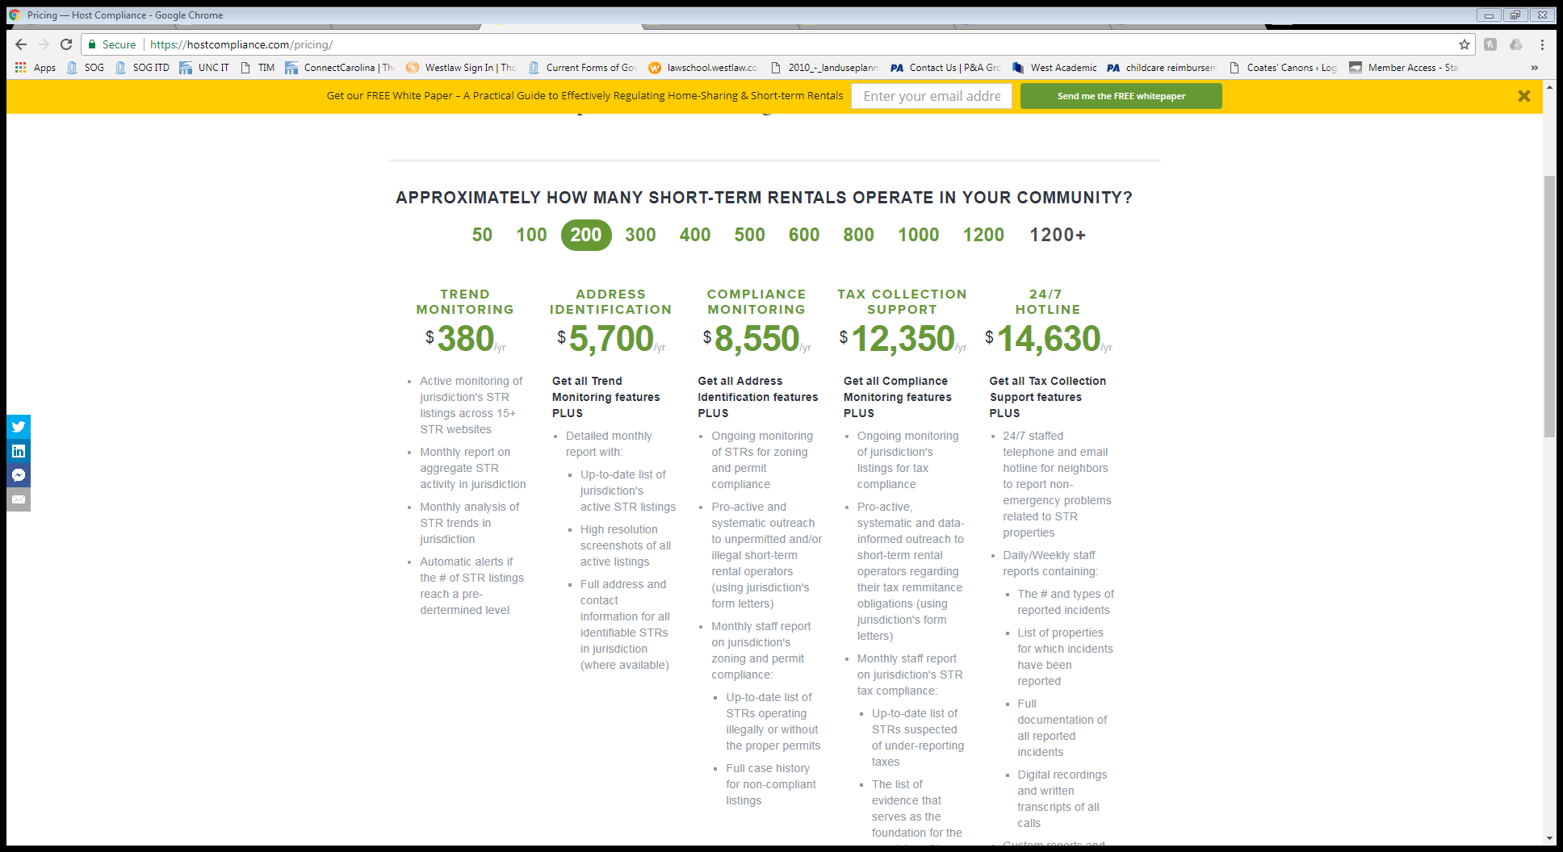
Cost

Slide 32
Summary
Clearly define a purpose
Registration
Allow for online registration of STRs rather than a traditional paper-based process
Consider keeping registration fees low to increase compliance
Use model ordinances
Initiate enforcement activities when an ordinance is passed or amended. Be prepared to act!
Compliance monitoring must be consistent
Make the regulations simple and enforceable

Slide 33
Local Occupancy Taxes

Slide 34
Poll #2: My jurisdiction is..
Already levying occupancy taxes
Not levying occupancy taxes now but considering levying occupancy taxes in the future.
No plans to levy occupancy taxes.

Slide 35
If you only remember one thing about local occupancy taxes, remember that . . .
It’s all about the local bill.

Slide 36
Why?
No general authority for local OT
No local bill = no local OT
Local bill will control:
Rate
Use of proceeds

Slide 37
How Do I Find My Local OT Bill?
List maintained by the General Assembly staff
Link in Coates’ Canons occupancy tax blog posts
Summarizes max rate, use of proceeds, unusual provisions
Search Session Laws on General Assembly’s website
https://www.ncleg.net/

Slide 38
General Admin Provisions
GS 153A-155 (counties)
GS 160A-215 (cities)
Links to both statutes in blog posts

Slide 39
S.L. 2013-414
Section 60 (link in blog posts)
Amended 15+ local bills to make those local OT conform to general provisions

Slide 40
Basic Steps for Local OT
Obtain local authorization
Adopt resolution (public hearing)
Create Tourism Development Authority
Collect taxes & distribute to TDA
TDA decides how to spend OT revenue

Slide 41
OT Rates
Check your local bill
Most capped at 3% or 6%
Lowest: 1% (Brunswick County)
Highest: 8% (Mecklenburg County)

Slide 42
Who is liable for OT?
A retailer who is required to remit to the Department of Revenue the State sales tax imposed by G.S. 105-164.4(a)(3) on accommodations is required to remit a room occupancy tax to the taxing city/county
GS 153A-155(c); GS 160A-215(c)
G.S. 105164.4(a)(3) points us to G.S. 105-164.4F
Which means . . .

Slide 43
No Unique Local OT Exemptions
Must honor the sales tax provisions in GS 105-164.4F . . .
Unless your local bill says something different (but it shouldn’t any longer)

Slide 44
GS 105-164.4F
Accommodation = “A hotel room, a motel room, a residence, a cottage, or a similar lodging facility for occupancy by an individual.”
Only 3 exceptions:
Private residence < 15 days per year and NOT listed with an agent
Accommodation rented to same person for >= 90 days
Accommodation included in tuition/fee for school or camp

Slide 45
Poll #3: Which of the following rentals would be subject to local OT?
Lakeside cabins owned by church and rented to public on weekly basis
Private cottage rented for 4 weekends per year via AirBnB
Beach house rented to the same family for all of June, July, and August
A and B only.
All of the above.
None of the above.

Slide 46
Poll #4: Which of the following is an “accommodation” for purposes of OT?
Bedroom
Houseboat
Campsite
A & B only.
All of the above.

Slide 47
Poll #5: What is the taxable price?
Mike rents a house on Bald Head Island for a week thru AirBnB. The rent is $3,000. As part of the rental, Mike is charged $200 in AirBnB service fees, $250 in cleaning fees, and a $50 damage waiver. Mike also buys a one-week family membership in the Bald Head Island Club for $300 thru the property owner. His total charge (before taxes) is $3,800.
What is the taxable price of this transaction for OT purposes?
$3,800
$3,500
$3,300
$3,250
$3,200
$3,000
It depends on your local bill.

Slide 48
Taxable Charges
Credit card fees or reservation/service fees
Damage waiver fees / security deposits (?)
Maid/cleaning fees
Resort fees
Early arrival/late departure fees
Extra person charges or crib/rollaway bed charges
Linen fees
“Peace of mind” fees (similar to insurance but provided by hotel or rental agency rather than third-party carrier)
Pet fees
See DOR guidance on course page
Notes:
NOTE to Chris: Removed underline so people do not think it is a clickable link

Slide 49
Other Charges
Not included in Taxable Price for OT:
Rental/use of separate personal property such as
beach equipment,
recreational equipment
audio-visual equipment
golf cart
Trip insurance paid to third-parties
Voluntary club memberships/guest privileges
Notes:
NOTE to Chris: Removed underline so people do not think it is a clickable link

Slide 50
Rental Agents and Facilitators
Who are they?
Responsibilities?
Rental Agent: liable for all taxes on rental
Facilitator:
liable for taxes collected from tenant
Taxes that should have been collected but were not?

Slide 51
OT Collection Remedies
Property tax remedies of attachment/garnishment and levy/sale available for ANY local tax
GS 153A-147 & GS 160A-207
No foreclosure (unless civil judgment obtained)
Set-off Debt Collection (GS 105A)
10-year statute of limitations

Slide 52
Who is responsible for OTs?
§ 105-164.4F. Accommodation rentals.
(c) Facilitator Transactions. . . . A facilitator that does not send the retailer the tax due on the sales price is liable for the amount of tax the facilitator fails to send. . . . A retailer is not liable for tax due but not received from a facilitator.

Slide 53
Who is responsible for OTs?
§ 105-164.4F. Accommodation rentals.
(d) Rental Agent. - A person who, by written contract, agrees to be the rental agent for the provider of an accommodation is considered a retailer under this Article and is liable for the tax imposed by this section. The liability of a rental agent for the tax imposed by this section relieves the provider of the accommodation from liability.

Slide 54
Poll #6: Liability for Occupancy Taxes
Roy rents out his beach house through Tar Heel Beach Vacations, Inc., a local rental agency. Occupancy taxes have not been paid on any rentals for summer 2018.
Which of these collection remedies are available to the town of Oak Island to collect the delinquent occupancy taxes?
Garnishment of Roy’s wages
Attachment of Tar Heel Beach Vacations, Inc.’s bank account
Foreclosure on the beach house
All of the above

Slide 55
Who is responsible for OTs?
The bad news:
Owners aren’t responsible for homes rented thru AirBnb or rental agents
The good news:
Rental agencies responsible for OTs on homes listed on AirBnb

Slide 56
OT Collection Remedies
No general successor liability
Roy owes occupancy taxes on his beach house.
Roy sells house to Mike.
Mike is not responsible for Roy’s unpaid occupancy taxes.
But check your local bill
Wake County incorporates sales tax successor liability GS 105-164.38(b)

Slide 57
Penalties for Late Payment
GS 105-236
Failure to file return:
5% per month up to 25% total
Failure to pay tax:
10%
How to calculate penalty if no return?

Slide 58
Use of Proceeds: Local Act Controls
Common Provisions
Establish a Tourism Development Authority (TDA)
Distribute OT proceeds to the TDA
(3% collection fee to city/county)
Permitted Uses of OT Revenue:
“promote travel and tourism”
“tourism-related expenditures”
OT returns and payment records NOT public

Slide 59
Town of Blowing Rock
Ordinance defines STRs as being a rental of 28 days or fewer. It bans STRs with the town’s limits.
Some residents have interpreted the town’s STR ordinance as allowing one rental for every 28-day period—not the intent of the ordinance
Loophole: Wealthy visitors will pay for 30 days, but only stay a week
Plans to use STR Helper software primarily for the purpose of identifying violators
Town anticipates that there will actually be a decrease in tax revenue once STR Helper is implemented
Residents who are illegally renting are still paying OT

Slide 60
Dare County, Outer Banks
Town of Nags Head—believes a substantial portion of TOT is being collected
This is because rental agencies and Airbnb remit the TOT directly to the county.
Payment cannot be made online
Allows whole-house STRs, but ordinance bans homestays/ room rentals
Affordable summer housing is an issue

Slide 61
Charlotte-Mecklenburg
Believes it is collecting most of the TOT, but wants to be more proactive
Contracting with Tax Management Services in the summer of 2018 to help locate properties
Has been allowing homeowners to remit TOT online since 2010
Tax Management Services allows fees to be paid on a contingent basis. No fee owed unless TOT violations are discovered
Educating the host is of paramount importance. Non-payment is usually not malicious

Slide 62
Summary
Lessons for Occupancy Tax Collection
Consider launching an educational campaign to increase awareness of the TOT (posters, commercials, local paper)
Implement an online tax payment portal
Suspend fines for previous non-compliance: take a clean-slate approach
Consider temporarily using software to help identify the STR properties listed on these sites.
Recognize your current success—you are collecting TOT, and probably a good portion of it

Slide 63
Evaluation:
https://unc.az1.qualtrics.com/jfe/form/SV_b2wZ5pTwqX8km5D

