Slide 1
North Carolina Laws & Foodborne Disease Response
Cris Harrelson, MPA, REHS
Food Defense Coordinator
David Sweat, MPH
Foodborne Disease Epidemiologist
North Carolina Division of Public Health

Slide 2
Applying Control Measures
August 4, 2011 – Hepatitis IgM Positive lab result assigned to Cumberland County Health Department
Patient had signs & symptoms consistent with disease
Was a food handler (wait staff) at a major restaurant chain located in Fayetteville
Worked during her infectious period before symptoms began

Slide 3
Appropriate Response
People with Hepatitis A are infectious for a week or more before onset of symptoms
People exposed to Hepatitis A may be vaccinated within 14 days of being exposed and prevented from progressing to disease
Restaurant Chain served more than 800 people per day during her work period
Patient worked on multiple days during her infectious period – more than 3,500 people were judged to be at risk

Slide 4
Cumberland County Immunization Effort
Coordinated with Division of Public Health & Ft. Bragg
Vaccine and immune globulin purchased by state and supplied to CCHD
Immunization clinics ran for more than 7 days
Key issues involved public information, communication with restaurant manager, applying control measures and immunizing the potentially exposed

Slide 5
Reporting Requirement
G.S. 130A-138
Operators of restaurants and other food or drink establishments are required to report to the local health director:
When the operator has reason to suspect an outbreak of foodborne illness in its customers or employees or
When it has reason to suspect a foodhandler at the establishment has foodborne disease or foodborne condition

Slide 6
Applying Control Measures
To determine the appropriate actions, we first had to determine the extent of exposure
Examined the ill worker’s job duties:
Member of wait staff
Handled clean, sanitized utensils, plates, glasses
Definition of “Food Employee” as defined in 1-201.10 of the FDA Food Code:
Food employee" means an individual working with unpackaged food, food equipment or utensils, or food-contact surfaces.
Definition of “employee” as defined in 15A NCAC 18A .2601(7):
"Employee" means any person who handles food or drink during preparation or serving, or who comes in contact with any eating, cooking, or processing utensils or equipment, or who is employed at any time in a room in which food or drink is prepared or served.

Slide 7
Applying Control Measures
North Carolina’s Current Rules:
15A NCAC 18A .2616(d):
No person who has a communicable or infectious disease that can be transmitted by foods, or who is a carrier of organisms that cause such a disease, or who has a boil, infected wound, or a disease with sudden onset and severe symptoms including cough or nasal discharge, shall work in a food service establishment in any capacity in which there is a likelihood of such person contaminating food or food-contact surfaces, with disease-causing organisms or transmitting the illness to other persons.

Slide 8
The Food Code Approach
Employee is required to report to the person-in-charge:
Diagnosis of the Big 5
Norovirus
Hepatitis A virus (HAV)
Shigella spp.
Enterohemorrhagic or Shiga toxin-producing E. coli (EHEC/STEC)
Salmonella Typhi (Typhoid fever)
Active symptoms
Vomiting
Diarrhea
Jaundice
Sore throat with fever, or
Lesion with pus or open infected or draining wound

Slide 9
Reportable History of Exposure
Consuming or preparing a food that caused an illness in another consumer due to a Big 5 pathogen
Consuming food at an event prepared by a person infected or ill with a Big 5 pathogen
Attending an event or working where there is a known disease outbreak
Close contact with a household member who is ill and diagnosed with a Big 5 pathogen or who works or attends an event where there is a known disease outbreak

Slide 10
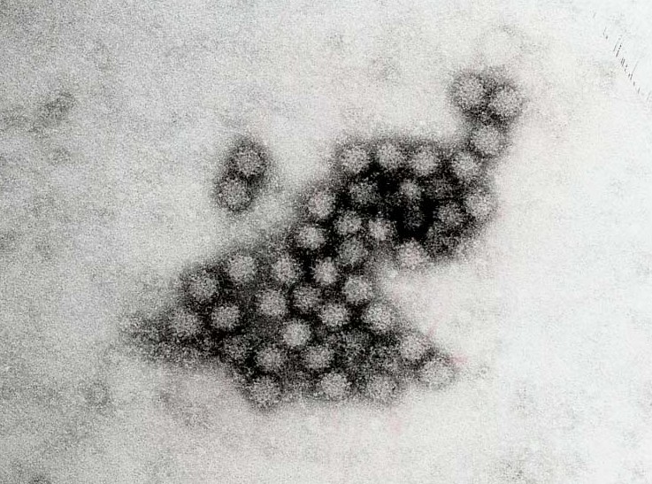
Time frame exposure to the Big 5 must be reported to the PIC
Norovirus- within 48 hours
Shigella spp.- within 3 days
EHEC/STEC- within 3 days
Salmonella Typhi (typhoid fever)- within 14 days
HAV- within 30 days

Slide 11
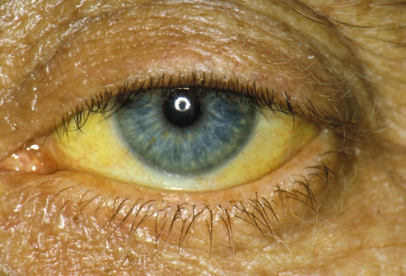
Food Establishment shall report to the Local Health Department when a food employee is:
Jaundiced; or
Diagnosed with an illness due to the Big 5

Slide 12
Applying Control Measures
FDA Food Code:
2-201.12
Exclude a food employee who is:
(1) Jaundiced and the onset of jaundice occurred within the last 7 calendar days, unless the food employee provides to the person in charge written medical documentation from a health practitioner specifying that the jaundice is not caused by hepatitis A virus or other fecal-orally transmitted infection;^{P}
(2) Diagnosed with an infection from hepatitis A virus within 14 calendar days from the onset of any illness symptoms, or within 7 calendar days of the onset of jaundice;^{P} or
(3) Diagnosed with an infection from hepatitis A virus without developing symptoms.

Slide 13
Lifting Control Measures
Reinstating the employee:
the person in charge obtains approval from the regulatory authority and one of the following conditions is met;
(1) The food employee has been jaundiced for more than 7 calendar days;^{P}
(2) The anicteric food employee has been symptomatic with symptoms other than jaundice for more than 14 calendar days;^{P} or
(3) The food employee provides to the person in charge written medical documentation from a health practitioner stating that the food employee is free of a hepatitis A virus infection

Slide 14
During an Investigation
August 1, 2011 – Stanly County Health Department began receiving illness complaints from patrons of a local restaurant
Ill persons had onset of diarrhea with severe cramps beginning July 24, following eating food from the establishment
45 cases ultimately linked to the outbreak
Initial laboratory cultures negative for routine pathogens

Slide 15
Key Legal Issues
130A-144. Investigation and Control Measures
(a) The local health director shall investigate, as required by the Commission, cases of communicable diseases and communicable conditions reported to the local health director pursuant to this Article.
(f) All persons shall comply with control measures, including submission to examinations and tests, prescribed by the Commission subject to the limitations of G. S. 103A-148.

Slide 16
Epidemic Curve

Slide 17
Stool samples taken from employees
Negative for enteric pathogens (Shigella, shiga-toxin producing e. Coli, salmonella spp.)
Epi profile suggested: ETEC (enterotoxin producing e. Coli); ETEC needs a human reservoir, not an animal reservoir, which suggests a fecal-oral route of transmission
Samples sent to CDC for further testing
Enterotoxigenic E. coli (ETEC) indicated in 2 patient specimens by PCR and one of those had ETEC isolated.
C. perfringens testing was negative from all stool specimens
Campylobacter has been ruled out in all stool specimens

Slide 18
Investigation
SCHD and NC DPH decided to conduct case-control study and pursue additional laboratory tests with CDC
Enterotoxigenic E. coli (ETEC)
Rarely recognized pathogen in the US
Major cause of traveler’s diarrhea worldwide
Diarrhea, bloody diarrhea with severe cramps and long duration of illness (often 7 days or longer)

Slide 19
Case-Control Study
Ill patrons and a sample of restaurant patrons identified from credit card receipts were enrolled in case-control study
Eating any salad in the restaurant was associated with illness (OR 2.83, CI 1.34-5.98, p = 0.00009)
Lettuce samples were tested negative by NC Department of Agriculture, but no approved method for ETEC testing of lettuce exists

Slide 20
Environmental Assessments
Also known as Environmental Field Investigation
Used to determine possible causes of an outbreak
Differs significantly from routine inspection

Slide 21
Environmental Assessments
a comprehensive evaluation of the foodhandling practices that may have occurred at the suspected outbreak source during the hours (or days) leading up to the time of the potential exposure.
The purpose of a field investigation is:
to determine the improper food handling practices and/or implicated food that may have contributed to the foodborne illness outbreak.

Slide 22
Why is it important?
A field investigation is important for two reasons:
to control the spread of the illness during the current outbreak
to serve as an important educational tool to prevent similar outbreaks in the future.

Slide 23
When should it be done?
The epidemiological investigation suggests a common source exposure and
The source is a particular food service establishment or gathering
** NCDA & CS will investigate if the source of contamination occurs prior to the point of retail food preparation (e.g. manufacturer, supplier, distributor, etc.)

Slide 24
Conducting the Investigation
An effective field investigation will look at all aspects of the establishment’s practices, such as:
Foodhandling
Food storage
Food storage temperatures
Food safety knowledge
Employee health
Cleaning and sanitizing
Notes:
What it is NOT: a obligatory visit to the FSE to ask if they have received complaints, etc. OR a routine inspection

Slide 25
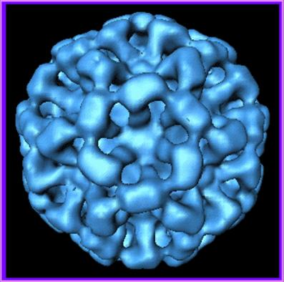
Where to begin…
Begin the field investigation based upon the Epi data
Suspected foods (case-control, cohort studies)
Specific pathogen (confirmed or suspected)

Slide 26
Interviews
Communication is a key ingredient to a successful field investigation!
Manager
Employees

Slide 27
Interviews
Managers
Menu Items
Number of people served
Employees responsible for preparation
Procedures used to prepare menu items
Ill Employees
Unusual circumstances
(Larger than normal event, malfunctioning equipment, etc.)

Slide 28
Interviews
Employees
Menu items prepared
Who? What? How? When? Where?
Preparation procedures actually used
Illnesses (worker and family members)
Unusual circumstances that break from the typical routine

Slide 29
Flow Diagrams
Can help identify shortfalls in recipes that could result in an “out of control” hazard
Uses the recipe and/or other written/unwritten prep procedures to group food flow into major operational steps

Slide 30
Initial Assessment: Palermo’s
2 people cook and perform all foodhandling
Foodhandlers did not appear to be ill or have active symptoms (N, V, D, jaundice); did not say they had been ill in time leading up to outbreak
Handle raw chicken
pre-portioned chicken breasts are supposed to go straight onto the grill
no raw chicken prep sink (only vegetable prep sink)

Slide 31
Control Measures
No Bare Hand Contact w/ RTE Foods
Ensure proper sanitization of work surfaces
No prepping of raw meat in vegetable prep areas
Ensure final cooking temperature of chicken (& thermometer calibration)
Ensure proper cooling
Ensure proper handwashing

Slide 32
Subsequent Assessments
Verified meals served per day (40 + seats in facility; lunch and dinner, 7 days a week)
Examined possibility of food being contaminated at source (e.g. lettuce)
Verified storage methods at restaurant
Verified suppliers of lettuce
NCDA&CS took samples for analysis (negative)

Slide 33
Conclusions
North Carolina General Statutes and the North Carolina Administrative Code empowers local health directors to investigate and control foodborne illnesses in North Carolina.
NC Division of Public Health is available to assist with both investigation steps and control measures.
Communicable Disease Branch – 919-733-3419
Environmental Health Branch – 919-218-6943

