Slide 1
EO 124: Payment Plans
Kara A. Millonzi
©UNC-CH School of Government
millonzi@sog.unc.edu
May 18, 2020

Slide 2
Announcements
Please keep your device muted
Type questions and comments in chat box
If call drops, wait a minute and log back in/call back
Recording and slides will be posted

Slide 3
May NOT disconnect residential utility service for account delinquency, no matter when delinquency incurred
Disconnections
Before March 31
March 31
June 1
After June 1
May disconnect according to your utility ordinance terms
May disconnect according to your utility ordinance terms
Except for amounts that went delinquent between March 31 and June 1

Slide 4
Payment Plans
Reasonable payment plans required
For residential customers
Who incurred delinquencies between March 31 and June 1
Must give until December 1 to pay, as long as customer honoring terms of payment plan

Slide 5
Before March 31
If amount was delinquent before March 31, may apply late penalties, no payment plan required and may terminate after June 1 according to normal policies
Between March 31 and June 1
If bill not paid between March 31 and June 1, no late penalties, payment plan required and may not terminate unless customer does not honor payment plan terms or unless customer does not pay bill that comes due after June 1
After June 1
If bill comes due after June 1 and is not paid, no payment plan required, may apply late penalties, and may terminate according to normal policies

Slide 6
Payment Plan Process
Develop
Develop payment plan terms
Inform
Inform customer of terms
Request
[Request signature on payment plan contract]
Add
Add amounts owed to regular bill according to payment plan terms
Follow
Follow payment plan terms

Slide 7
Payment Plan Terms
Determine how you will allow amount owed to be paid off. Equal increments each month? Percentage of total amount on account each month?
Does customer have to sign up or will pay plan be automatic?
Determine how amounts will be added to regular bill
Determine how long customer has to pay off (at least until December 1)
Specify that customer must remain current on amounts that come due after June 1.
Specify what will happen if payment plan amounts and new amounts are not paid by due date.
Identify contact person to field questions or problems
Refer to normal written policies for new delinquencies (after June 1)

Slide 8
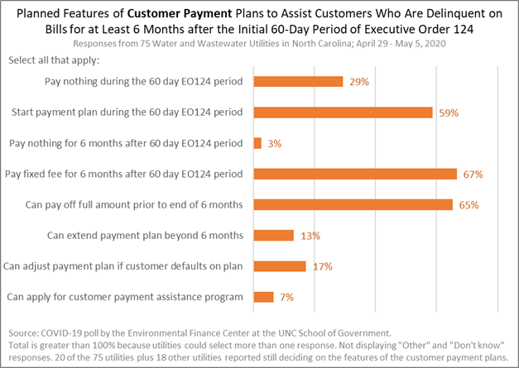

Slide 10
What if customer had delinquency on account before March 31?
Bill date: March 1
Due date: March 15
No payment plan required
May disconnect if amount remains unpaid June 1, according to normal policies

Slide 11
What if customer had delinquency on account before March 31 and also failed to pay new bill between March 31 and June 1?
Bill date 1: March 1
Due date 1: March 15
Bill date 2: April 1
Due date 2: April 15
June 1: Payment plan required for amount that went delinquent on April 15; No payment plan required for amount that went delinquent on March 15
May disconnect, but only if amount from March 15 remains unpaid June 1
Likely must apply any partial payment to March bill first

Slide 12
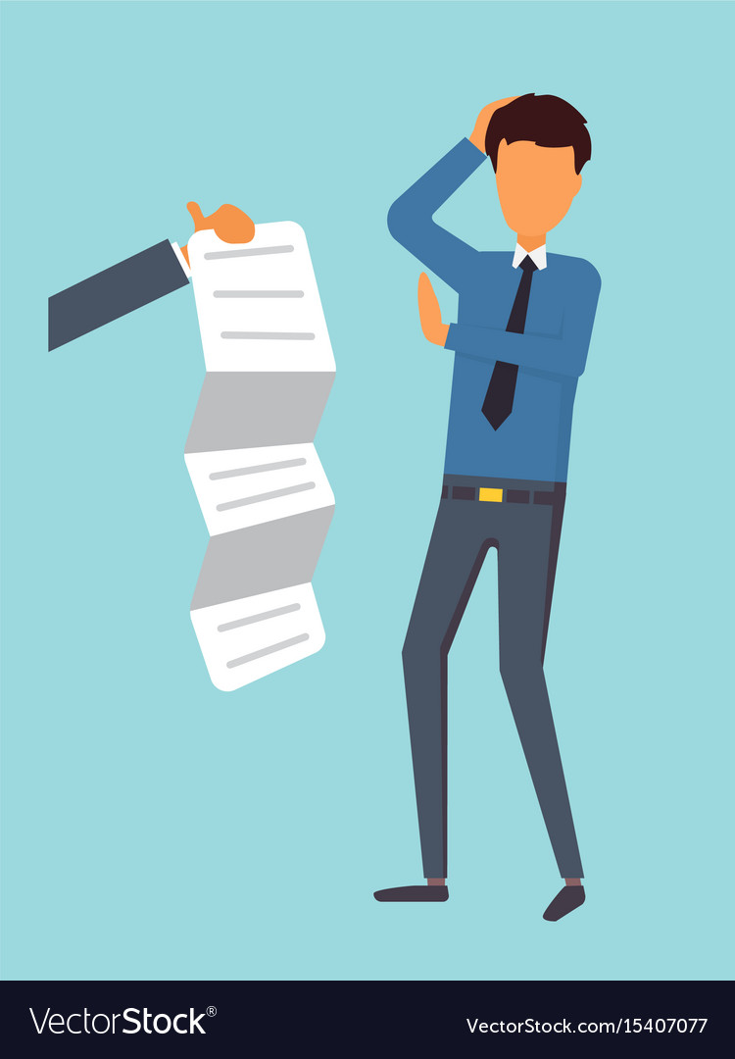
What if customer refuses to sign payment plan?
Have option to require customer to opt-in to payment plan or simply to put customer on payment plan
Best practice to get customer to actually sign payment plan agreement, but not legally required
Customer must abide by payment plan terms.
If you have informed the customer of the terms and they do not abide by them, you may proceed to disconnect service according to your stated policy.
You need to spell out when services will be disconnected and if/when late penalties will apply if payment plan payments are not received.

Slide 13
What if customer makes payment plan payment but does not pay June or July bill (or some other later bill)?
May disconnect according to your normal policies and apply late penalties, even if customer still makes payment plan payments

Slide 14
What if customer does not pay full amount owed by December 1, 2020?
Up to local government utility to determine whether or not customer may seek extension. Should be specified in policy ordinance.
If no extension allowed under policy, may terminate service and use other collection remedies.

Slide 15
Must we suspend late penalties during payment plan period?
Yes, but only on amounts that went delinquent between March 31 and June 1.
You may specify in payment plan terms that if payments not made according to terms late penalties will be assessed and services will be disconnected.

Slide 16
Collection Options
If delinquency occurred before March 31 or after June 1, may submit to debt set-off, collection agency, or sue.
If delinquency occurred between March 31 and June 1, must allow customer to make payments according to payment plan at least until December 1, 2020, unless customer violates payment plan terms.

Slide 17
Customer Assistance
May establish customer assistance programs for low- or moderate- income customers and/or for senior citizen customers (over 60), using general fund monies
May NOT reduce or waive utility fees directly

